Slide 1
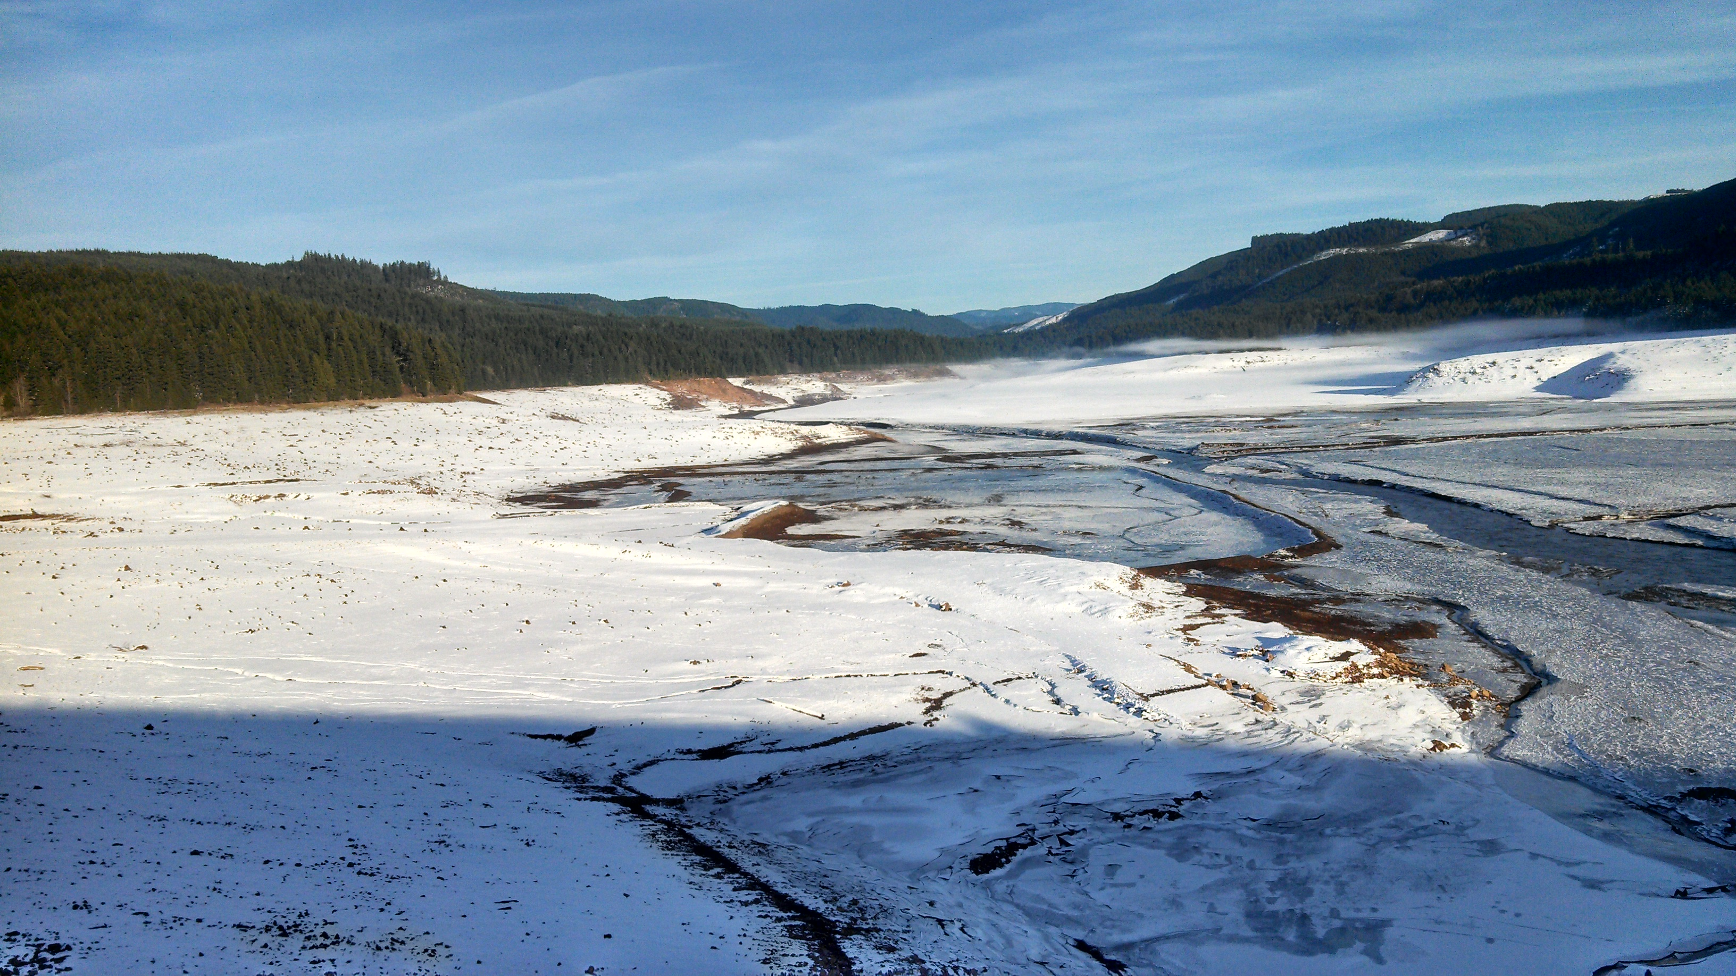

Trends in Suspended-Sediment Transport below Fall Creek Dam During Operational Drawdowns of Fall Creek Lake, 2012-2015
Liam Schenk (lschenk@usgs.gov)
Heather Bragg (hmbragg@usgs.gov)

Slide 2
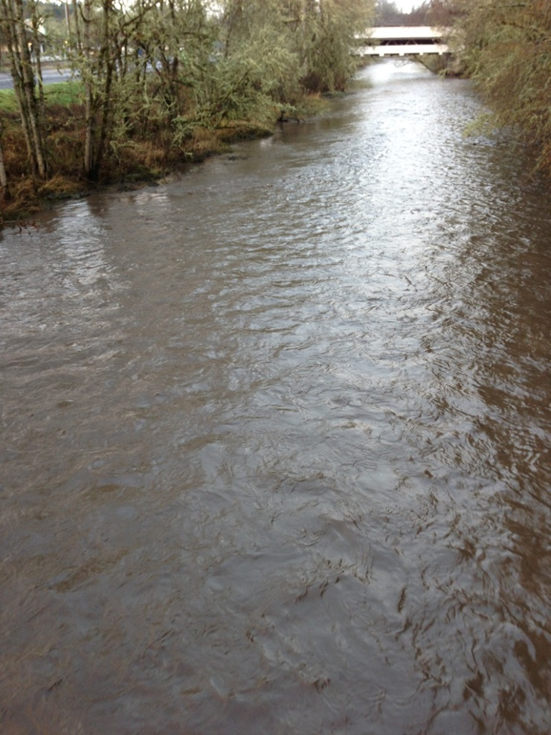
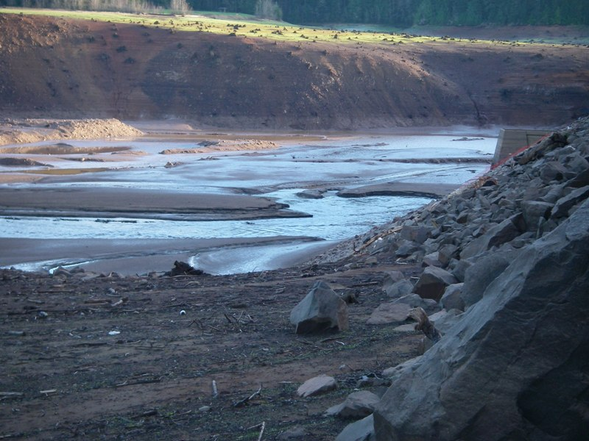
Presentation Outline
Background
Review 2012-2013 drawdown data, sediment budget
2013-2014 suspended sediment loads (SSL)
2014-2015 turbidity data and SSL estimates

Slide 3
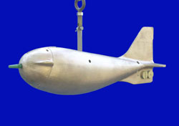
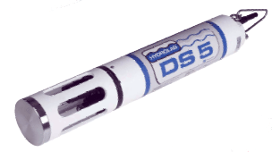
Approach
Monitor turbidity and collect suspended sediment concentration (SSC) samples below Fall Creek Dam
  Hydrolab SC turbidity sensors on DS 4a and 5x
  Campbell OBS-500 sensor; WY 2014 and 2015
  EWI sampling protocols for SSC
Continuous dissolved oxygen at Jasper and Fall Creek Outflow WY 2013/2015
US D-74

Slide 4
Turbidity as an SSC surrogate
Turbidity: expression of optical properties of liquid that causes light to be scattered and absorbed rather than transmitted
  Caused by:
    Suspended and dissolved matter
    Clay, silt, plankton, organic dyes
  Not a direct measure of particle concentration
  Commonly used surrogate for SSC
    Locally derived regressions
    Estimate nearly continuous concentrations and loads of suspended sediment

Slide 5
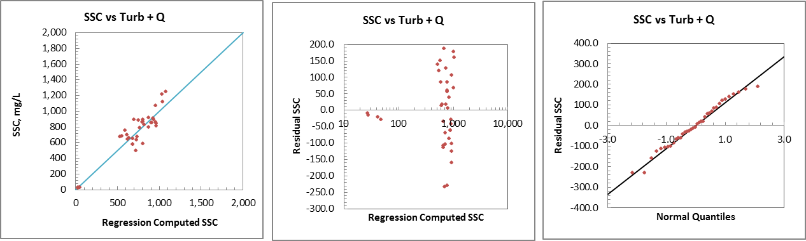
Regression Model Development Methods
Turbidity/streamflow as explanatory variables
Log-transformed vs non-transformed models
  Probability plot correlation coefficient (PPCC)
  Duan BCF used for transformed data
SLR vs MLR
  Multi-collinearity
Notes:
-Turbidity and streamflow evaluated together and separately
PPCC used to choose b/w log-transformed and non-transformed regressions
-PPCC is the correlation coefficiet b/w residuals and normal quantiles on probability plot, looking to satisfy the normality assumption for linear regression by maximizing the PPCC (i.e. close to 1 is closer to normally distributed data)
-Figure is a copy of the model output for the 2013 drawdown

Slide 6
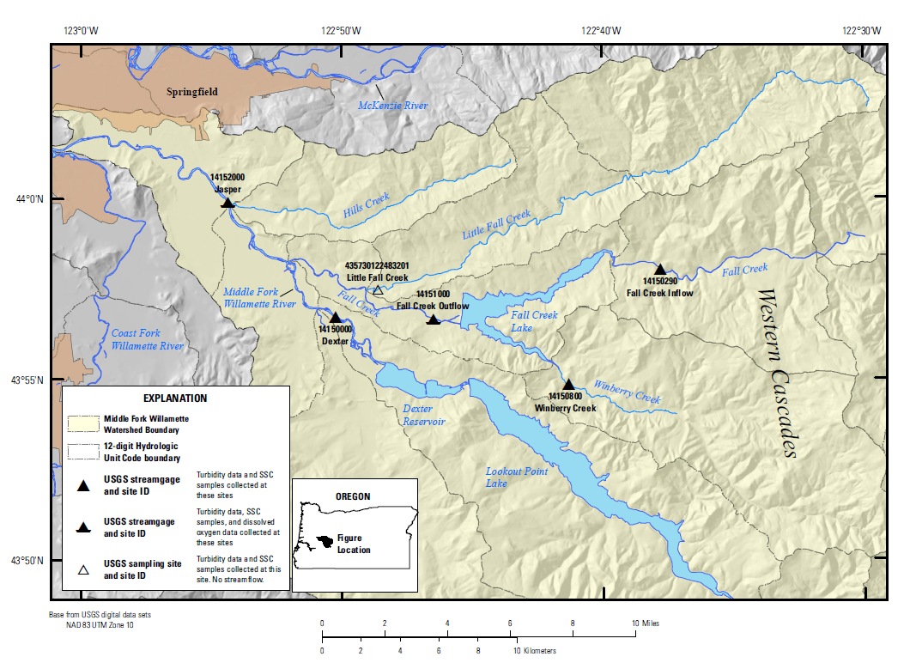
Project Sites: 2012/2013

Slide 7
Project Sites: 2013/14 and 2014/15

Slide 8
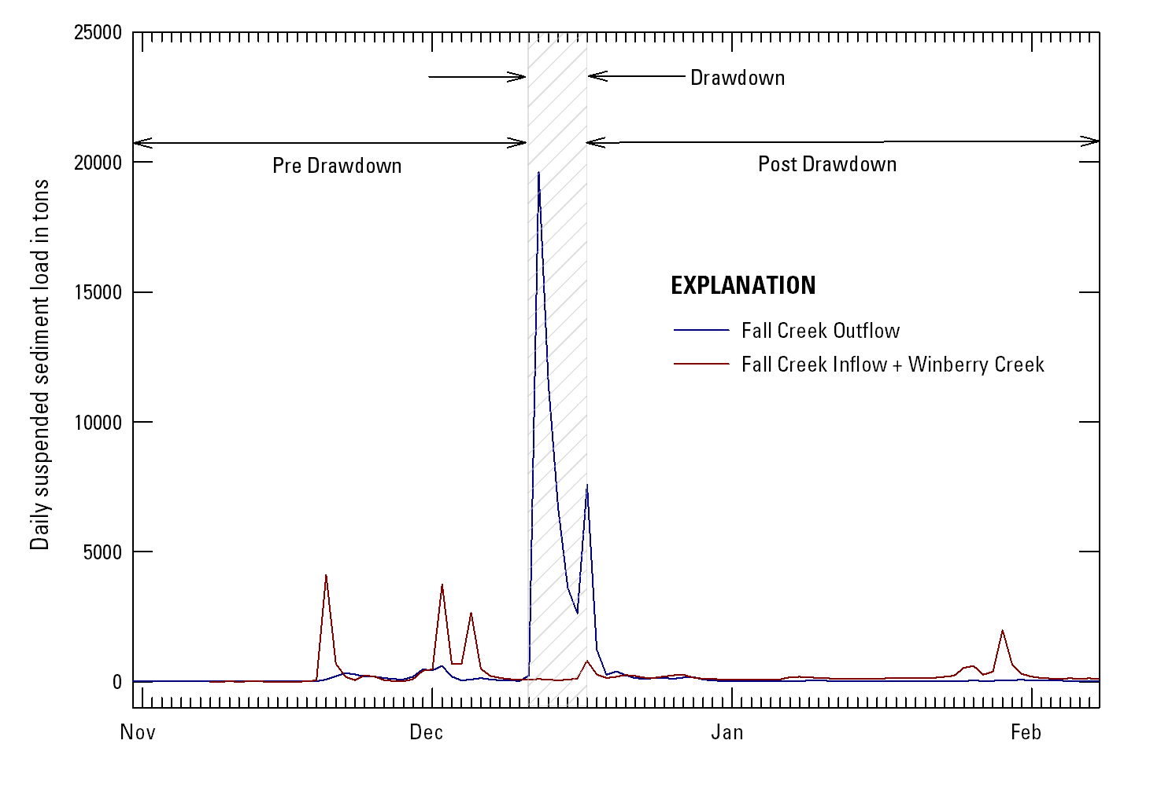
Suspended Sediment Loads
Fall Creek Outflow – 2012/13
Pre-drawdown: 4,300 tons (34 days)
Drawdown: 51,600 tons (6 days)
Post-drawdown: 4,030 tons (53 days)
Notes:
The first of two review slides to remind everyone of our results from first year of monitoring, to put into context of 2013/14

Slide 9
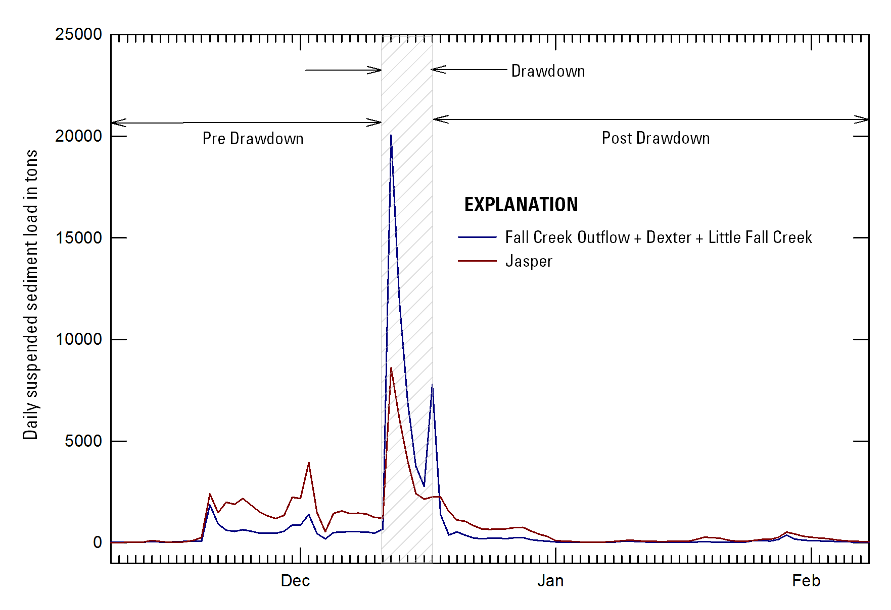
Suspended Sediment Loads
Middle Fork Willamette at Jasper – 2012/13
Pre-drawdown: +22,800 tons (34 days)
Drawdown: -27,700 tons (6 days)
Post-drawdown: +10,680 tons (66 days)
Notes:
Second review slide, (+) and (-) refer to the positive and negative differences of SSL at Jasper compared to the three contributing sites. Positive difference means more SSL computed at Jasper than the three other sites, Negative difference means less SSL computed at Jasper than the other three sites.

Slide 10
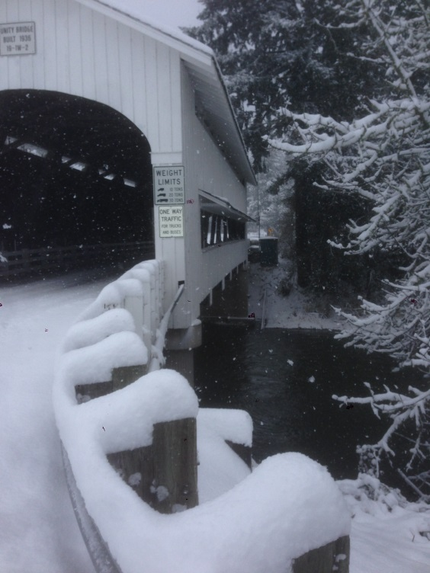
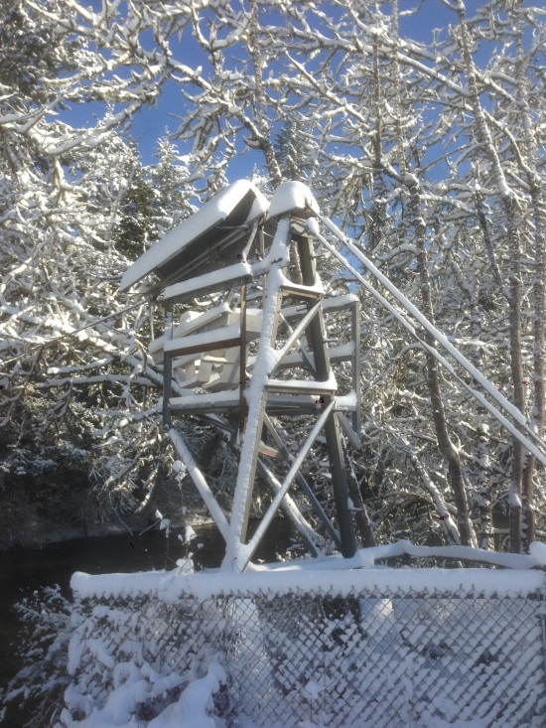
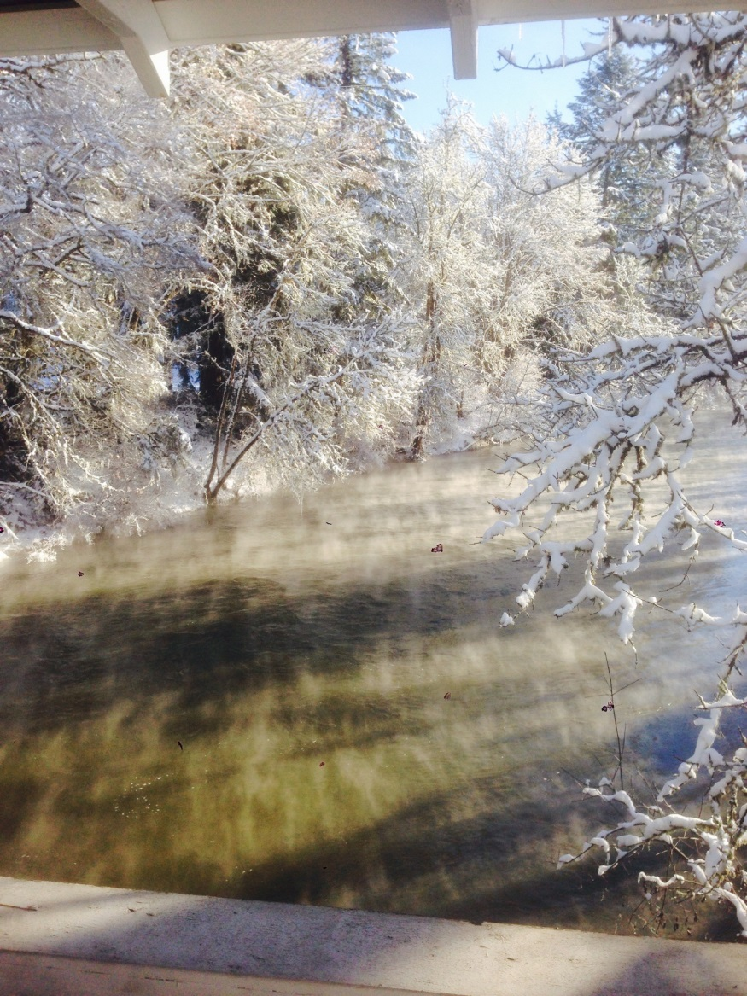
2013/14 Drawdown Conditions
Notes:
Winter Wonderland pictures showing differences in weather conditions

Slide 11
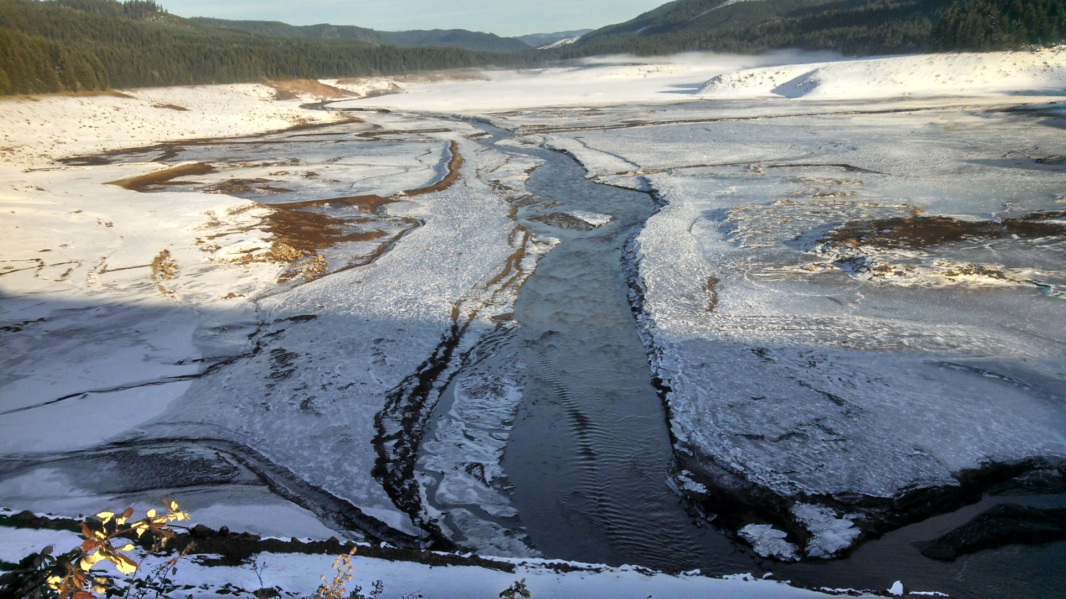
2013/14 Drawdown Conditions

Slide 12
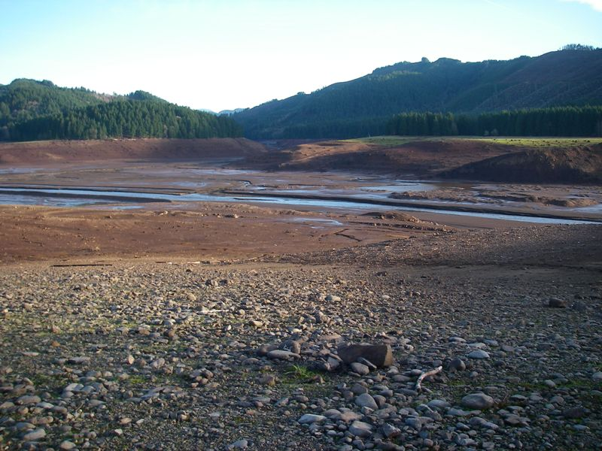
2012/13 Drawdown Conditions

Slide 13
Fall Creek Outflow, 2013/14 drawdown
Fall Creek below Winberry Creek, near Fall Creek, OR (14151000)
Fall Creek below Winberry Creek, near Fall Creek, OR (14151000)
Fall Creek Lake near Lowell, OR (14150900)
600
1300
711
550
1200
708
500
1100
705
450
1000
702
400
900
699
Elevation (feet above NGVD 1929)
350
800
696
Turbidity (FNU)
Discharge (cfs)
300
700
693
250
600
690
200
500
687
150
400
684
100
300
681
50
200
678
0
100
675
12-07-2013
12-08-2013
12-09-2013
12-10-2013
12-11-2013
12-12-2013
12-13-2013
12-14-2013
12-15-2013
12-16-2013
12-17-2013
12-18-2013
12-19-2013
12-20-2013
Notes:
Output from data grapher tool, showing reservoir elevation

Slide 14
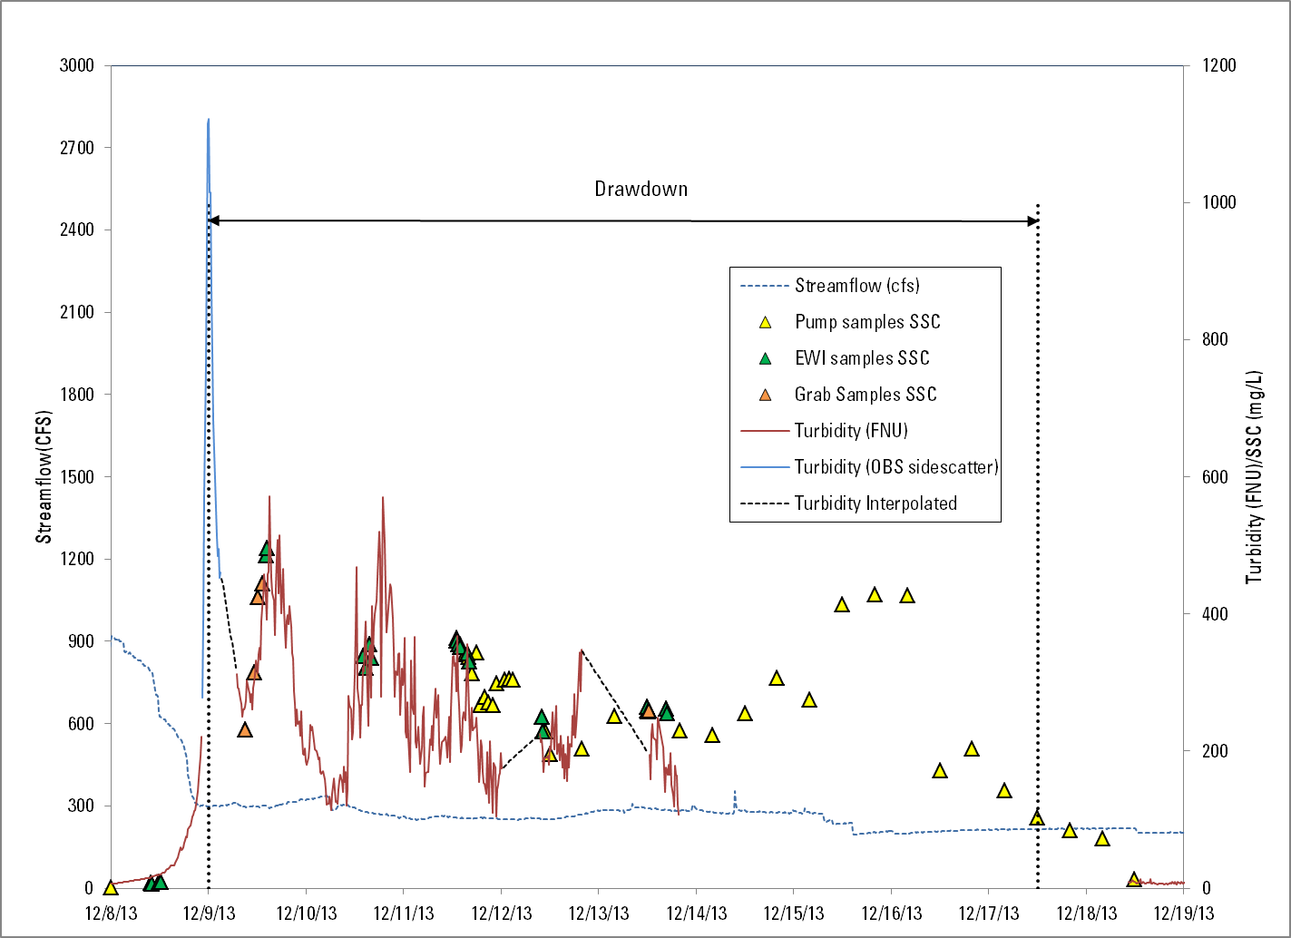
Fall Creek Outflow, 2013/14 drawdown
Notes:
Talk briefly about how we dealt with missing data (interpolating turbidity, and using OBS data for the initial peak)

Slide 15
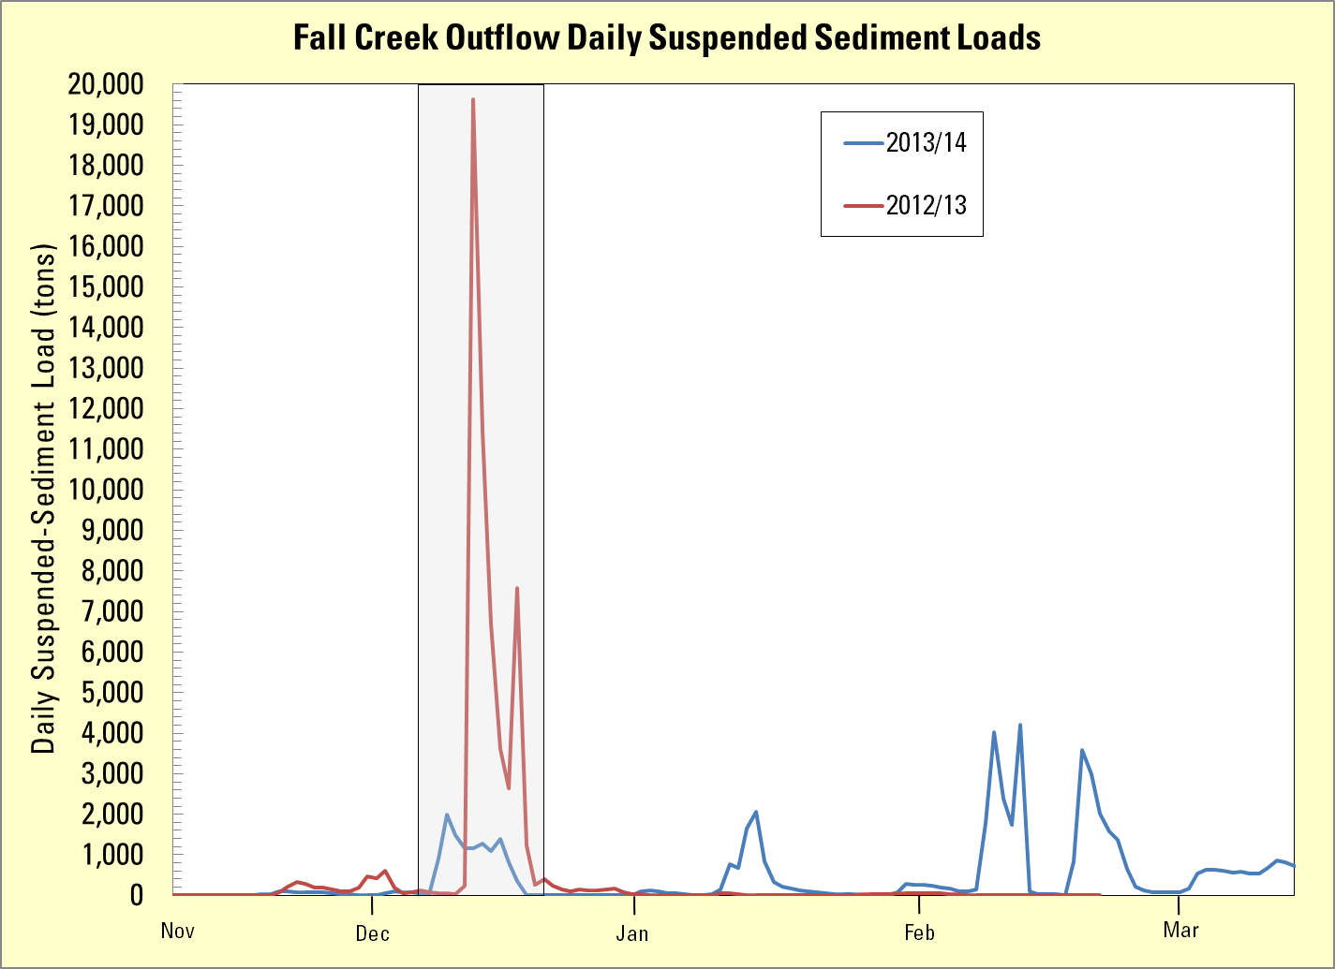
2012/2013 Drawdown: 51,600 tons (6 days)
2013/2014 Drawdown: 5,220 tons (10 days)
Feb. 2014 total SSL: 13,310 tons (28 days)
Notes:
Time series graph showing daily SSL for both years. February 2014 data shown to highlight the fact that the highest instantaneous loads we measured happened long after the drawdown during the highest streamflow event of the year

Slide 16
Fall Creek Outflow, Feb-Mar 2014
Fall Creek below Winberry Creek, near Fall Creek, OR (14151000)
Fall Creek below Winberry Creek, near Fall Creek, OR (14151000)
Fall Creek Lake near Lowell, OR (14150900)
350
7000
820
300
6000
800
250
5000
780
200
Discharge (cfs)
4000
760
Turbidity (FNU)
Elevation (feet above NGVD 1929)
150
3000
740
100
2000
720
50
1000
700
0
0
680
2-01-2014
2-05-2014
2-09-2014
2-13-2014
2-17-2014
2-21-2014
2-25-2014
3-01-2014
3-05-2014
3-09-2014
3-13-2014
3-17-2014
Notes:
Lake Elevation, Turb, streamflow in February 2014. Streamflow ~3,800 is approaching channel capacity on Fall Creek. That’s the maximum streamflow they can send down Fall Creek, so at low reservoir elevations, there’s a potential to move a lot of sediment.

Slide 17
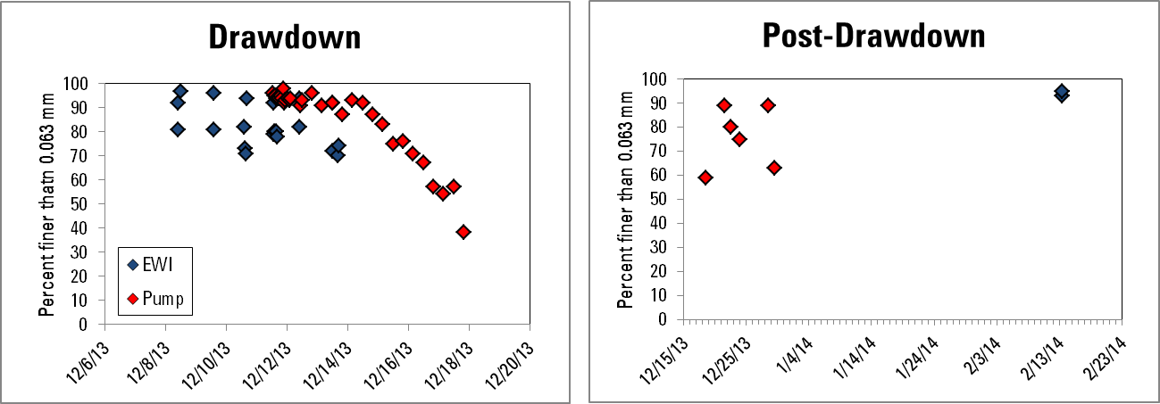
Percent Fines in EWI samples
2013/14
Notes:
Wanted to show percent fines to put the type of sediment into context, especially for the February high flow situation. We have two EWI samples in February, but they were collected at low flows, elevated turb (109 fnu), resulting in moderate SSC (~80 mg/L). Hard to say what type of sediment was transported during the high flows since we don’t have EWI or pump samples there (ISCO ended up downstream). But wanted to make the point that although the loads were high, it’s possible the transport was mostly fine-grained as opposed to the drawdown, when the sediment load was more coarse. Also, turb remained low at those really high flows, and didn’t really increase until reservoir EL got to about 694

Slide 18
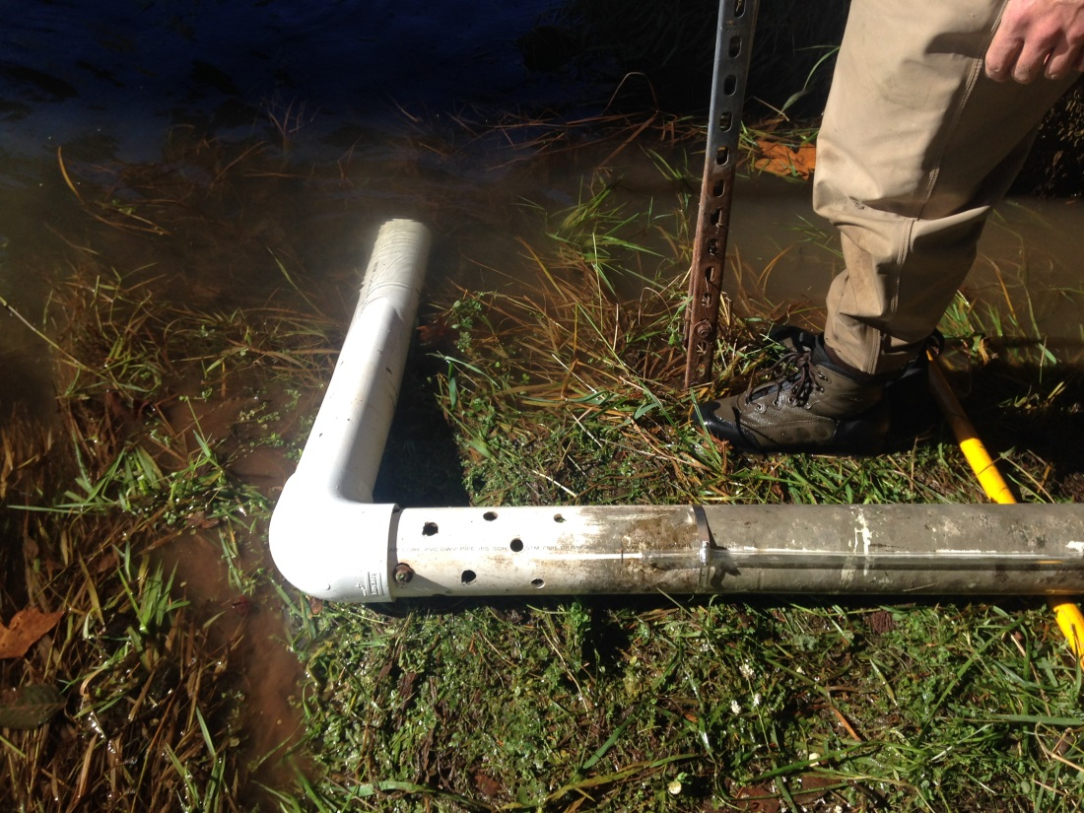
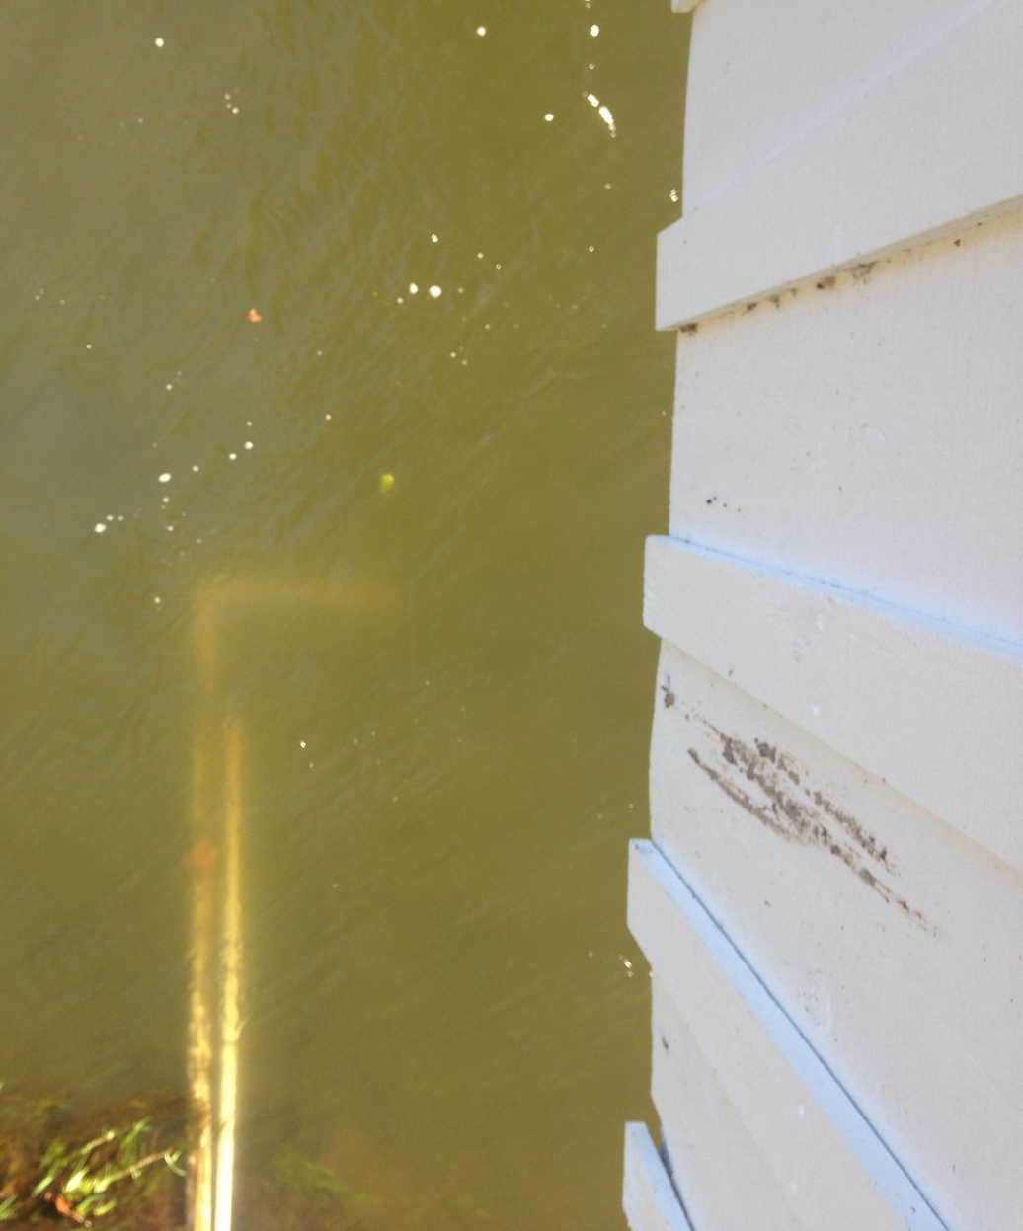
Deployment Alterations: 2014-15
Flow Direction
Notes:
Picture showing how we attempted to minimize our data loss through innovative deployment tube design courtesy of USACE engineering

Slide 19
Preliminary Data – 2014/15 Drawdown
Fall Creek below Winberry Creek, near Fall Creek, OR (14151000)
Fall Creek below Winberry Creek, near Fall Creek, OR (14151000)
Fall Creek Lake near Lowell, OR (14150900)
Data from U.S. Geological Survey
3000
1700
750
2800
1600
745
2600
1500
740
2400
1400
735
2200
1300
730
2000
1200
725
1800
1100
720
Discharge (cfs)
1600
1000
715
Turbidity (FNU)
Elevation (feet above NGVD 1929)
1400
900
710
1200
800
705
1000
700
700
800
600
695
600
500
690
400
400
685
200
300
680
0
200
675
Provisional data, subject to revision
11-20-2014
11-21-2014
11-22-2014
11-23-2014
11-24-2014
11-25-2014
11-26-2014
11-27-2014
11-28-2014
11-29-2014
11-30-2014
12-01-2014
12-02-2014
12-03-2014
Notes:
Time series data from 2014 drawdown (this year)

Slide 20
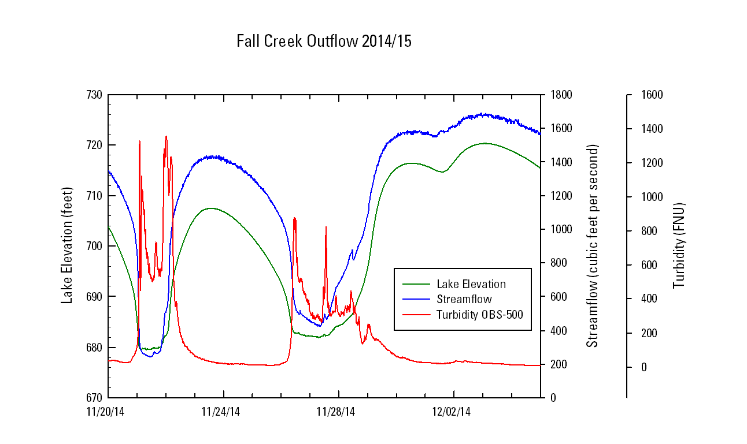
OBS-500 Data – 2014/15 Drawdown
Fall Creek Outflow
Provisional data, subject to revision
Notes:
Wanted to show our OBS-500 data, constraining the peaks in turbidity during the drawdownthat caused “pegging” in the Hach sensor

Slide 21
Summary
2012 Drawdown: Net transport of 50,400 tons of sediment from Fall Creek Lake
  17,000 tons sediment stored in the reaches of Fall Creek and Middle Fork Willamette
2013/14 Drawdown: 5,220 tons in 10 days
  Large sediment loads in February 2014 concurrent with extremely high streamflow
Sediment transport during drawdowns can be variable affected by weather, lake elevation
What’s happening to the sediment after the drawdowns?
  Year-round monitoring may be required

Slide 22
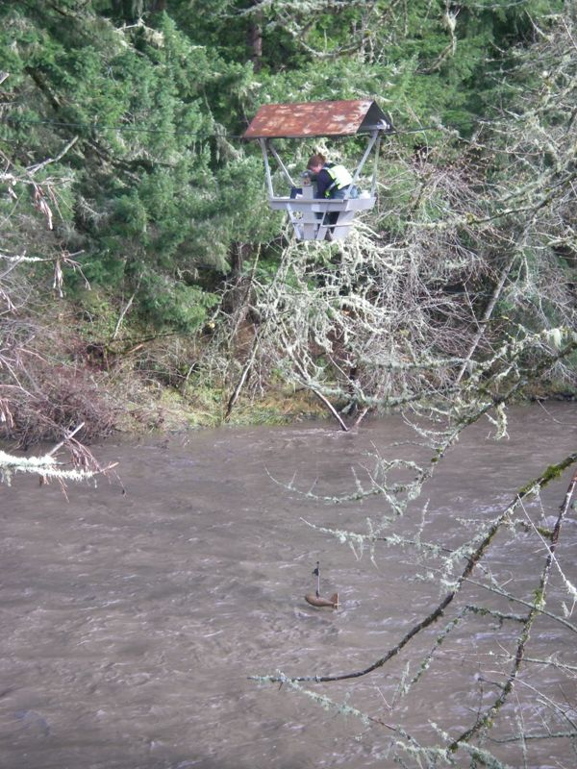
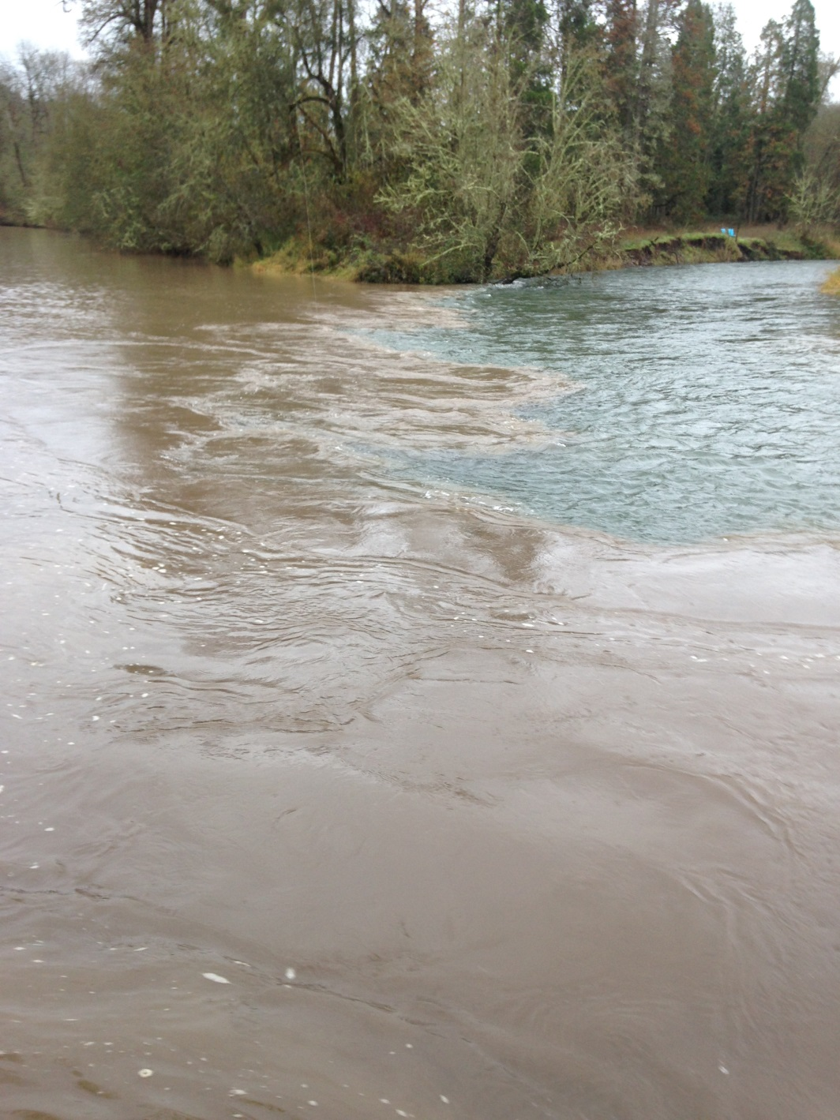
Questions?

