Slide 1
Genetic pedigree analysis of spring Chinook salmon reintroduced above Foster Dam
Melissa Evans, Kathleen O’Malley, Marc Johnson, Michael Banks, Dave Jacobson, and Michael Hogansen
Notes:
Thank you for the introduction. So I am a postdoctoral researcher at Hatfield Marine Sciences Center. My colleagues and I from the Fisheries Genetics lab at HMSC have been working in collaboration with the US Amry corp and ODFW to study Chinook salmon reintroductions to historical spawning habitat located above Foster Dam on the South Santiam River.
Today’s talk is an update of the work we presented last year on this project, as we’re now working with an additional year of data which has allowed us to follow the total lifetime fitness of salmon reintroduced above the during during 2007 and 2008.

Slide 2
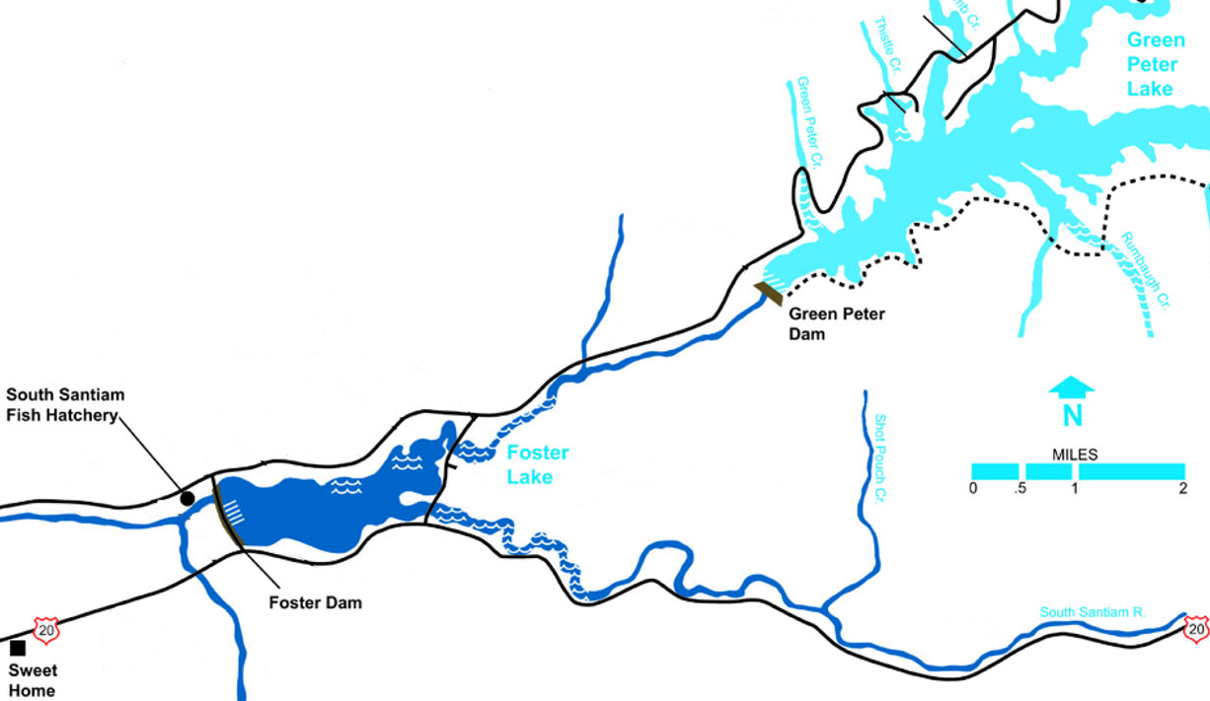
Foster Dam and Chinook salmon
Notes:
Foster Dam stands 38m high and was constructed in the 1960s on the South Santiam River. It, along with Green Peter Dam, inundates and blocks access to an estimated 85% of historical spring Chinook salmon spawning habitat. Since dam construction, salmonid populations have been largely supported through the operation of the fish hatchery located at the base of the dam.

Slide 3
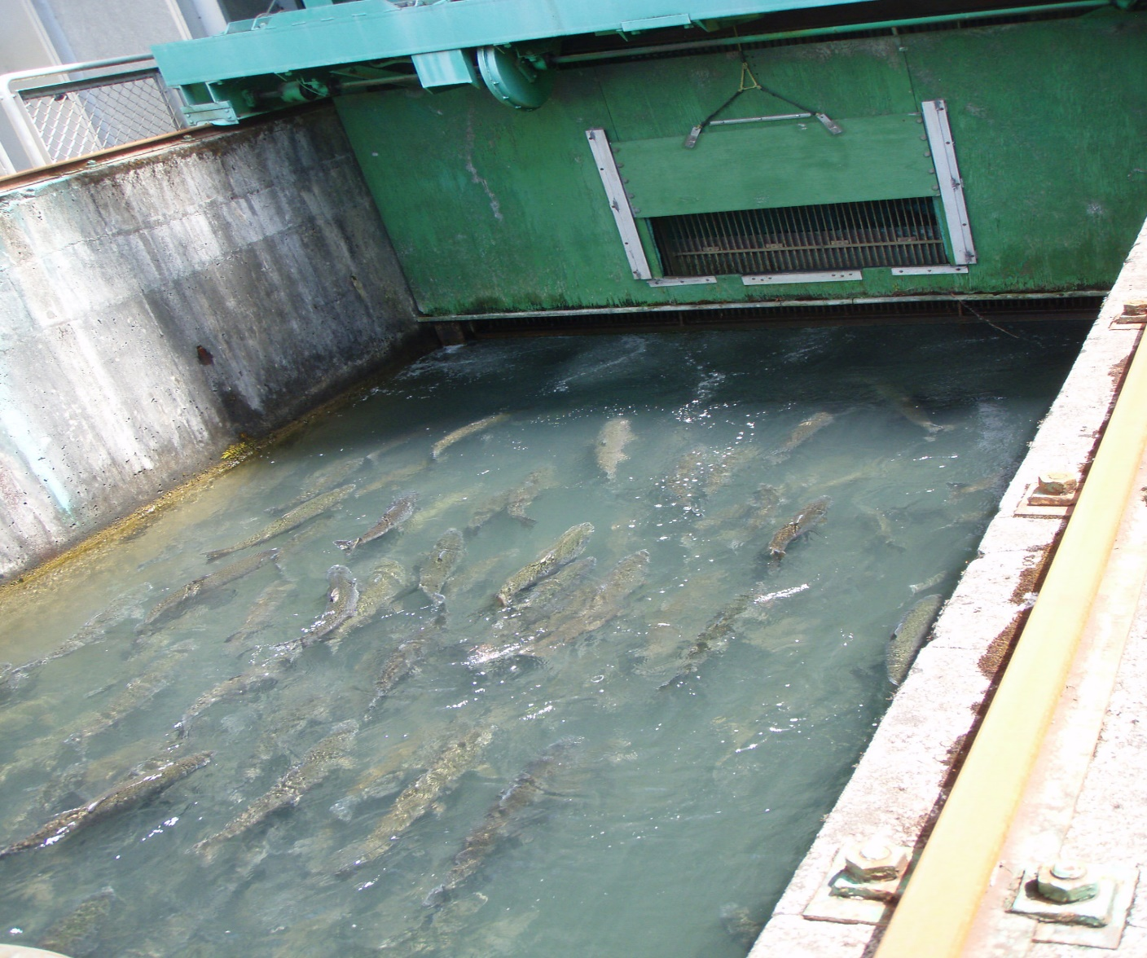
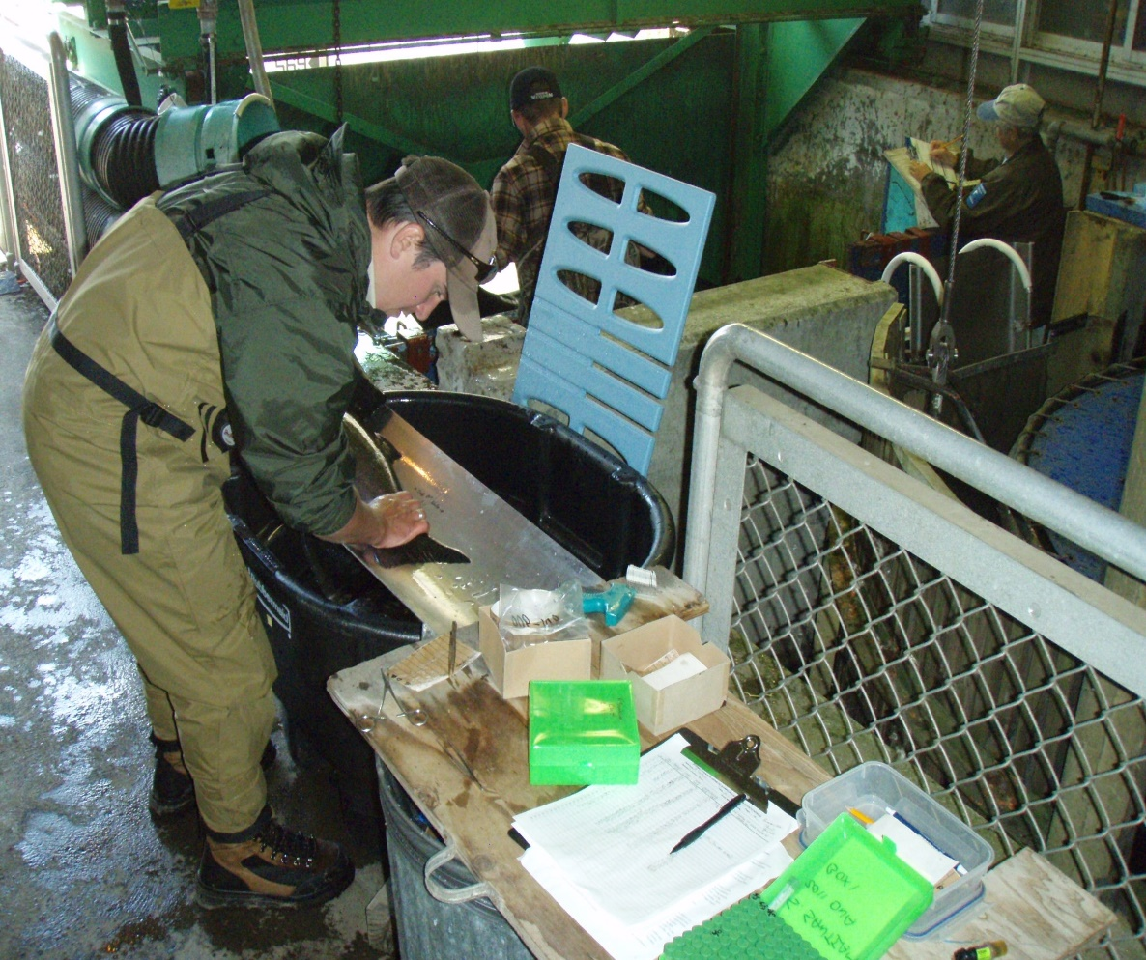
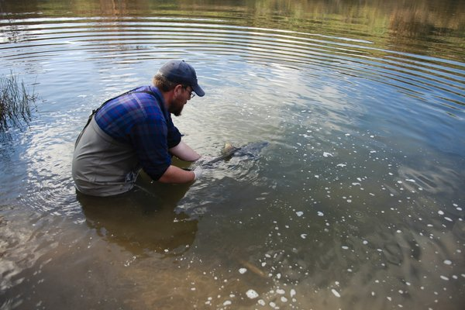
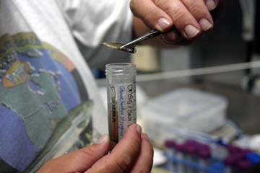
Notes:
Beginning in the 1990s, Oregon Department of Fish and Wildlife initiated an outplant programs, wherein HOR salmon that were surplus to the needs of the South Santiam hatchery were trucked and released above the dam.
The reintroduction effects have since become more formalized and there has been a move towards releasing wild fish above the dam.
Wild salmon that home back to the South Santiam River are trapped at the base of the dam, processed, which includes floy-tagging and the collection of a tissue sample for genetic analyses, and then transported and released above the dam

Slide 4
Objectives
Using genetic parentage analysis, evaluate the contribution of the reintroduction program to natural spring Chinook salmon production
Examine the fitness of spring Chinook salmon reintroduced above Foster Dam
Investigate how different management strategies, i.e. hatchery (HOR) and natural origin (NOR) salmon reintroductions, and release timing and location, affect fitness

Slide 5
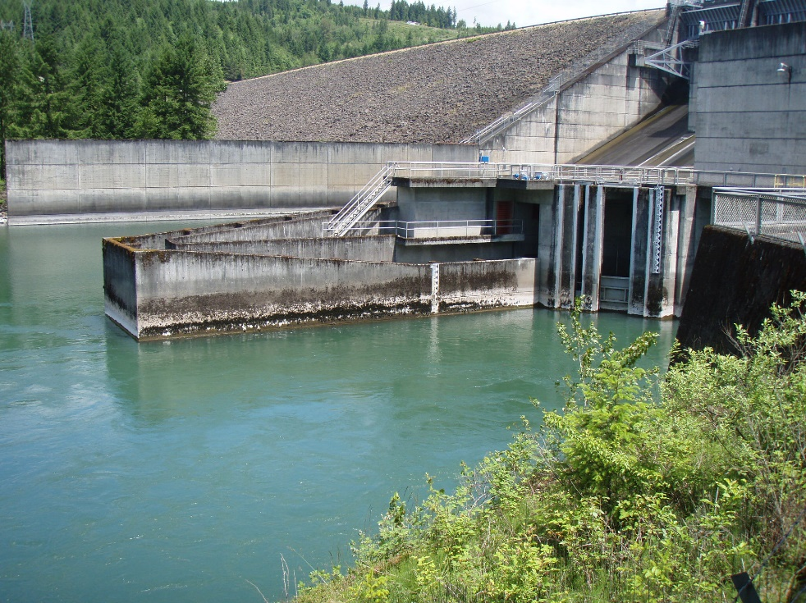
Releases Above Foster Dam
Year | HOR | NOR
2007 | 403* | 0
2008 | 527 | 163
2009 | 0 | 445
2010 | 0 | 730
2011 | 0 | 1222
2012 | 0 | 1047
2013 | 0 | 940
* 64% of reintroduced salmon genetically sampled
Notes:
This table shows a summary of the number of spring Chinook salmon that have been released above Foster Dam since 2007, which was the first year that tissue samples were collected for genetic analyses.
In 2007 of the fish released above the dam were all HOR and importantly, only 64% of individuals were tissue-sampled, meaning that not all of the progeny of this release cohort can be identified using genetic methods. In 2008, there was a mix of HOR and NOR salmon released above the dam, though the majority of fish were still HOR salmon. And beginning in 2009, all salmon released above the dam were unmarked, presumed NOR salmon.
Reintroductions of NOR salmon only is the management paradigm currently utilized in this system.
Last year, we presented results looking at pedigrees covering salmon reintroductions over 2007-2012; now we are working with an additional year of data, collected in 2013.

Slide 6
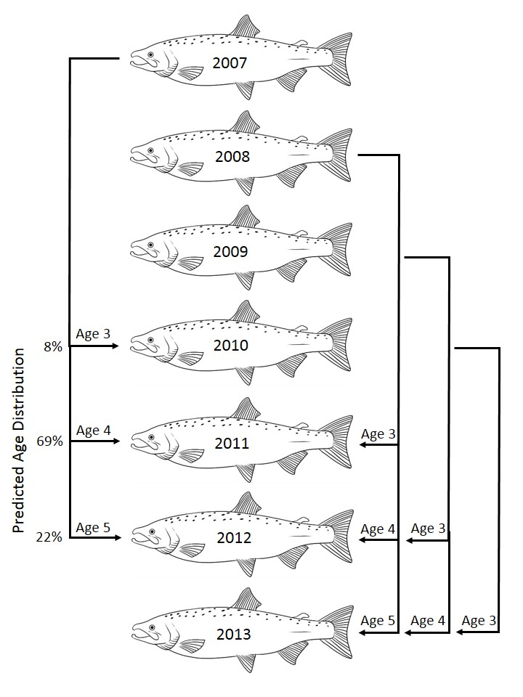
Notes:
This is a schematic overview of how we identify the adult progeny of reintroduced salmon. For salmon that were reintroduced above Foster Dam in 2007, progeny should recruit back to the system as adults between 2010-2012, since the majority of spring Chinook salmon mature as 3, 4, or 5 year olds.
Similarly for salmon reintroduced above the dam during 2008, their progeny would return during 2011-2013.
Because progeny return across multiple age classes we are currently working with estimates of total lifetime fitness for the 2007 and 2008 cohorts, but only incomplete fitness estimates for reintroduced salmon above the dams during 2009 and 2010.

Slide 7
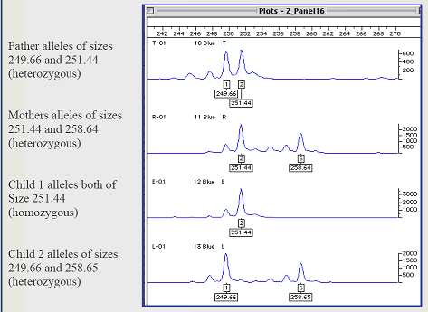
Genetic Parentage Assignment
11 highly variable genetic markers (microsatellites)
Probability of observing identical genetic profiles in population extremely low
Maximum likelihood (ML) approach used to identify parent-offspring matches
mom
dad
kid
kid
Notes:
We use genetic methods to identify the progeny or previously reintroduced salmon. Genetic parentage analysis takes advantage of the fact that offspring inherit one half of their DNA from their mom and one half from their dad.
So, an example of how these comparisons are made is on the right of the slide where the genetic profile of a putative mom and dad at one DNA marker is compared to that of two putative kids. You can see that the kids in this case match both of the parents.
To ensure that there is sufficient variation found among individuals in order to assign parentage unambiguously, all salmon are genotyped at 11 highly variable genetic markers – in the case we used markers called microsatellites.
The markers are so variable that the probability of observing individuals with identical genetic profiles at them in a population is extremely small.
These assignments require a fair amount of computational power and time (many millions of comparisons of parents and offspring are conducted) and are implemented in programs that are designed to find that most likely matches.

Slide 8
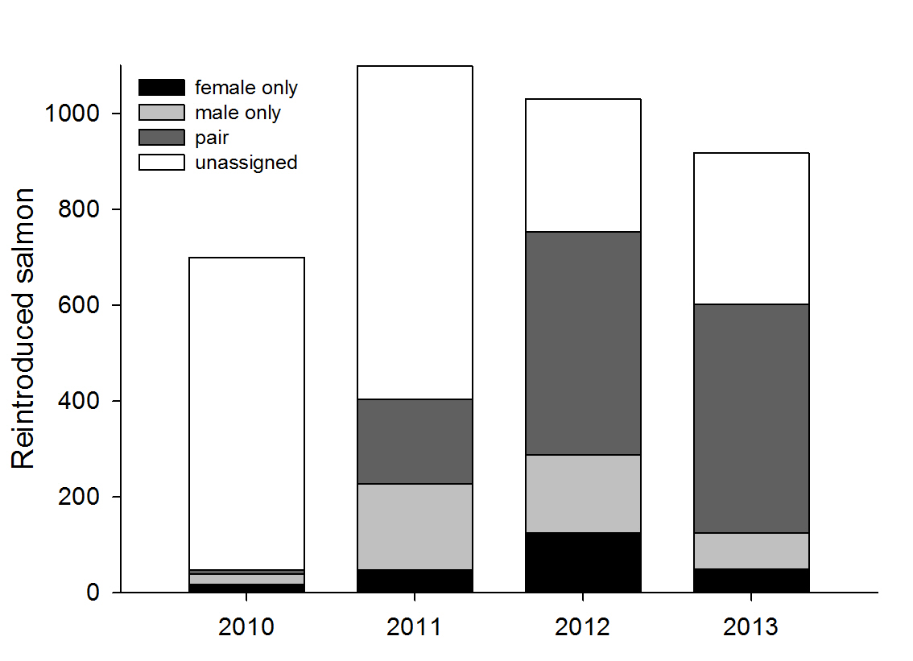
Salmon Reintroduced Above Foster
34%
74%
66%
7%
Evans et al. in revision, Rest. Ecol.
Notes:
This figure summarizes the proportion of salmon in each year that were identified as progeny of previously reintroduced parents. The first year that we looked for progeny was 2010, in which we expected 3 year old offspring of parents reintroduced above the dam in 2007 to return. In total 7% of individuals were identified as progeny of reintroduced parents - this assignment rate is ~ what would be expected based on the proportion of 3 year olds in the South Santiam population
In 2011, we identified 34% of reintroduced individuals as progeny of parents reintroduced above the dam in 2007 and 2008.
2012 and 2013 were the first years that we had near-complete sampling of potential parents and so these years provide our best insight into the proportion of salmon reintroduced above the dam that were actually produced there. Our results suggest that the majority of salmon reintroduced in these years were the progeny of previously reintroduced parents.

Slide 9
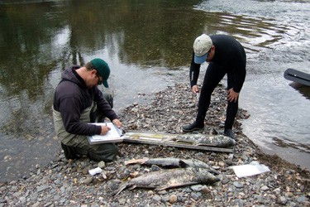
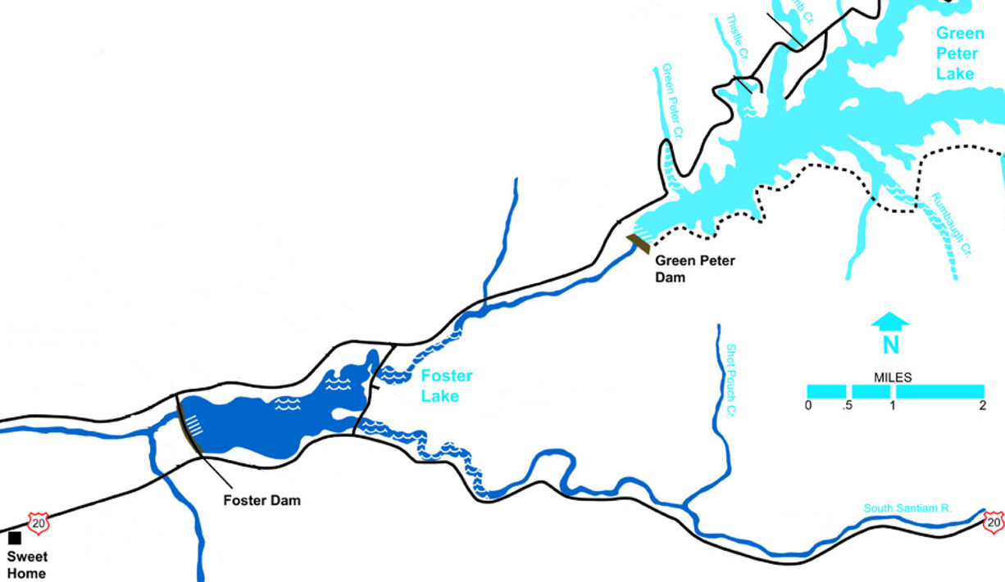
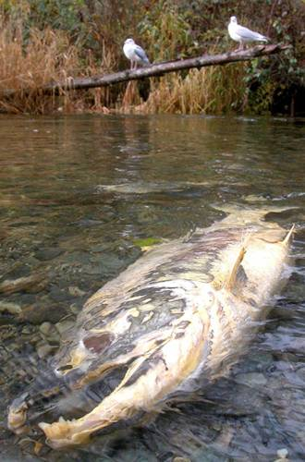
Chinook Recruits Below Dam
Genotyped 193 samples collected
from carcasses (2011-2013)
Evans et al. in revision, Rest. Ecol.
Notes:
We also have the opportunity to examine the parentage of salmon samples as carcasses from the South Santiam below Foster Dam by ODFW since 2011 during spawning ground surveys.
In total we were able to genotype ~200 samples across the 3 years.

Slide 10
Chinook Recruits Below Dam
12% (23/193) were progeny of
reintroduced salmon
Evans et al. in revision, Rest. Ecol.
Notes:
Our parentage analysis indicated that the parentage of about 12% of those salmon can be attributed to reintroduced salmon.
So this suggests that salmon production above the dam is contributing to adult recruitment below the dam and that the reintroduction program may be having positive effects on population productivity beyond the bounds of the historical above-dam habitats.

Slide 11
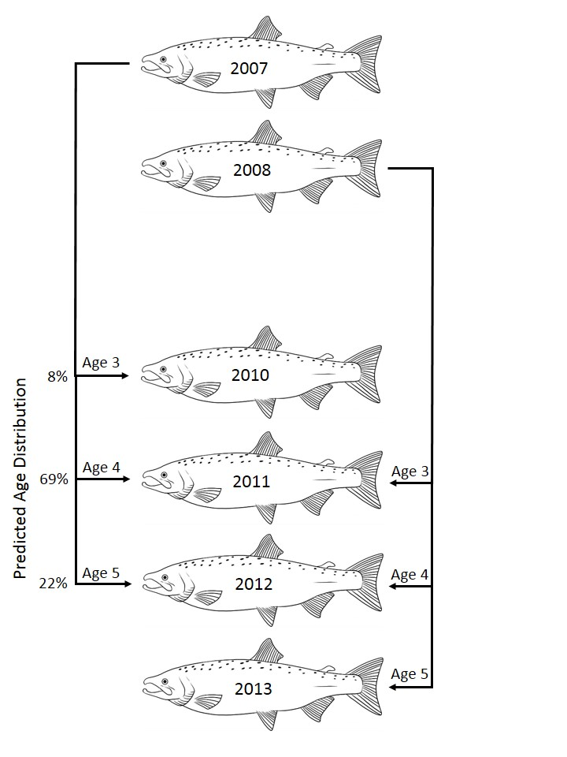
Cohort Replacement Rate
“Number of spawners produced by a spawner”
2007 CRR = 0.96
(120 female offspring / 125 female parents)
2008 CRR = 1.16
(253 female offspring/219 female parents)
Evans et al. in revision, Rest. Ecol.
Notes:
From our parentage assignments we have been able to examine a metric of population productivity called cohort replacement rate, which is defined as the number of spawners produced by a spawner.
We calculated this metric based on the number of females in the population, as they are expected to be the limiting sex in salmonid mating systems, and indeed in most years, females were the limiting sex. We calculated CRR for cohorts released above the dam during 2007 and 2008 as we have complete estimates of adult offspring returns for these individuals.
Our estimates of CRR for salmon reintroduced above Foster dam during 2007 was just below one, and for the 2008 cohort, slightly exceeding one.
These findings suggest that replacement of reintroduced cohorts is occurring through adult offspring recruitment back to the Foster Dam trap.

Slide 12
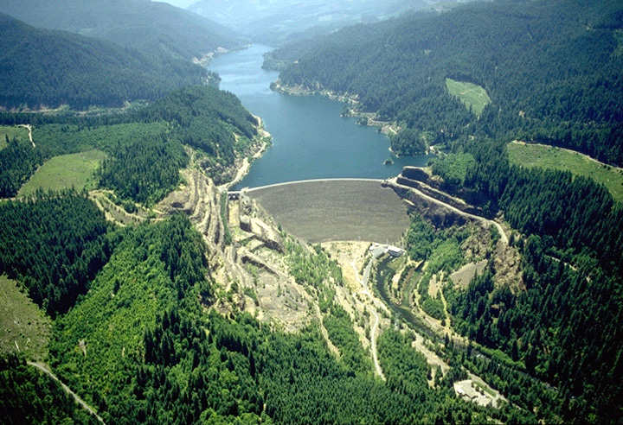
CRR and Dam Passage
“Number of spawners produced by a spawner”
2007 CRR = 0.96
(120 female offspring / 125 female parents)
2008 CRR = 1.16
(253 female offspring/219 female parents)
Cougar Dam: CRR ~0.3-0.4
Evans et al. in revision, Rest. Ecol.
Notes:
Our CRR findings on the South Santiam river contrast starkly to those associated with the reintroduction programs on the SF McKenzie river where CRR approximates 0.3-0.4
The CRR comparison between the South Santiam and SF Mckenzie programs highlights the need for juvenile passage through dams in order for these reintroductions to be effective. Indeed, we have some evidence that salmon can spill over Foster Dam which is only 38m tall, compared to Cougar dam’s 158m, which may be facilitating these higher CRR.

Slide 13
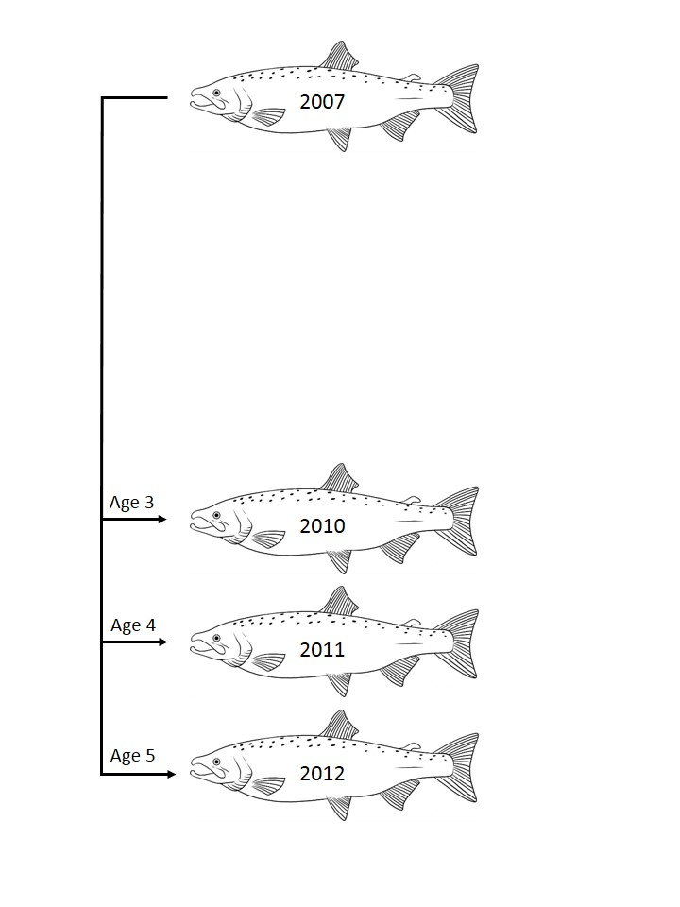
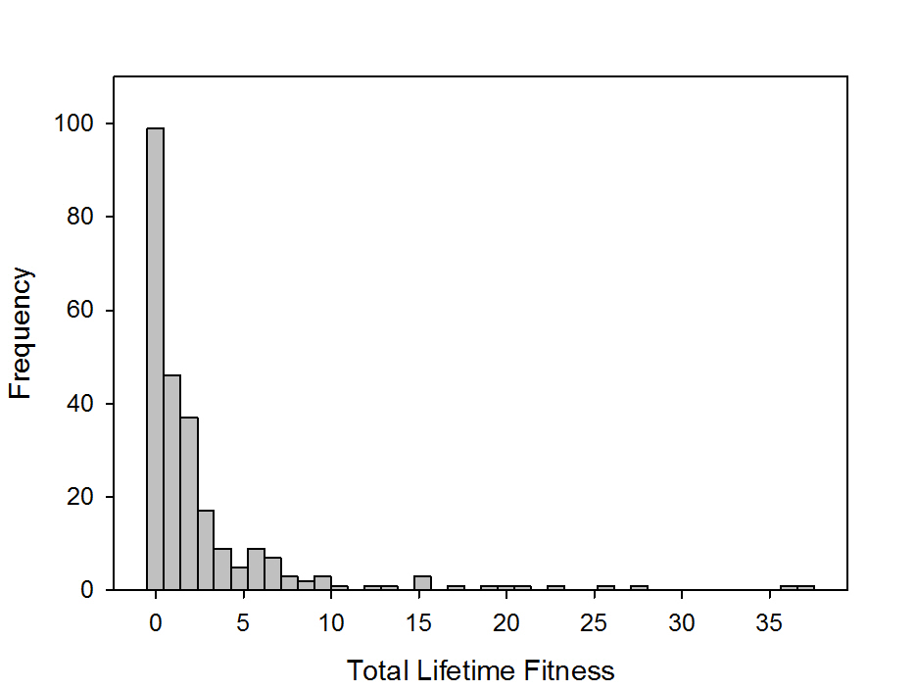
TLF of Reintroduced Salmon: 2007
61% (154/254) of salmon produced adult offspring
TLF = 2.9±5.4 offspring
Evans et al. in revision, Rest. Ecol.
Notes:
Looking at estimates of total lifetime fitness (total number of adult progeny) for salmon reintroduced above the dam during 2007, we see that fitness values are highly skewed in the cohort, with about 40 % of individual producing no adult recruits back to the system. However, some individuals were highly successful, producing over 30 offspring!
Mean total lifetime fitness was around 3 progeny.

Slide 14
TLF of Reintroduced Salmon: 2007
 | P | Parameter (β)
Sex | 0.075
Date | < 0.001 | Later > Earlier (1.04×10⁻⁶)
Date × Sex | 0.010 | Males > Females, Sept. 21 (-4.43×10⁻⁷)
61% (154/254) of salmon produced adult offspring
TLF = 2.9±5.4 offspring
Evans et al. in revision, Rest. Ecol.
Notes:
There were actually only three release dates used in 2007 and all reintroduced salmon were HOR, likely surplus to the broodstock needs of the hatchery.
We didn’t find that mean fitness differed between males and females overall, however, there was an indication that males released on the last day of the program were more successful than females at producing offspring

Slide 15
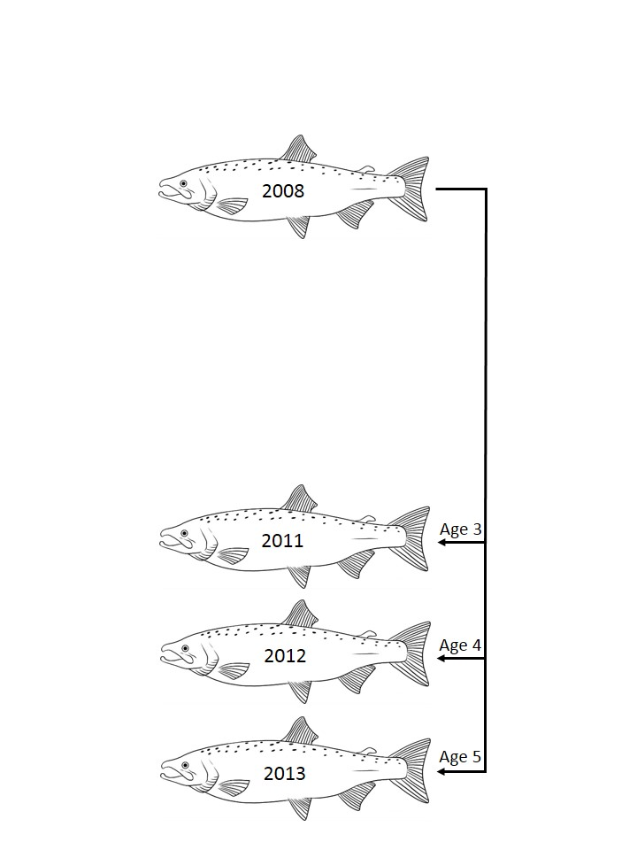
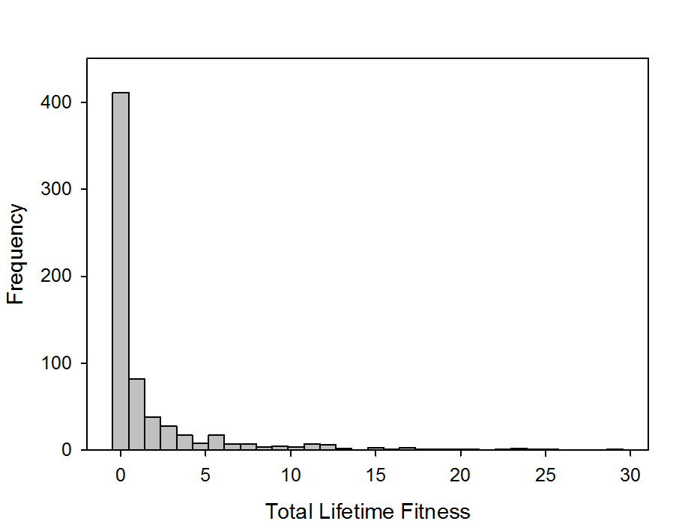
TLF of Reintroduced Salmon: 2008
38% (249/660) of salmon produced offspring
TLF = 1.9 ± 4.1
Evans et al. in revision, Rest. Ecol.
Notes:
For salmon reintroduced above the dam in 2008, the majority of individuals exhibited zero TLF and mean number of adult progeny recruiting back to the system was lower than in 2007 at ~ 2 progeny, albeit the standard deviation estimates around this estimate overlap, and again some individuals exhibited high TLF values

Slide 16
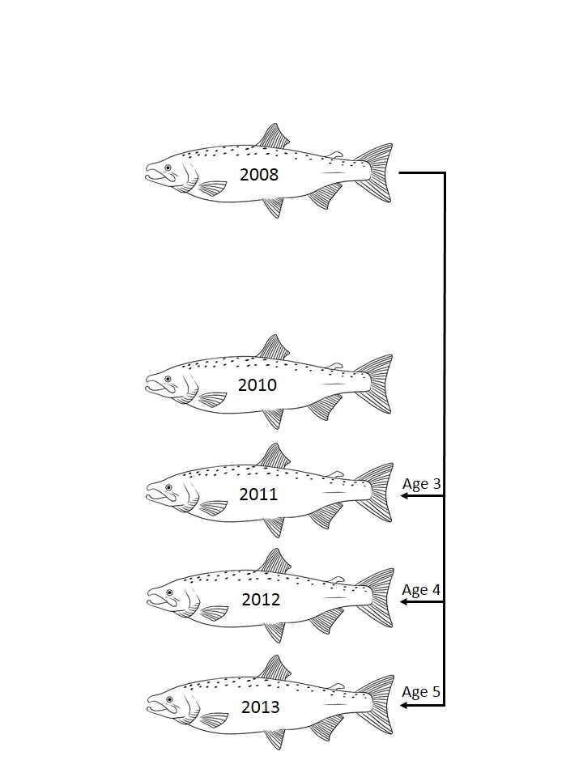
TLF of Reintroduced Salmon: 2008
 | P | Parameter (β)
Sex | < 0.001 | Female (0.29)
Date | 0.036 | Later > Earlier (2.48×10⁻⁷)
Origin | 0.687
38% (249/660) of salmon produced offspring
TLF = 1.9 ± 4.1
Evans et al. in revision, Rest. Ecol.
Notes:
In this year, females achieved higher mean fitness compared to males, which could be driven by the skew in sex ratio towards males.
We also observed a relationship between TLF and release date, with later returns showing evidence of higher TLF. Again, this year involved the predominant release of surplus HOR salmon so it is unclear as to how well release date reflects actual arrival time of these fish.
2008 was the only year comprised of a mix of NOR and HOR releases so we were able to compare whether fitness differed between salmon of different origins. Interestingly, we found no evidence that salmon of HOR or NOR exhibited differences in individual-based estimates of fitness, which is in contrast to what other studies have suggested

Slide 17
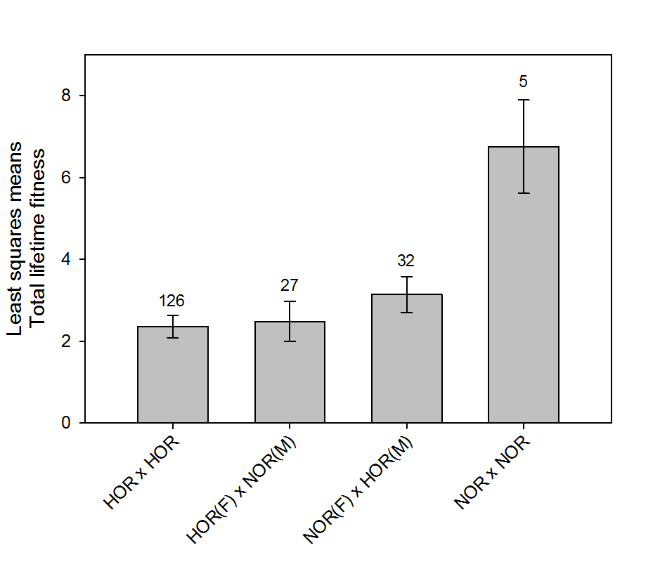
TLF of Reintroduced Mate Pairs: 2008
Evans et al. in revision, Rest. Ecol.
Notes:
However, given that the majority of NOR salmon likely mated with an HOR mate as there was a large skew towards HOR reintroductions in this year, we also looked at how TLF was related to mate pair type.
So we have four mate pair types in the system, those comprised of a HOR males and females, those comprised of a mix of hatchery and NOR parents and pairs comprised of NOR parents.
These analysis, while somewhat limited by samples size of each mate pair type, which is shown above the bars, suggests that NOR mate pairs produce more offspring than mate pairs involving HOR parents, and thus may suggest that mating with HOR salmon is dragging down the fitness of NOR salmon.

Slide 18
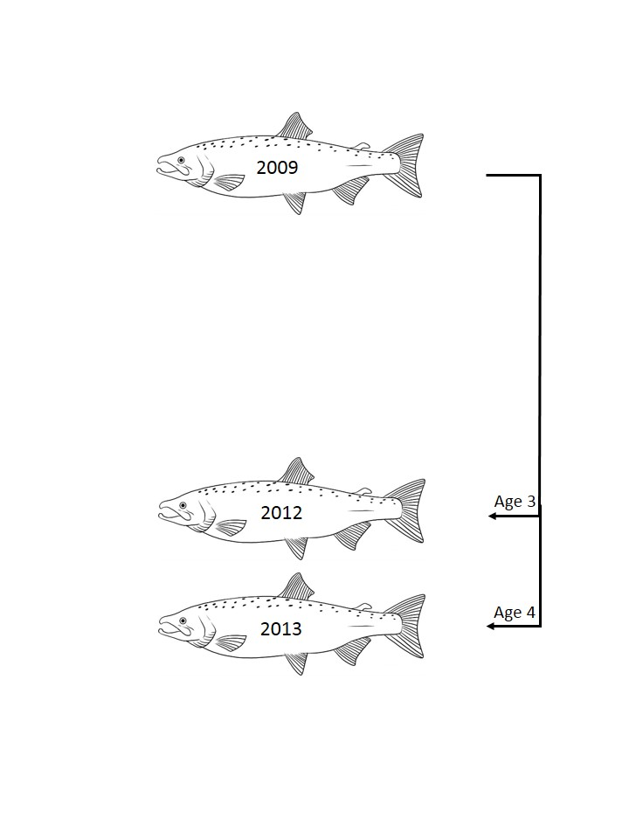
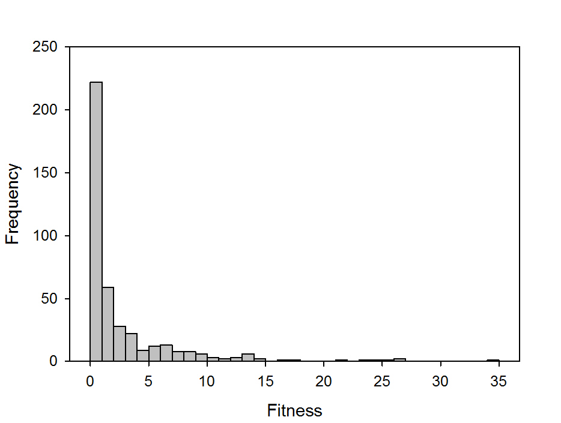
Fitness of Reintroduced Salmon: 2009
46% of salmon produced at least one 3 or 4-year old adult offspring
Evans et al. in revision, Rest. Ecol.
Notes:
Finally, looking at some preliminary estimates of fitness for the 2009 reintroduced cohort, the first cohort entirely comprised of unmarked, presumed NOR salmon.
Again we see skew in fitness estimates, with about half of all reintroduced salmon not producing any offspring.

Slide 19
Fitness of Reintroduced Salmon: 2009
 | P | Parameter (β)
Sex | 0.012 | Female (0.24)
Date | 0.200
Location | 0.782
46% of salmon produced at least one 3 or 4-year old adult offspring
Evans et al. in revision, Rest. Ecol.
Notes:
We found that sex was again a significant predictor of variation fitness, but neither release date or location, which was variable in this year, appear to influence fitness. The lack of an effect of release date on the fitness of this cohort is in contrast to what we observed in the two previous cohorts for reintroductions of surplus HOR salmon, which may suggest that release effects on fitness are specific to HOR salmon.

Slide 20
Summary
CRR was 0.96 and 1.16 for the 2007 and 2008 reintroduction years, respectively, indicating that population replacement is occurring
Total lifetime fitness averaged 2.8±5.4 (range: 0-38) offspring (2007) and 1.9±4.1 (range 0-30) offspring (2008)
Suggestion of HOR salmon “dragging down” fitness of NOR salmon
Later reintroduction dates associated with higher TLF in 2007 and 2008 but no evidence of date or location effects on fitness in 2009
Notes:
CRR was 0.96 and 1.16 for the 2007 and 2008 reintroduction years, respectively, indicating that population replacement is occurring
Total lifetime fitness averaged around three progeny for the 2007 cohort and 2 progeny for the 2008 cohort, but again, in each year, many salmon produced no progeny and there was iincredble variance in TLF of reintroduced fish
While we didn’t find that an individual’s origin was a predictor of variation in TLF for salmon reintroduced above the dam in 2008, mate pair type was predictive. Our findings, whicle based on a limited sample size suggested that when NOR salmon mate with HOR salmon, their fitness is adversely affected.
Later reintroduction dates associated with higher TLF in 2007 and 2008 but no evidence of date or location effects on fitness in 2009. Reintroduction year is confounded by the origin of salmon used in reintorductions so we can’t say at this point what is really driving this difference across years, and the influence of release date in early years could simply be a consequence of suing surplus HOR salmon in the program. And location of release does not appear to influence fitness.

Slide 21
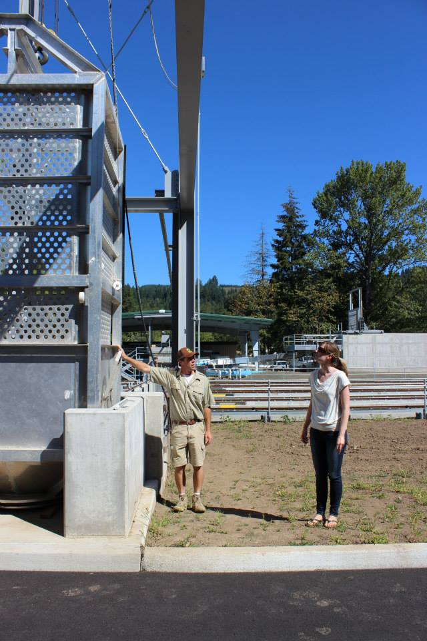
Future Directions
Evaluating parentage of 2014 returns
Provide first estimate of TLF for current reintroduction paradigm i.e. releases of unmarked salmon only
BUT, there were attraction flow issues at new trap facility
2014 pNOR below dam ~0.55 vs. pNOR ~0.1-0.4 (2010-2013)
Notes:
So we will be continuing our work this year examining the parentage of salmon reintroduced above the dam in 2014. This will provide the first estimate of TLF for the current reintroduction paradigm, which used unmarked, presume NOR salmon in reintroductions only.
I think it is important to note that there may be some limitations associated with our fitness and CRR estimates that depend on progeny identified in this return year as there were attraction flow issues at the new trap facility this year, which resulted in about half of the typical number of salmon being released above the dam this year compared to in recent years. Indeed, preliminary evidence from below the dam shows a higher proportion of NOR salmon that spawning below compared to in previous years, suggesting that many salmon produced above the dam were not reintroduced this year.
So, I expect that out CRR and fitness estimates for the 2009 cohort will be downwardly biased.

Slide 22
Acknowledgements
Dave Griffiths and U.S. ACE
Cameron Sharpe, ODFW
ODFW field staff
Banks and O’Malley labs

