Slide 1
Potential Causes and Management of Prespawn Mortality in Adult Upper Willamette River Spring Chinook
Carl Schreck, M.L. Kent, S. Benda, C. Sharpe, J.T. Peterson, and B. Dolan

Slide 2




Acknowledgements
Funding: USACE
ODFW
  Hatchery
  Research
  Managers
USACE
University of Idaho
Oregon State University
Oregon Cooperative Fish and
Wildlife Research Unit
Notes:
# Acknowledgements
This project is a largely collaborative effort funded by the US Army Corps of Engineers. Data and field samples have been graciously provide by folks from the Oregon Department of Fish and Wildlife, US Army Corps of Engineers, and the University of Idaho. Day to day operations of this project are due to a tremendous effort from folks at Oregon State University and Oregon Cooperative Fish and Wildlife Research Unit.

Slide 3
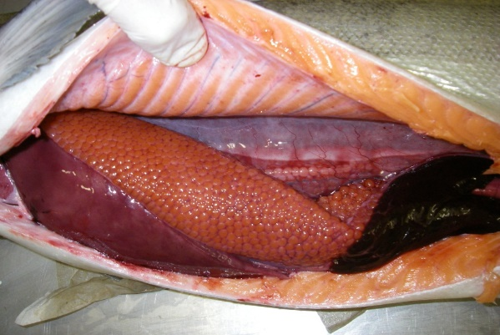
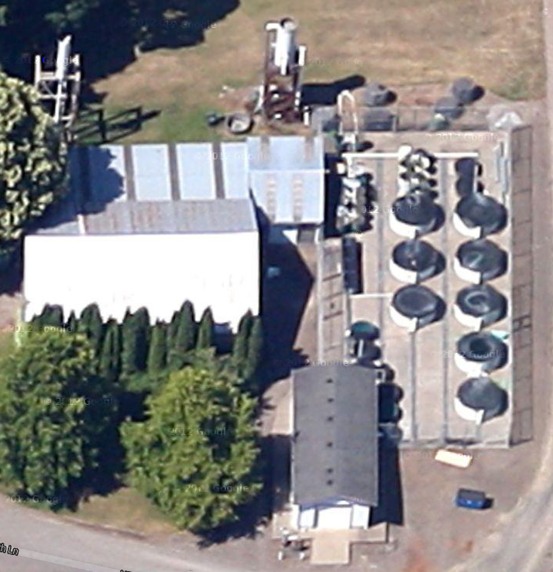
Prior Research
Race against time
Mortality
Threshold
Prespawn mortality
Accumulated degree days
Energetic status
Pathogens
Spawning Period
March
Time
October
Optimal Decision Analysis
Annual holding experiments
at ~ 13C

Slide 4
Estimates of Prespawn Mortality in the Mainstem Willamette River
J. Tyrell Deweber¹, Mike Colvin±,
Jim Peterson¹, Carl Schreck¹,
¹Oregon Cooperative Fish and Wildlife Research Unit
± Assistant Professor, Mississippi State University

Slide 5
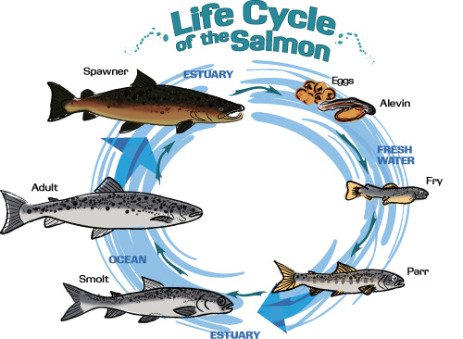
Prespawn Mortality

Slide 6
Prespawn mortality estimates
Notes:
# Prespawning mortality (PSM)
… and these high mortality events occur in most years in upper Willamette River tributaries.

Slide 7
Prespawn Mortality Estimates
ODFW Carcass Surveys:
  >30% in most years
  5 – 100 %
  Radiotagging in Middle Fork (Keefer et al. 2010)
  Mean of 48%
  0 – 93%
What about PSM rate in the mainstem?
  Between Willamette Falls and projects
  Would mortalities be counted?

Slide 8
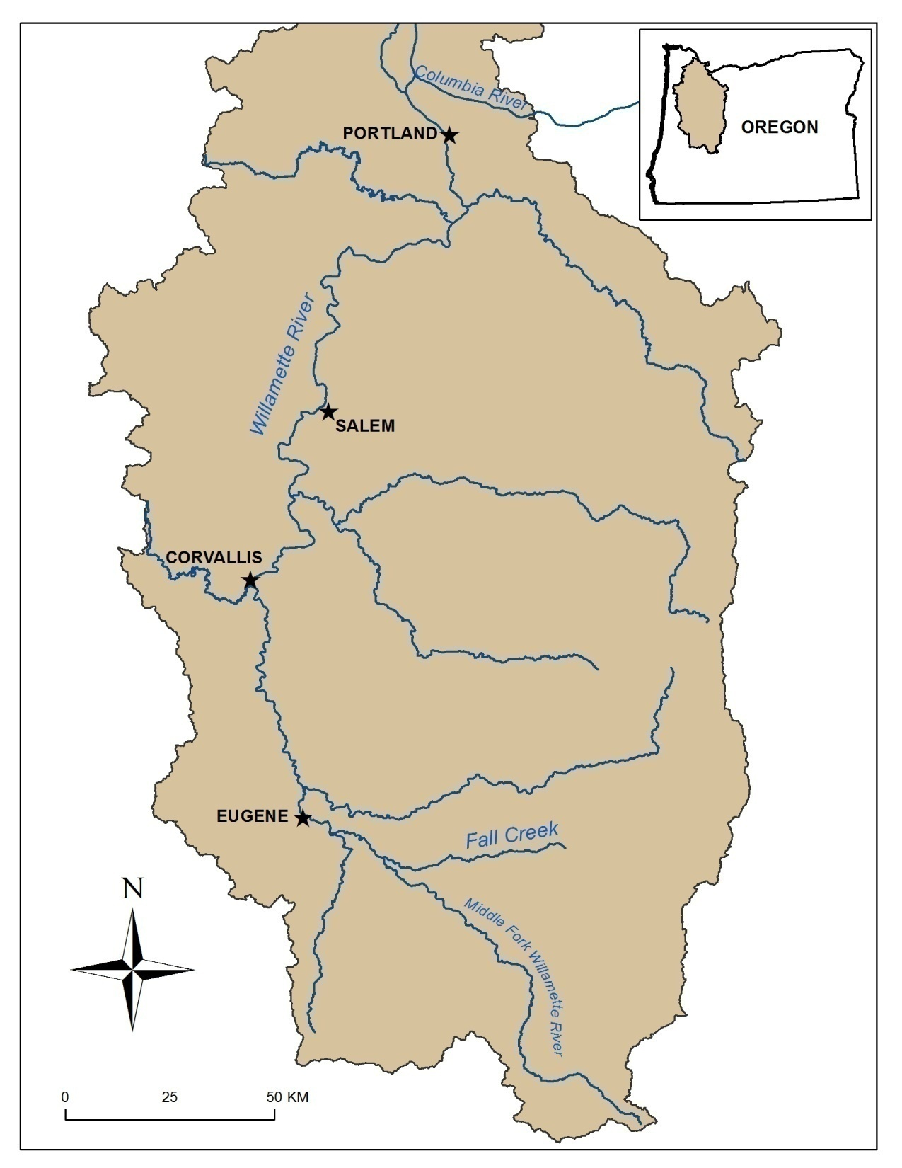
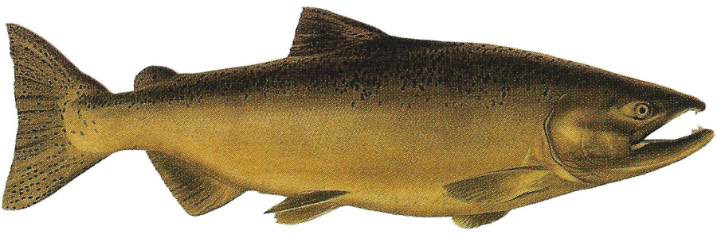
Willamette Falls
Each spring, they come by the tens of thousands …
and we count them all (hopefully)

Slide 9
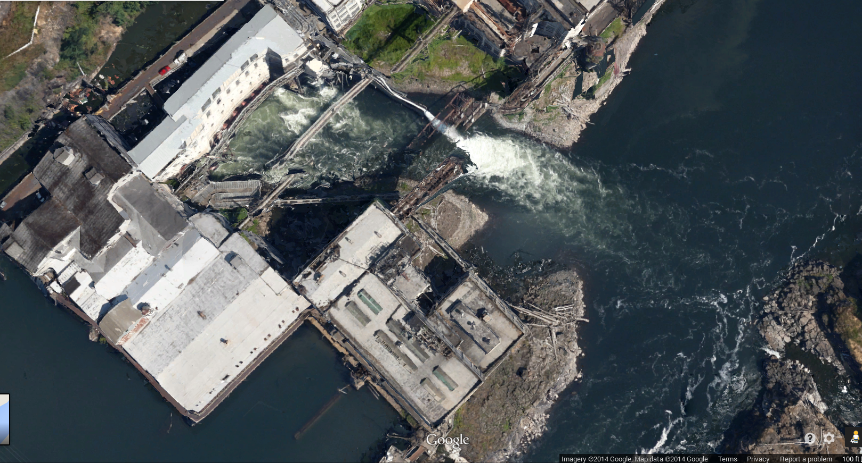
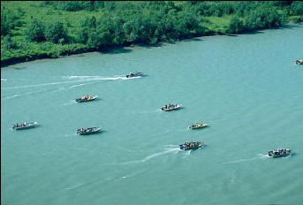
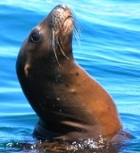
Passage at Falls

Slide 10
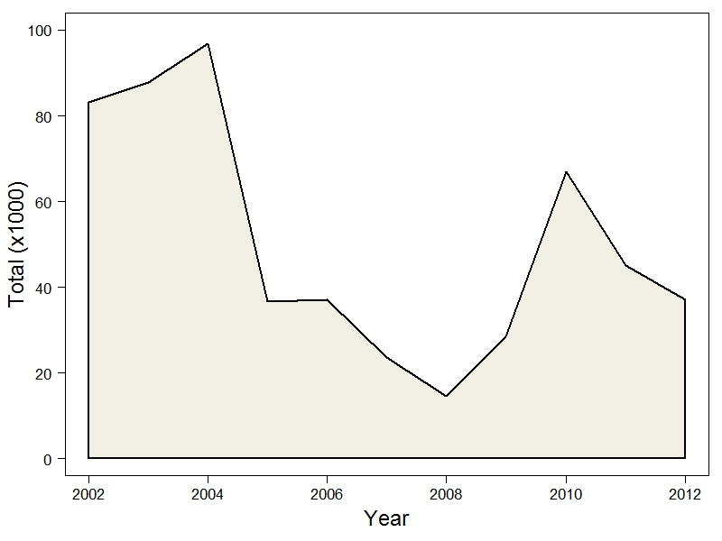
Passing Willamette Falls

Slide 11
Total Passing WF ~=
Upstream Projects +
Harvest +
Tributary and Mainstem Spawners

Slide 12
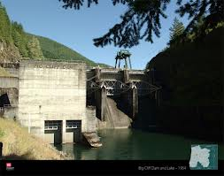
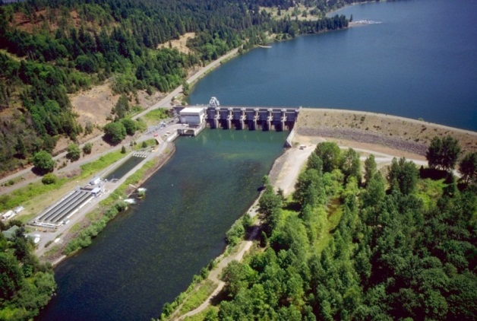
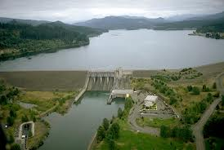
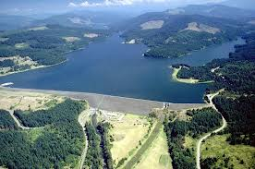
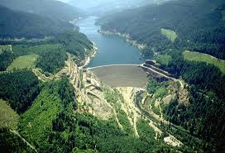
Salmon counts for hatcheries, outplanting, etc.
Big Cliff: 1953
Willamette Falls
Bennett Dam
Dexter: 1954
Big Cliff
Foster: 1968
Foster
Fall Creek: 1966
Cougar
Cougar: 1963
Fall Creek &
Dexter
www.nwd-wc.usace.army.mil
Notes:
# 1950-60s Barriers to adult migration
Specifically, tributaries of the mainstem Willamette River were dammed to provide flood control in the 1950s and 60s. However these projects did not provide upstream fish passage, thereby limiting access of spring Chinook to historic spawning grounds.

Slide 13
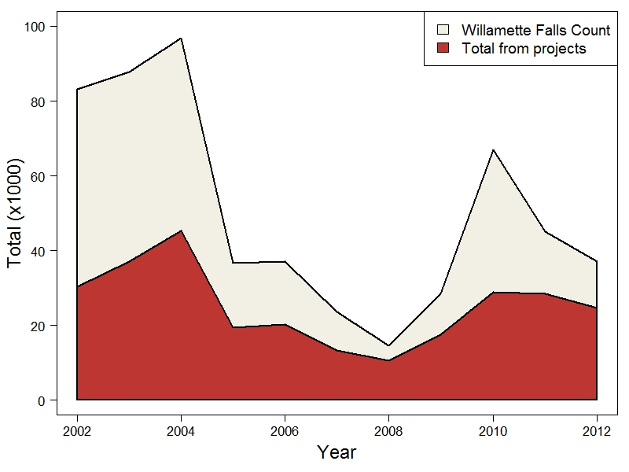

Slide 14
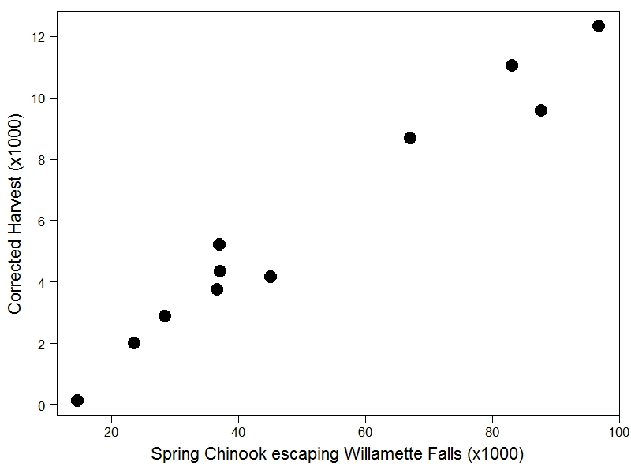
Corrected angler harvestª
ªODFW

Slide 15
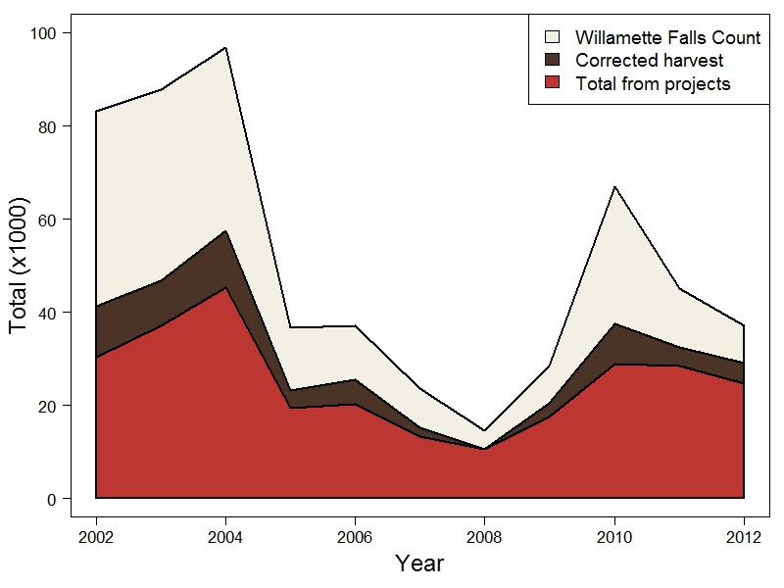

Slide 16
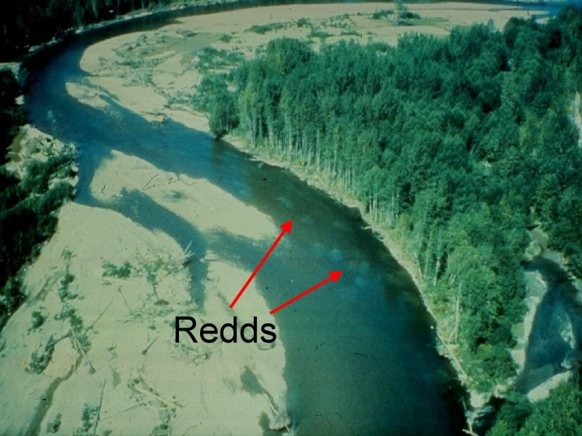
Estimated Number of Spawners

Slide 17
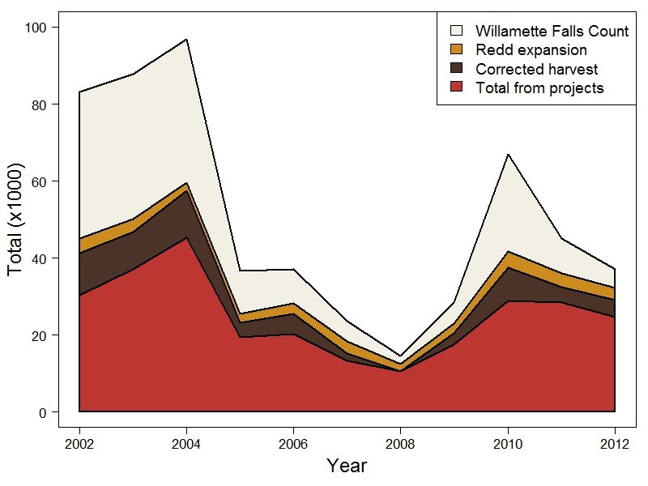
?
Notes:
Redd expansion = the estimated number of fish that spawned between Willamette Falls and other projects

Slide 18
Potential Explanations
Unreported harvest?
Fallback?
Tributaries?
Prespawn mortality in mainstem
?
Evidence?
Notes:
Where are all these fish? Unaccounted for by projects, harvest and spawning surveys. One thing seems clear – some fish are unaccounted for in all years, but the proportion varies a lot. Let’s look at that.

Slide 19
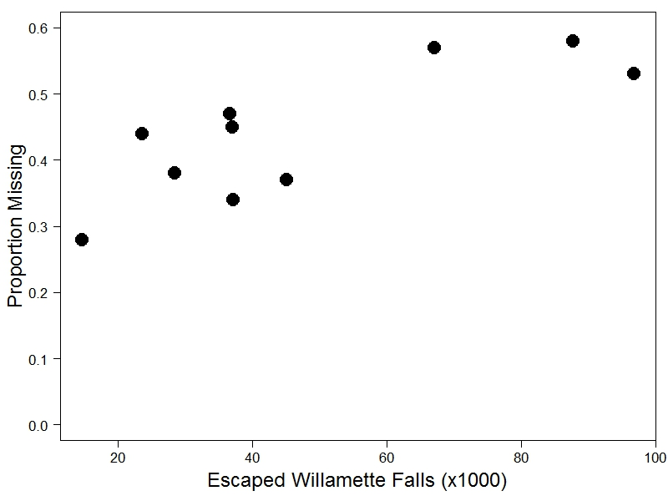
Relationship with Run Size
Density Dependent?

Slide 20
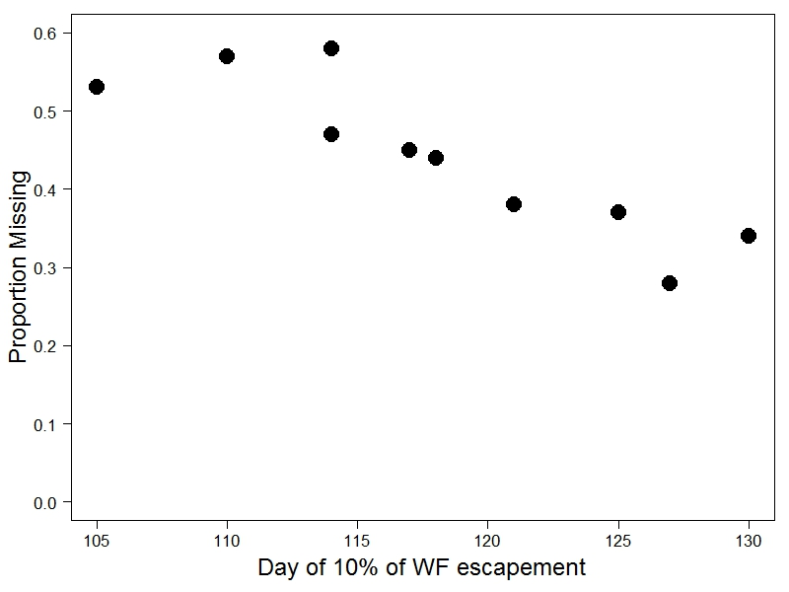
Larger Runs Enter Earlier
More Time in the River

Slide 21
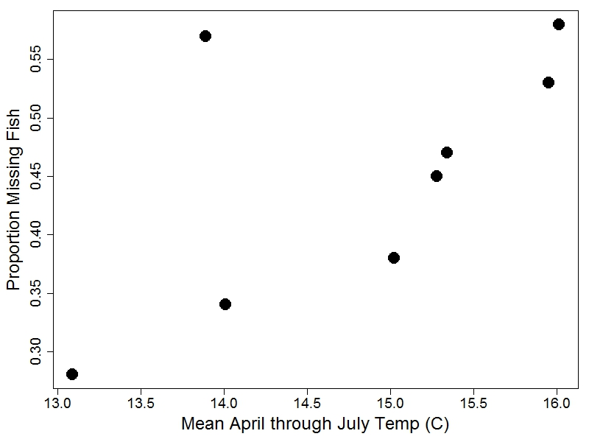
Water Temperature Effect

Slide 22
Potential Explanations
Unreported harvest?
Fallback?
Tributaries?
Prespawn mortality in mainstem
?
Evidence from PSM studies?
Notes:
Where are all these fish? Unaccounted for by projects, harvest and spawning surveys. One thing seems clear – some fish are unaccounted for in all years, but the proportion varies a lot. Let’s look at that.

Slide 23
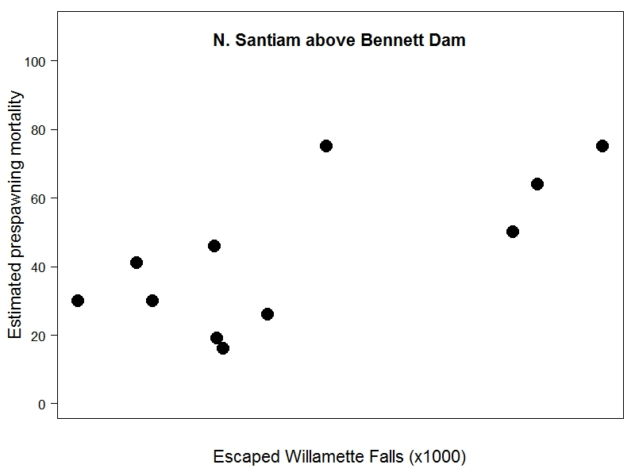
Evidence for Prespawn Mortality
Other tributaries show the same trend
Notes:
Higher prespawn mortality in years with more fish

Slide 24
Evidence for Prespawn Mortality
Notes:
Higher prespawn mortality in years with more fish

Slide 25
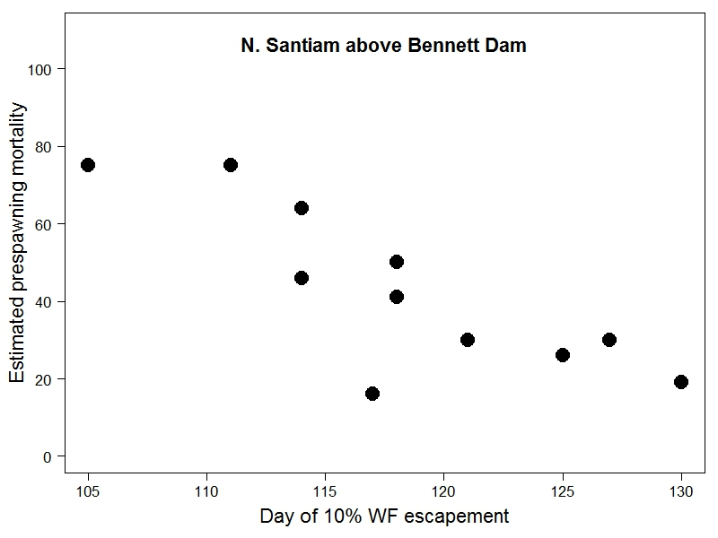
Evidence for Prespawn Mortality
Other tributaries show the same trend
Notes:
Higher prespawn mortality in years with more fish

Slide 26
Evidence for Prespawn Mortality
Evidence suggests that missing fish may die in the mainstem
Notes:
Higher prespawn mortality in years with more fish

Slide 27
Assuming PSM, Potential Explanations?
Evidence:
Fast acting
Horizontal transmission
Mediated by temperature
?
?
Notes:
Where are all these fish? Unaccounted for by projects, harvest and spawning surveys. One thing seems clear – some fish are unaccounted for in all years, but the proportion varies a lot. Let’s look at that.

Slide 28
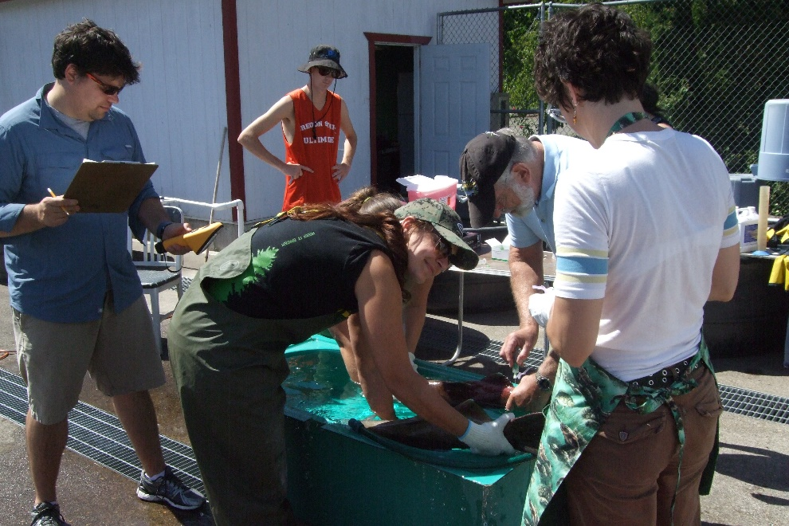
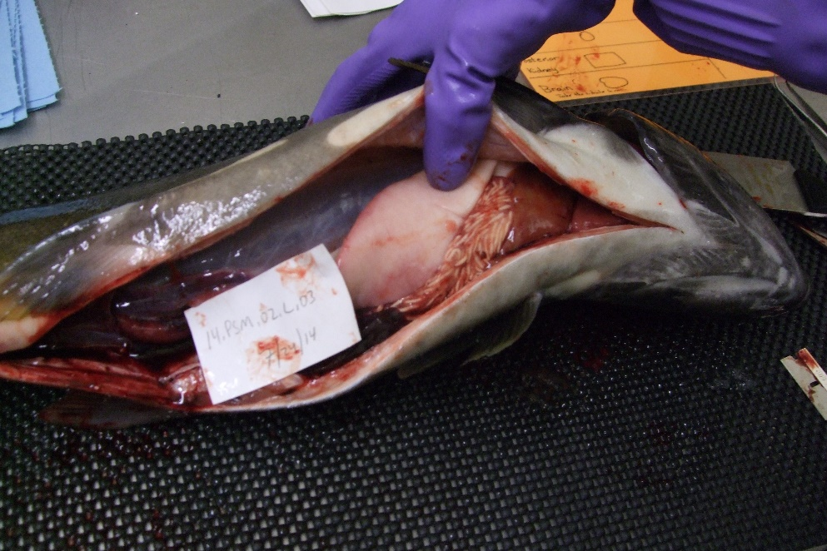
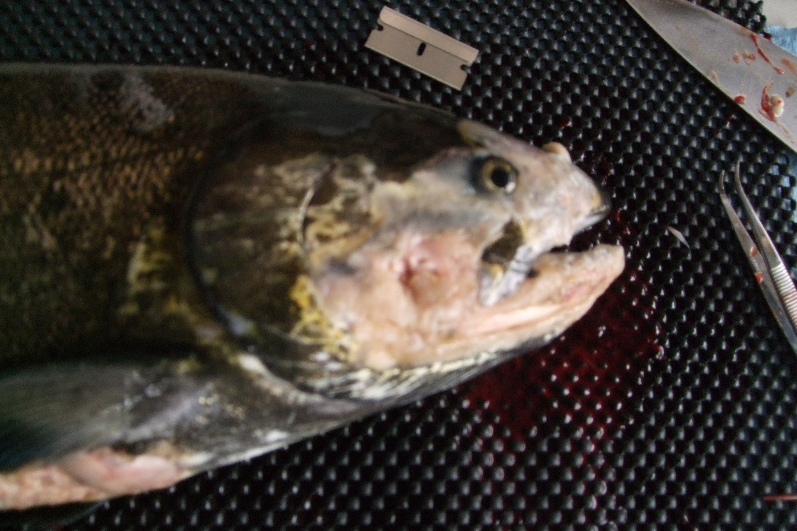
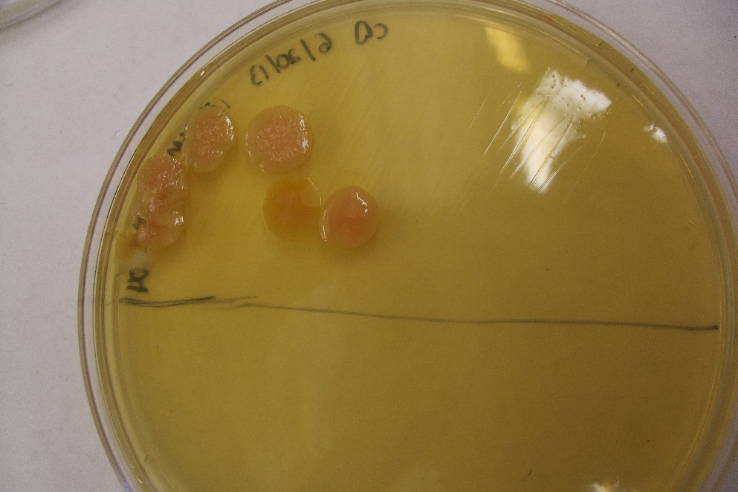

Slide 29
Furunculosis (Aeromonus salmonicida)?
% Prevalence
Evidence:
Replicates in host
Horizontal transmission
Mortality in < 3 weeks
Other pathogens?
Bacterial kidney disease
Notes:
N=7; a. salmonicida

Slide 30
Broader Implications
?
Notes:
Redd expansion = the estimated number of fish that spawned between Willamette Falls and other projects

Slide 31
Implications for management
Fewer fish =
Lower harvest &
Fewer outplants
Big Cliff: 1953
Dexter: 1954
Big Cliff
Foster: 1968
Foster
Fall Creek: 1966
Cougar
Cougar: 1963
Fall Creek &
Dexter
www.nwd-wc.usace.army.mil
Notes:
# Limited natural reproduction
What we are talking about there is the limitation to spring Chinook production which was constrained to the limited suitable spawning habitat located in stream reaches below dams after Upper Willamette tributaries were impounded in the 1950s and 60s for flood control.

Slide 32
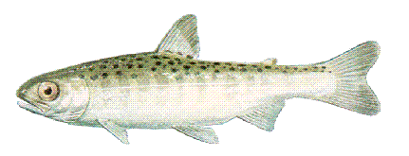

Natural production
Historic spawning habitats
Historic spawning habitats
Trap and haul
Could we have outplanted the missing fish?
Historic spawning habitat
Historic spawning habitat
Notes:
# Natural production
To mitigate for this loss of historical spawning habitats and natural production, excess adult fish trapped at trapped at hydro projects and not needed for broodstock were outplanted above impoundments.

Slide 33
?
Questions or additional thoughts?
Notes:
So we don’t have reliable estimates of where all these fish are? There are many explanations

