Slide 1
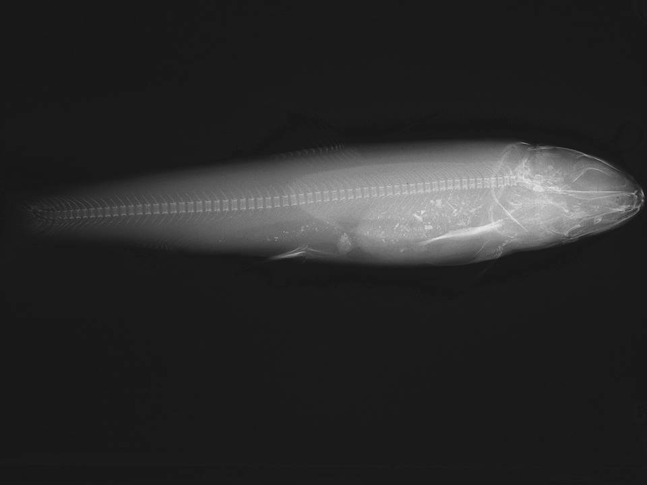
The Hideous and the Insidious –
Implications of Pathogens for Recovery of Bull Trout in the Upper Willamette
Michael Kent – OSU Microbiology Dept.
Nik Zymonas, Michael Scheu, and Michael Hogansen
– ODFW Corvallis Research Lab

Slide 2
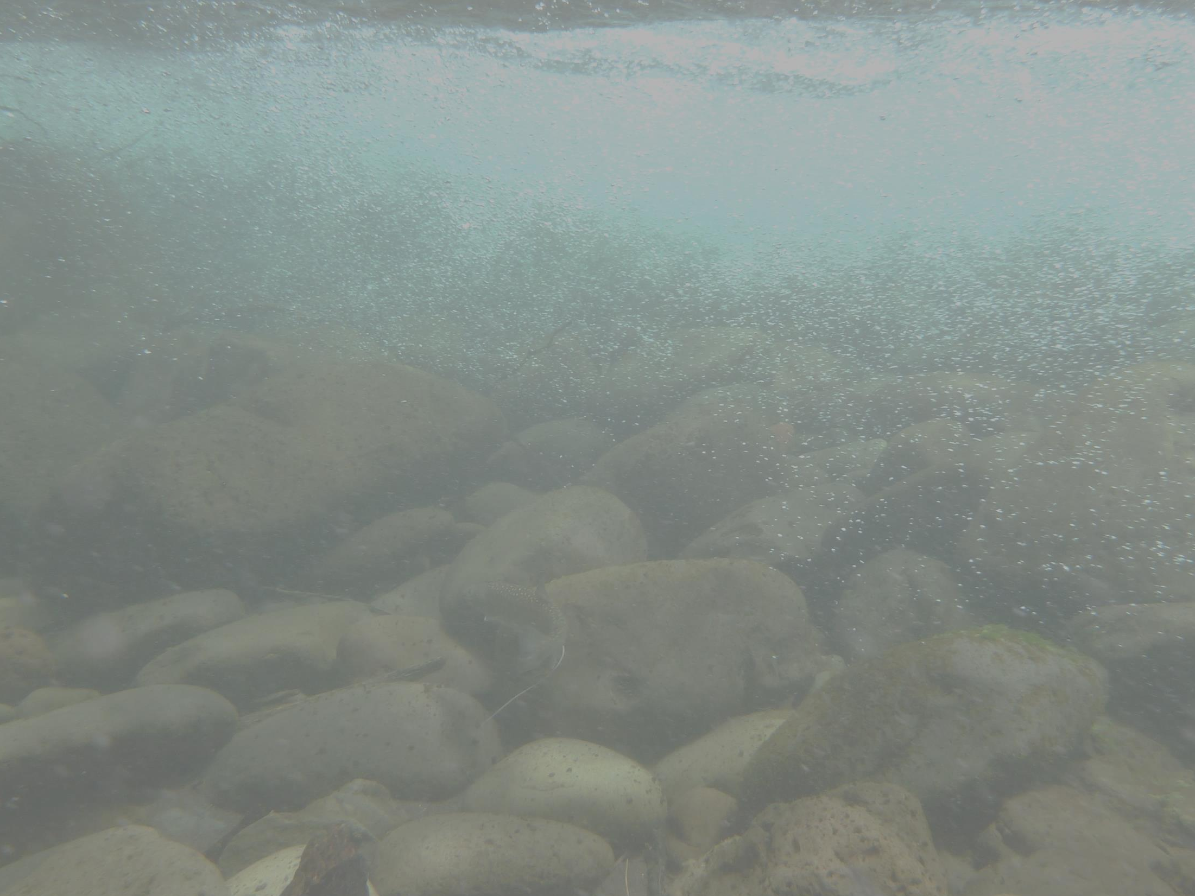
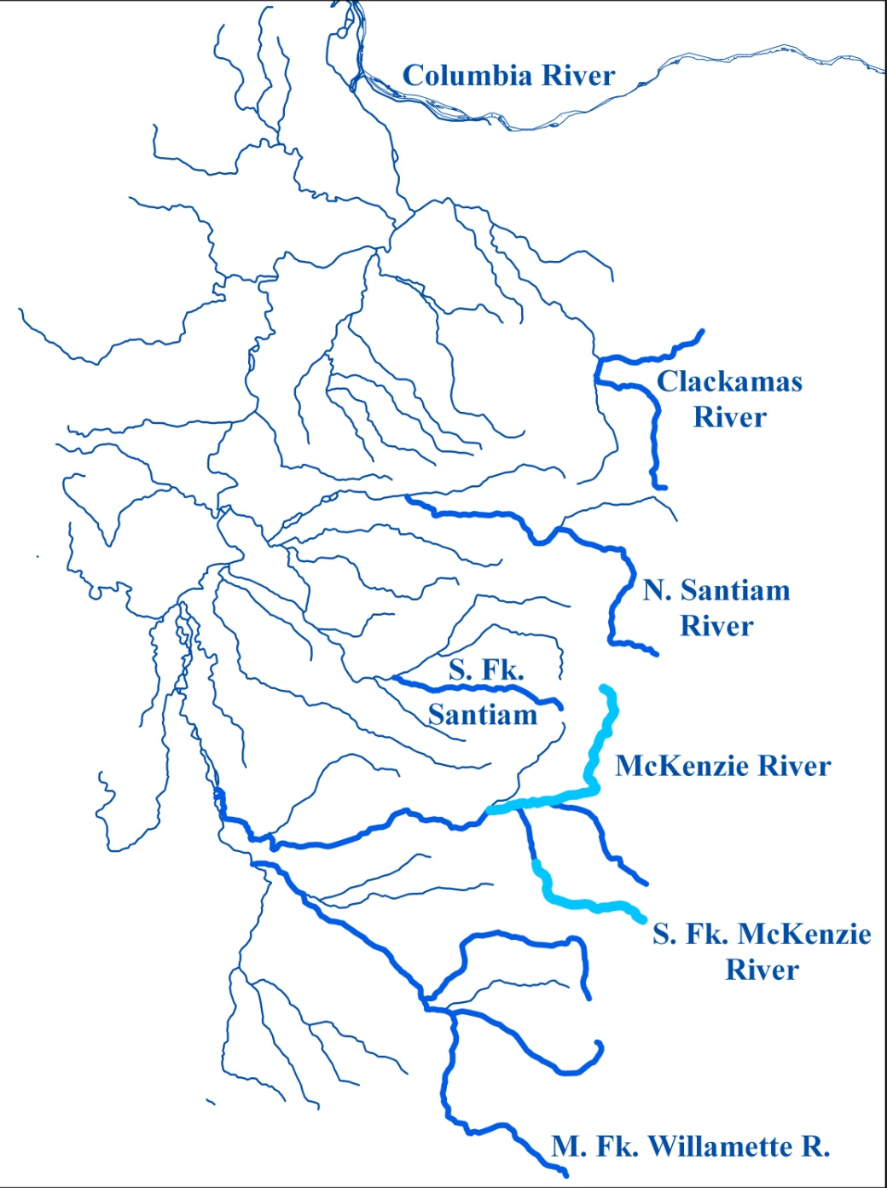
Historical Distribution of Bull Trout
Notes:
Historically widespread
Reduced to 3 spawning tribs
Suite of actions to recover, including reintroductions

Slide 3
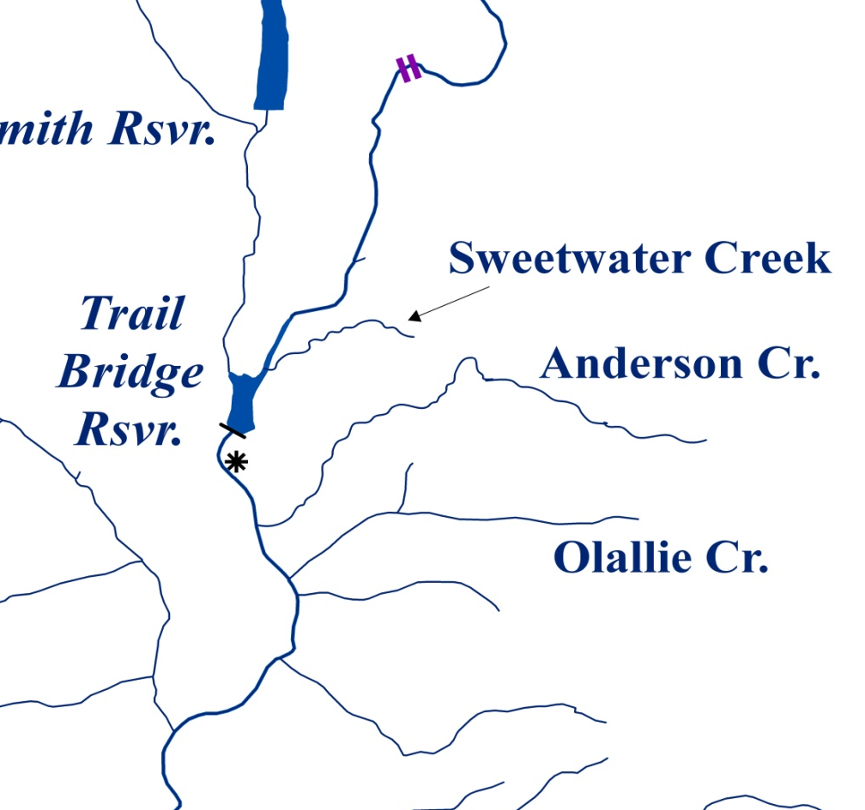
Reintroductions
McKenzie
River
Notes:
Fry – Anderson Creek screw trap → Sweetwater and Olallie

Slide 4
Reintroductions
McKenzie
River
Notes:
Fry – Anderson Creek screw trap → MFW Basin

Slide 5
Fry → Spawning Adults
1997–2005: Directly transferred 10,408 fry to M Fk Willam.
*Swift Cr: 2,773 fry → No Spawning Detected
Notes:
Transfers to the MFW → some spawning in small tribs
No adults in the largest trib (2,773 fry)

Slide 6
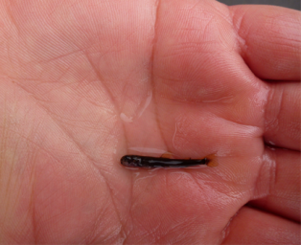
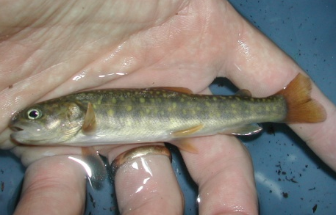
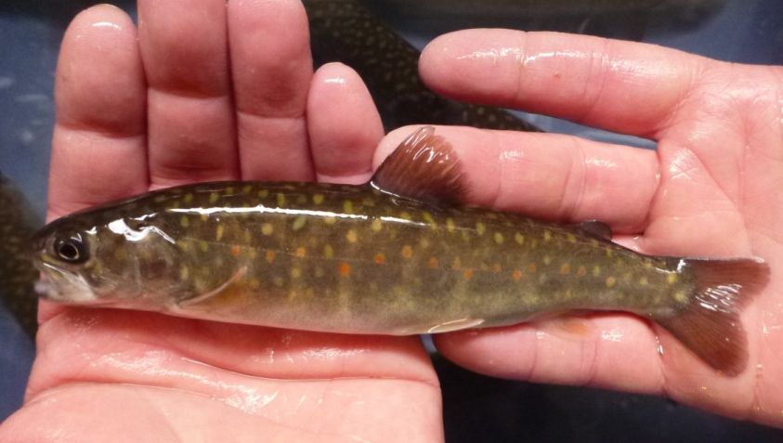
Captive Rearing Program (Headstart)
Circumvent predation, minimize effect on donor pop.
Fry → Leaburg Hatchery (Feb-May) → Release autumn
Notes:
Headstart program = decrease predation → increase survival
Usually ~70% survival to out-planting

Slide 7
Captive Rearing Program (Headstart)
Circumvent predation, minimize effect on donor pop.
Fry → Leaburg Hatchery (Feb-May) → Release autumn
Well McKenzie R. (UV)
Notes:
Headstart program = decrease predation → increase survival
Usually ~70% survival to out-planting

Slide 8
Captive Rearing Program (Headstart)
Circumvent predation, minimize effect on donor pop.
Fry → Leaburg Hatchery (Feb-May) → Release autumn
Well McKenzie R. (UV)
Notes:
Headstart program = decrease predation → increase survival
Usually ~70% survival to out-planting

Slide 9
Captive Rearing Mortality - 2013
N = 132 transferred to Leaburg in spring 2013
N = 24 remaining Jan 2014 (18% survival)
N = 5: BKD

Slide 10
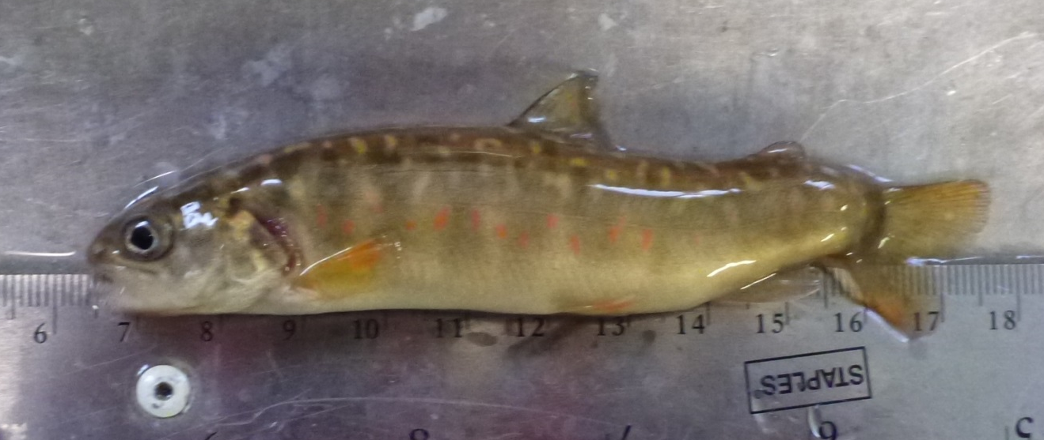
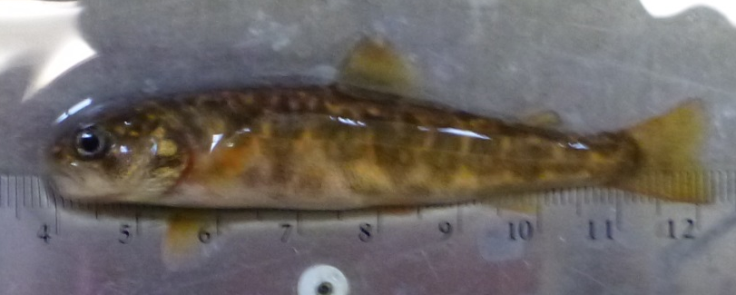
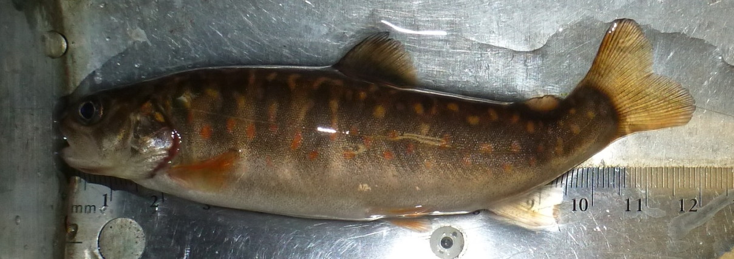
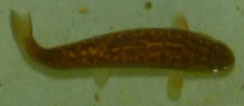
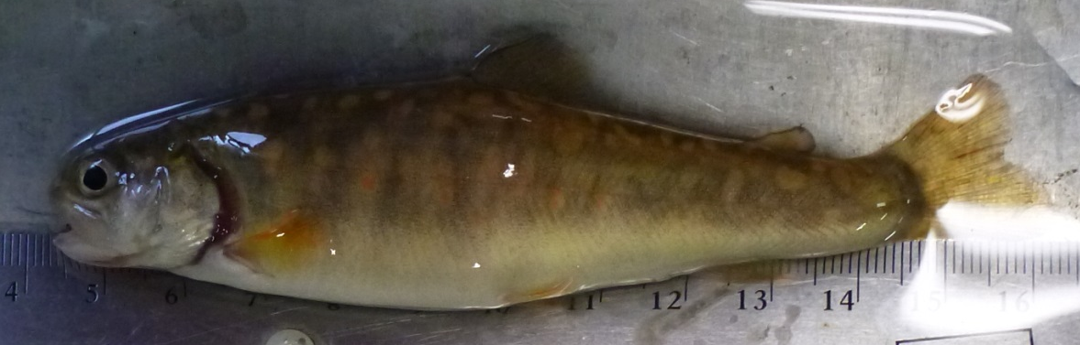
Survivors

Slide 11
Low Survival & High Deformity in 2013
– Potential Factors
In the wild:
- Trap selective for less-fit fish
- Low density-dependent emigration
- Inbreeding
- Pathogens

Slide 12
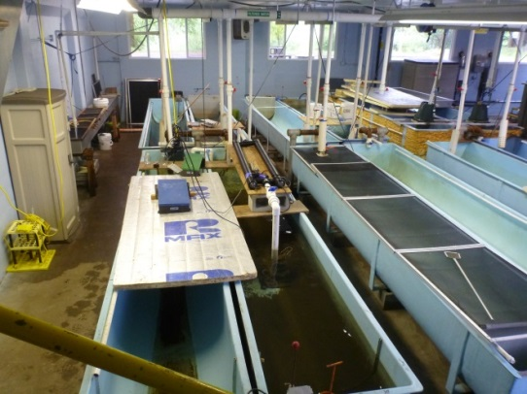
Low Survival & High Deformity in 2013
– Potential Factors
In the wild:
- Trap selective
- Density-dependence
- Inbreeding
- Pathogens
At Leaburg Hatchery:
- Less competition & cannibalism
- Physiochemical environment
- Pathogens

Slide 13
Objectives
1) Determine factors causing high mortality and deformities in captive-reared bull trout.

Slide 15
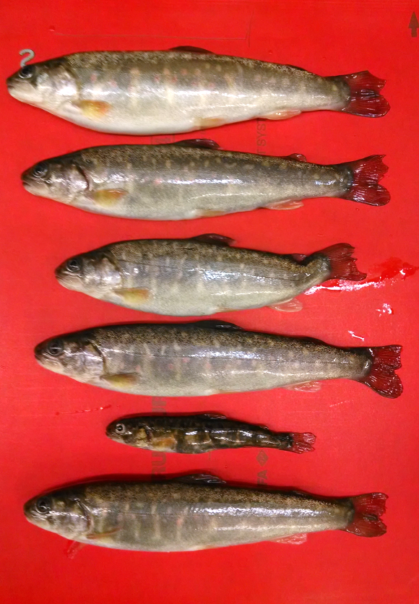
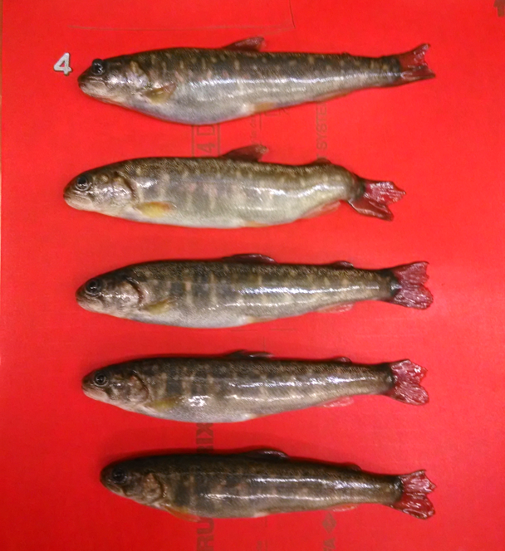
Leaburg Survivors 2013

Slide 16
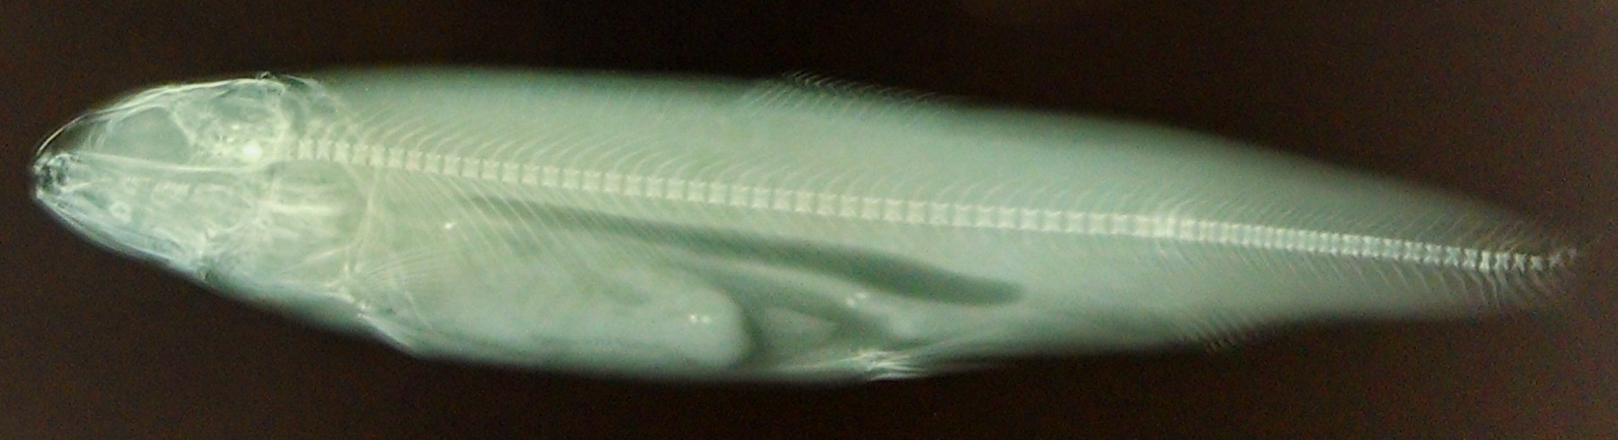
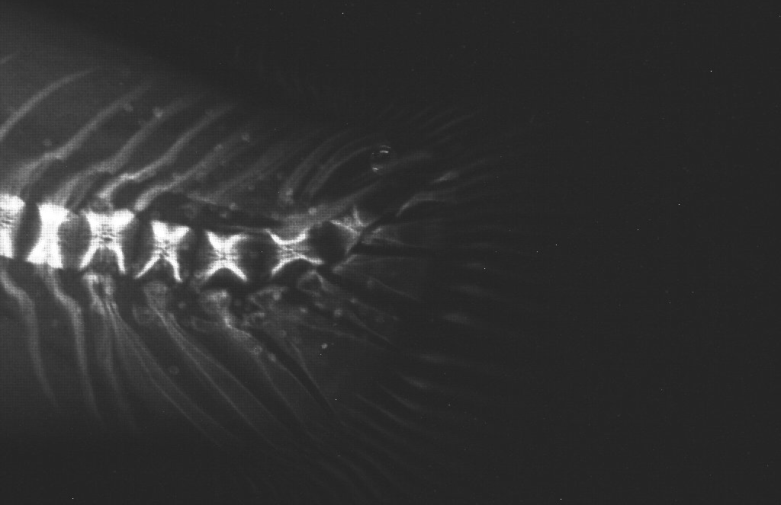
BLT 13 - 23
Metacercariae of Nanophyetus salmincola

Slide 17
Pathology
Histology
  Provides general assessment of pathogens without a priori designations
  Provides data on severity of infection & associated tissue damage

Slide 18
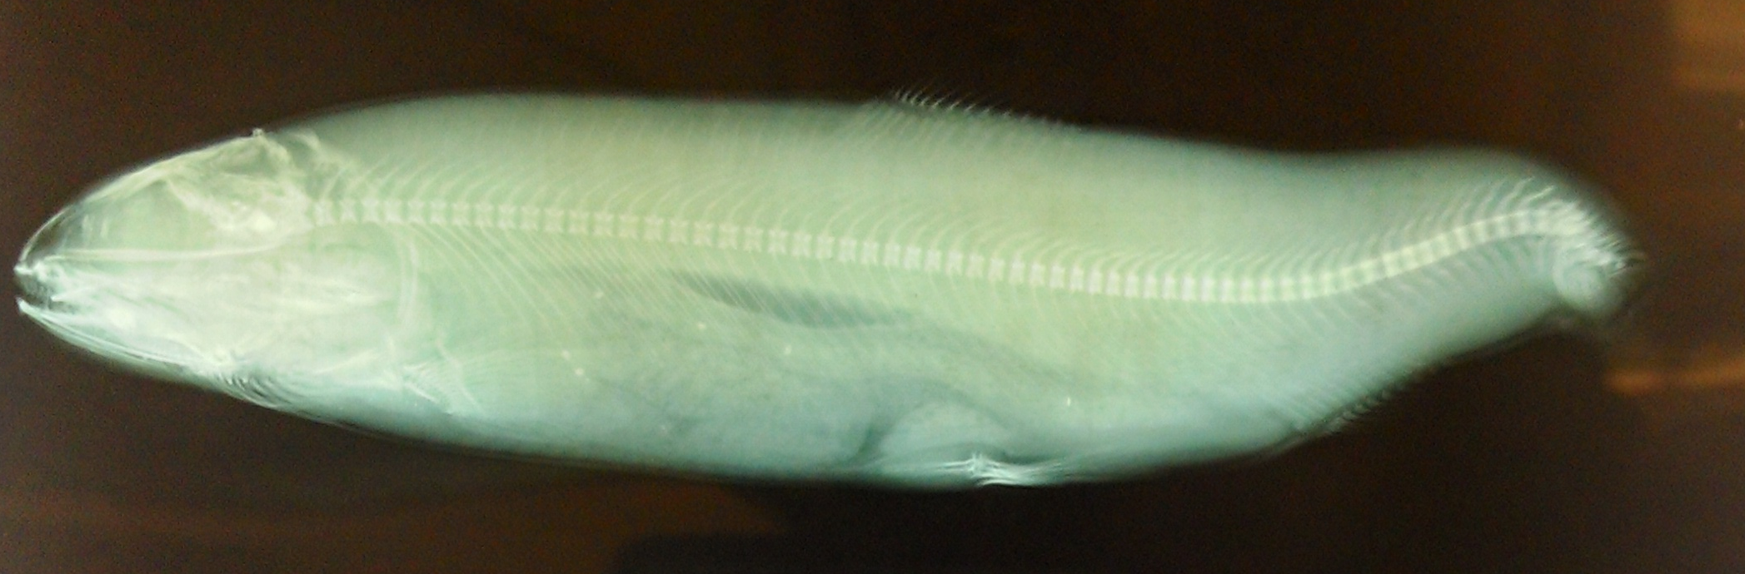
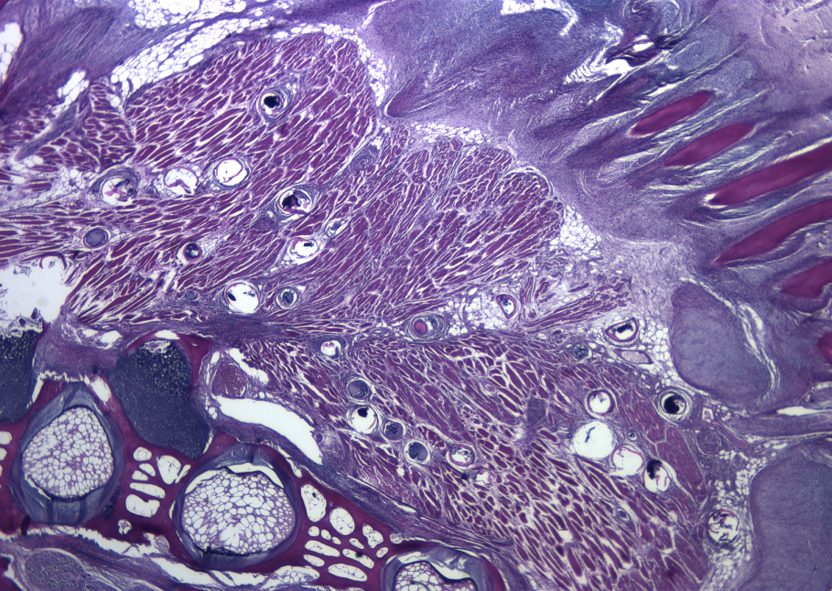
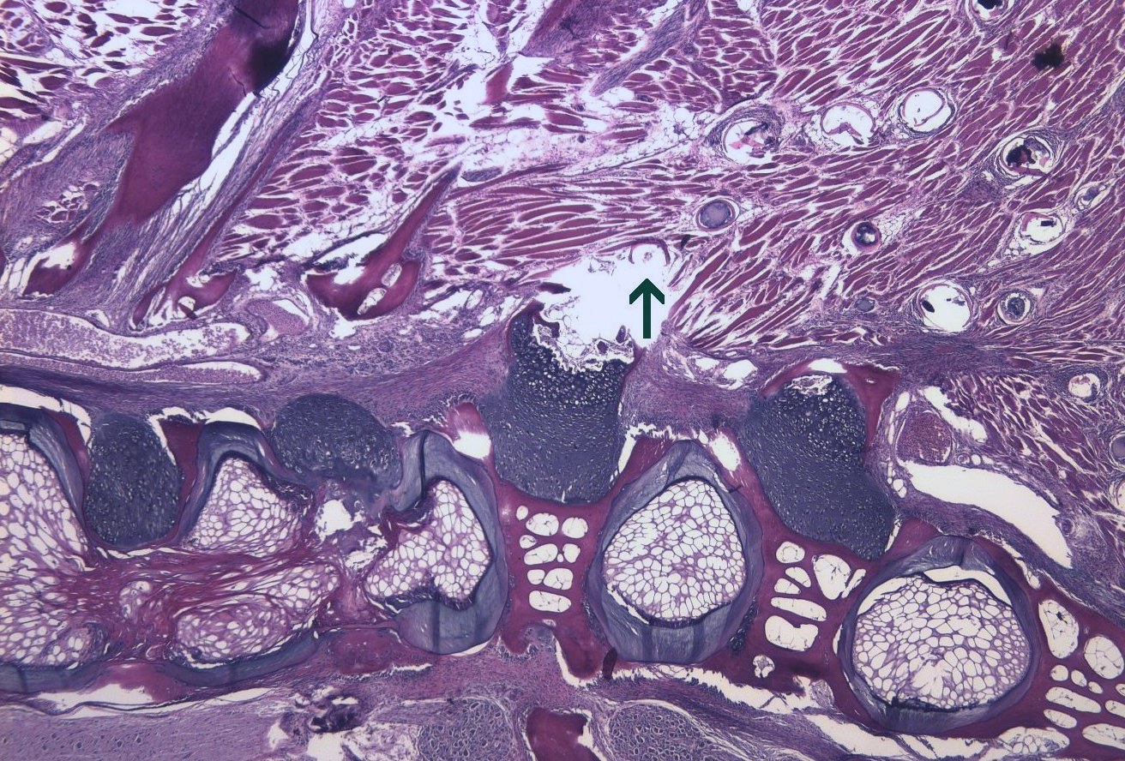
BLT13 -19

Slide 19
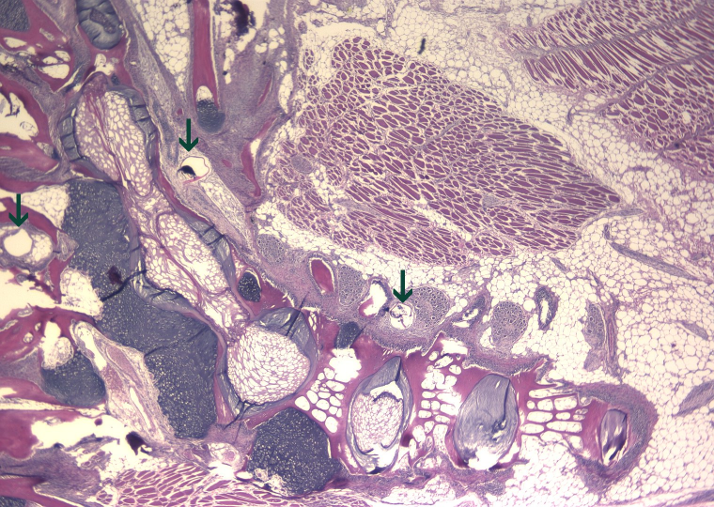
BTL13-23

Slide 20
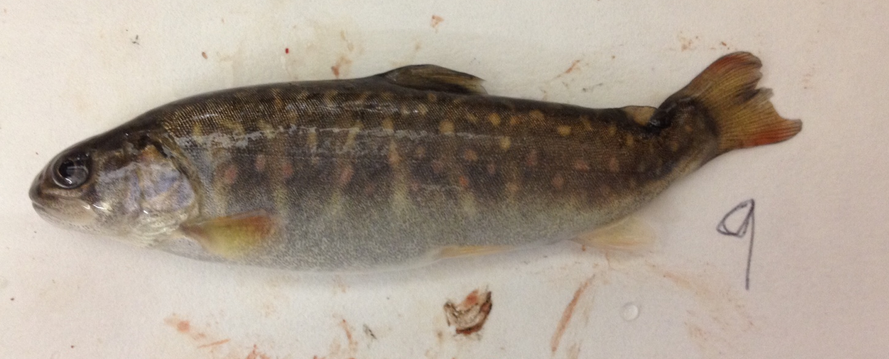
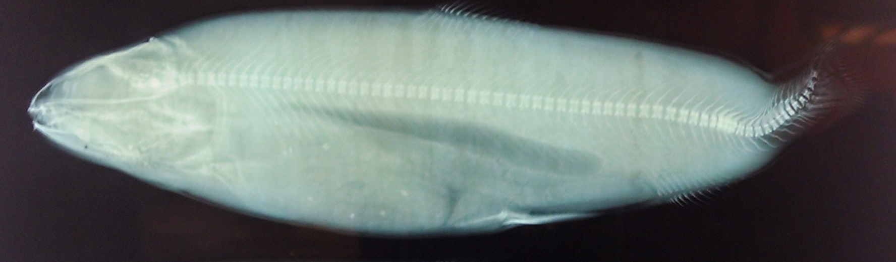
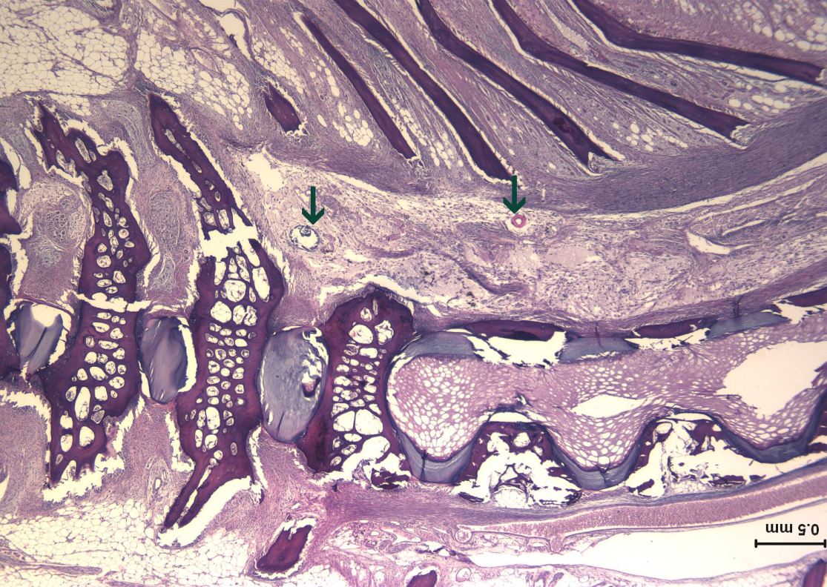
BLT13 -9

Slide 21
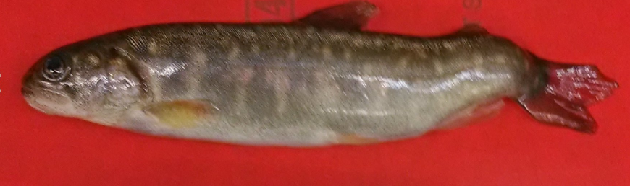
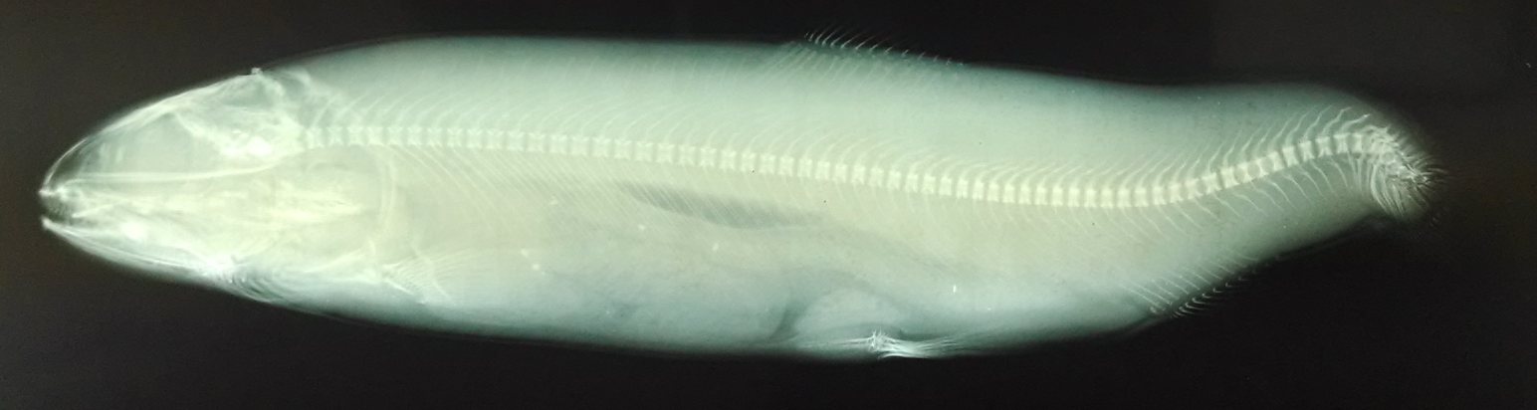
BLT13 -20

Slide 22
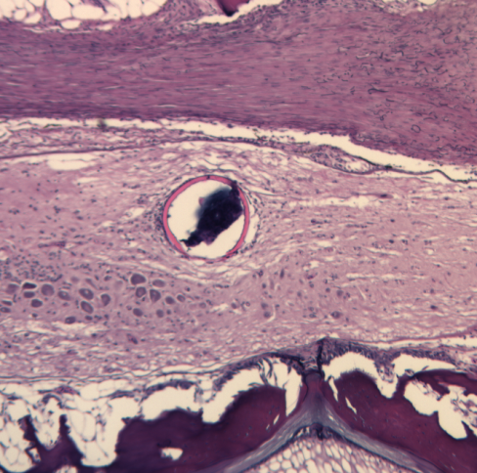
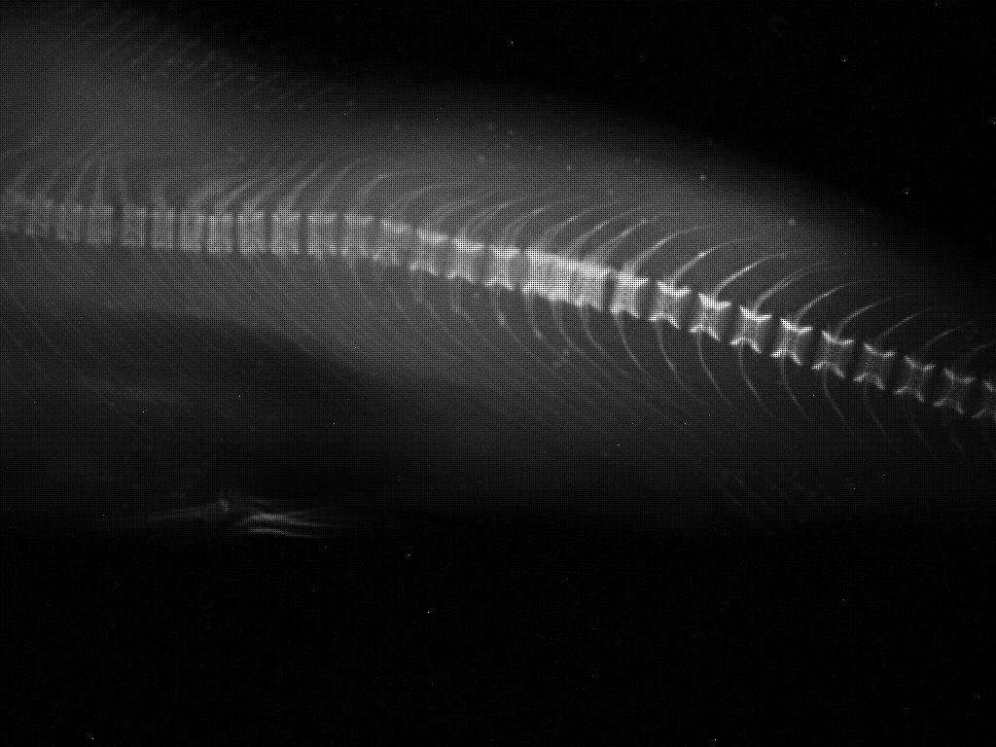
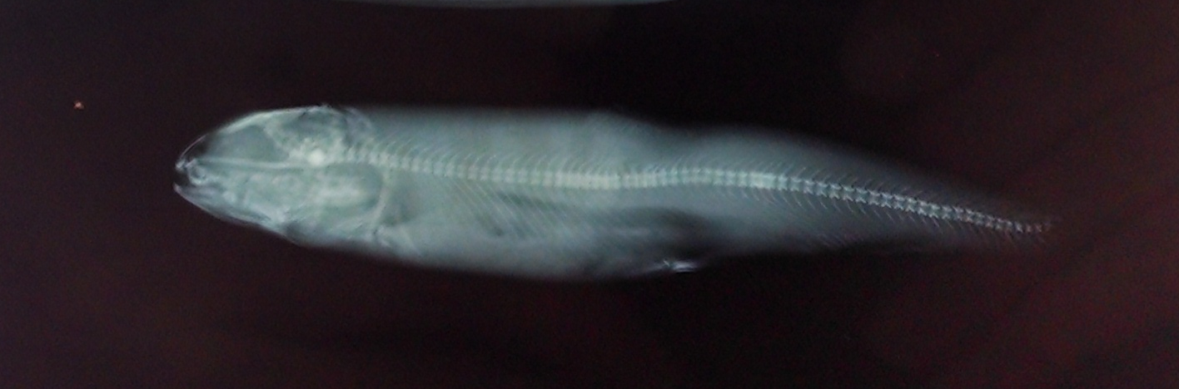
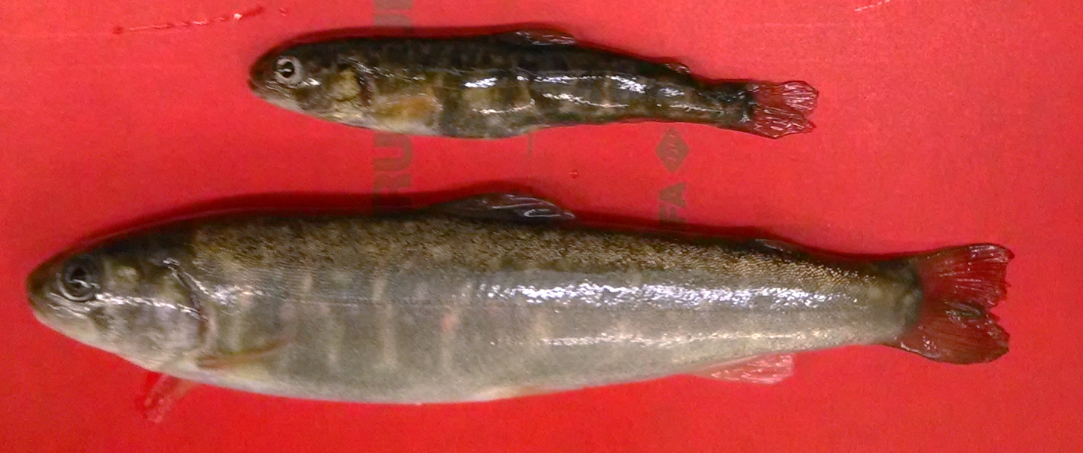
BTL13- 11

Slide 23
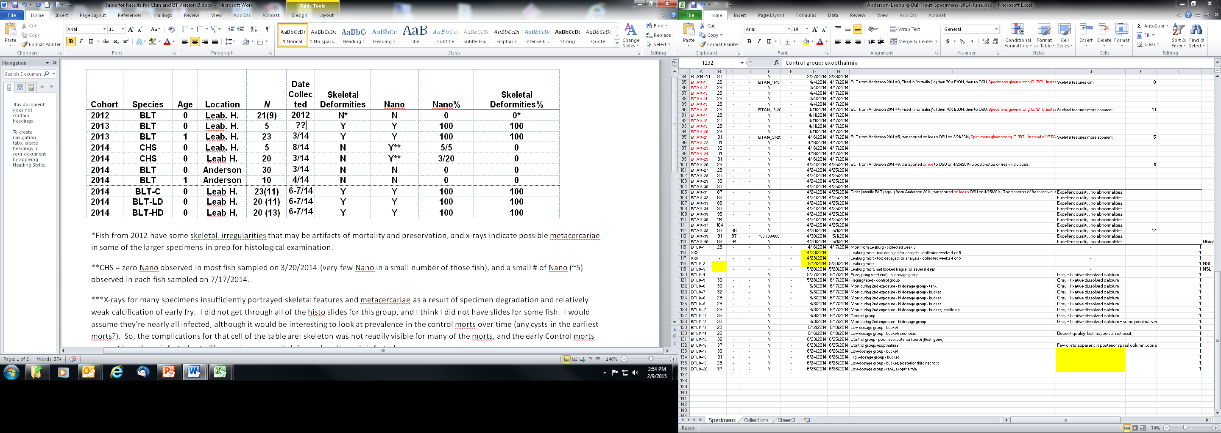
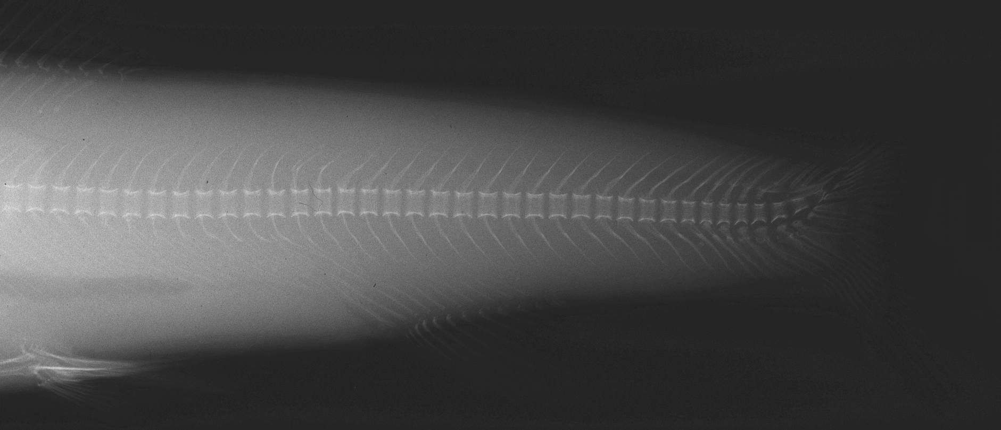
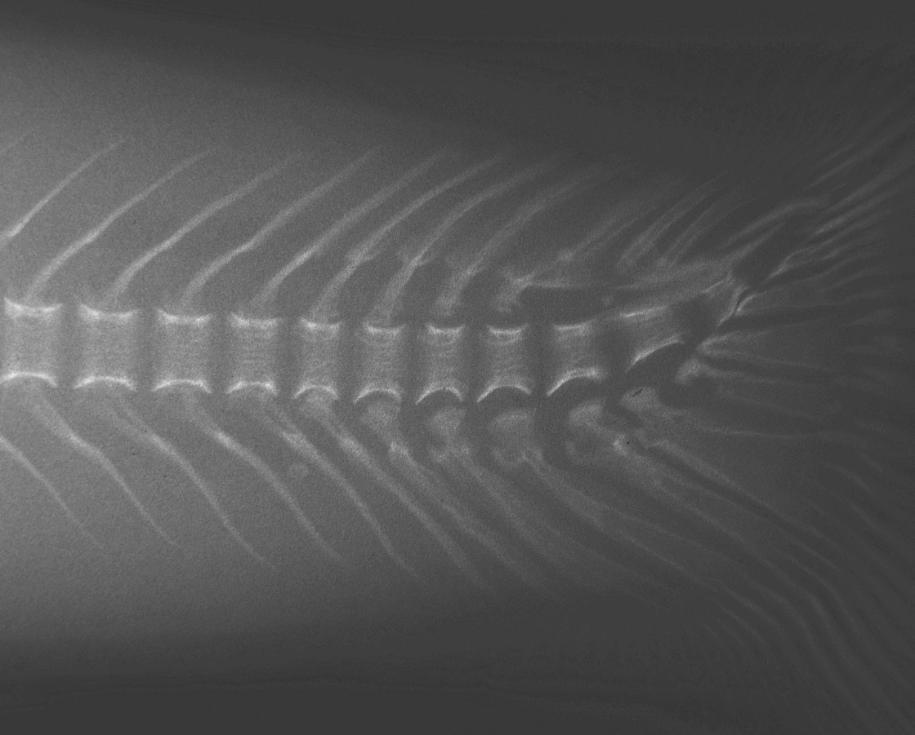
Histology
Fish Species, Age, Sample Size, Location,

Slide 24
1) Initial Results (The Insidious):
Nanophyetus salmincola assoc. with deformed Leaburg fish in 2013
No worms or skeletal deformities in fish from Anderson Creek
Low or no infection in Leaburg morts from 2012

Slide 25
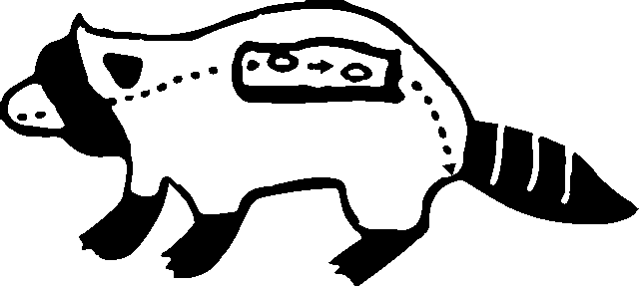
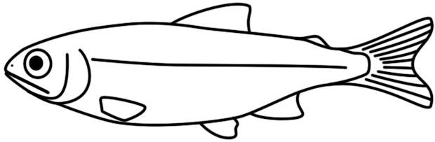
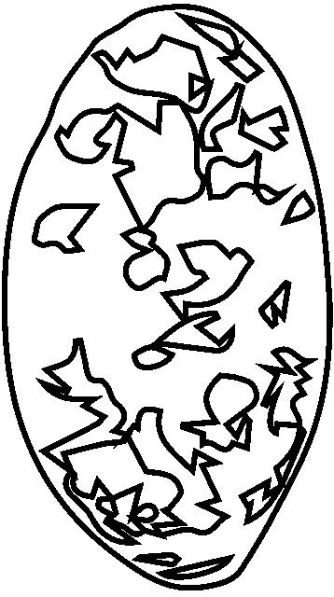
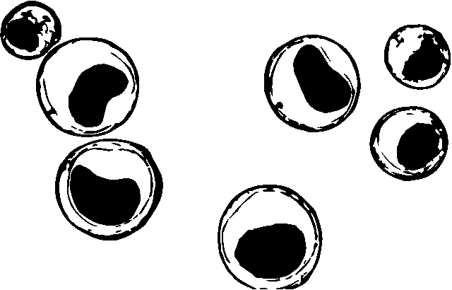
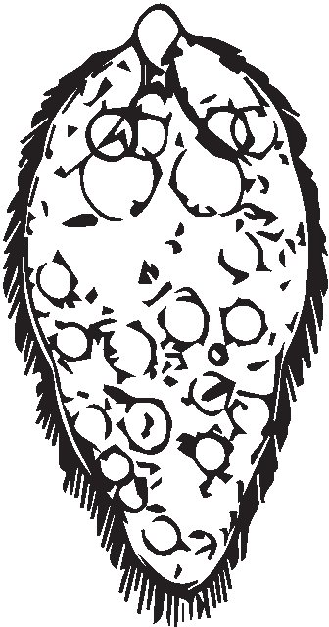
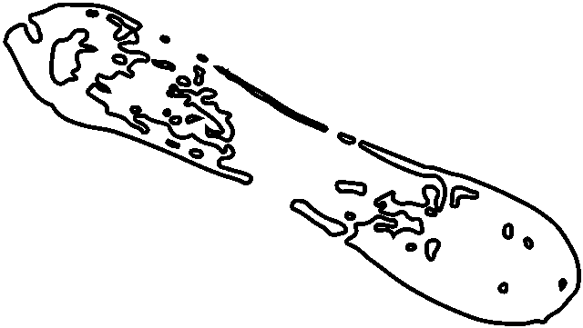
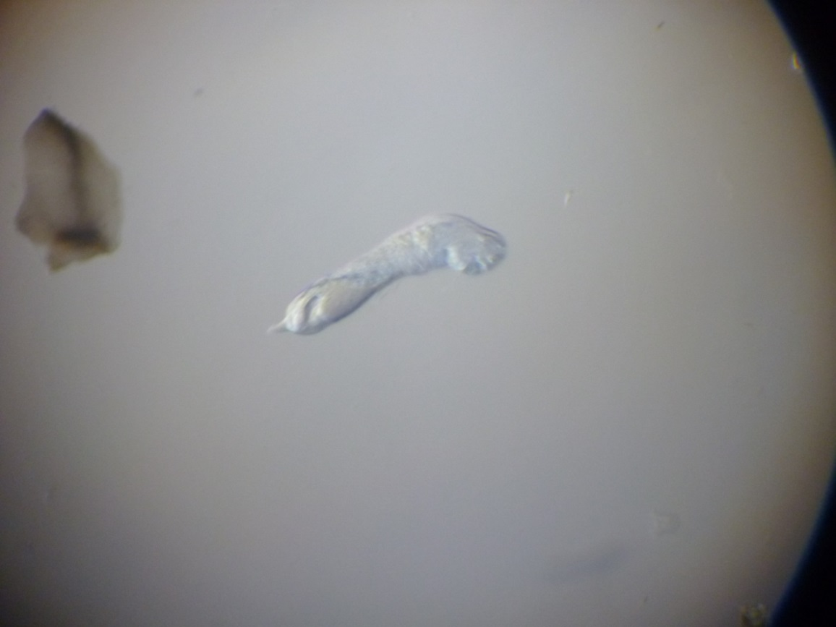
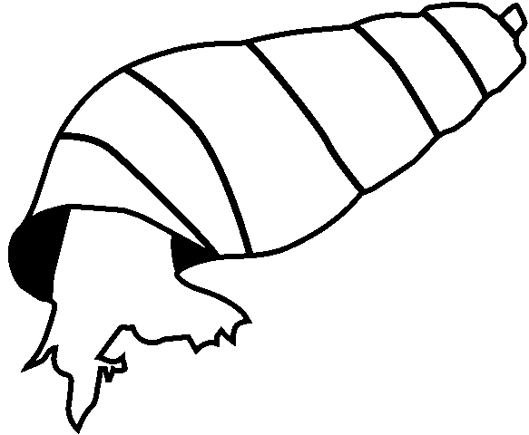
Courtesy of Sean Roon
Juga

Slide 26
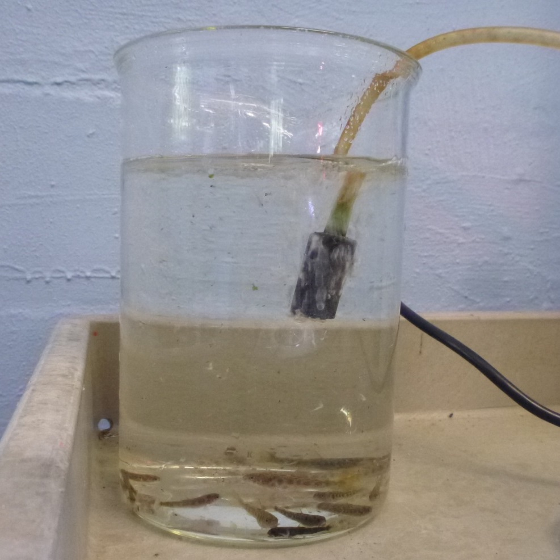
2) Experimental Infection Study at Leaburg: Expose bull trout fry from Anderson to Nano
20 May – 9 Sep:
23 Control
20 High-dosage
20 Low-dosage

Slide 27
1) Initial Results (The Insidious):
Nanophyetus salmincola assoc. with deformed Leaburg fish in 2013
None in specimens brought directly to OSU from Anderson Creek
Low or no infection in Leaburg morts from 2012
2) Experimental Infection Study at Leaburg:
20 May – 9 Sep:
23 Control = 53% Survival
20 High-dosage = 43% Survival
20 Low-dosage = 35% Survival

Slide 28
Fish Species, Age, Sample Size, Location,
Date, Gross, X-ray, histology.

Slide 29
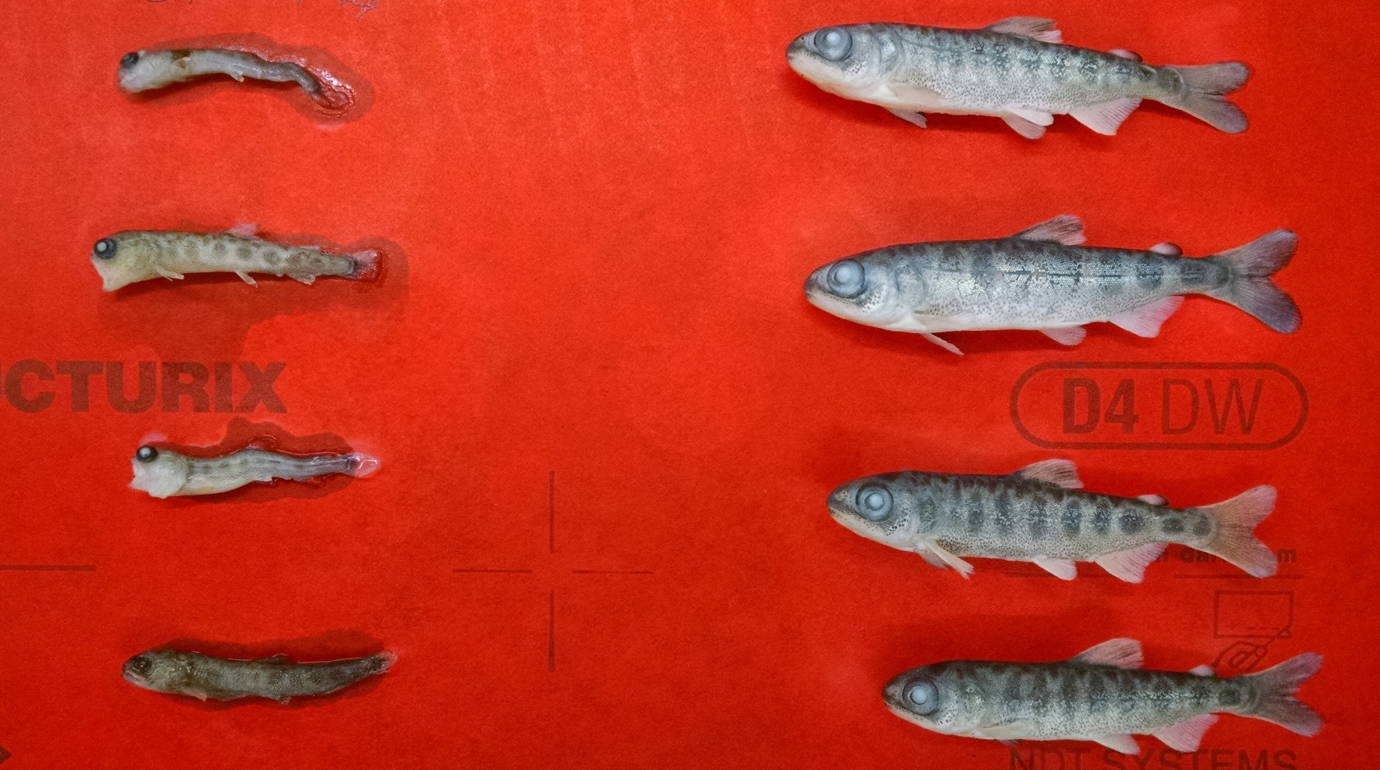
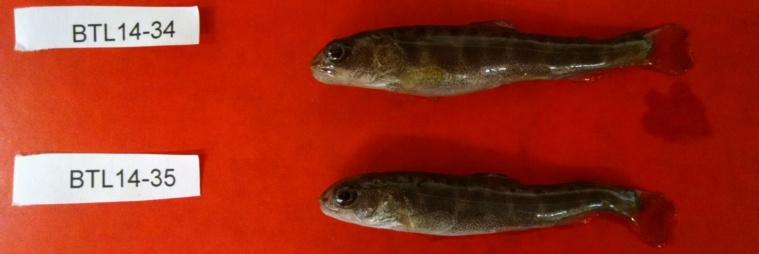

Slide 30
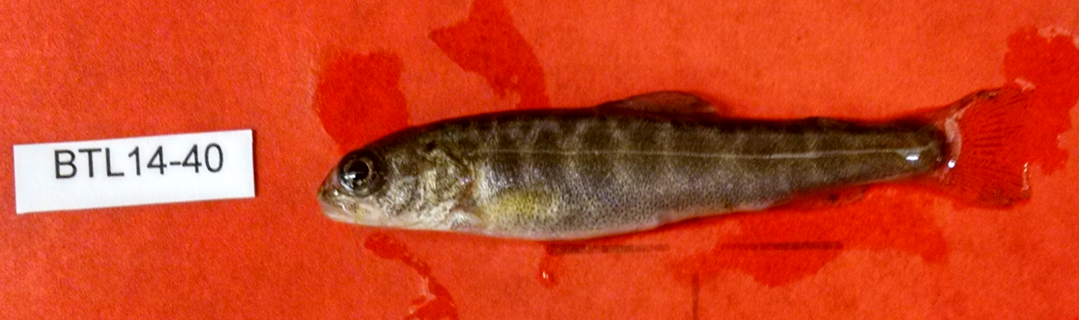
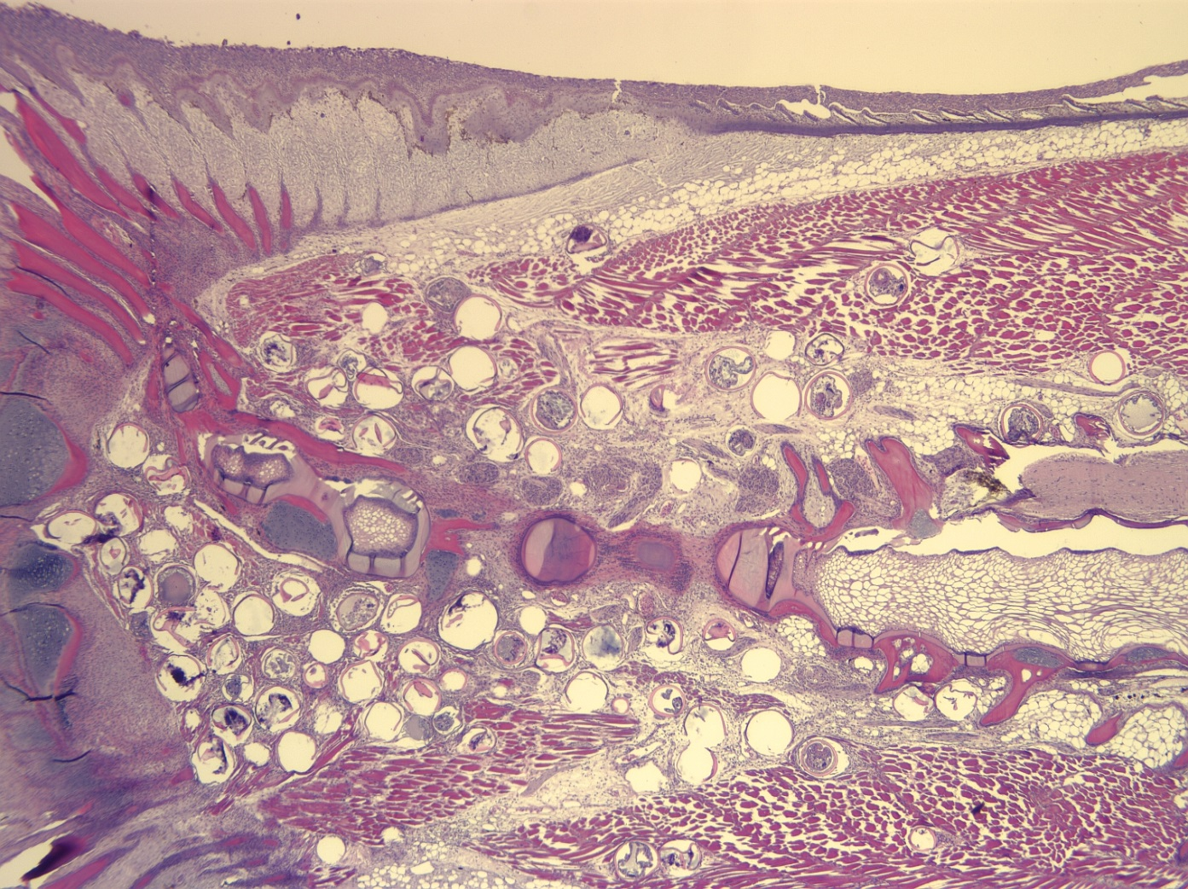
BLT14-40
Low dose
(Controls,
# 30-37)

Slide 31
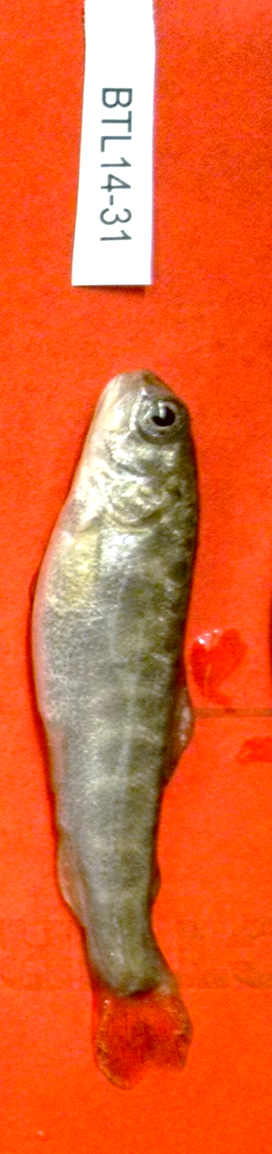
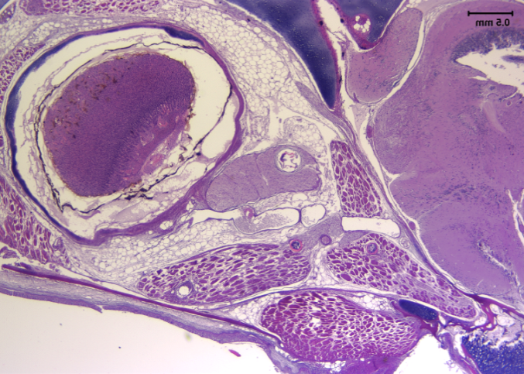
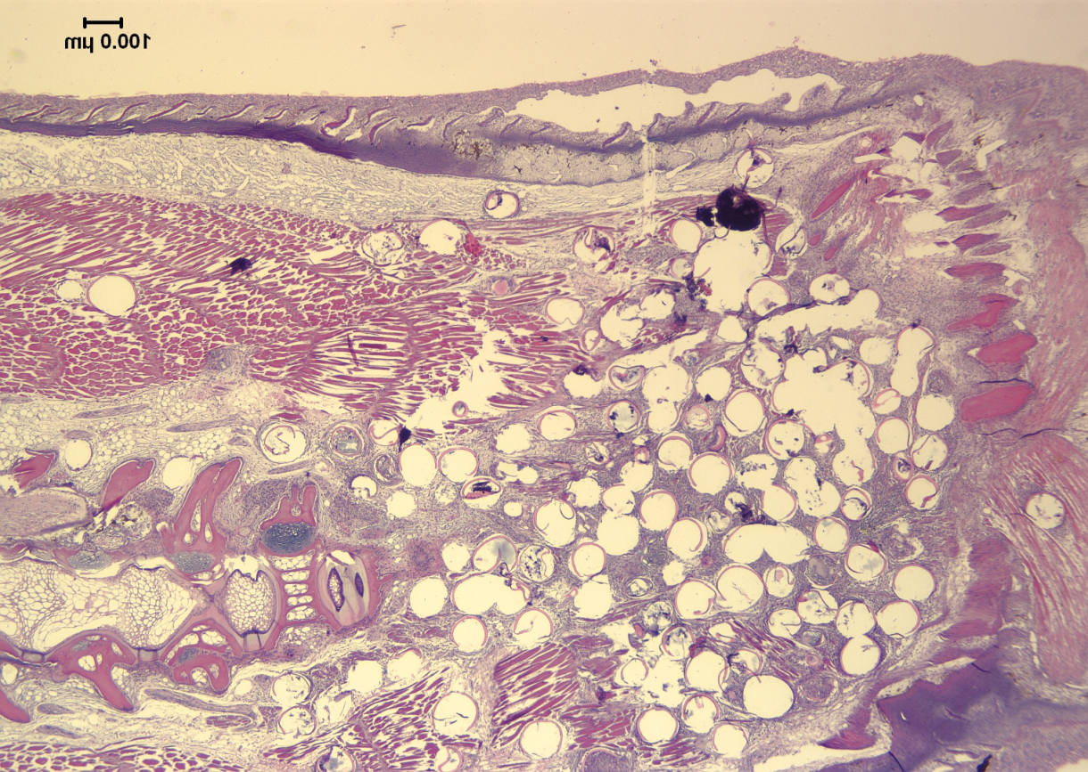
BLT14-31- UV treated water

Slide 32
BTL14 – 35 (low dose)

Slide 33
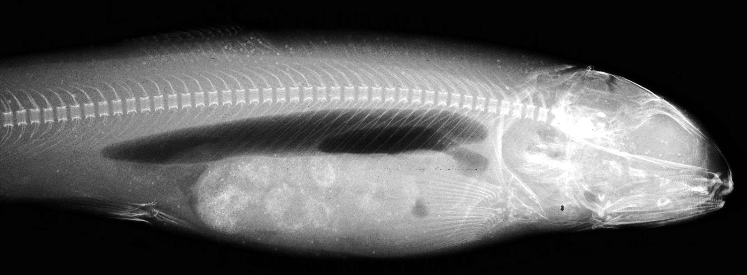


Slide 34


B
BTL – 30, control

Slide 35
1) Initial Results:
Nanophyetus salmincola assoc. with deformed Leaburg fish in 2013
None in specimens brought directly to OSU from Anderson Creek
Low or no infection in Leaburg morts from 2012
2) Experimental Infection Study at Leaburg:
20 May – 9 Sep:
23 Control = 53% Survival
20 High-dosage = 43% Survival
20 Low-dosage = 35% Survival
→ All 3 groups heavily infected, high mort. and deformity
= UV sterilization ineffective for bull trout tanks at Leaburg

Slide 36



Slide 37



Slide 38



Metacercariae in Cleared Fish

Slide 39



Slide 40


Fathead Minnow Deformities

Slide 41



Fathead Minnow Deformities

Slide 42
Objectives
Determine factors causing high mortality and deformities in captive-reared bull trout.
Assess pathogen risk to wild bull trout in the Upper Willamette River basin.

Slide 43


Pathogen Risk Assessment
1) Assess distributional overlap of Juga snails and bull trout
Notes:
Initiated a field survey for Juga snails

Slide 44

Pathogen Risk Assessment
1) Assess distributional overlap of Juga snails and bull trout
No Juga found
Juga found
Notes:
Found Juga snails upstream to some point below spawning tribs
None in spawning tribs

Slide 45




Pathogen Risk Assessment
2) Assess prevalence of parasites shed from snails
- 32 Collections (>2,500 snails) from 10 waterbodies
Notes:
Juga = Nano
Other bugs TBID

Slide 46



Pathogen Risk Assessment
3) Assess pathogen/parasite types and prevalence in various fishes within the range of Upper Willamette bull trout
Existing sampling efforts
ODFW Fish Health Lab – Oregon Wild Fish Health Survey

Slide 47


Pathogen Risk Assessment
3) Assess pathogen/parasite types and prevalence in various fishes within the range of Upper Willamette bull trout
To date:
167 fish
19 species
20 sites

Slide 48

Implications
N. salmincola:
    Threat to bull trout captive-rearing
        Water supply/treatment
    Potential threat in wild?
        Spawning/rearing upstream
        Potential reintroduction sites
Changes in parasite spp./distrib./prevalence
    Downstream habitat conditions
    Non-native species invasions
    Climate

Slide 49
Acknowledgements
Upper Willamette Bull Trout Working Group (EWEB, ODFW, USACE, USFS, USFWS)
Funding: USACE
Program Management: Tom Friesen – ODFW; Carl Schreck – OSU
Craig Banner – ODFW Fish Health Lab
Michelle Steinauer – OSU/WUHS
Lab:
Field:
Sara Bjork – ODFW Fish Health Lab
Jerry Heidel – OSU Veterinary School
Leaburg Hatchery Staff
Brian Sidlauskas – OSU Icthyology Lab
Dave Simon – OSU/ODFW
Sean Spagnoli – OSU
Amelia Thornhill – ODFW Fish Health
Kerstin Beerwieler – ODFW
Adrian Gonzales – ODFW
Matt Helstad – USFS
Kate Meyer – USFS
Ray Rivera – USFS
Vince Tranquilli – ODFW
James Wilkes – ODFW
Willam. Rsvr. Project – ODFW

