Slide 1


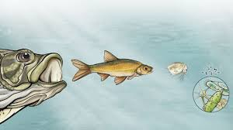

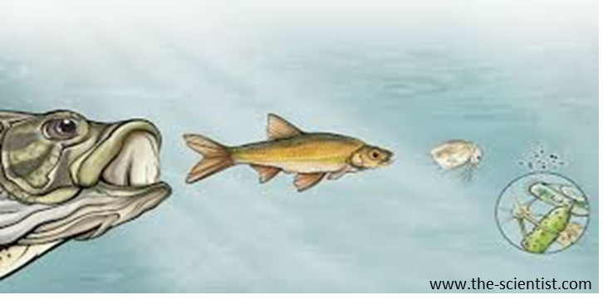

What are the effects of deep drawdown at Fall Creek Reservoir?
Understanding trophic relationships using stable isotope ratios
Do not distribute
Ivan Arismendi¹, Christina Murphy¹ & Sherri Johnson²
¹Department of Fisheries and Wildlife, Oregon State University
²USDA Forest Service, PNW Research Station
www.the-scientist.com

Slide 2
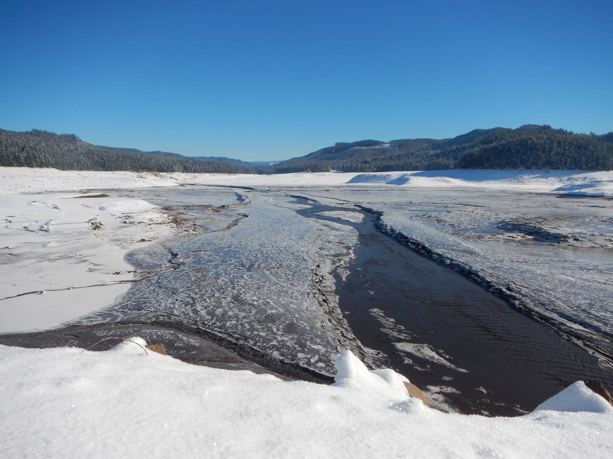




USACE
Lookout Point
Greg Taylor
Todd Pierce
Portland
Cindy Studebaker
Bob Wertheimer
OSU
Brendan Coffin
Brent Johnson
Margaret Whitmore
Randy Wildman
NOAA
Kim Hatfield
ODFW
Michelle Weaver
Dan Peck
Springfield
Jeff Ziller
Kelly Reis
Shannon Richardson
Reservoir Dogs
Tom Friesen
Fred Monzyk
Jeremy Romer
Ryan Emig
RME Team

Slide 3

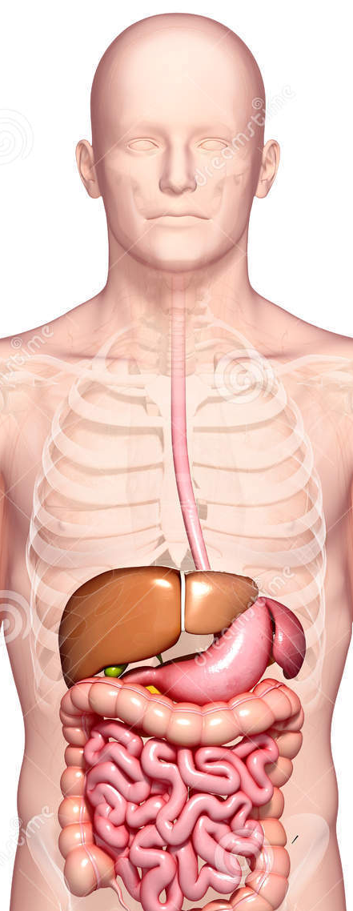
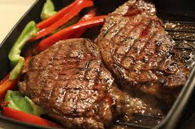
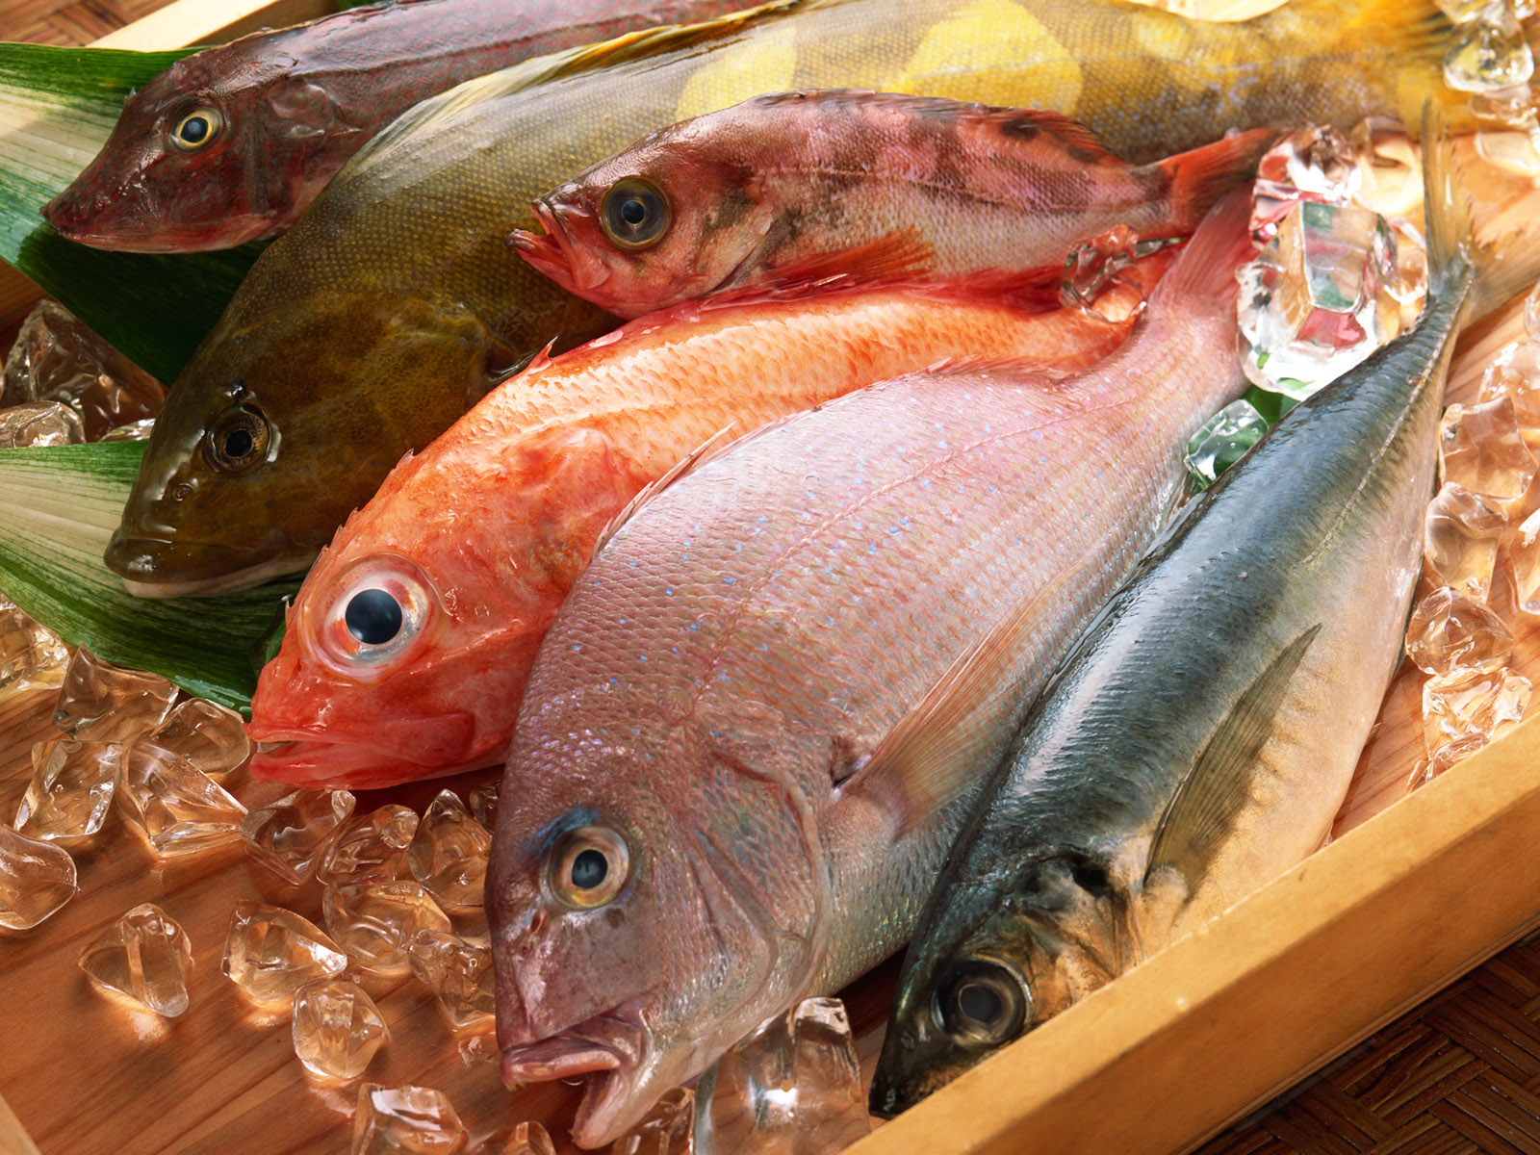

You are what you eat
Day 1
Day 7
Day 14

Slide 4
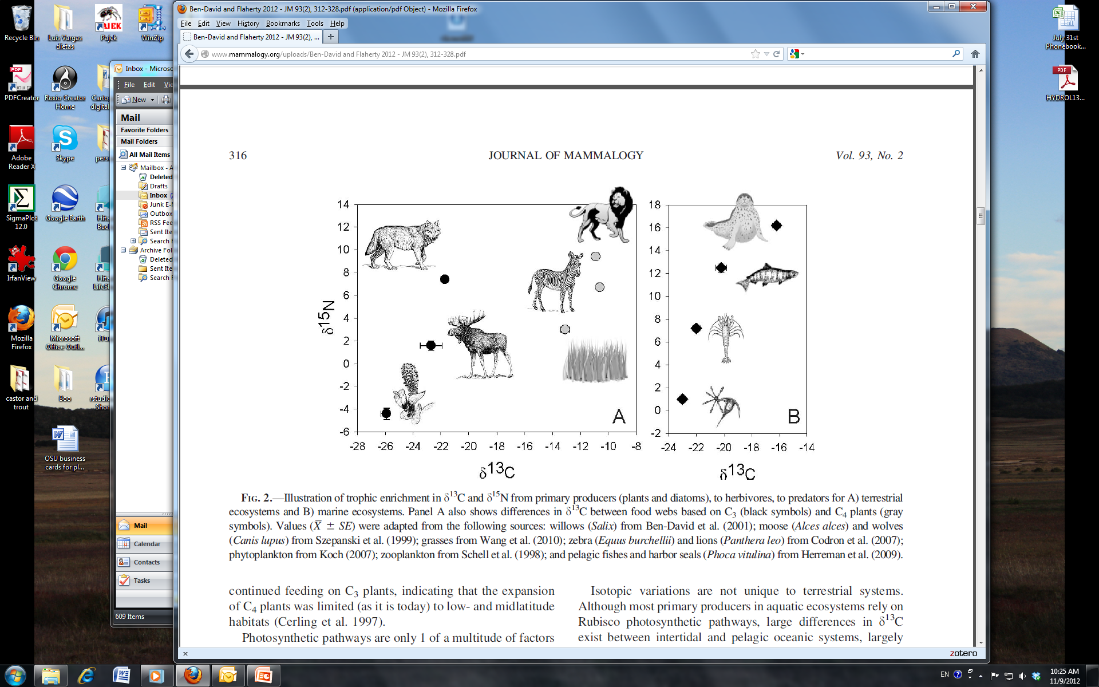
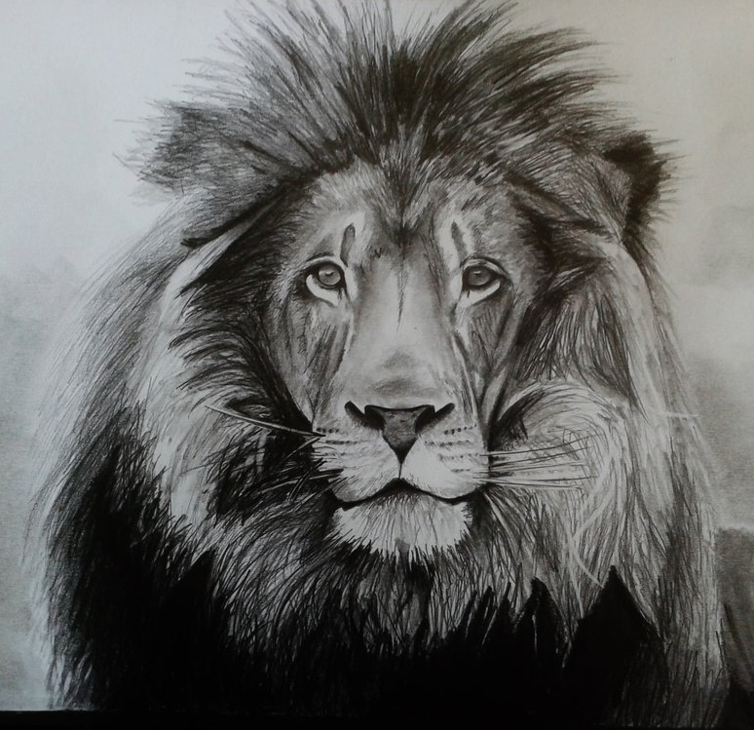
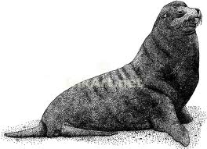


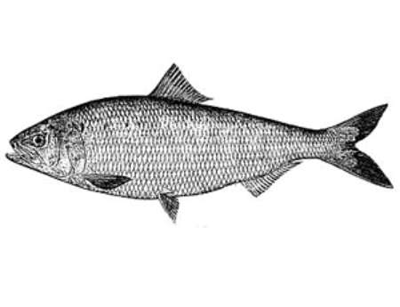
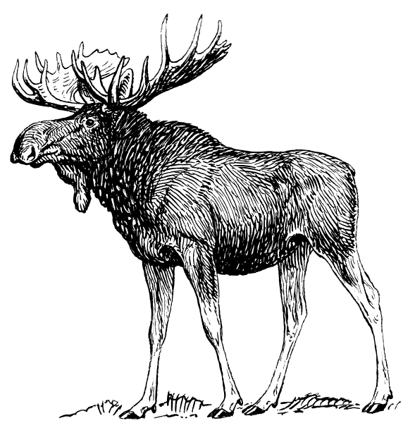
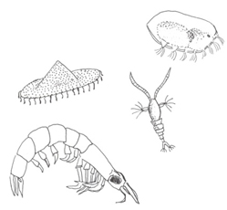
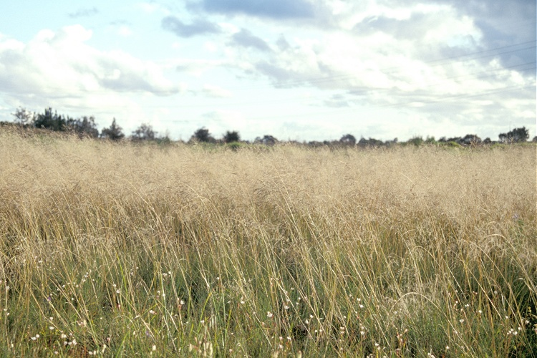
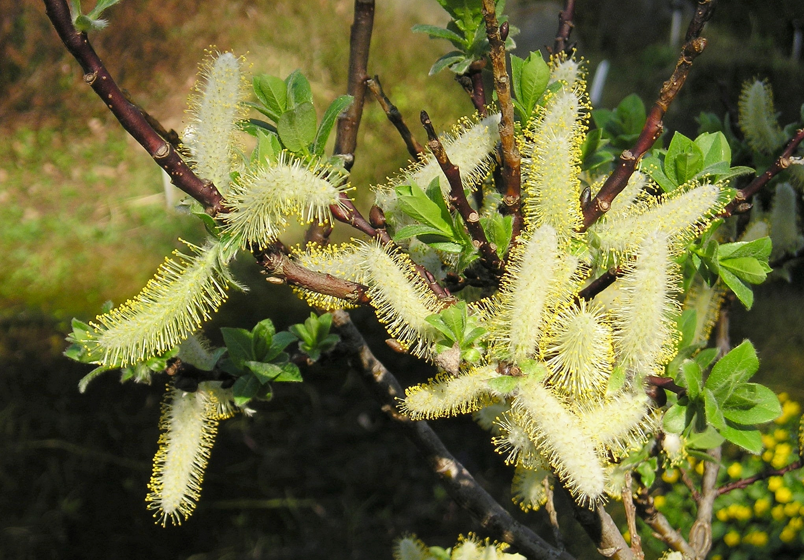

Stable isotopes and food webs
We will be focused on trophic position (δ¹⁵N)
higher trophic level
Modified from Ben-David and Flaherty (2012)

Slide 5
Stable isotopes and food webs
We will be focused on trophic position (δ¹⁵N)
higher trophic level
Modified from Ben-David and Flaherty (2012)

Slide 6
Stable isotopes and food webs
We will be focused on trophic position (δ¹⁵N)
higher trophic level
Modified from Ben-David and Flaherty (2012)

Slide 7
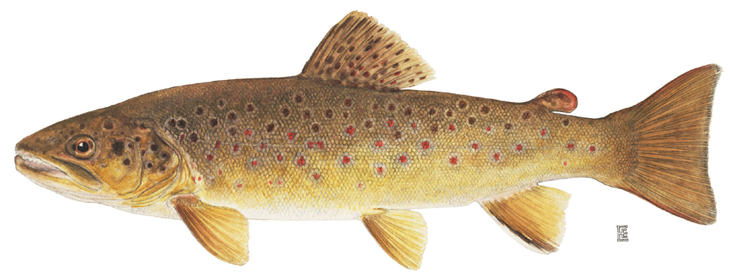
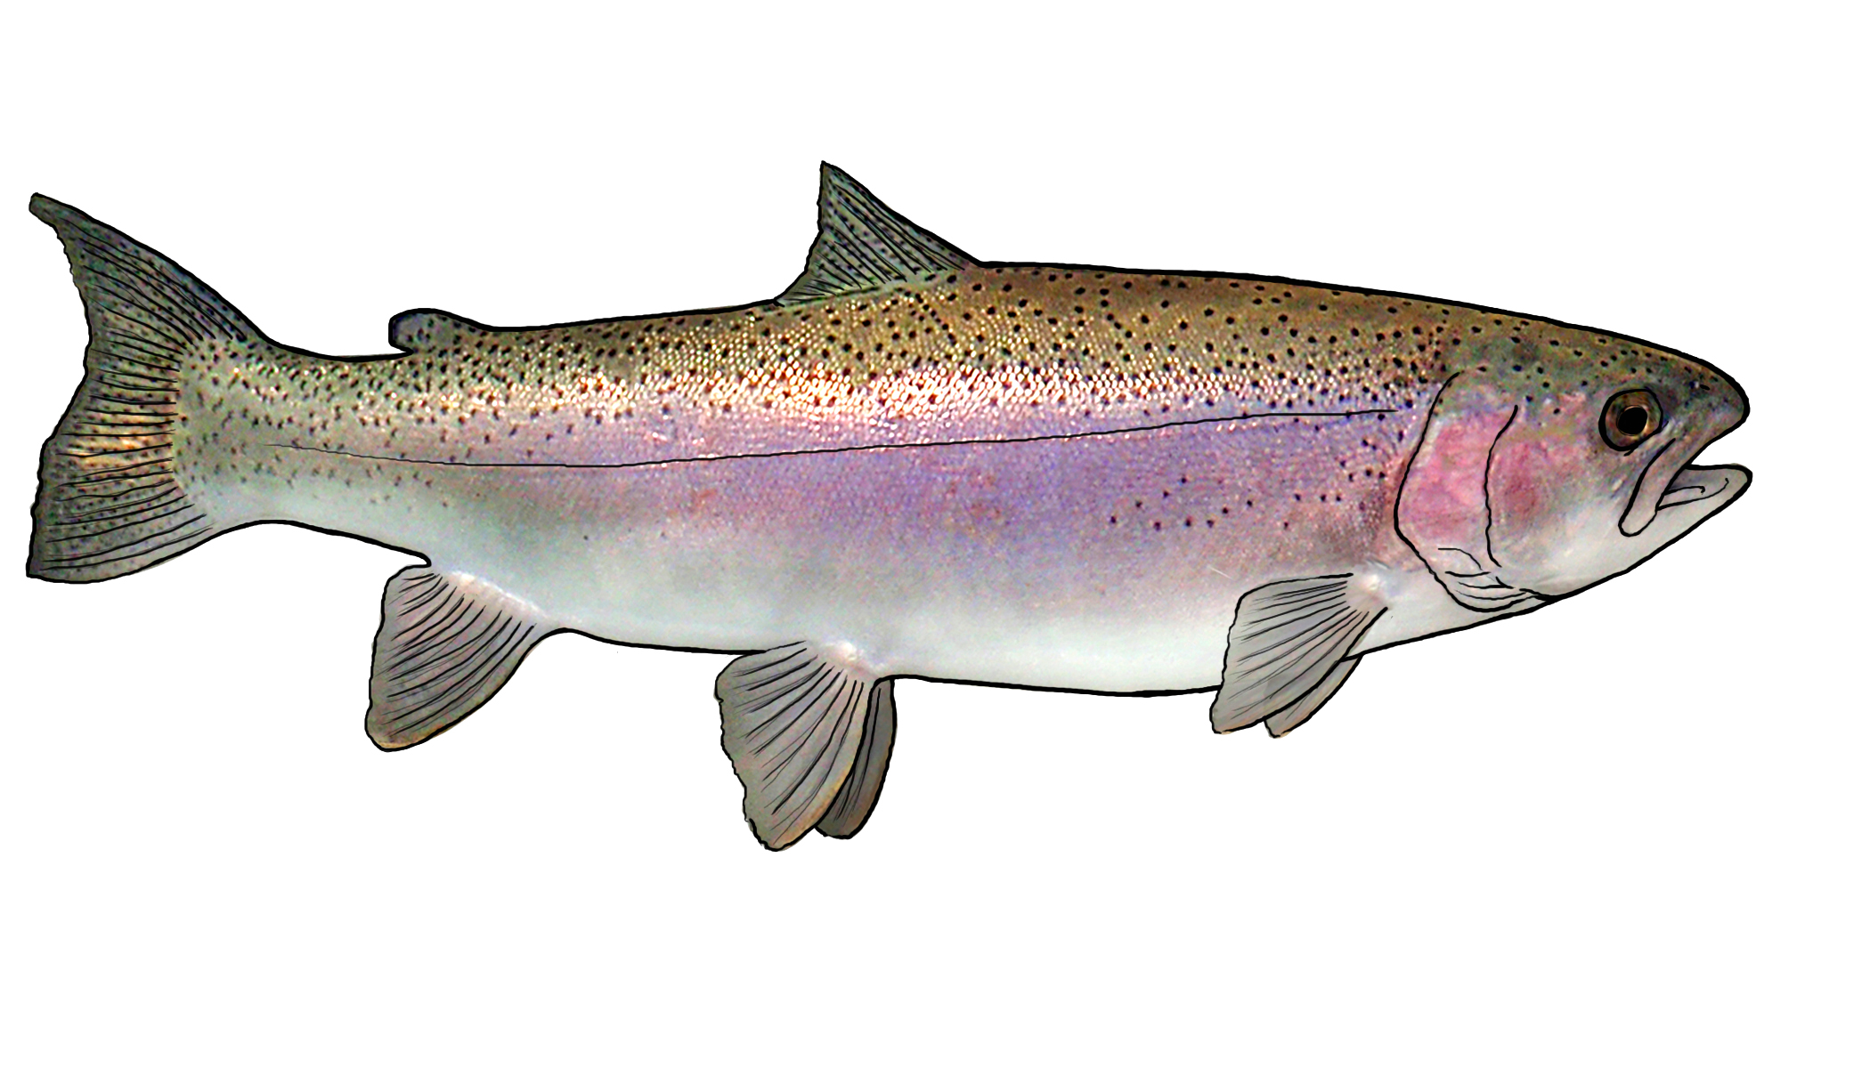
Detecting piscivory using stable isotopes ratios and diet analysis
Frequency of fish in trout stomachs
Rainbow Trout vs.
Brown Trout
Nitrogen Stable isotope ratio δ¹⁵N
Modified from Arismendi et al. (2012)

Slide 8
Sampling during summer/fall 2013-2014
We sampled tissue from phytoplankton, zooplankton, macroinvertebrates and fish from reservoirs using standard limnological and fisheries techniques (additional fish sampling from screw traps)
  Lookout Point
  Fall Creek
  Hills Creek
  Blue River
Stable isotopes analyses at Colorado Plateau Stable Isotope Laboratory
We estimated trophic position according to Post (2002)

Slide 9
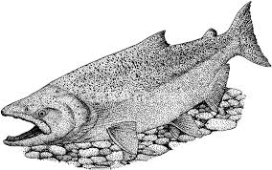
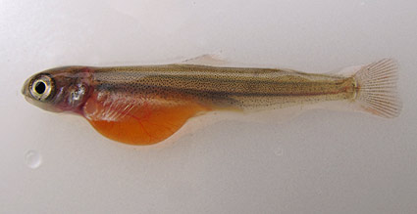
Maternal effect and piscivory
Maternal effect
Piscivory

Slide 10
Zooplanktivory
Piscivory

Slide 11
Piscivory at larger sizes
Piscivory

Slide 12
Piscivory at larger sizes
Piscivory

Slide 13
Piscivory at larger sizes
Chinook fry?
Piscivory

Slide 14
Omnivory
Chinook fry?
Piscivory

Slide 15
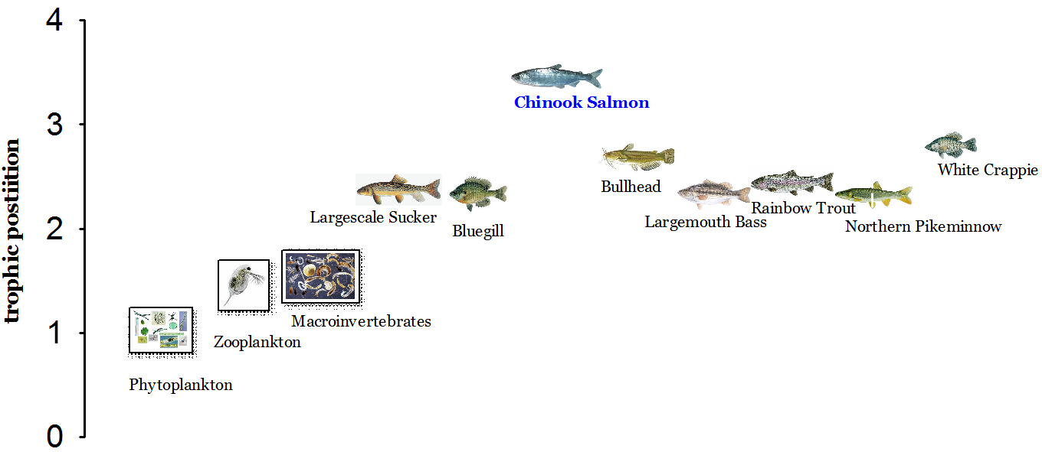
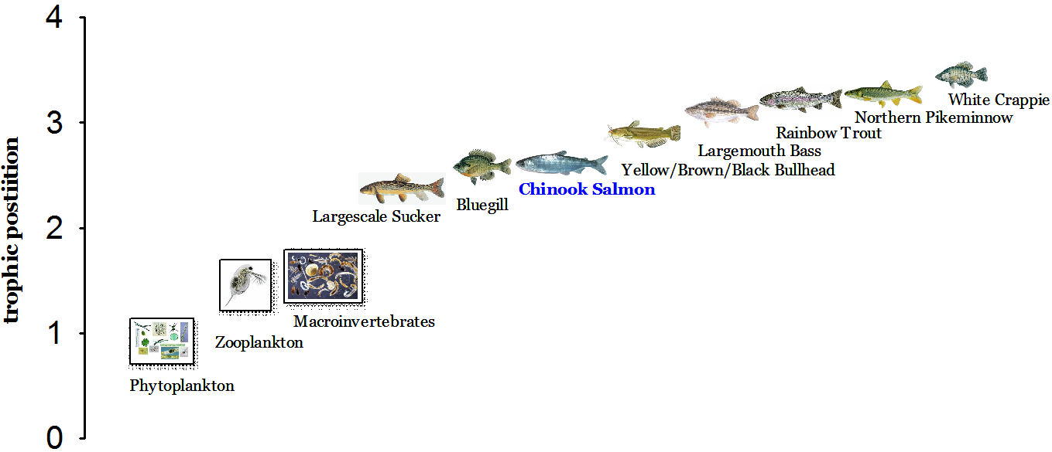
Trophic position (length >150 mm)
Maternal effect
Piscivory
Piscivory
Zooplanktivory/macroinvertevrates
Zooplanktivory/macroinvertebrates
Trophic position (length <150 mm)

Slide 16
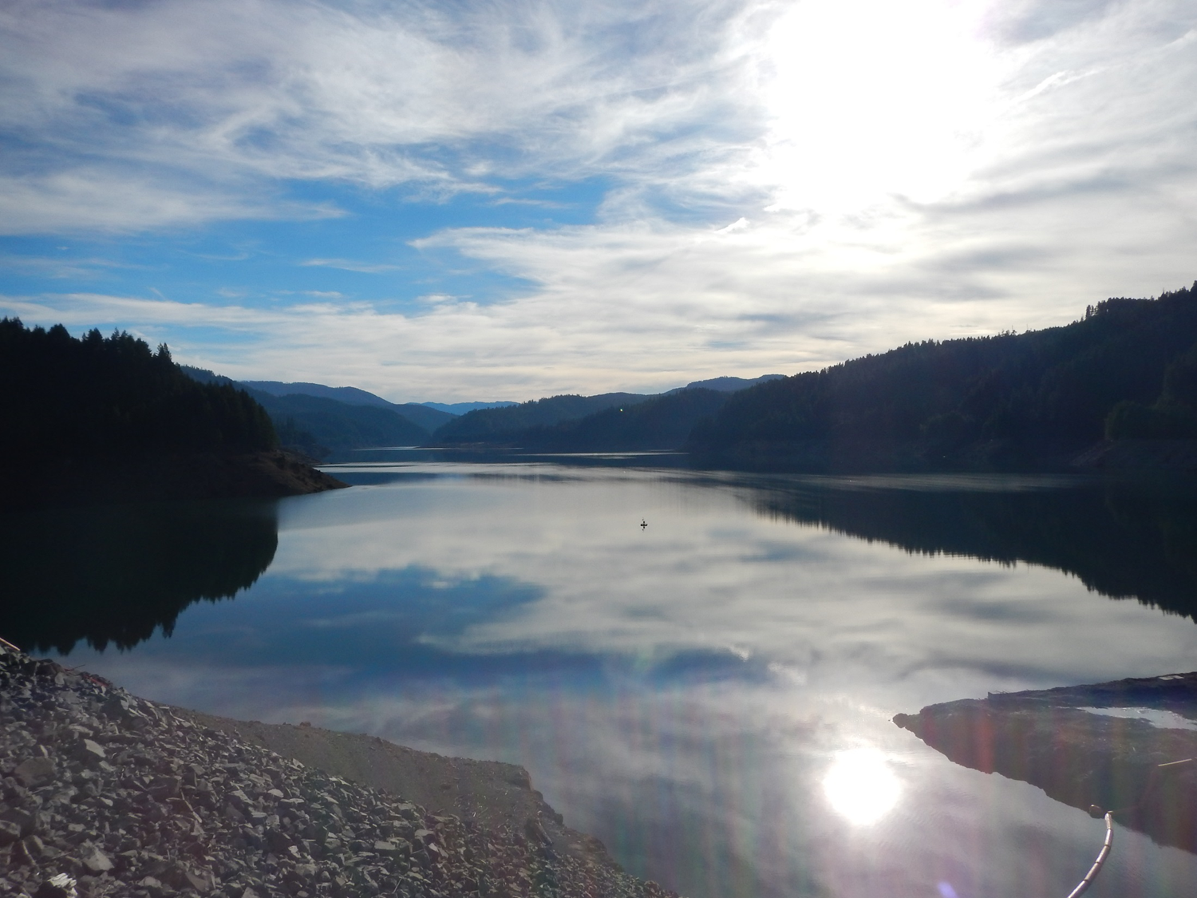
Take home message:
There are ontogenic shifts in trophic position in most of the fishes from exclusively zooplanktivory towards different levels of piscivory

Slide 17
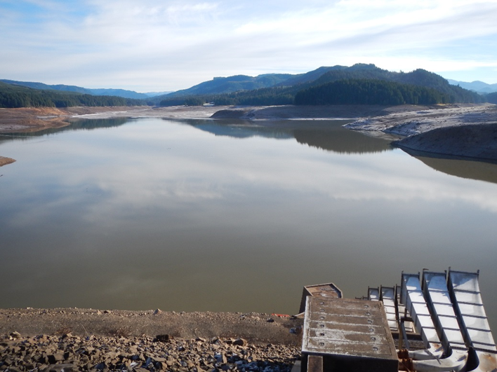
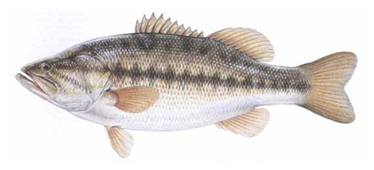

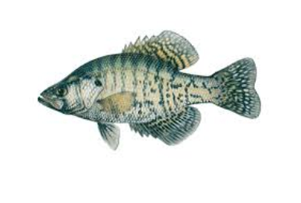
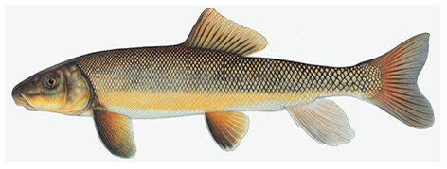
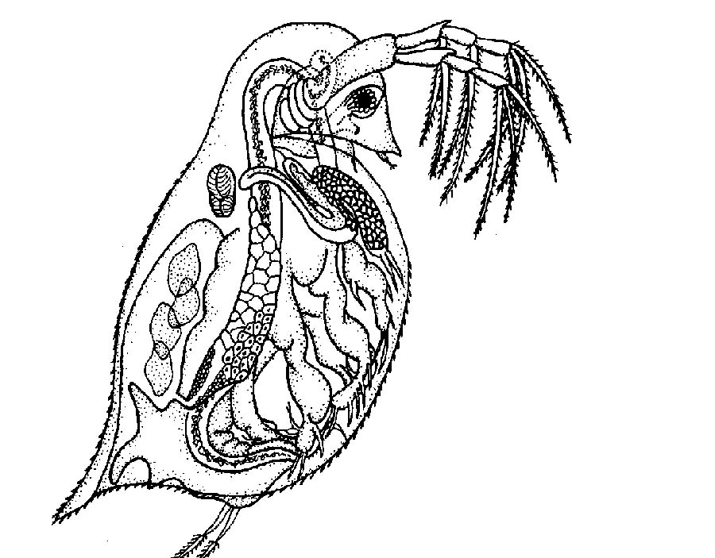
Hypothesized food-web in Fall Creek

Slide 18
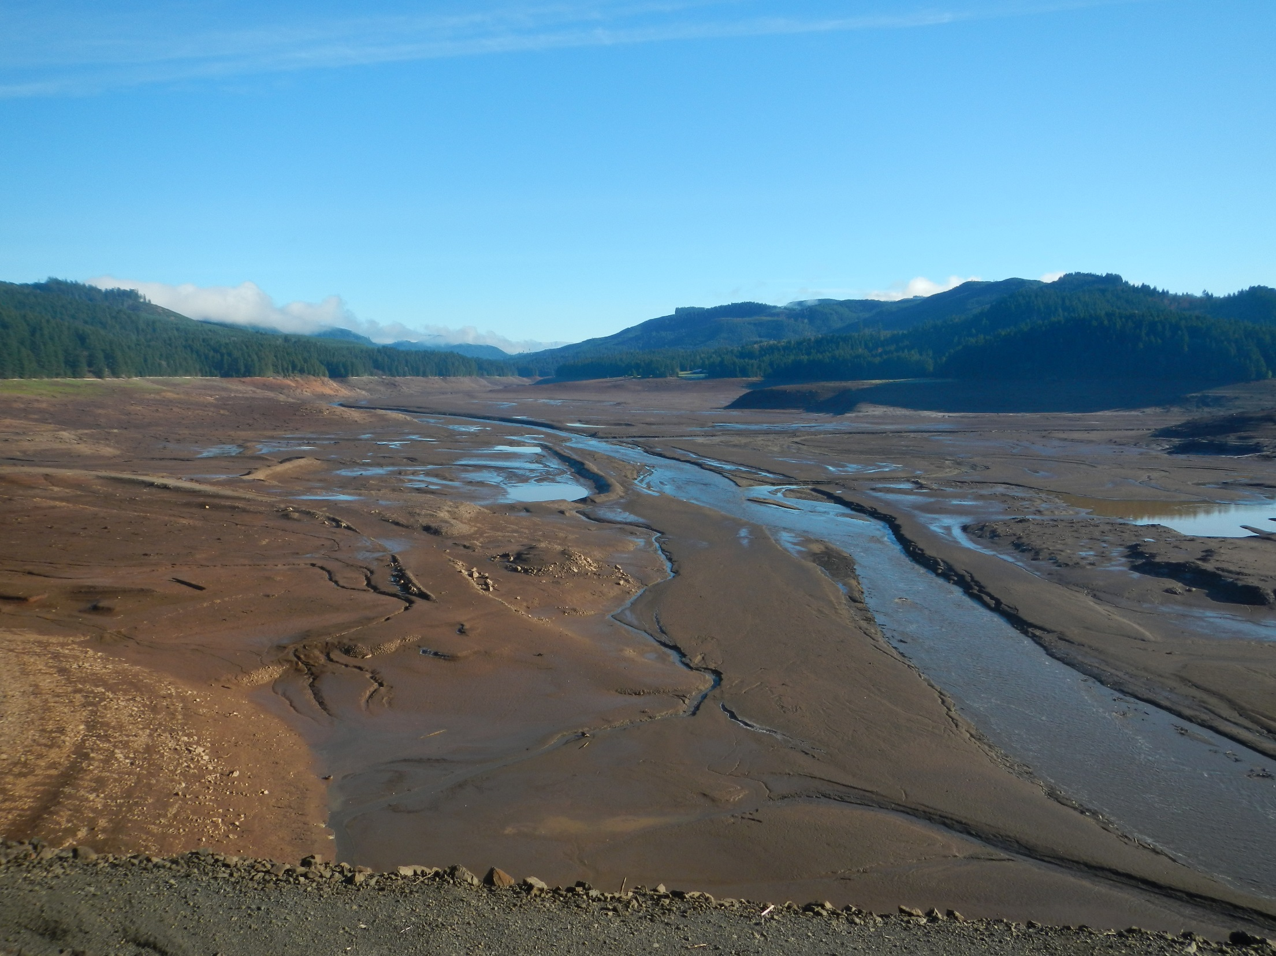
What are the effects of deep drawdown at Fall Creek Reservoir?
Engineered food-web after deep drawdown (short-term)

Slide 19
Expected changes in reservoir food webs due to deep drawdown
Length > 150 mm
Less piscivory and densities (fish moved downstream)
Lower trophic position of larger fish

Slide 20
Deep drawdown in reservoir may alleviate predation upon Chinook Salmon
Length > 150 mm

Slide 21


Our findings are consistent with deep drawdown reduction in piscivory by larger fish

