Slide 1
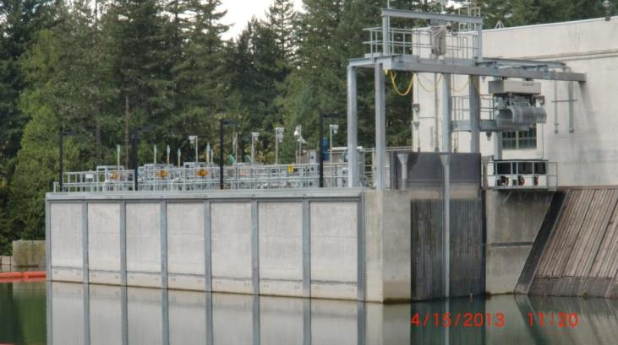
Design and Performance of the River Mill Surface Collector
Willamette Science Review
February 2015
Presented by:
Nick Ackerman
Portland General Electric
Acknowledgements:
Tim Shibahara - PGE
Garth Wyatt - PGE
Dan Cramer - PGE
Maggie David - PGE
Brian Pyper -
Fish Metrics, Inc.
Portland General Electric
Clackamas Hydro Project
FERC No. 2195
Estacada, OR

Slide 2
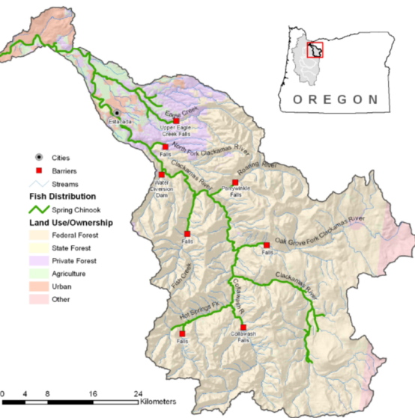
Setting
Native Anadromous Fish Species:
Spring Chinook
Coho
Winter Steelhead
Pacific Lamprey
PGE Clackamas Hydro Project
River Miles 22.3 – 31.7
Notes:
Clackamas situated in NW Oregon. Enters Willamette River just below Willamette Falls between Oregon City and Gladstone.
Anadromous species: spring Chinook, coho, winter steelhead, Pacific lamprey

Slide 3
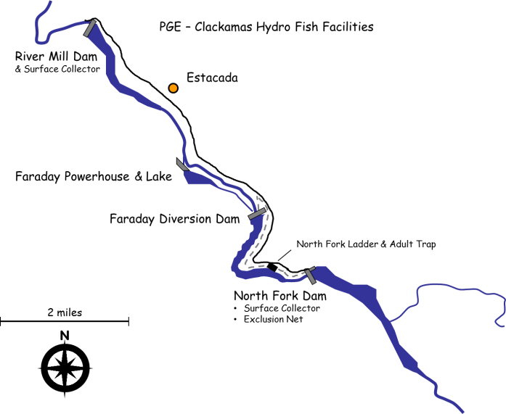
Setting
Flow
Notes:
Upstream passage historically provided at River Mill and North Fork.
Downstream passage available at North Fork.
Previously, downstream passage at River Mill was through turbines or over spillway.

Slide 4
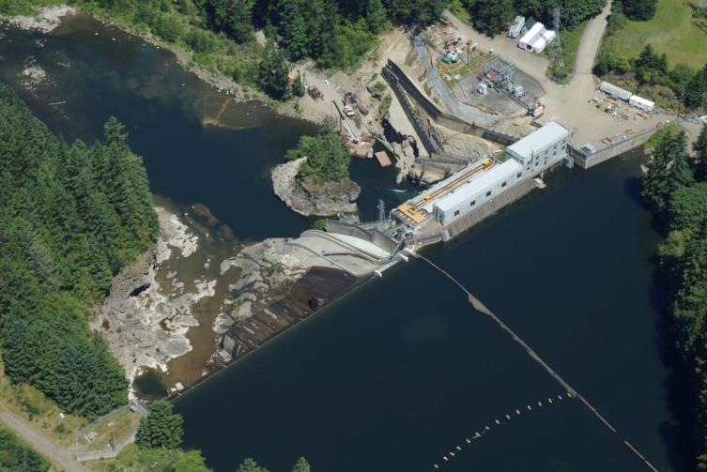
Setting
Characteristics:
Built: 1911
Max Height: 85 ft
Impoundment: 150 acres
Generation: 23 MW
Capacity: 4,850 CFS
Run-of-river project
Powerhouse Intakes
Controlled Spillway
Uncontrolled Spillway w/ Flashboards
Forebay

Slide 5
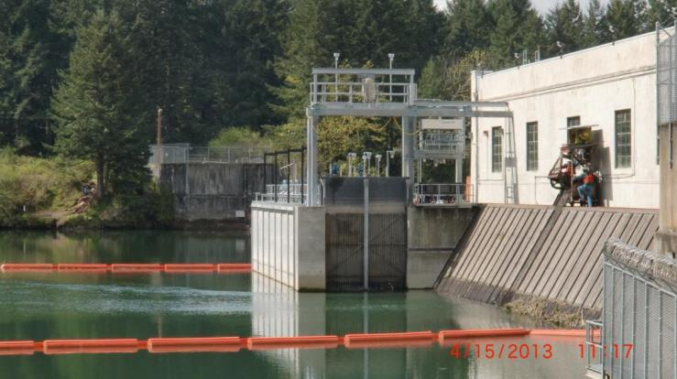
Surface Collector Design
Purpose:
Provide downstream passage for juvenile salmon and steelhead
Regulatory context:
97% smolt survival standard for the Clackamas Project
Planning and Design:
Prototype & Feasibility Studies: 2001-2004
Design Phase: 2010 – 2011
Construction: 2011 – 2012
Operation: Nov. 2012
Cost:
Design & Build = $12M

Slide 6
Surface Collector Design
RMSC Components:
Collection channel
3 screen systems
Transport Channel
Fish Sorting Facilities
Exit Pipeline
Flow Design:
Unit #5 Turbine
500 CFS flow design
700 CFS at high flow
Notes:
RMSC tied directly to unit 5 turbine, not pumped flow

Slide 7
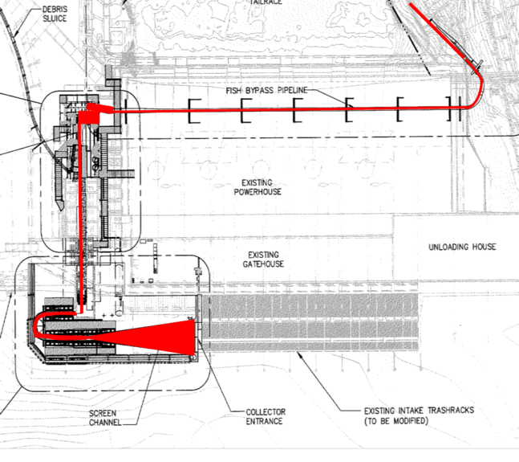
Surface Collector Design

Slide 8

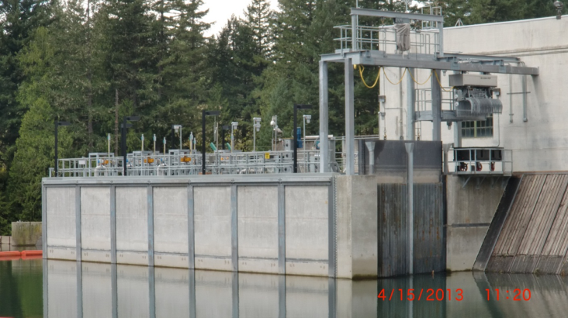
Surface Collector Design
Entrance and grizzly racks
Entrance depth = 13’
Grizzly spaced at 3.5” (3 feet deep)
Grizzly spaced at 10’5” >3 ft deep
Powerhouse Trash Rack spaced at 1.25”

Slide 9
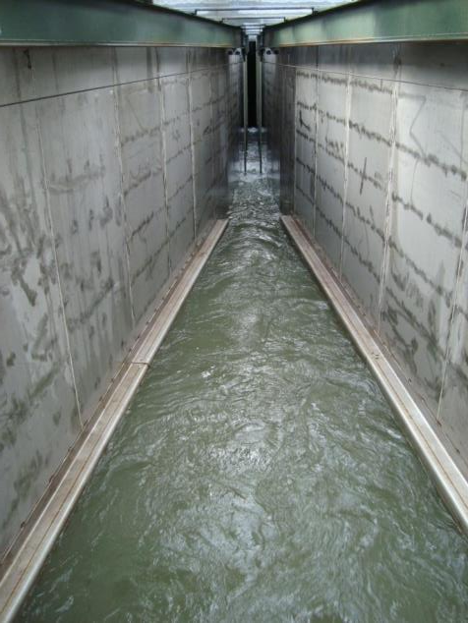
Surface Collector Design
Primary and secondary screens
500 cfs

Slide 10
Surface Collector Design
160 cfs
340 cfs
Primary and secondary screens

Slide 11
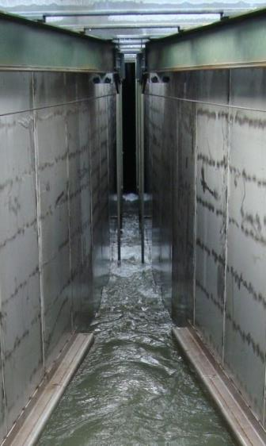
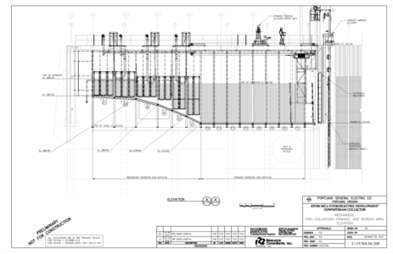

Surface Collector Design
22 cfs
138 cfs
Primary and secondary screens
160 cfs

Slide 12
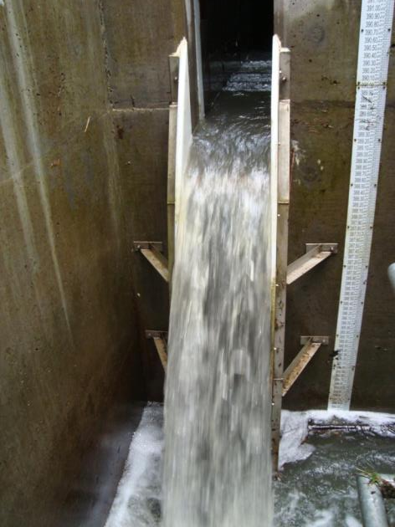
Surface Collector Design
7 cfs
Ramp weir

Slide 13
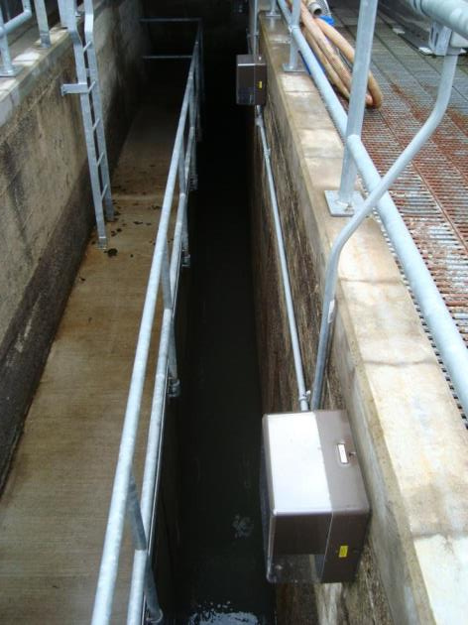
Surface Collector Design
Transit channel

Slide 14
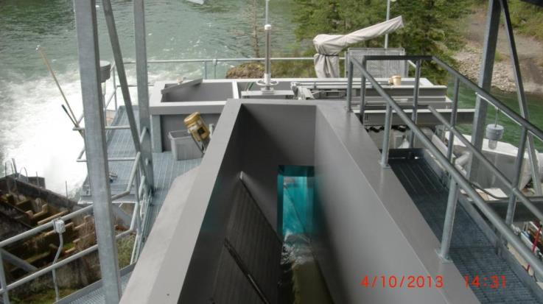
Surface Collector Design
Primary dewatering screens
1 cfs

Slide 15
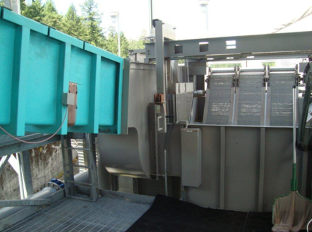
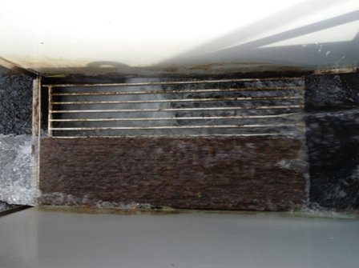
Surface Collector Design
PIT antenna and large fish separator

Slide 16
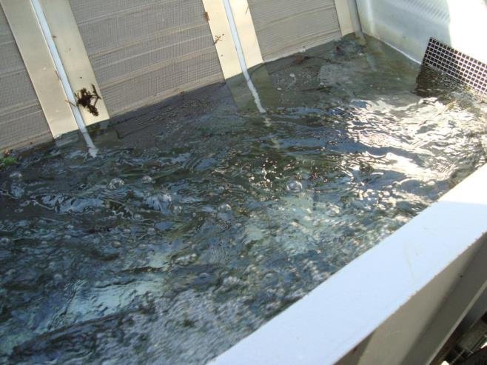
Surface Collector Design
Juvenile holding tank

Slide 17
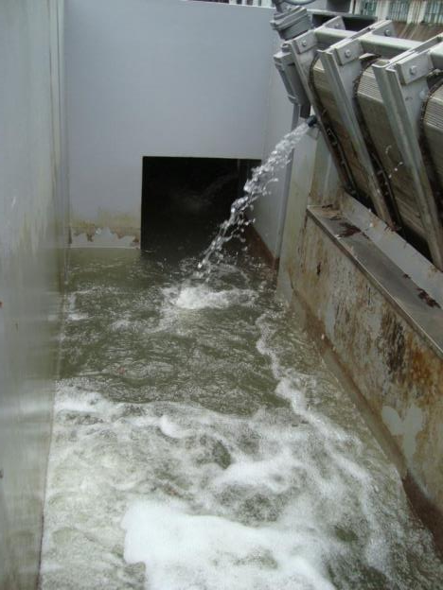
Surface Collector Design
Adult holding tank and facility exit

Slide 18
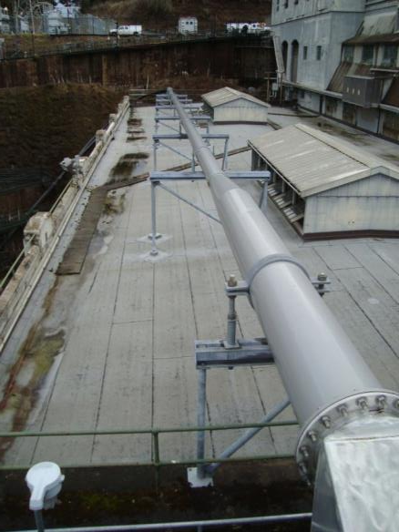
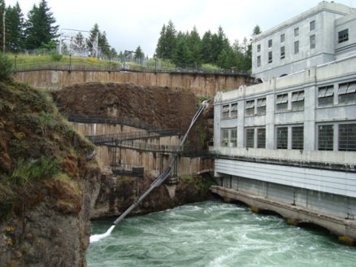
Surface Collector Design
Exit pipeline and articulating outfall

Slide 19
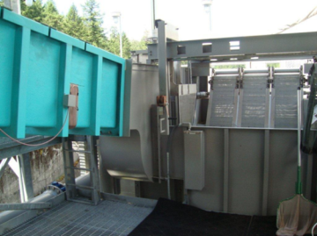
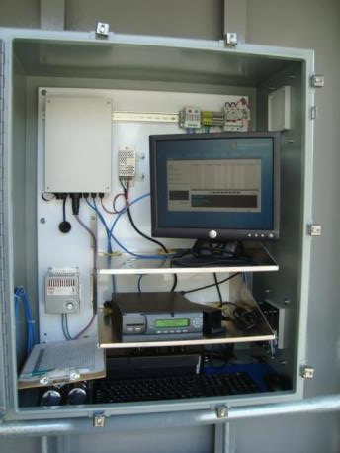
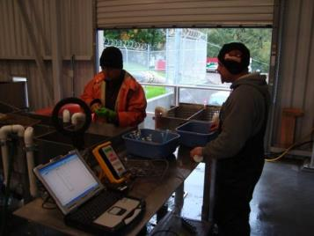
Performance Assessment – PIT Tag Evaluation
Parameters of Interest:
Fish Guidance
Injury Rate
Survival Rate
Survival through Estacada Lake
Objectives:
Evaluate all three species at three different flow levels
Notes:
KarlTek KLK5000 monitoring system
10 guage speaker wire wrapped in a fiberglass flume
User friendly system with auto-tuning and easy to check diagnostics
Easy to set up
High detection efficiencies

Slide 20
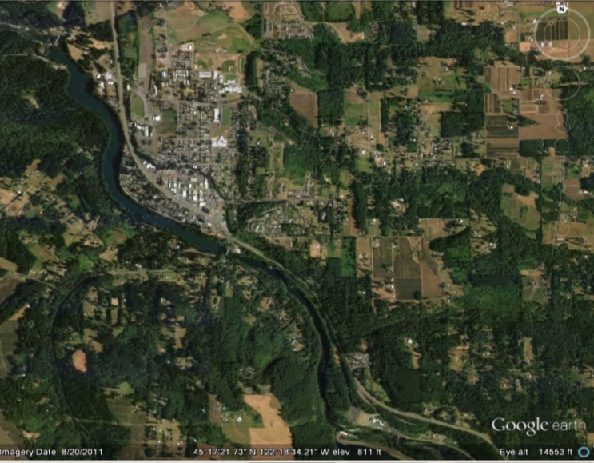
Performance Assessment – PIT Tag Evaluation
Fish Guidance Efficiency:
g = r1
R1
Detected at River Mill
(r₁,r₂)
Guidance (g)
Forebay Release
(R₁)
Reservoir Survival:
s = r2R1
r1R2
Survival (s)
Injury Rates:
Examine recaptured PIT tagged fish
Head of Reservoir Release
(R₂)
Notes:
Paired release design
Assume all fish released at r1 survive, and that lack of detection implies lack of guidance
Groups released at head of reservoir approximately 24h prior to forebay groups.
Goal is to cover each species in each of three different flow ranges…

Slide 21
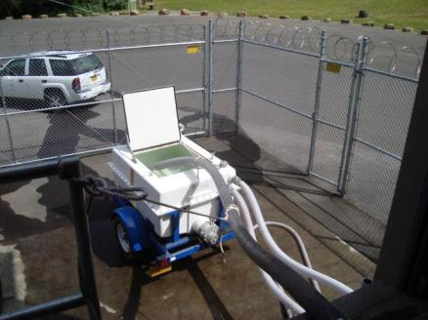
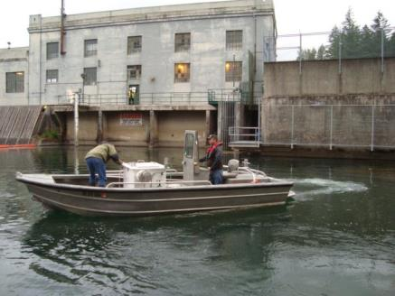
Performance Assessment – Reservoir Survival Results
 |  |  |  |  |  | Survival |  | 95% CI
Species | Groups | R₁ | t₁ | R₂ | t₂ | rate | SE | Lower | Upper
Chinook | 5 | 209 | 204 | 185 | 178 | 0.986 | 0.018 | 0.951 | 1.021
Coho | 3 | 239 | 234 | 251 | 243 | 0.989 | 0.015 | 0.960 | 1.018
Steelhead | 2 | 156 | 150 | 166 | 152 | 0.952 | 0.027 | 0.899 | 1.005
Notes:
R1 = fge releases
T1 = fge detections
R2 = HOR release
t2 = HOR detections

Slide 22
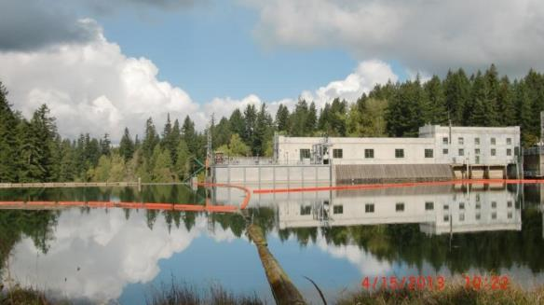
Performance Assessment – FGE Results
 |  |  |  |  |  |  | 95% CI
Species | Groups | Rel. | Det. | Det. Eff. | FGE | SE | Lower | Upper
Chinook | 5 | 209 | 202 | 0.984 | 0.983 | 0.013 | 0.957 | 1.008
Coho | 3 | 160 | 155 | 0.981 | 0.994 | 0.011 | 0.972 | 1.016
Steelhead | 2 | 156 | 149 | 0.997 | 0.958 | 0.017 | 0.926 | 0.991
Notes:
FGE = (Det/Det.Eff)/Rel

Slide 23
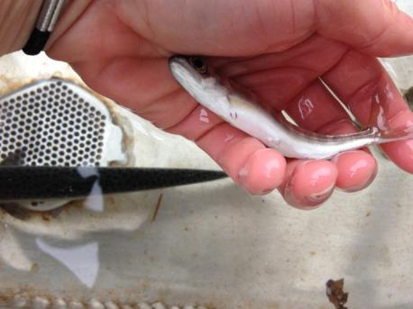
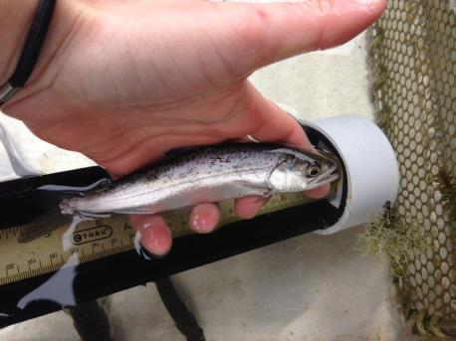
Performance Assessment – Injury Results
 |  |  |  | Injury Rate
Species | Examined | Minor | Major | Minor | Major
Chinook | 178 | 1 | 2 | 0.6% | 1.1%
Coho | 204 | 1 | 2 | 0.5% | 1.0%
Steelhead | 286 | 0 | 1 | 0.0% | 0.3%
Notes:
# Examined from HOR and FB releases. Represents injuries incurred from release to examination.
Minor = minor scale loss
Major = all others (lacerations, hemorraghed eyes, torn fins, scrapes, major scale loss)

Slide 24
2013 & 2014 Fish Collection Benefits
 | Fish Collected |  | Estimate of Added Juveniles |  | Estimate of Added Adults
Species | Smolts | Presmolts | Smolts | Presmolts | Smolts to Adult | Presmolts to Adult | Total Adults
Chinook | 43,347 | 27,432 | 6,502 | 4,115 | 65 | 21 | 86
Coho | 21,211 | 2,278 | 3,101 | 342 | 93 | 5 | 98
Steelhead | 5,407 | 473 | 811 | 71 | 41 | 2 | 43
Assigned 15% turbine mortality to all fish collected
Chinook: Smolt – Adult survival = 1.0%; Presmolt – Adult Survival = 0.5%
Coho: Smolt – Adult survival = 3.0%; Presmolt – Adult Survival = 1.5%
Steelhead: Smolt – Adult survival = 5.0%; Presmolt – Adult survival = 2.5%
 | Fish Collected |  | Estimate of Added Juveniles |  | Estimate of Added Adults
Species | Smolts | Presmolts | Smolts | Presmolts | Smolts to Adult | Presmolts to Adult | Total Adults
Chinook | 58,890 | 67,410 | 8,834 | 10,112 | 88 | 51 | 139
Coho | 30,474 | 5,258 | 4,571 | 789 | 137 | 12 | 149
Steelhead | 8,603 | 1,059 | 1,290 | 159 | 65 | 4 | 69

Slide 25

Conclusions
First two years of operation were relatively smooth though some design issues were raised and required attention.
Facility performance in terms of guidance and fish condition were excellent.
Improved passage should result in increased adult returns of roughly 3-6% (50-150 adults per species/year).
Factors contributing to success:
  Run-of-river operations (relatively steady forebay levels);
  Position of entrance relative to powerhouse intakes;
  Grizzly spacing relative to powerhouse trash rack spacing;
  High attraction flow relative to powerhouse flow;
  Favorable reservoir environment (paucity of predators/parasites);
  Small reservoir and narrow forebay;

Slide 28
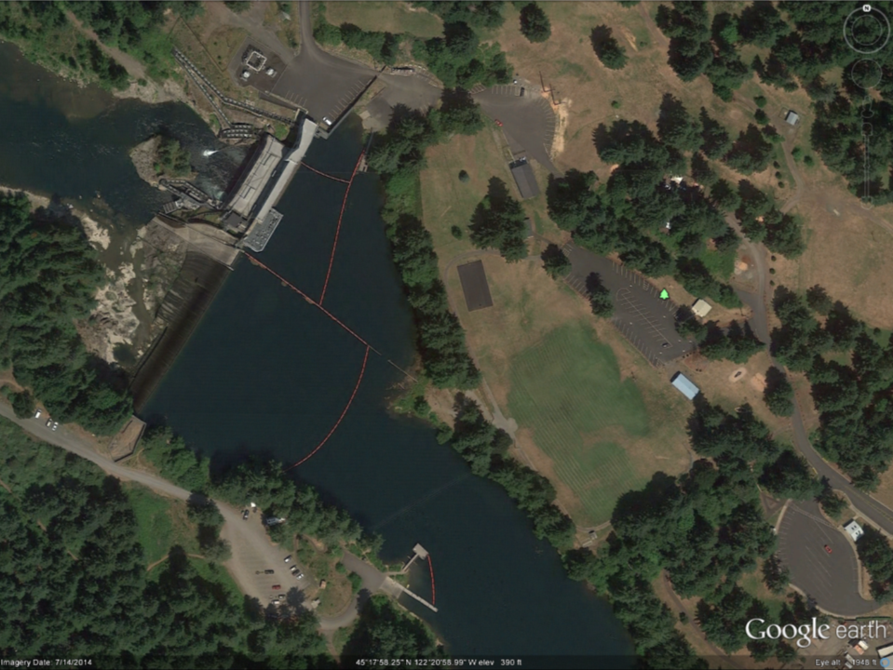
Setting

Slide 29
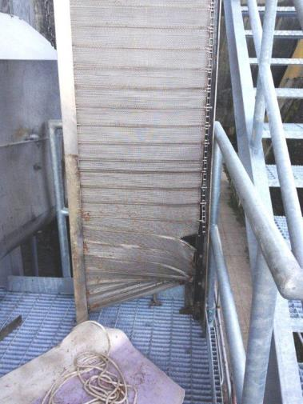
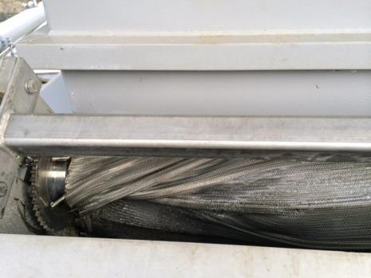
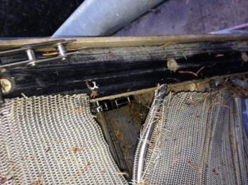
River Mill Surface Collector - Challenges
Notes:
Debris screens – design issue resulted in screen failure (cotter pins/ice buildup)
Difficult to properly maintain (design issue)
Over-run in 1st year of operation (lack of operating experience)

Slide 30
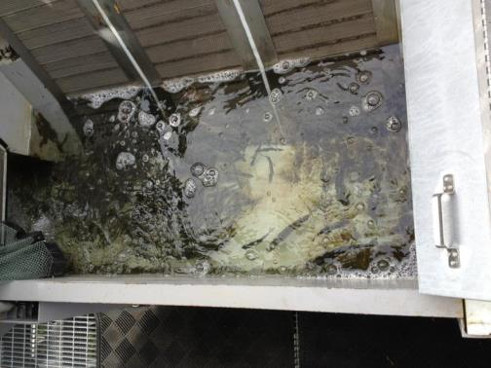
River Mill Surface Collector - Challenges
Notes:
Too many fish (expected big fish days to be ~1,000)
By end of first year we had days with over 4,000

