Slide 1
Willamette High Head Bypass
August 2014 FPT Brief
Jeff Ament, Marie Phillips, Fenton Khan
Portland District
August 2014

Slide 2
Project Introduction
Support DS passage teams
Preliminary analysis - volitional appeared not as cost effective as trap and haul
Volitional passage may have biological benefits
Project Goal: Fill data gaps on high head bypass to inform PDTs

Slide 3
Benefits of HHB
Biological
  Less sorting and handling
  Reduces delay
  Can better deal with large run sizes
Reduced O&M costs
  Trucking costs
  Debris
Can simplify the design of collection facilities
  Sorting
  Debris handling

Slide 4
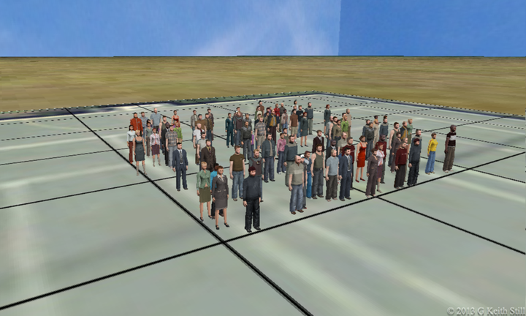
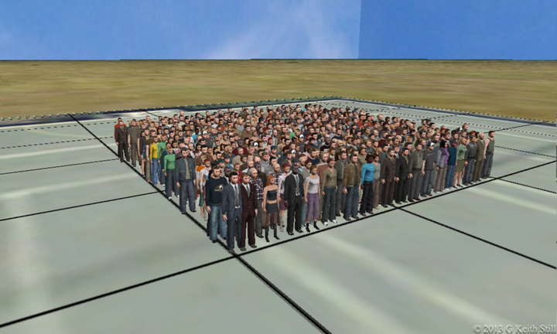
Density
Truck Transport
Volitional Passage

Slide 5
Challenges
High Structures
Large forebay elevation fluctuations under normal operations
Existing outlets positioned low on dam
Literature Review Results
1563
(Max. Conservation Pool)
1450
(Min. Conservation Pool)
Height of dam > 300ft
1340
(Test Conduit CL)
Section through dam at test conduit
Spillway, Penstocks and Lower ROs not shown
1235ft
Typical TW Elev.)

Slide 6
Project Goals
Goals of Literature Search:
  See what others had done (don’t need to reinvent the wheel)
  Find a test location or conduct computer modeling to further develop and test parameters
Are there ways to make volitional passage safe and cost effective?
Determine effects of bypass on downstream migrants at high head project
Begin filling in data gaps

Slide 7
90% EDR
Green Peter Test Potential
  Existing pipes
    Various elevations
      potential for pressurized, open channel and high velocity tests
    large radius curves
    Valves
      Potential for varying flow

Slide 8
Path Forward
After Green Peter Testing
  Evaluate data
  Determine if any additional data or new tests needed
    At Green Peter or elsewhere
    Additional data, odd findings, long term effects

Slide 9
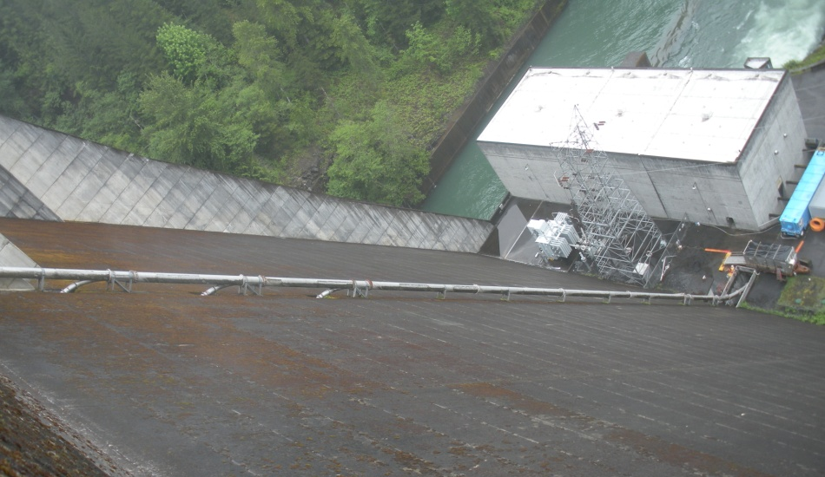
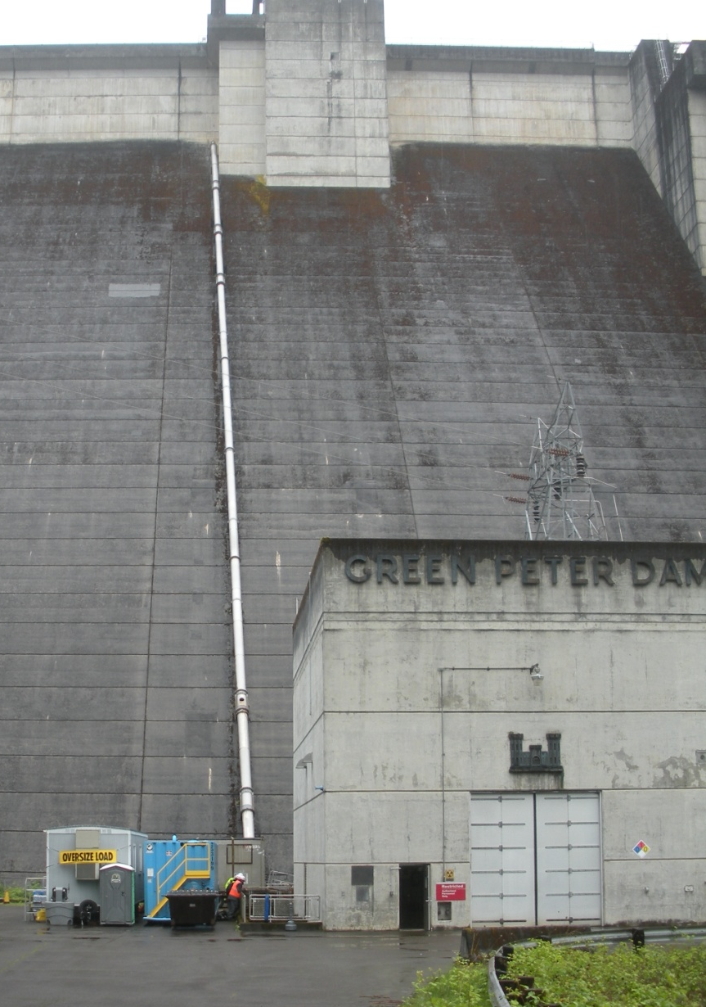
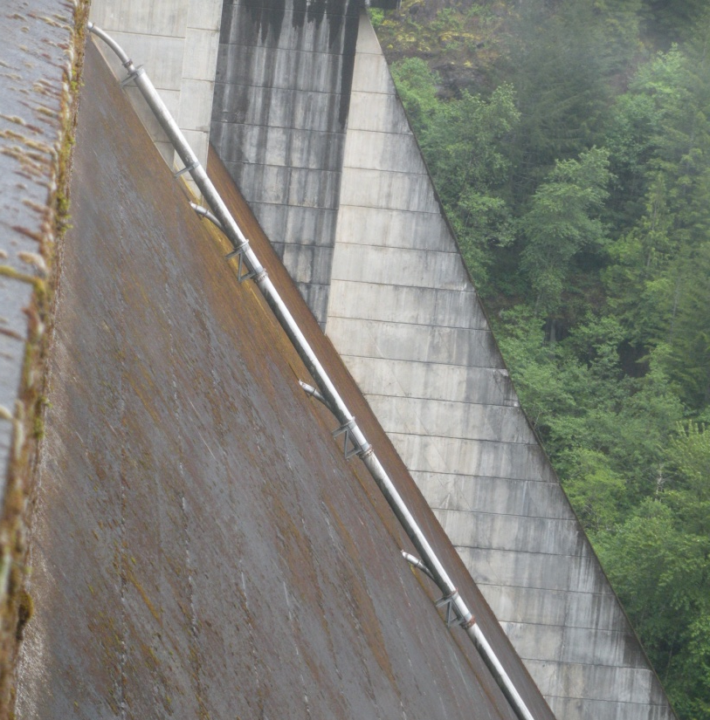
Questions?

