Slide 1
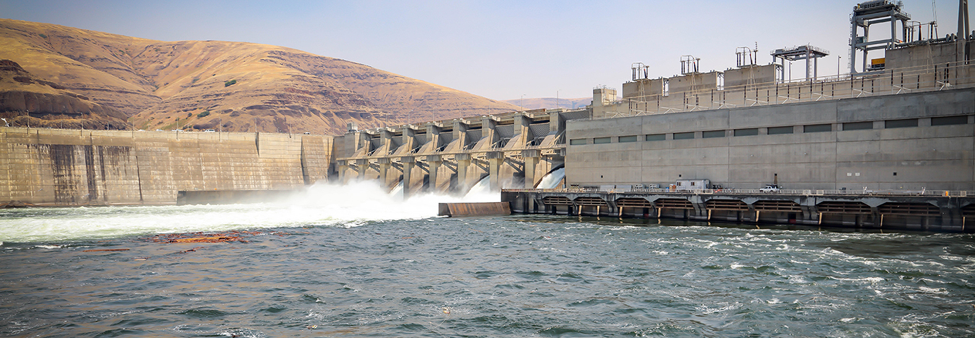
Spring Chinook Fallback at
Lower Granite in 2022
FPOM
07/14/2022
Kelsey Swieca Ph.D
Blane Bellerud Ph.D

Slide 2
Definitions
Fallback: pit tagged fish detected making two trips up the fish ladder. It passes through the last detector at the ladder exit and is subsequently observed re-entering the ladder at the bottom.
Only fish tagged at or above Lower Granite Dam as juveniles were used in the analysis to exclude the influence of overshoot (fish originating from downstream of LGR) fish falling back.
Based on PIT tag detections of fish falling back over the RSW (where the exact time of fallback is known), fish which fell back were assumed to fallback within 1 hour of ladder exit.

Slide 3
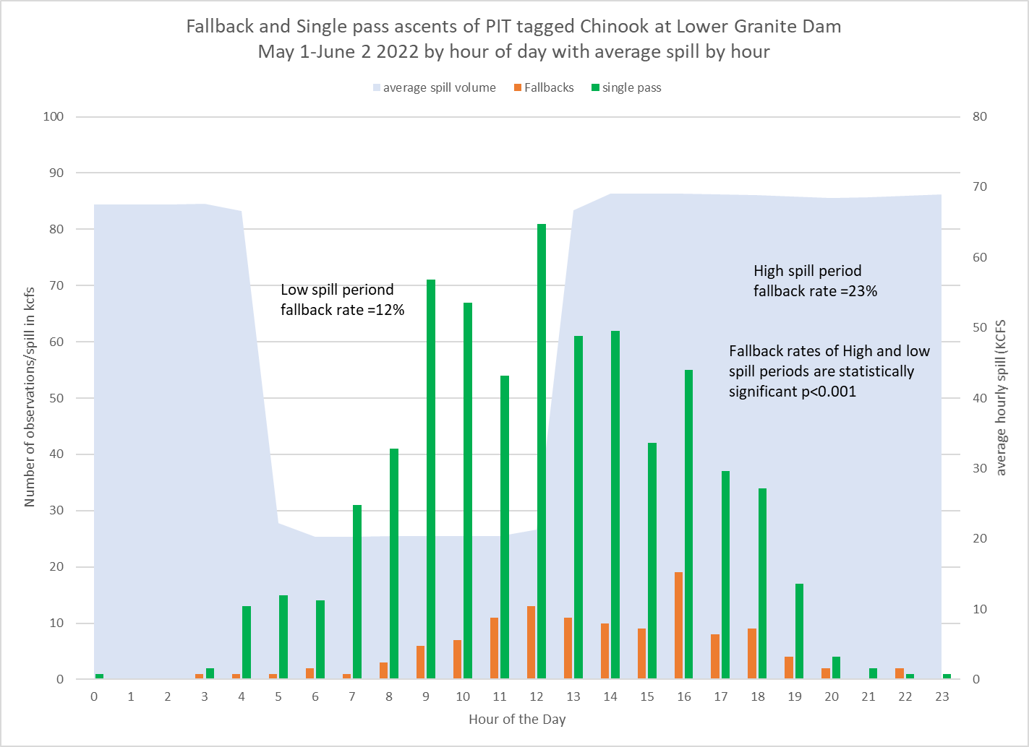
X
May 1
to
June 2
(period of highest fallback)
Hour is the hour the fish exited the top of the ladder on its first ladder ascent

Slide 4
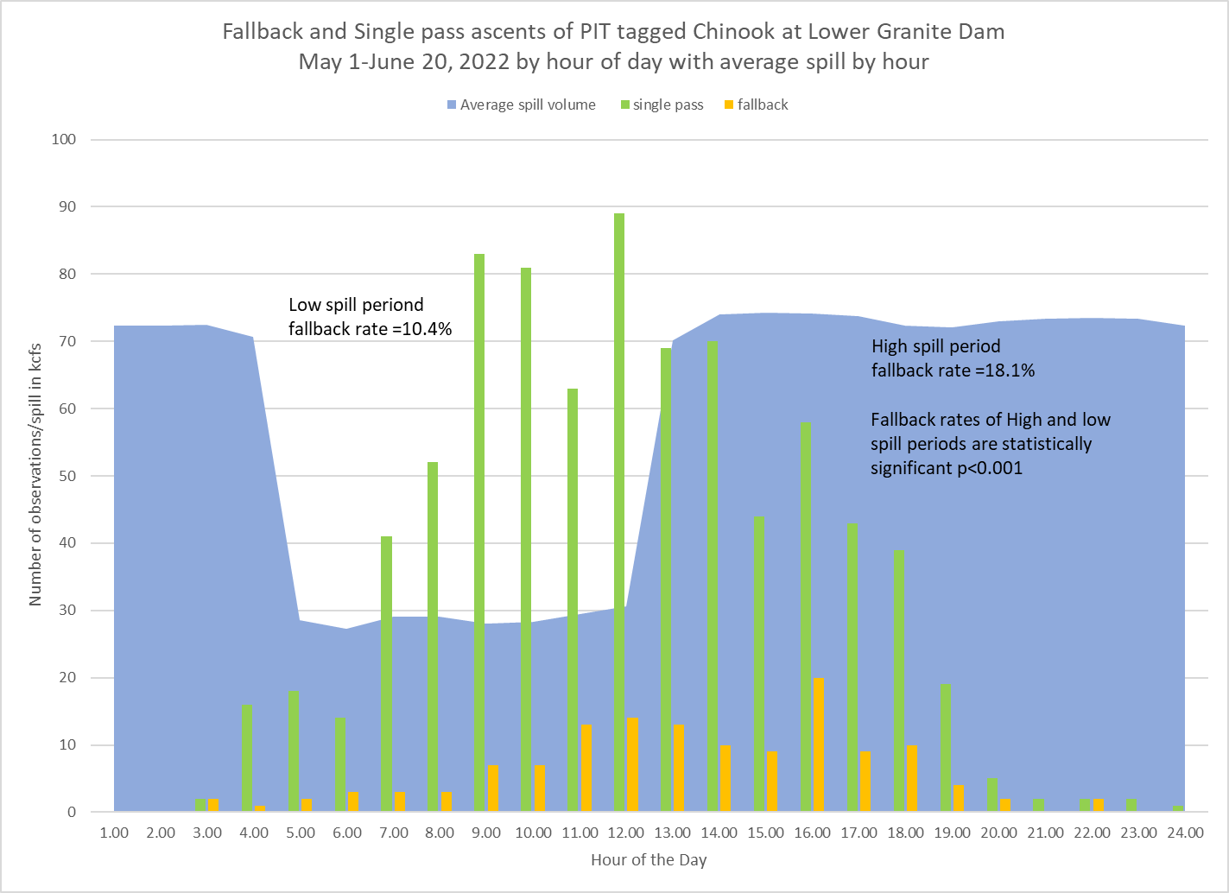
X
May 1
to
June 20
52% of ladder ascents
48% of ladder ascents
Hour is the hour the fish exited the top of the ladder on its first ladder ascent

Slide 5
Parameters derived from RSW PIT tag observations of fallbacks
Year | Fallbacks | RSW Obs | Fallback with no reascent | %RSW fallback | CI.lower | CI.upper | Ladder exit to RSW median time (Hr) | RSW to ladder median time (Hr) | % Fallback with no reascent | CI.lower | CI.upper
2020 | 57 | 7 | 1 | 12.3% | 5.1% | 23.7% | 0.20 | 6.0 | 14.3% | 34.52% | 7.41%
2021 | 26 | 3 | 0 | 11.5% | 2.4% | 30.2% | 2.46 | 2.4 | 0.0% | 0.00% | 0.00%
2022 | 163 | 29 | 2 | 17.8% | 12.3% | 24.5% | 0.39 | 15.0 | 6.9% | 10.02% | 5.00%
pooled | 246 | 39 | 3 | 15.9% | 0.12 | 0.21 | 0.42 | 12.8 | 7.7% | 10.58% | 5.80%

Slide 6
Data specifics
Fallback = a fish seen entering and subsequently exiting the same project more than one time on the same day or on a later day (coded as ‘asc’ on DART)
Attempted ascents excluded from analysis (coded as ‘att’ on DART)
Removed days where < 10 fish were detected at the ladder
Data limited to spring spill season: 4/3 – 6/20
Environmental conditions matched to the estimated time of fallback (1 hr after ladder exit)
Notes:
Estimated time of fallback based on Blane’s results above, which indicate that the majority of fish fallback within 1 hr of ladder exit

Slide 7
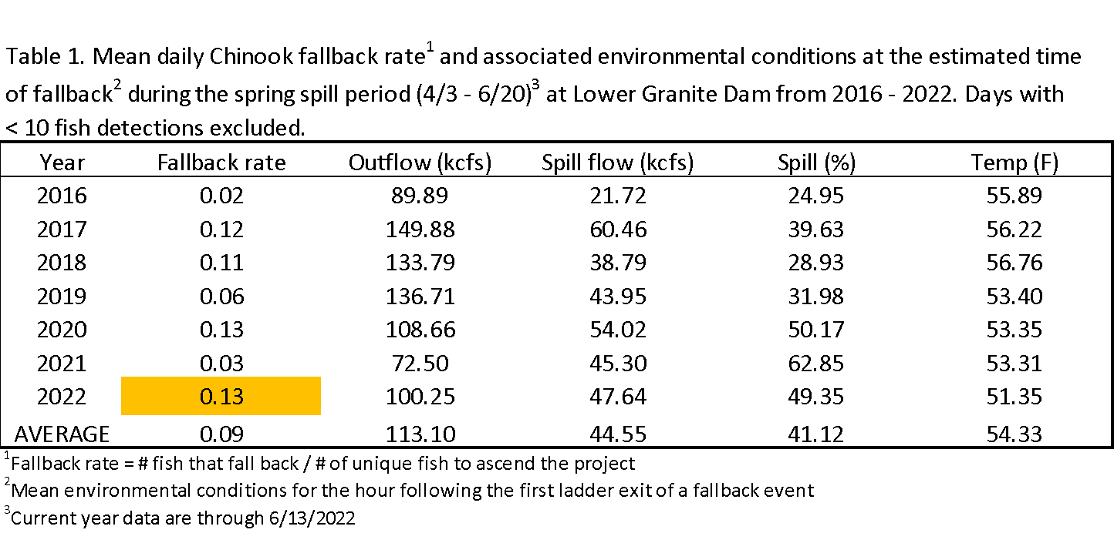
Annual overview

Slide 8
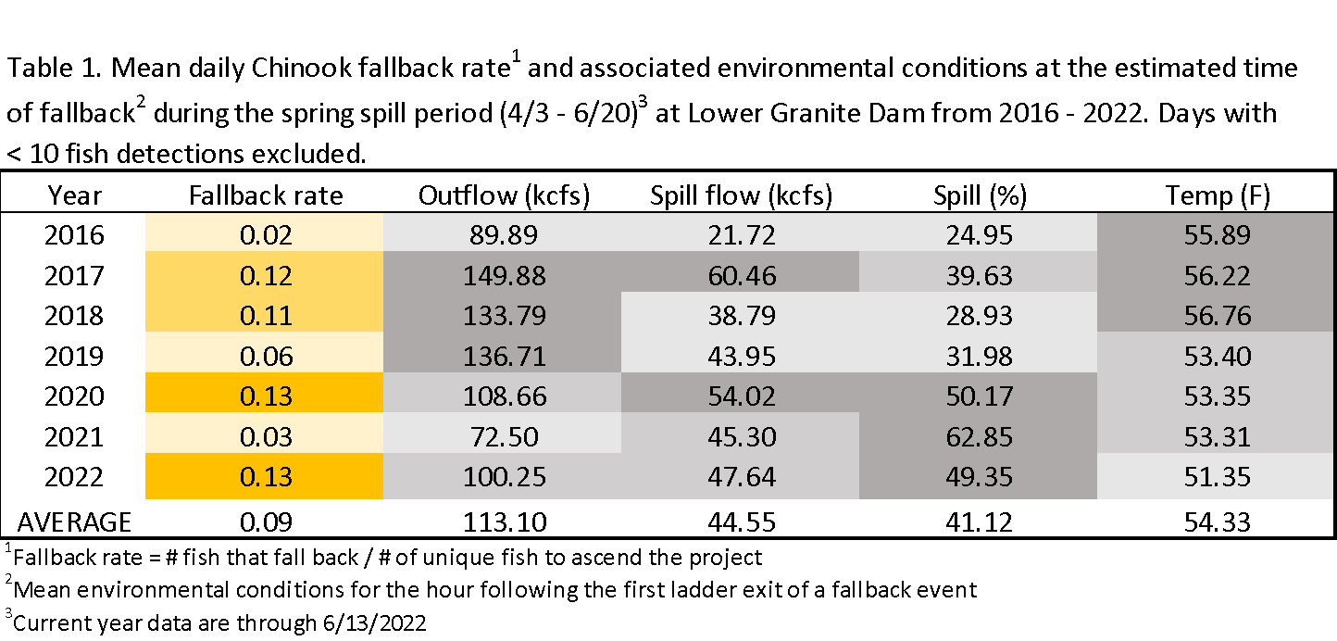
Annual overview
Notes:
Darker colors = higher values

Slide 9
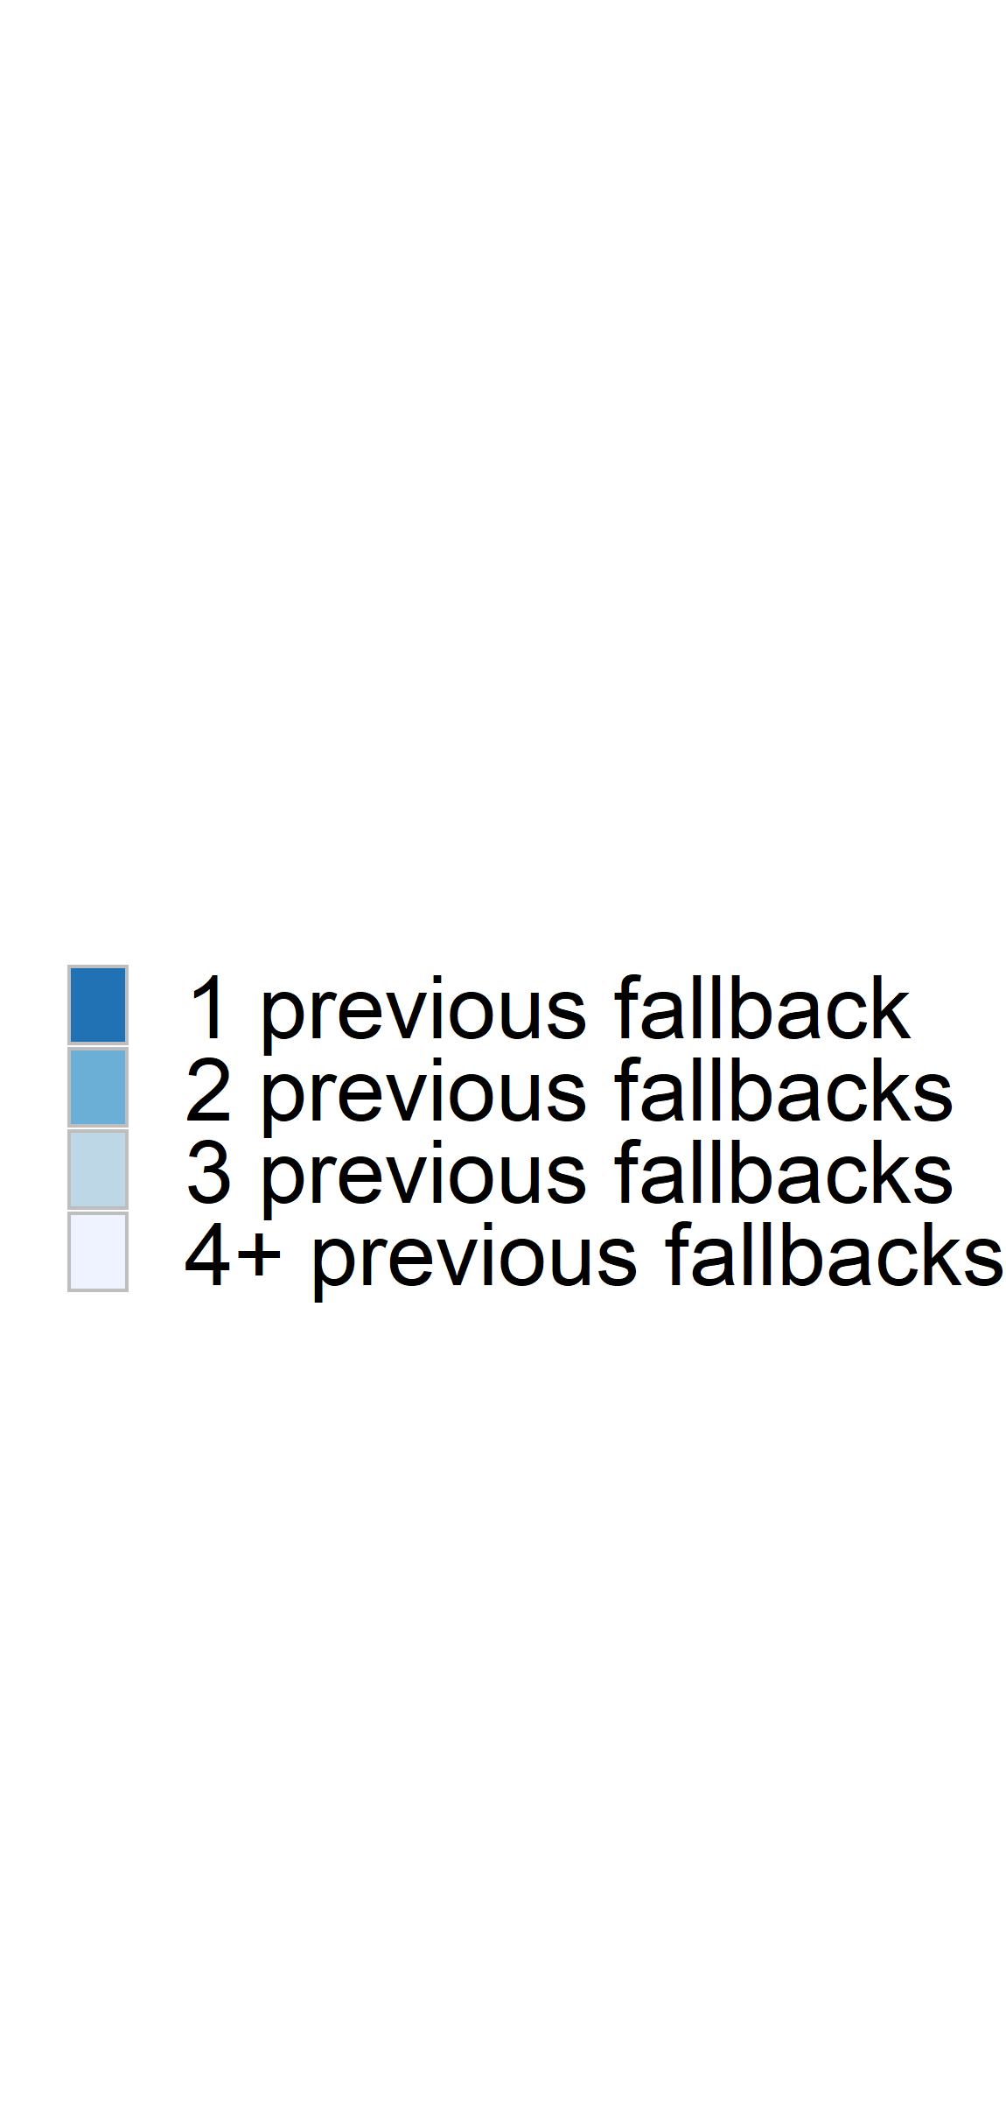
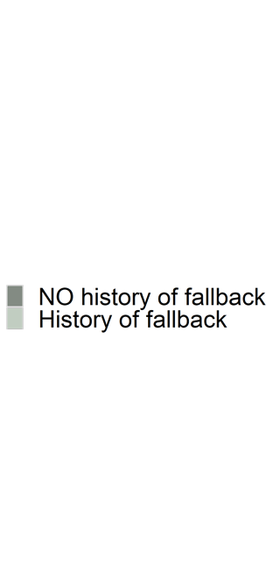
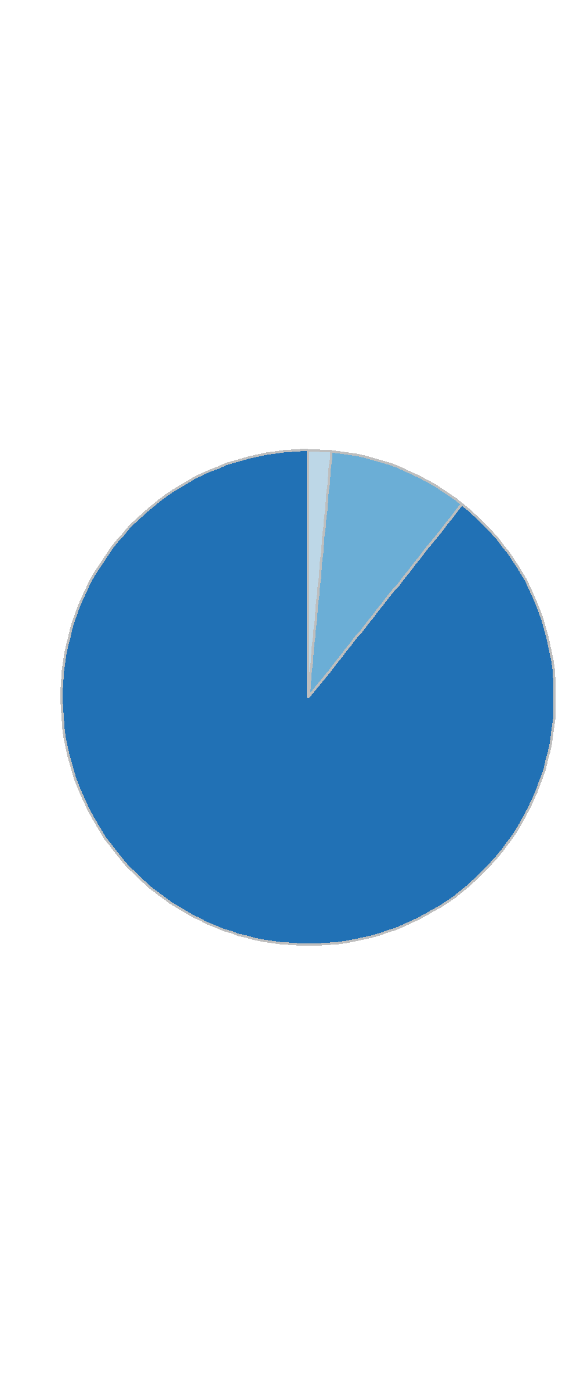
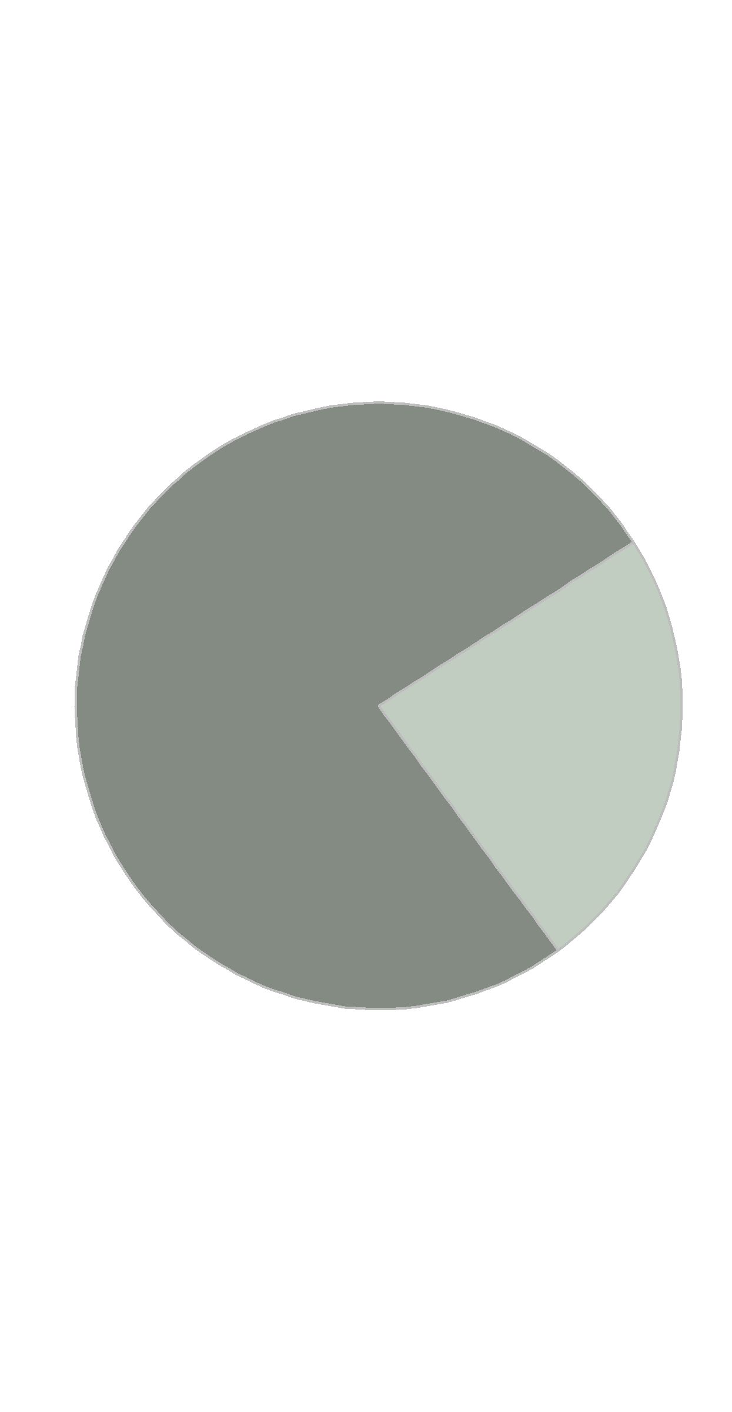

Fallback history
24% of the Chinook that fellback at LWG also fellback at a downstream project
89%

Slide 10
Multivariable model of LWG fallback
Full model:
Fallback rate =
daily # of fish to ascend LWG +
# previous fallbacks + travel time BON + travel time LGS +
outflow (kcfs) + spill (kcfs) + temp (°F)
Final model:
Fallback rate =
outflow (kcfs) + spill (kcfs) + temp (°F)
Notes:
Generalized additive model (GAM) because nonlinear;
Model selection w/ AIC & GCV;
Collinearity VIF cutoff of < 2.5, precluded inclusion of spill % and spill flow (kcfs) in a single model. Moved forward with spill flow based on linear regressions which indicated a stronger relationship between spill flow and fallback than spill % and fallback.

Slide 11
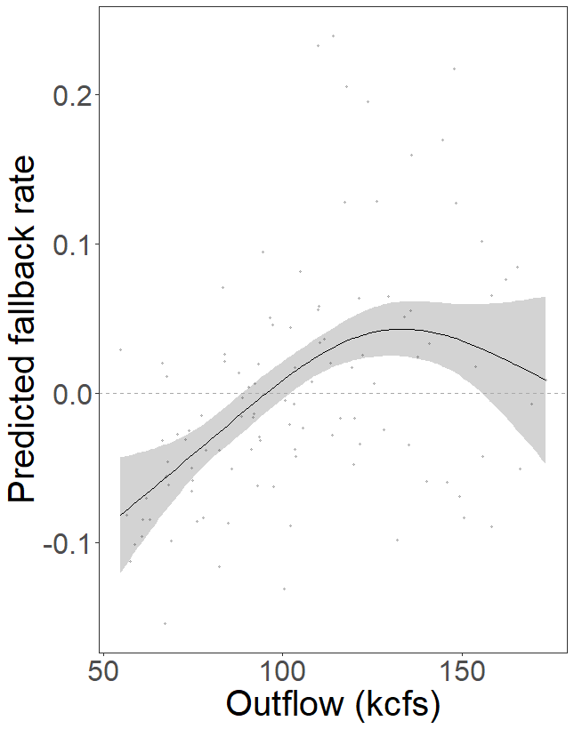
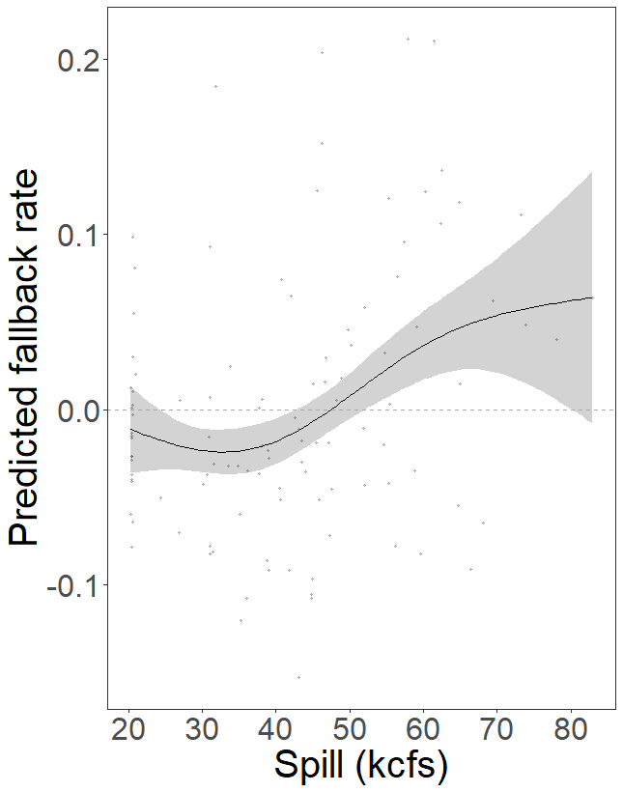
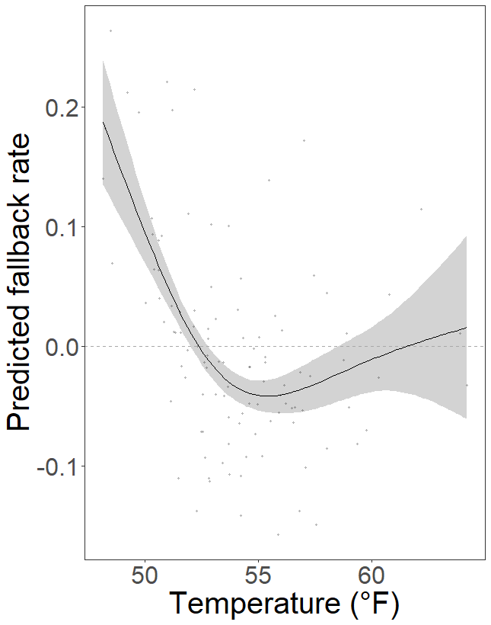
p < 0.001
p = 0.02
p < 0.001
Dev. explained = 43.4%
VIF cutoff 2.5
Notes:
Values above 0 = above avg. predicted fallback; values below 0 = below avg. predicted fallback

Slide 12
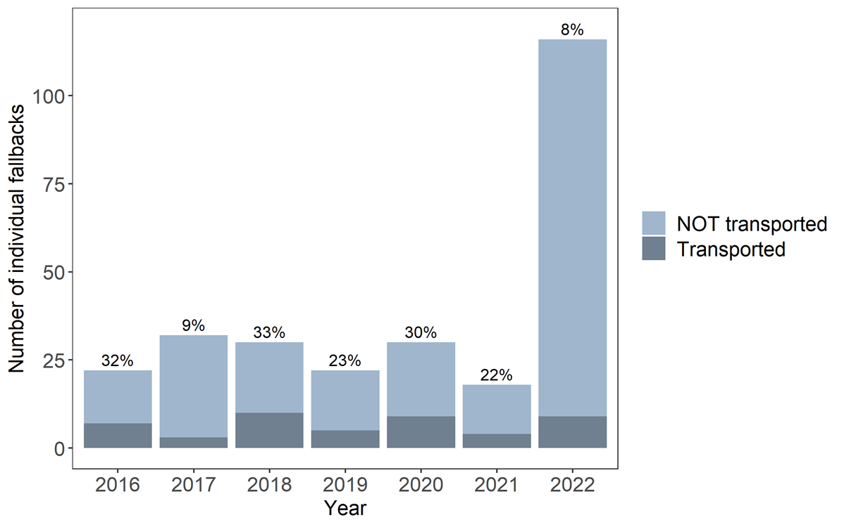
Transportation
17% of the fish that fellback @ LWG since 2016 were transported as juveniles

Slide 13
Takeaways
2022 LWG fallback rate was high, but similar to 2020 and 2017
Significantly lower rates of fallback were observed during the reduced spill period
Fallbacks cannot be solely attributed to ‘weak’ fish
  Number of downstream fallbacks did not significantly impact predicted fallback @ LWG
  Transported individuals did not make up the majority of fish fallingback @ LWG
Fallback rate @ LWG was significantly influenced by outflow, spill flow, & forebay temperature
  Fallback rate was above avg. @ LWG when…
    outflows > ~100 kcfs
    spill > ~50 kcfs
    forebay temps < 53°F

