Slide 1
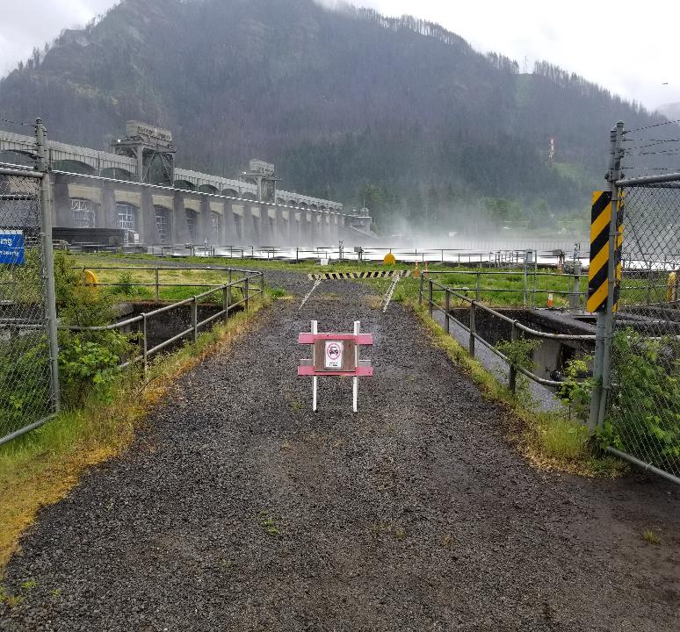
Cascade island subsidence interim repair project
Ben Hausmann
Fish Biologist
Bonneville Project
Date: 11 July 2019

Slide 2
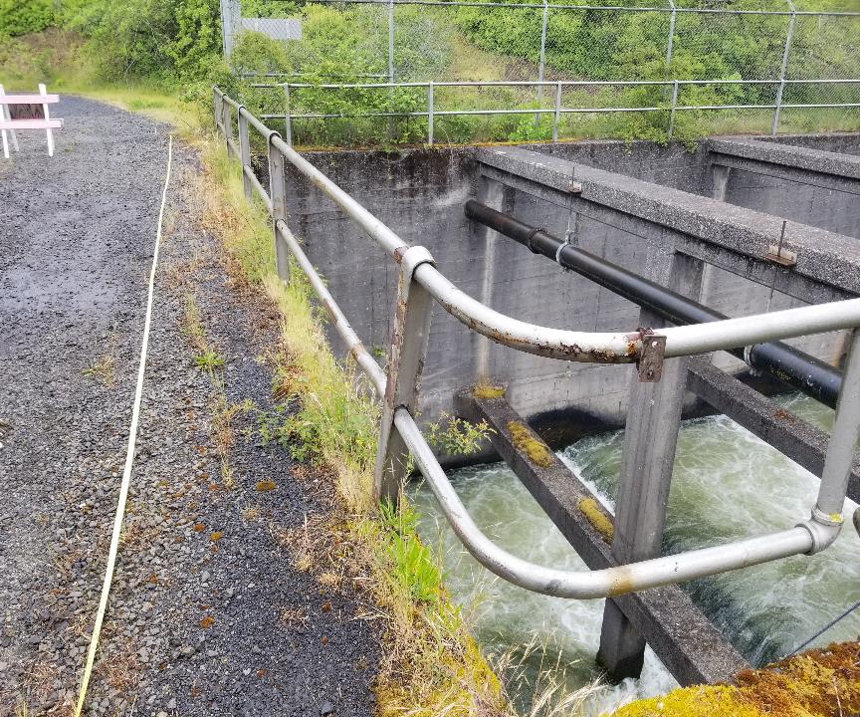
Hand Rails and Vegetation
Fence Corner
Removal
August
5-8, 2019
Hand Rails
and Vegetation
Fence Corner
Removal
August
5-8, 2019

Slide 3
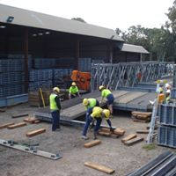
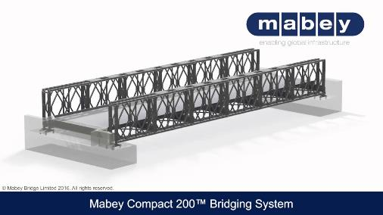
“Mabey” bridge installation with 671st Engineering
Company: October
18th Mobilize
19th installation
20th Demob

Slide 4
Crane Pad
Repairs After
December 15
(in-water work window)

