Slide 1
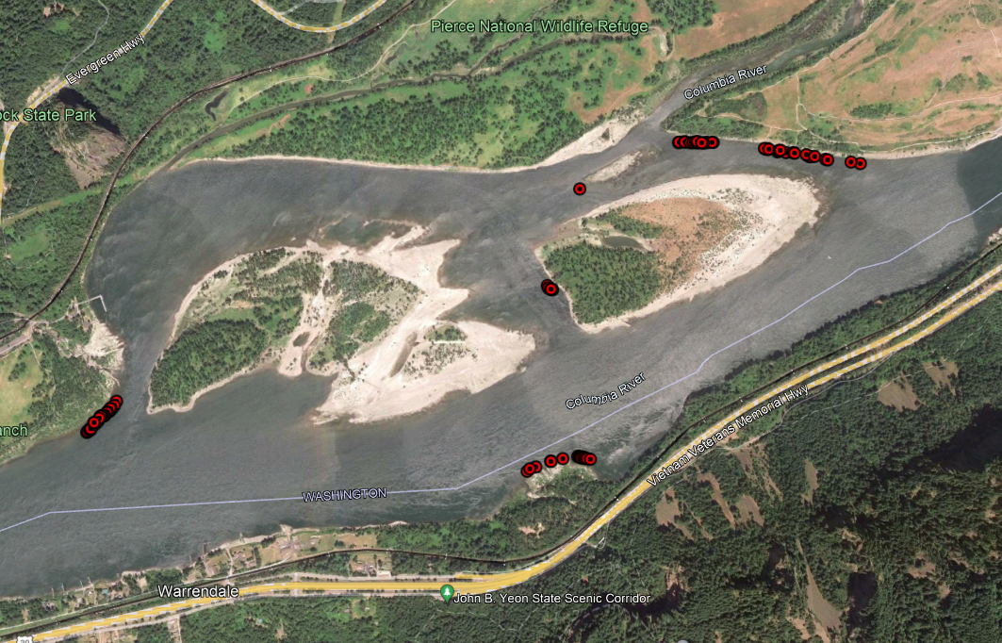
2021 Redd Locations
Ives Channel (no redds observed)
Ives Pocket (One redd observed)
Strawberry
Breaks
Woodard
McCord

Slide 2
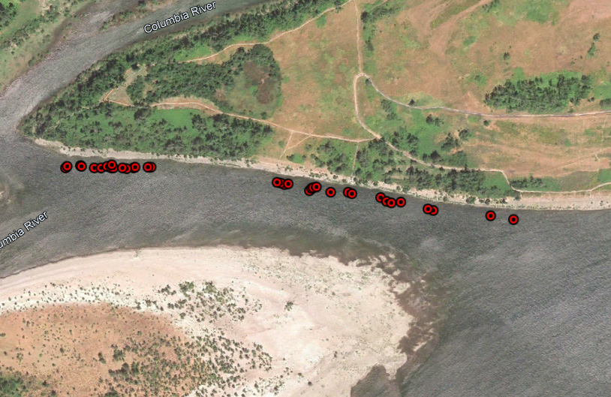
2021 Strawberry Redd Locations

Slide 3
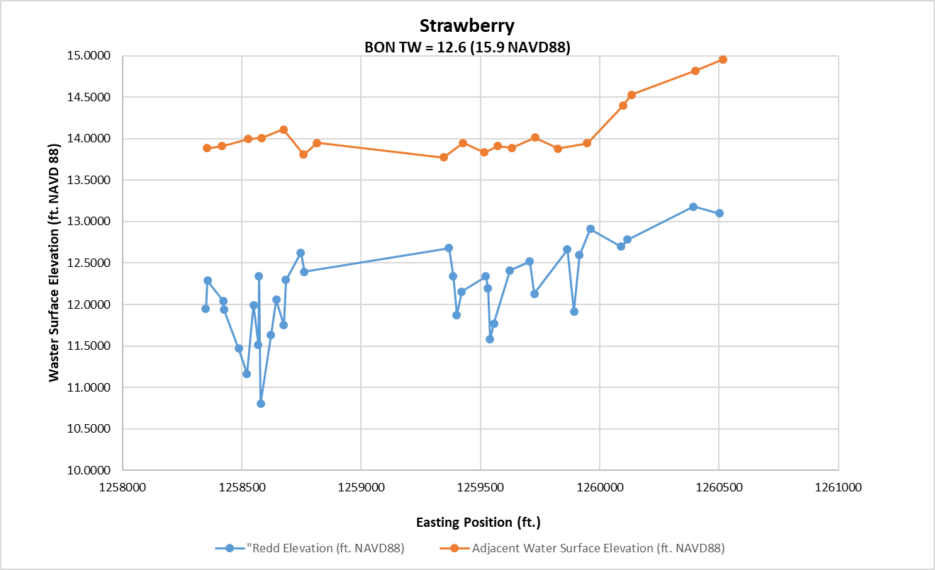
2021

Slide 4
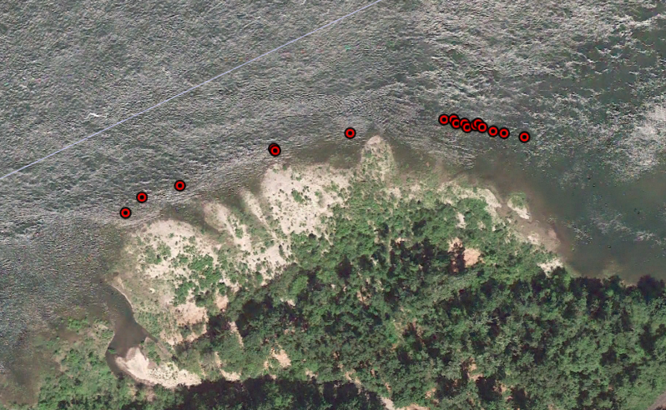
2021 McCord Creek Redd Locations

Slide 5
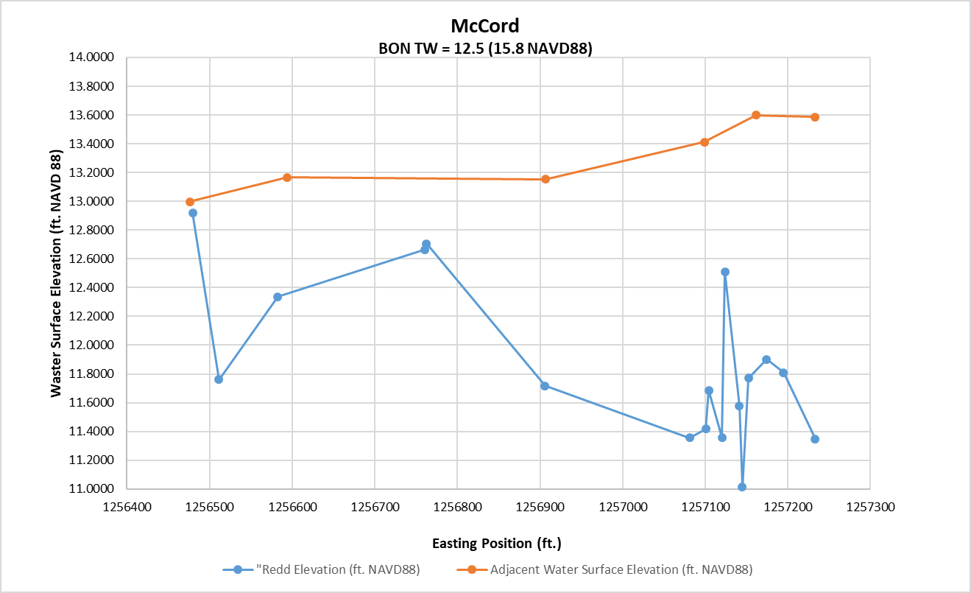
2021

Slide 6
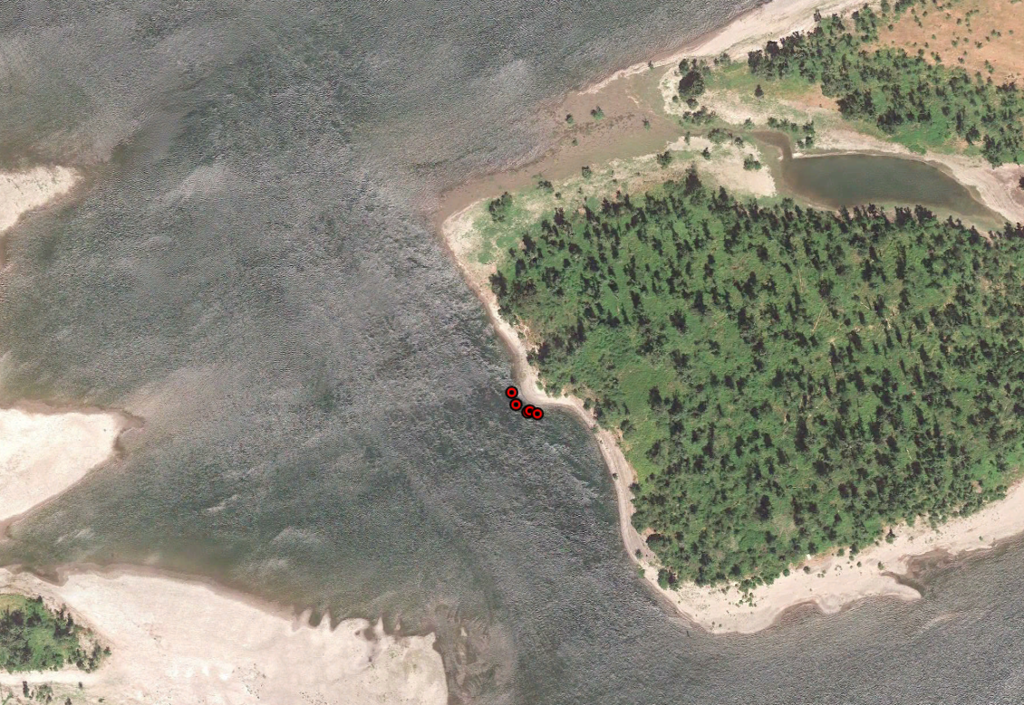
2021 Breaks Redd Locations

Slide 7
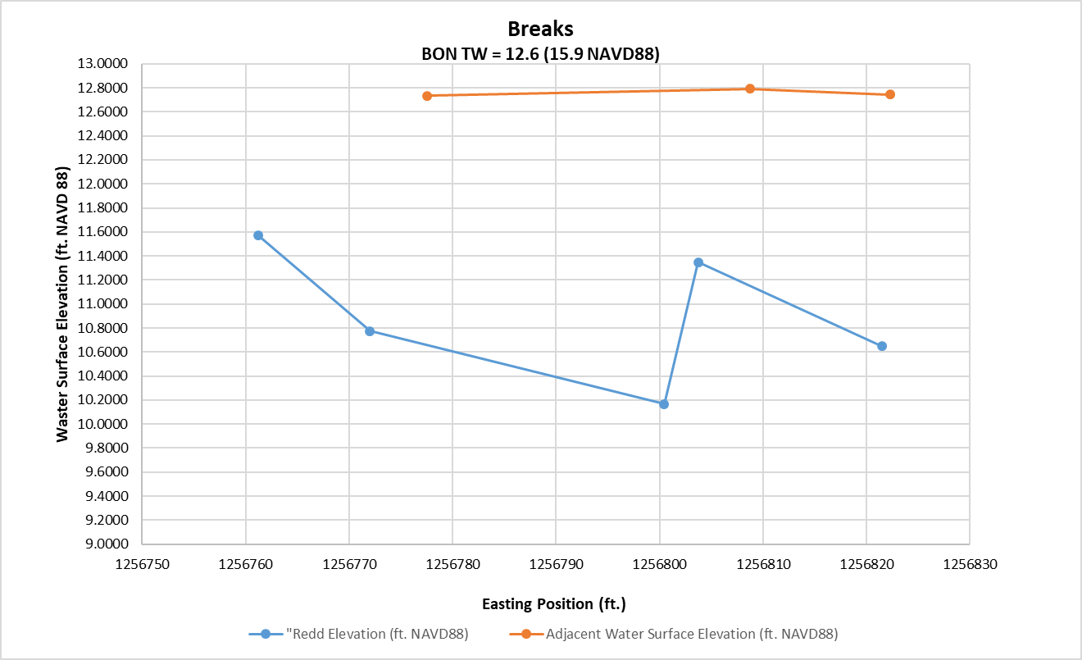
2021

Slide 8
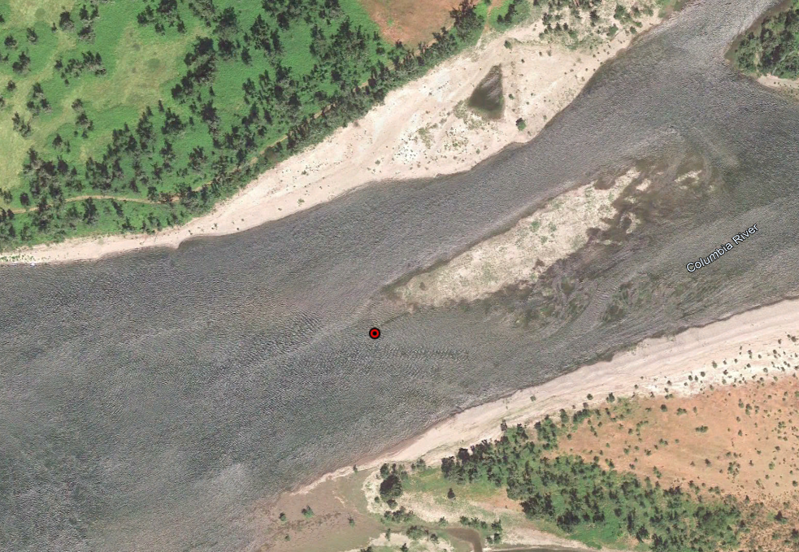
2021 Ives Redd Locations

Slide 9
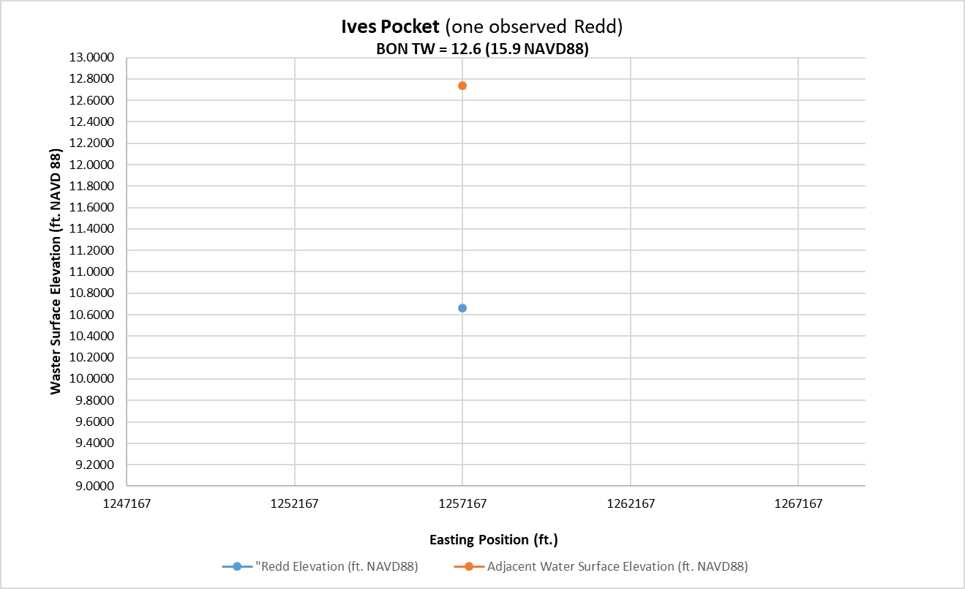
2021

Slide 10
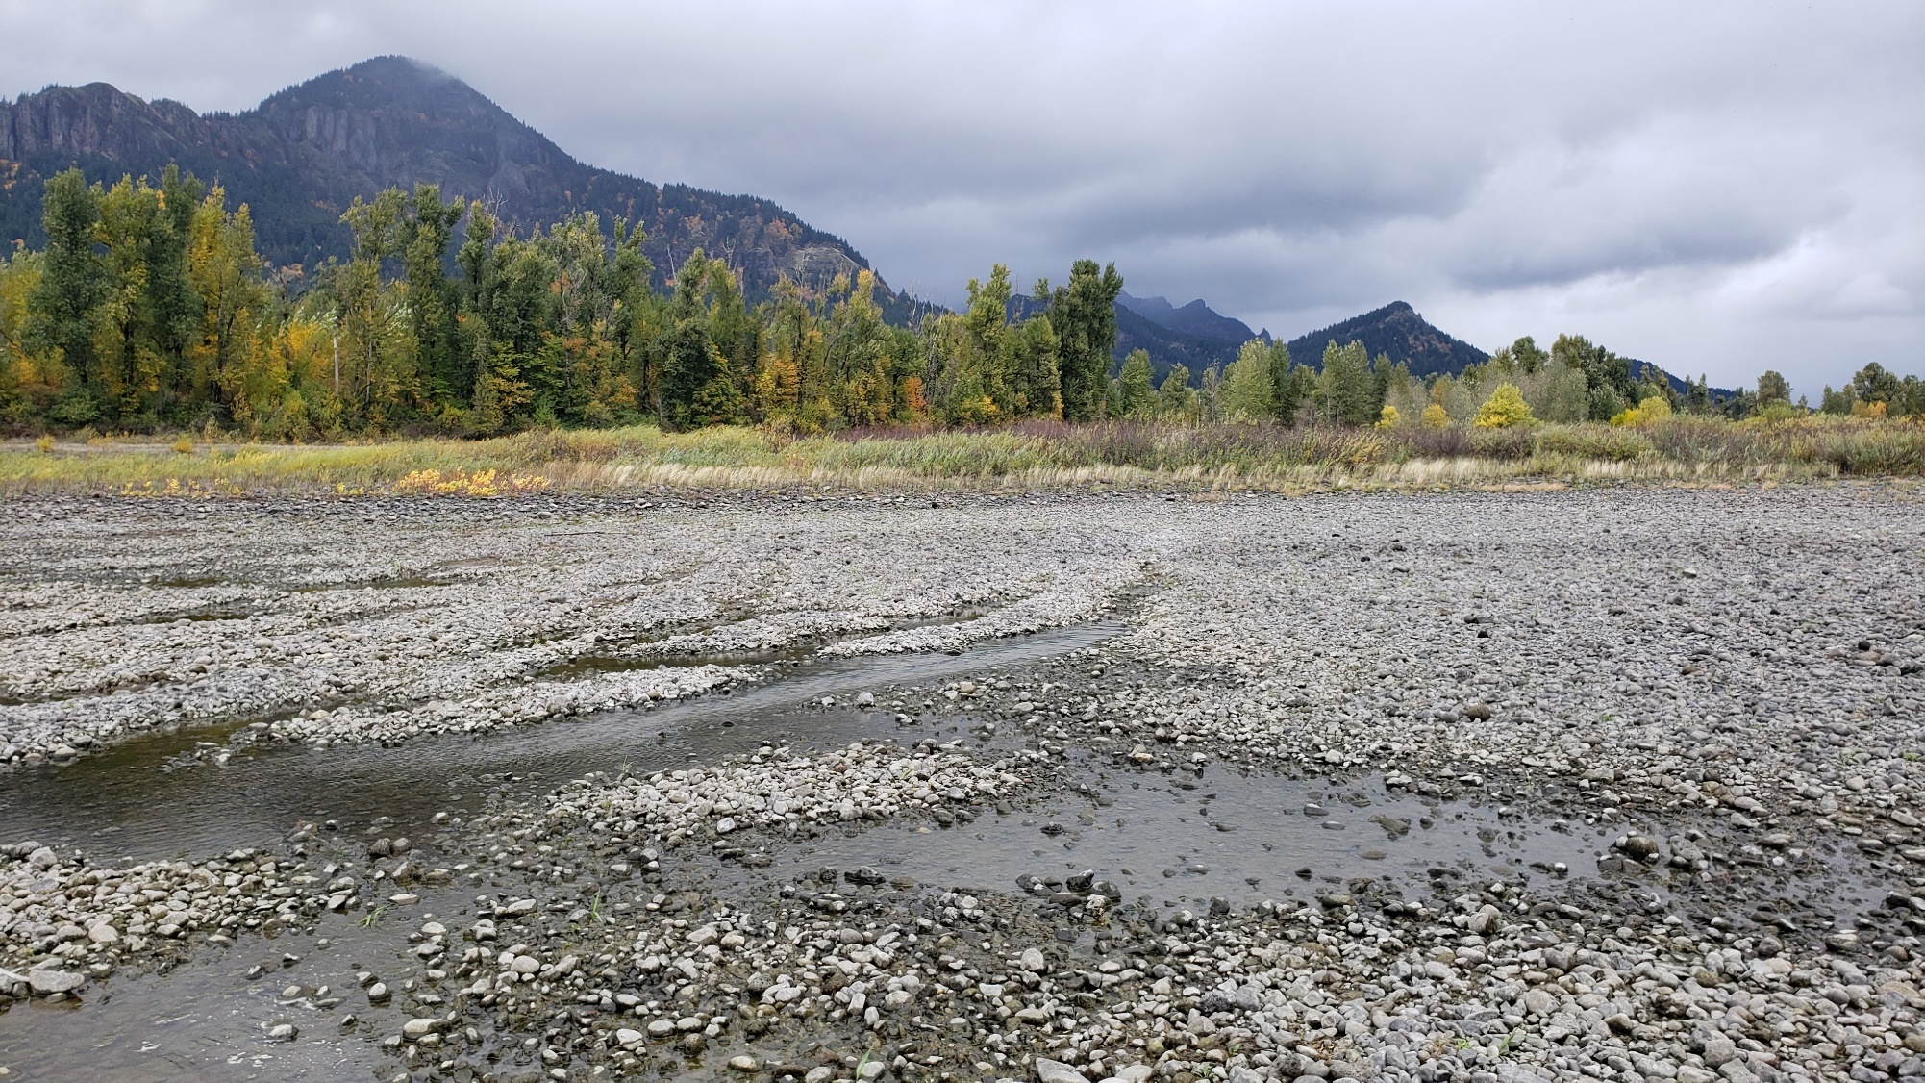
Ives Pocket October 28, 2021 BON TW of 8.5 feet
Significant flow up through the gravel prior to the start of the chum operation.
Approximate water surface at BON TW of 11.5 feet.

