Slide 1
Zero Generation Flexibility 2021-2022 Usage 12/17/2021 – 2/01/2022
 | LWG | LGS | LMN | IHR | Total Hours Used | Available Hours
Total Hours Used | 27 | 82 | 77 | 71 | 257 | 2820
Available Hours | 705 | 705 | 705 | 705 |  | 2820
 | LWG | LGS | LMN | IHR | Average
% of Available Hours Used | 3.8% | 11.6% | 10.9% | 10.1% | 9.1%
% of Total Hours Used | 2.4% | 7.3% | 6.8% | 6.3% | 5.7%
% of Available Days Used | 9% | 38% | 34% | 32% | 28%

Slide 2
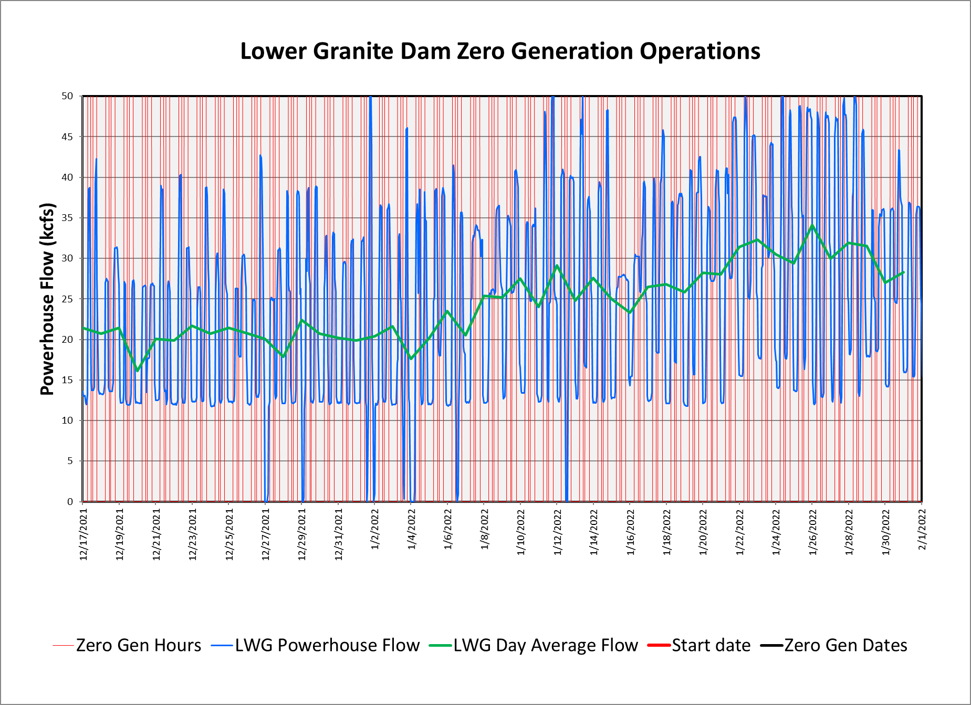
Zero Generation Flexibility 2021-2022 Usage 12/17/2021 – 2/01/2022

Slide 3
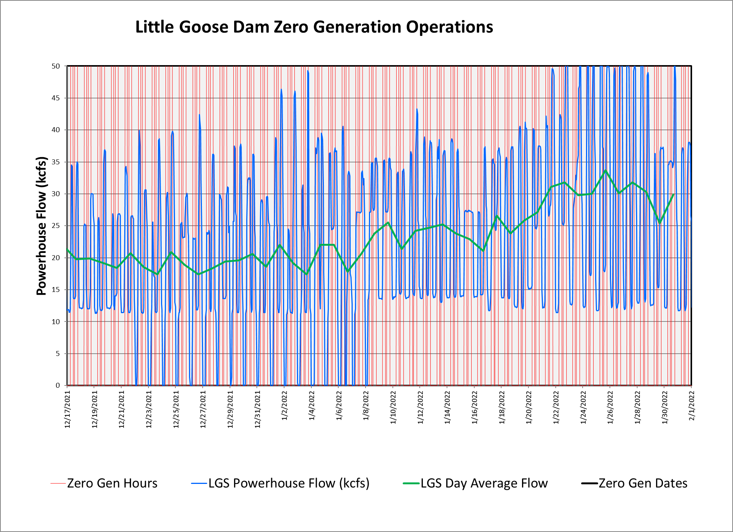
Zero Generation Flexibility 2021-2022 Usage 12/17/2021 – 2/01/2022

Slide 4
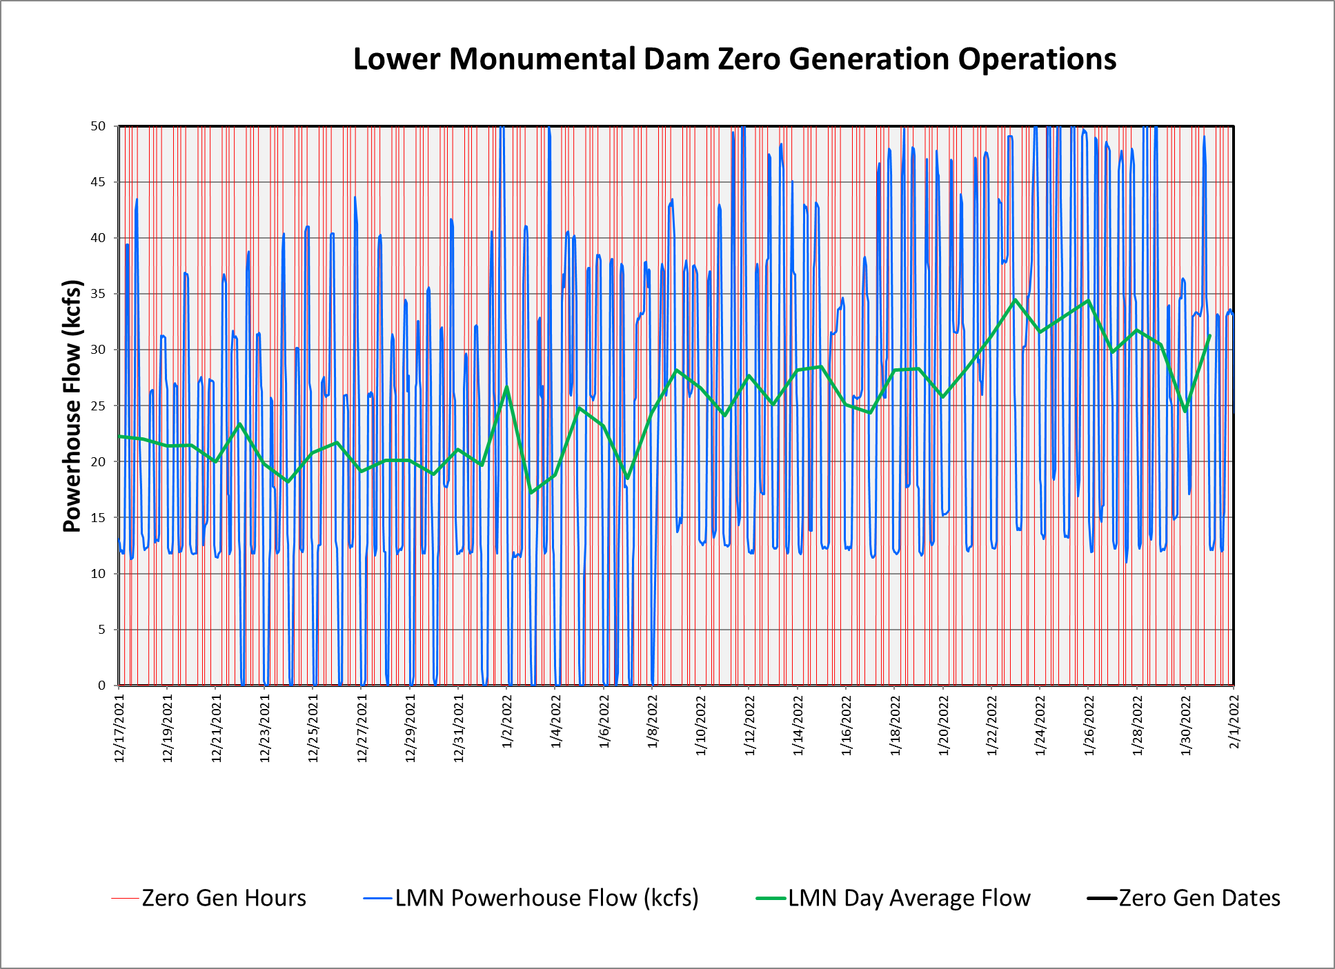
Zero Generation Flexibility 2021-2022 Usage 12/17/2021 – 2/01/2022

Slide 5
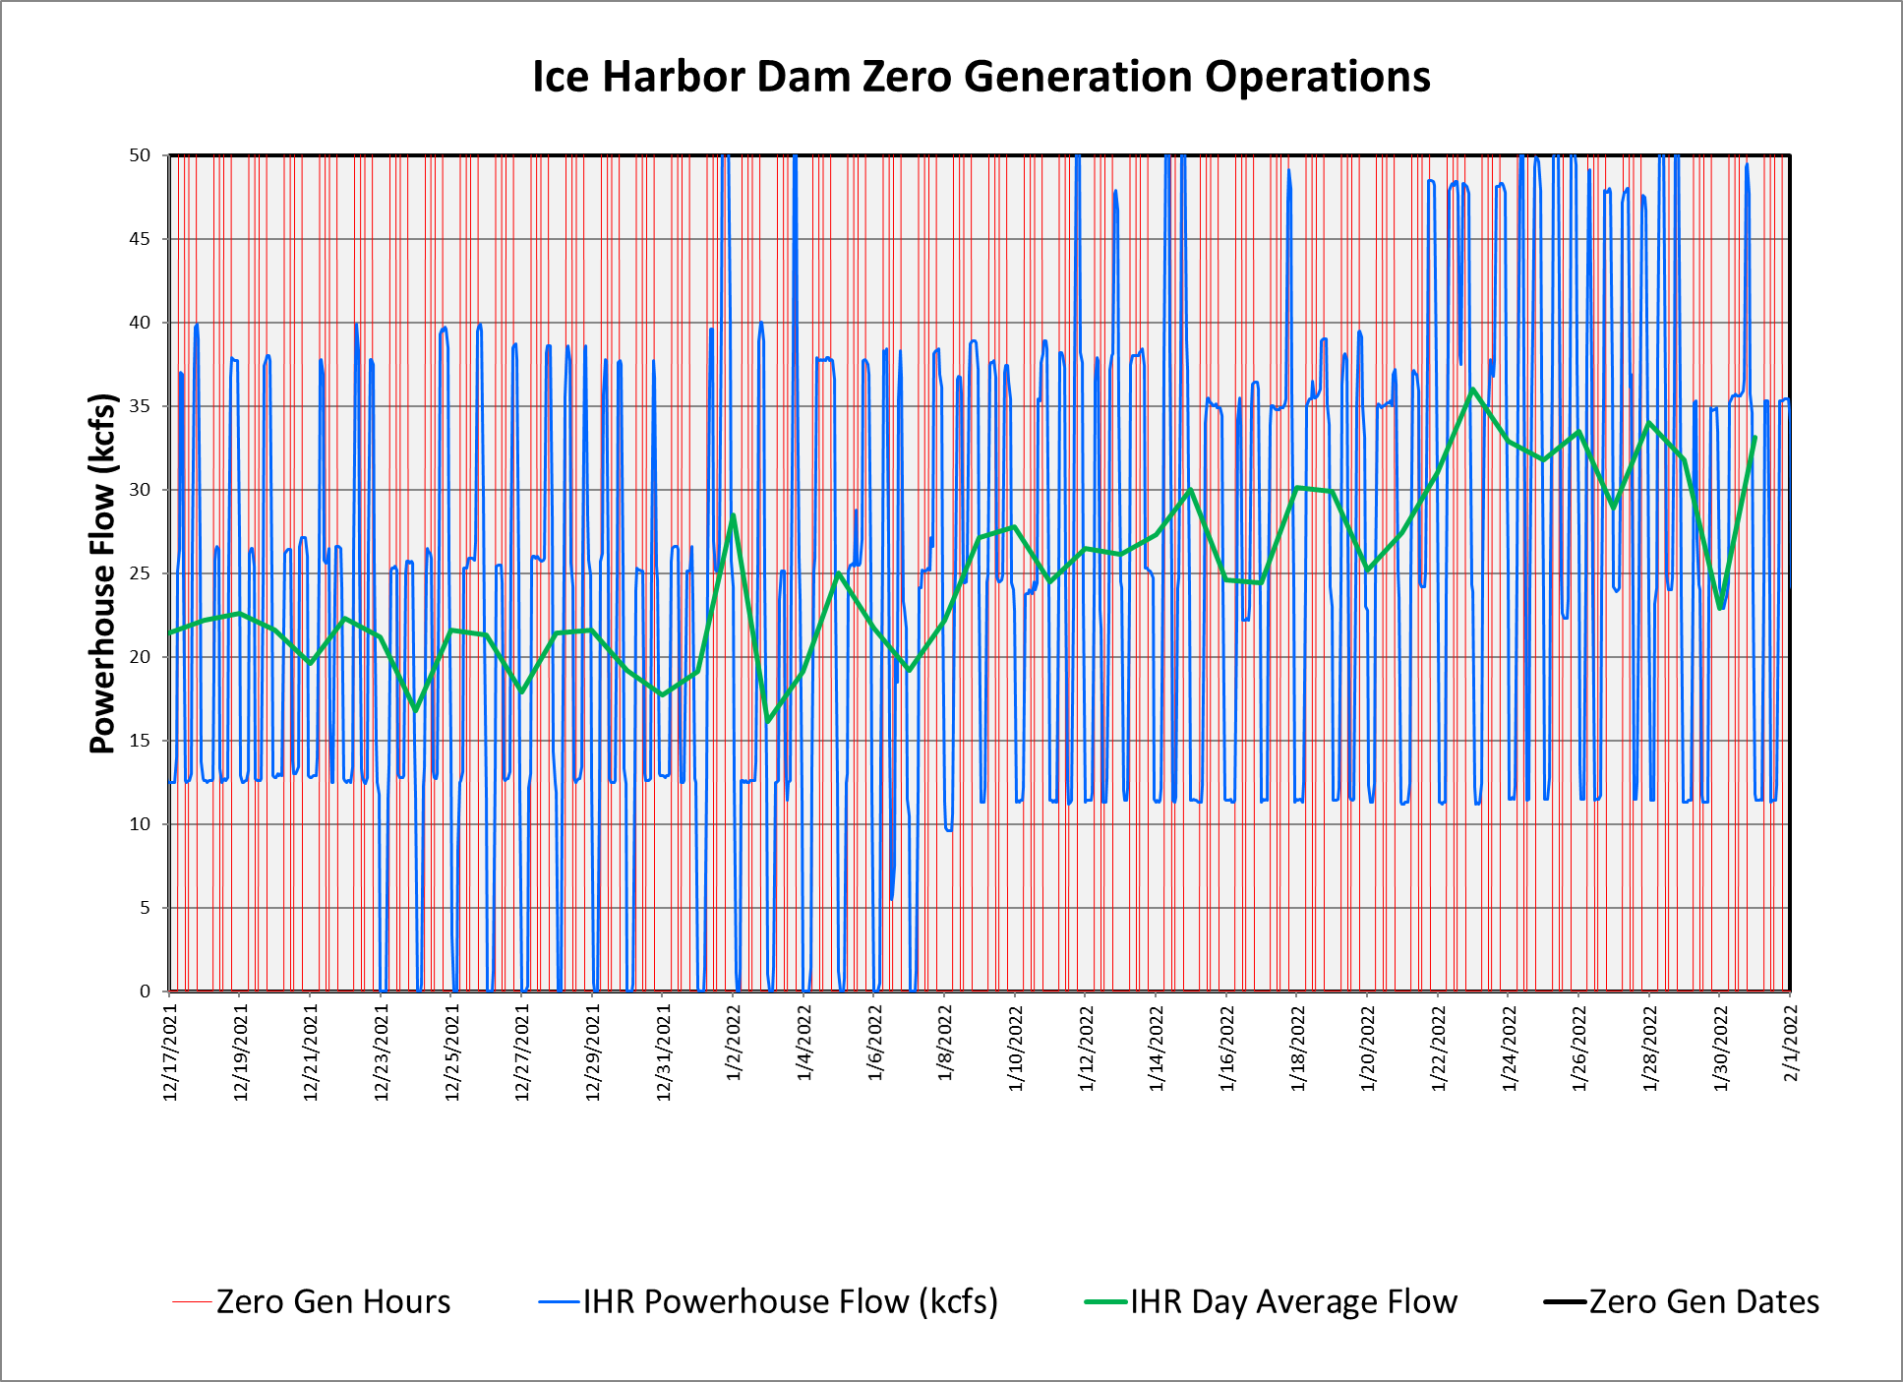
Zero Generation Flexibility 2021-2022 Usage 12/17/2021 – 2/01/2022

Slide 6
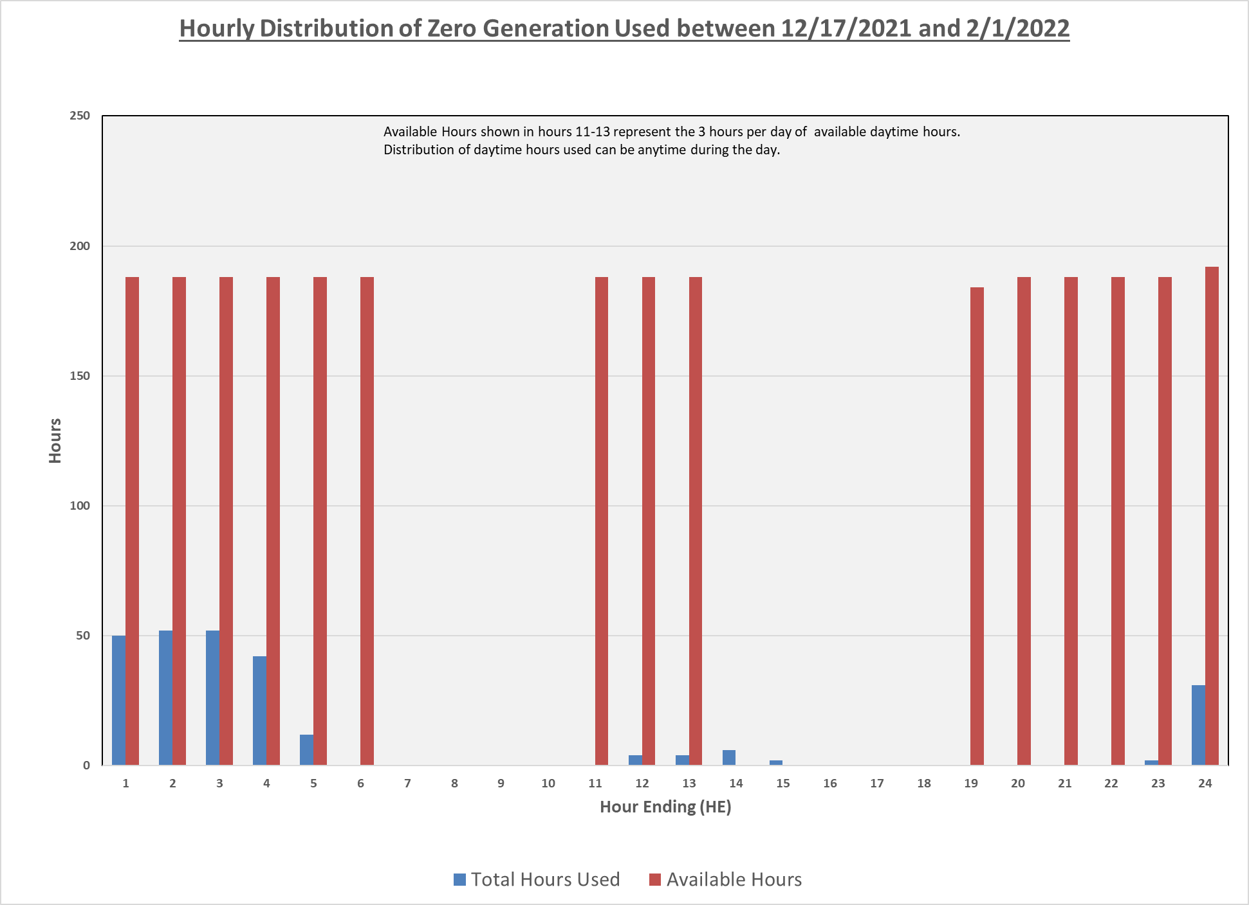

Slide 7
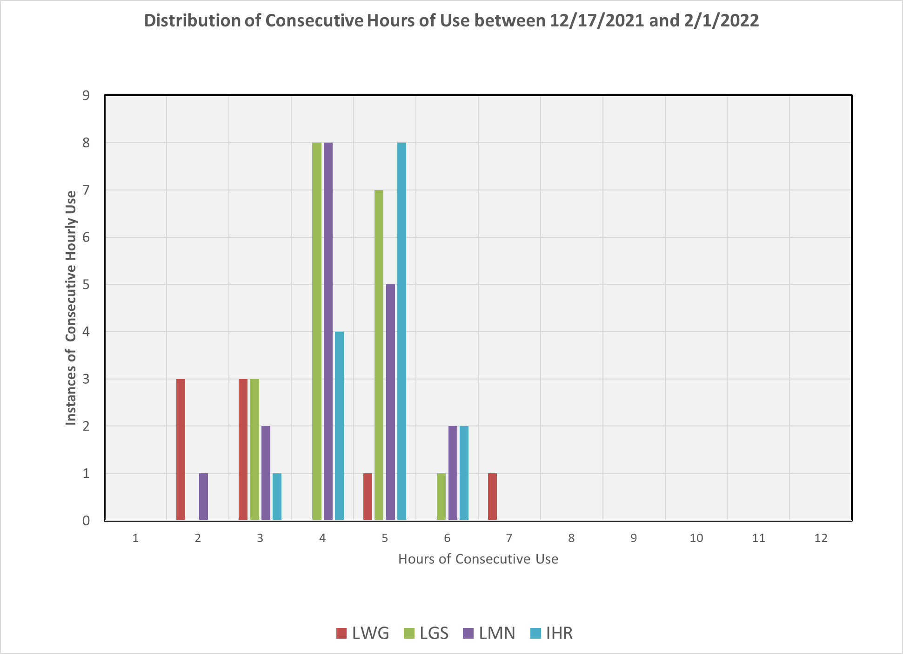

Slide 8
