Slide 1
Smolt Survival and Travel Time & Transportation Analyses
Update with 2021 Data
Northwest Fisheries Science Center
Technical Management Team
2021 Year-End Review
December 1, 2021
Steven G. Smith
steven.g.smith@noaa.gov

Slide 2
Outline – Smolt Survival
Migration conditions, travel time and survival of PIT-tagged smolts through the hydropower system in 2021
  Preliminary Results Memo: October 7, 2021
  Draft report to BPA in prep
    Only those fish left to migrate in-river
    Only juvenile data, not survival to adult

Slide 3
2021 Spring Conditions
  Flow well below average throughout season
  Water temperature above average most of season
  Record high spill percentage
  Travel times
    Slightly shorter than in other recent low-flow years
  Less than 10% transported
  Very low numbers passed dams via juvenile bypass systems
    Low PIT-tag detection probabilities (data quality diminished)
    Low numbers collected for transportation

Slide 4
2021 Spring Survival Estimates
Snake River Yearling Chinook: Near average
Snake River Steelhead: Below average
McNary-to-Bonneville below average for multiple stocks
Generally imprecise because of low detection rates
- some >100%, likely for same reason
Bird-colony PIT-recoveries not used for estimates in this presentation

Slide 5
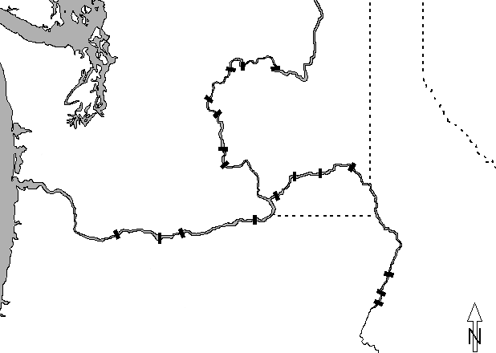


PIT-tag Data Sources
Chief Joseph
Hatchery
Releases
Wells
Grand Coulee
Rocky Reach
Rock Island
Wanapum
Ice Harbor
Priest Rapids
Snake R. trap
PIT-trawl
Bird colonies
PIT barge
etc.
Juvenile detectors
Lower Granite
Little Goose
Lower Monumental
Hatchery &
Trap Releases
McNary
Bonneville
John Day
The Dalles
Hells Canyon
Oxbow
Brownlee
Notes:
Map etc.

Slide 11
Passage Timing at Lower Granite Dam

Slide 17

Yearling
Chinook salmon
reach survival
LGS
LWG
LMO
SRT
IHR
91.5* (90.6)
98.5 (93.4)
BON
TDA
JDA
MCN
2021
83.8*
97.7*
97.0
106.4
79.2
85.6
BON
JDA
MCN
LMO
LGS
LWG
SRT
Mean 02-21
82.4
87.9
87.2
95.7
91.8
91.6
* Bird colony data not available
at time of these calculations
Notes:
Source: for most recent year: Table 25 of Report (Table 16 for LMO-ICE, ICE-MCN)
For average: sgs’s “Clean S” spreadsheet – averages for 2002-2011

Slide 18
Steelhead
reach survival
LGS
LWG
LMO
SRT
IHR
83.9* (88.9)
82.3 (88.2)
BON
TDA
JDA
MCN
2021
70.5*
76.5*
67.7
107.9
108.0
93.0
BON
JDA
MCN
LMO
LGS
LWG
SRT
Mean 02-21
79.7
86.7
78.1
93.4
95.5
96.5
* Bird colony data not available
at time of these calculations
Notes:
Source: for most recent year: Table 25 of Report (Table 16 for LMO-ICE, ICE-MCN)
For average: sgs’s “Clean S” spreadsheet – averages for 2002-2011

Slide 20
Bird colony data not available
at time of these calculations

Slide 21
Bird colony data not available
at time of these calculations

Slide 22
Bird colony data not available
at time of these calculations

Slide 25
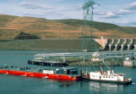

Slide 26
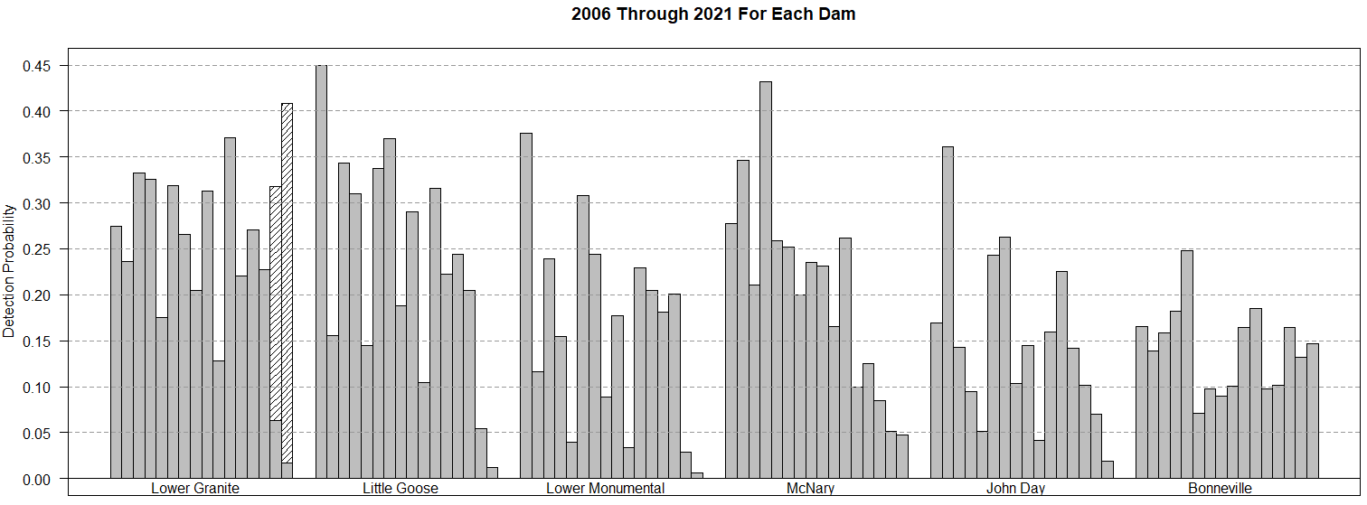
Annual Detection Probabilities
Yearling Chinook

Slide 27
Consequences of (Very) Low
PIT-Tag Detection Rates
Less information means generally lower precision in all estimates
Measures taken for broad-scale estimates
  - Adjustments for finer scales not possible
Lost Resolution
  Subsets of smolts (e.g. wild vs hatchery; LGR spillway-detected vs. bypass-detected)
  Some one-project reaches extremely imprecise
  Temporal resolution is degraded; virtual release groups must be pooled over longer periods
  More difficult to investigate effects of seasonally changing conditions
    “2021 is basically worthless for the COMPASS model” – J. Faulkner

Slide 28
Acknowledgments
Bonneville Power Administration
PTAGIS – Pacific States Marine Fisheries Commission
Avian Predation Detection Project
  Real Time Research -- Astoria-Megler Bridge etc.
  Corps of Engineers Fish Field Units – East Sand Island
DART – University of Washington Columbia Basin Research
NOAA Colleagues: Jim Faulkner, Dan Widener
Legions of Taggers, Coordinators, Agencies, etc.

Slide 29
Smolt Transportation Seasonal Analyses
Yearling Chinook & Steelhead
Data from Migration Years 2016-2019
      Updated with adult returns through Nov 29, 2021
      Added smolt migration year 2019
      Data from LGR, LGS, and LMN

Slide 30
Estimating Patterns of SAR vs. Date
Need a “time-stamp” – date of passage/detection.
Annual summaries today, but time-stamp still necessary.
These analyses use fish that entered JBS at LGR, LGS, or LMN
  tagged upstream of LGR or at LGR
  either transported (T) or bypassed (B or “C1”)
  can adjust “standards” based on observed C0 > C1
  e.g.: if (C0/C1 = 1.1)
  and (T/C1 > 1.1)
  then (T/C0 > 1)

Slide 31
Snake River Conditions
Migration Year | Flow | Spill% | Temperature | Dissolved gas
2016 | Above average (flat) | Average (~30%) | Warm | Average (112-115%)
2017 | Very high | Very high (40-50%) | Average | Very high (118-126%
2018 | High | High (35-55%) | Warm | Above average (116-122%)
2019 | High | Above average (35-45%) | Average; fluctuating | Above average (118-120%)

Slide 32
Annual Summaries

Slide 33
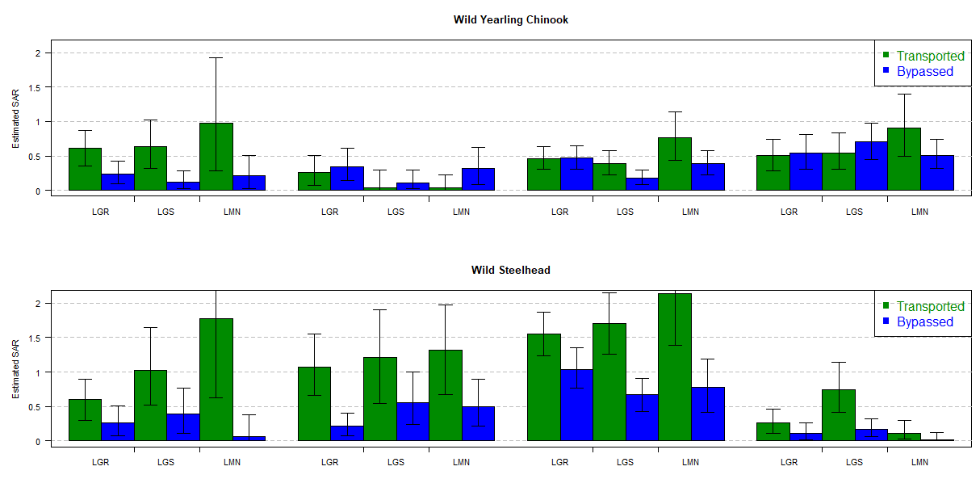
Annual Estimated SARs – Transport Period
2016
2017
2018
2019

Slide 34
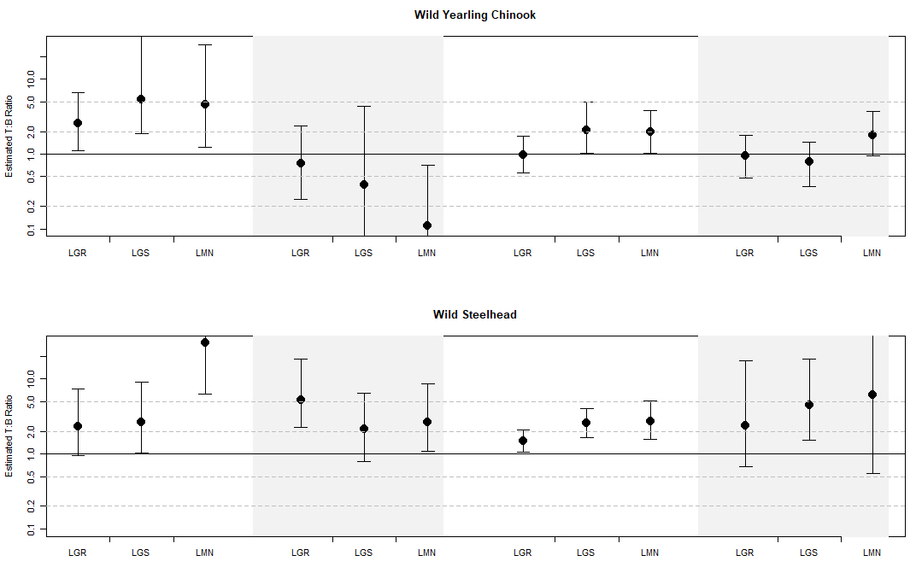
Annual Estimated T:B – Transport Period
2016
2017
2018
2019

Slide 35
Some Seasonal Stuff

Slide 38
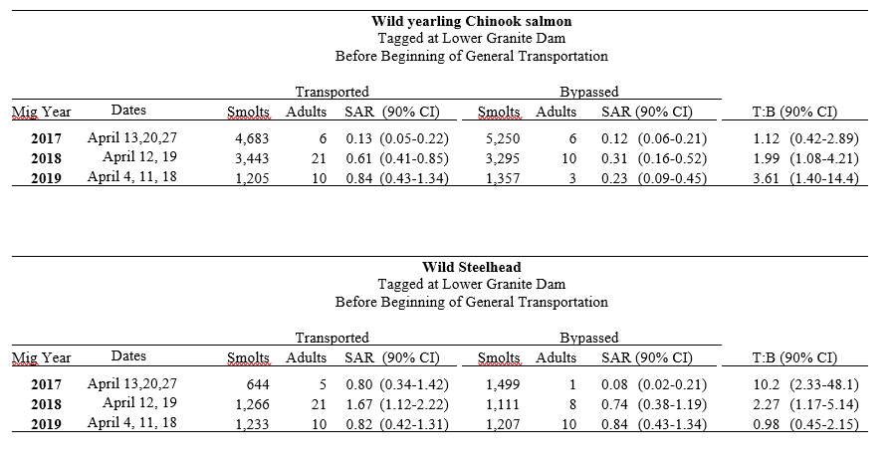
Test Barges Before Beginning of General Transportation

Slide 39
Transportation Highlights
Wild Chinook:
  Bypassed fish: SARs <0.5% for 2016-2018; bit higher for 2019
  T:B < 1 from Lower Granite for 2017-2019
  T:B > 1 for fish passing LGR in early-to-mid April (limited data)
Wild Steelhead:
  Transported fish: SARs > 1.0% for 2016-2018; lower for 2019
  Range of T:B ratios: 2.0-5.0% in almost all cases, including 2019
  T:B > 1 for fish passing LGR in early-to-mid April (2 of 3 years; limited data)

Slide 40
Wild Chinook – Tagged Upstream of LGR
 | Before Transport Began |  | During Transportation Period
 | SAR-Bypass (90% CI) |  | SAR-Transport |  | SAR-Bypass |  | T:B Ratio
2016
LGR | 0.35 (0.26-0.44) |  | 0.61 (0.35-0.87) |  | 0.24 (0.10-0.42) |  | 2.57 (1.12-6.57)
LGS | 0.31 (0.22-0.40) |  | 0.63 (0.32-1.02) |  | 0.12 (0.02-0.28) |  | 5.30 (1.86-37.4)
LMN | 0.38 (0.25-0.52) |  | 0.98 (0.28-1.92) |  | 0.21 (0.03-0.51) |  | 4.59 (1.25-28.8)
2017
LGR | 0.18 (0.10-0.26) |  | 0.26 (0.07-0.51) |  | 0.34 (0.14-0.61) |  | 0.75 (0.25-2.38)
LGS | 0.17 (0.11-0.25) |  | 0.04 (0.00-0.29) |  | 0.11 (0.03-0.30) |  | 0.39 (0.00-4.38)
LMN | 0.15 (0.08-0.23) |  | 0.04 (0.00-0.23) |  | 0.32 (0.09-0.62) |  | 0.11 (0.00-0.71)
2018
LGR | 0.57 (0.39-0.77) |  | 0.46 (0.31-0.64) |  | 0.47 (0.31-0.65) |  | 0.98 (0.56-1.73)
LGS | 0.40 (0.26-0.56) |  | 0.39 (0.23-0.58) |  | 0.18 (0.09-0.30) |  | 2.10 (1.02-4.95)
LMN | 0.47 (0.28-0.71) |  | 0.76 (0.44-1.14) |  | 0.39 (0.23-0.58) |  | 1.97 (1.02-3.82)
2019
LGR | 0.48 (0.27-0.74) |  | 0.51 (0.28-0.74) |  | 0.54 (0.31-0.81) |  | 0.94 (0.48-1.78)
LGS | 0.77 (0.48-1.12) |  | 0.54 (0.31-0.84) |  | 0.70 (0.45-0.98) |  | 0.78 (0.37-1.45)
LMN | 0.96 (0.56-1.44) |  | 0.91 (0.50-1.41) |  | 0.51 (0.32-0.74) |  | 1.79 (0.94-3.67)

Slide 41
Wild Steelhead – Tagged Upstream of LGR
 | Before Transport Began |  | During Transportation Period
 | SAR-Bypass (90% CI) |  | SAR-Transport |  | SAR-Bypass |  | T:B Ratio
2016
LGR | 0.73 (0.49-1.01) |  | 0.60 (0.30-0.89) |  | 0.26 (0.07-0.51) |  | 2.31 (0.95-7.33)
LGS | 0.55 (0.36-0.78) |  | 1.02 (0.52-1.64) |  | 0.39 (0.11-0.76) |  | 2.62 (1.02-9.23)
LMN | 0.55 (0.28-0.88) |  | 1.77 (0.62-3.21) |  | 0.06 (0.00-0.38) |  | 30.7 (6.26-Inf )
2017
LGR | 0.67 (0.30-1.03) |  | 1.07 (0.66-1.55) |  | 0.21 (0.08-0.40) |  | 5.21 (2.24-18.6)
LGS | 0.18 (0.02-0.36) |  | 1.21 (0.54-1.90) |  | 0.56 (0.24-1.00) |  | 2.15 (0.80-6.53)
LMN | 0.13 (0.04-0.34) |  | 1.32 (0.67-1.97) |  | 0.50 (0.21-0.89) |  | 2.64 (1.08-8.73)
2018
LGR | 1.01 (0.36-1.67) |  | 1.55 (1.23-1.87) |  | 1.04 (0.77-1.35) |  | 1.48 (1.06-2.11)
LGS | 0.72 (0.30-1.27) |  | 1.70 (1.26-2.15) |  | 0.67 (0.43-0.91) |  | 2.56 (1.65-4.00)
LMN | 0.76 (0.28-1.48) |  | 2.14 (1.39-2.98) |  | 0.78 (0.42-1.19) |  | 2.75 (1.55-5.10)
2019
LGR | 0.40 (0.17-0.72) |  | 0.26 (0.11-0.46) |  | 0.11 (0.02-0.26) |  | 2.37 (0.68-17.8)
LGS | 0.26 (0.04-0.62) |  | 0.74 (0.42-1.14) |  | 0.17 (0.06-0.32) |  | 4.45 (1.54-18.4)
LMN | 0.30 (0.05-0.70) |  | 0.11 (0.03-0.30) |  | 0.02 (0.00-1.12) |  | 6.22 (0.55-Inf )

Slide 42
Acknowledgments
U.S. Army Corps of Engineers
PTAGIS – Pacific States Marine Fisheries Commission
Legions of Taggers, Coordinators, Agencies, etc.

Slide 43
Spillway PIT Detection at Lower Granite Dam
Differences in fish using spillway vs. juvenile bypass system
Increase number of detections at Lower Granite Dam
  Larger sample sizes for estimation of survival and SAR beginning at LGR
  Increased precision of survival estimates
  Compare SAR and survival between LGR passage routes
Time-stamp on non-bypassed fish (at Lower Granite Dam)
  - CJS estimates may allow estimates of daily numbers of C₀ fish

Slide 44
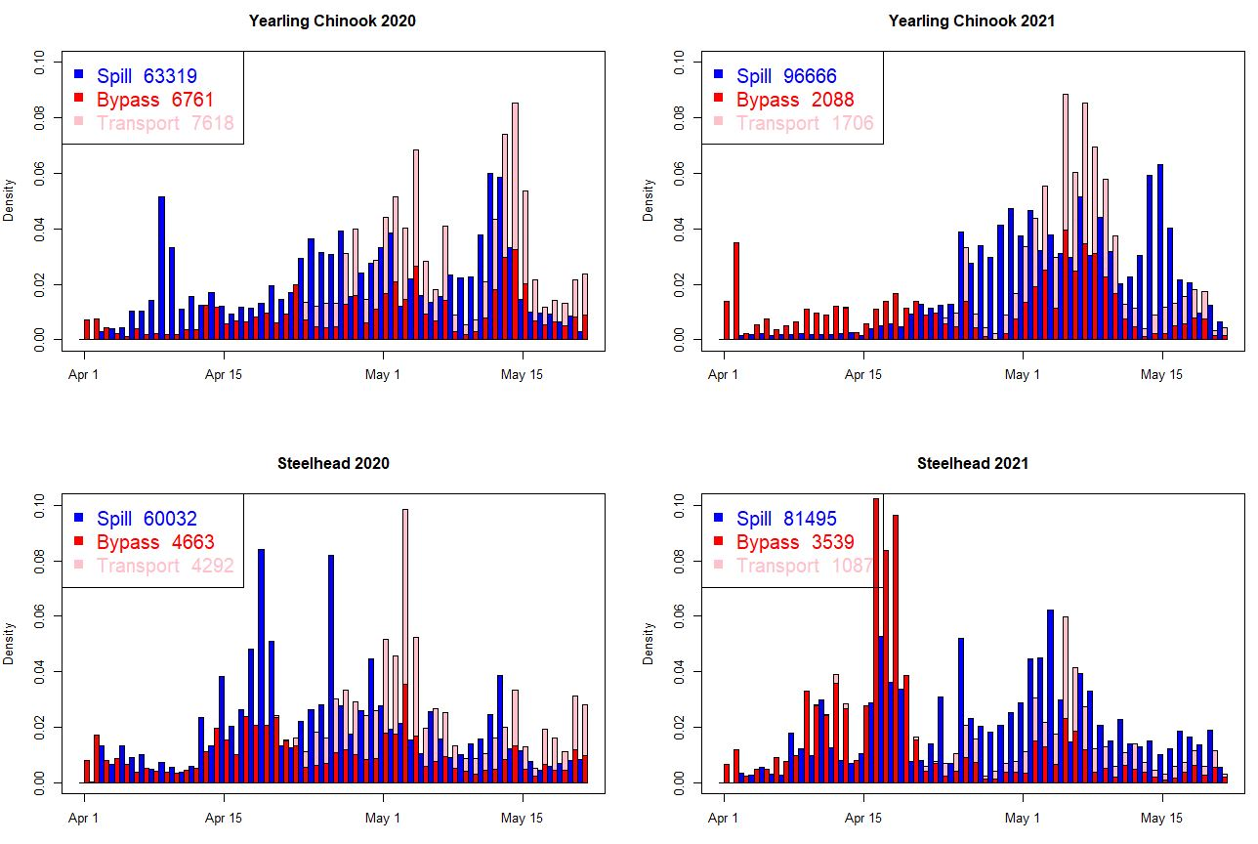

Slide 45
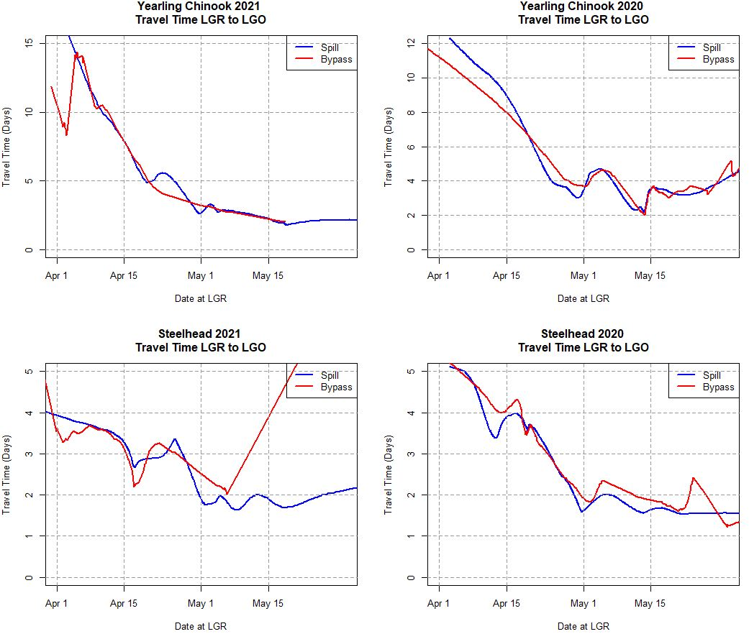

Slide 46
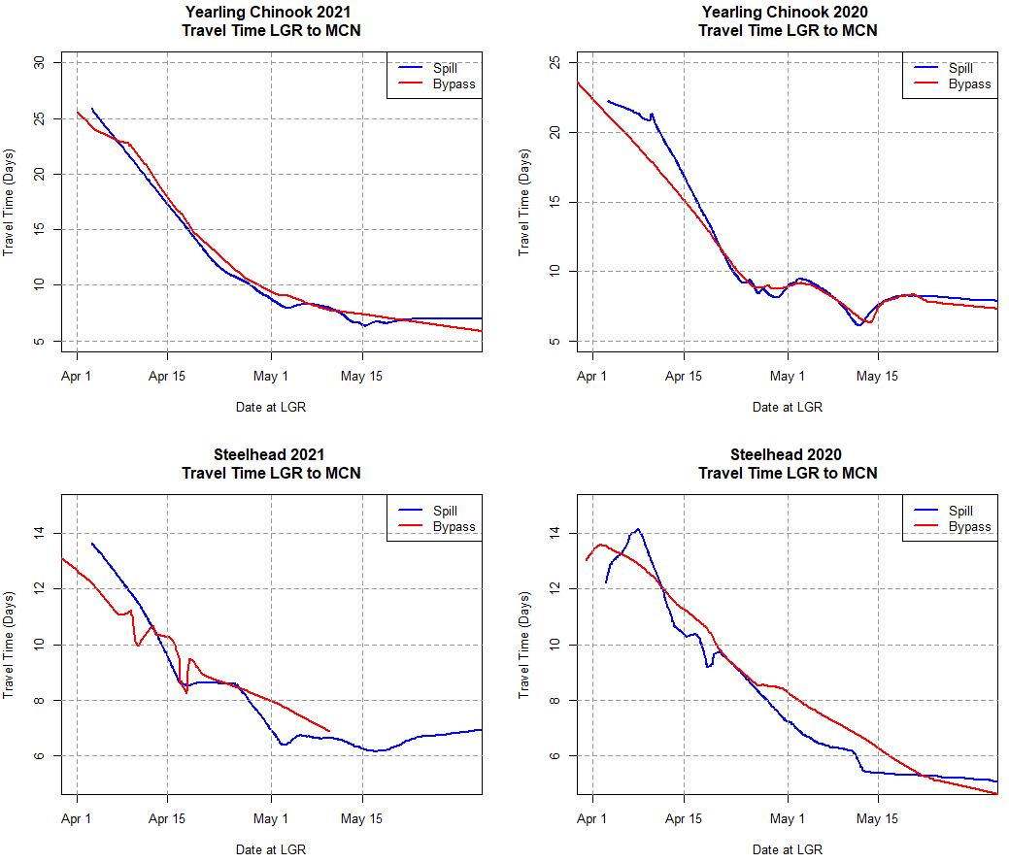

Slide 47
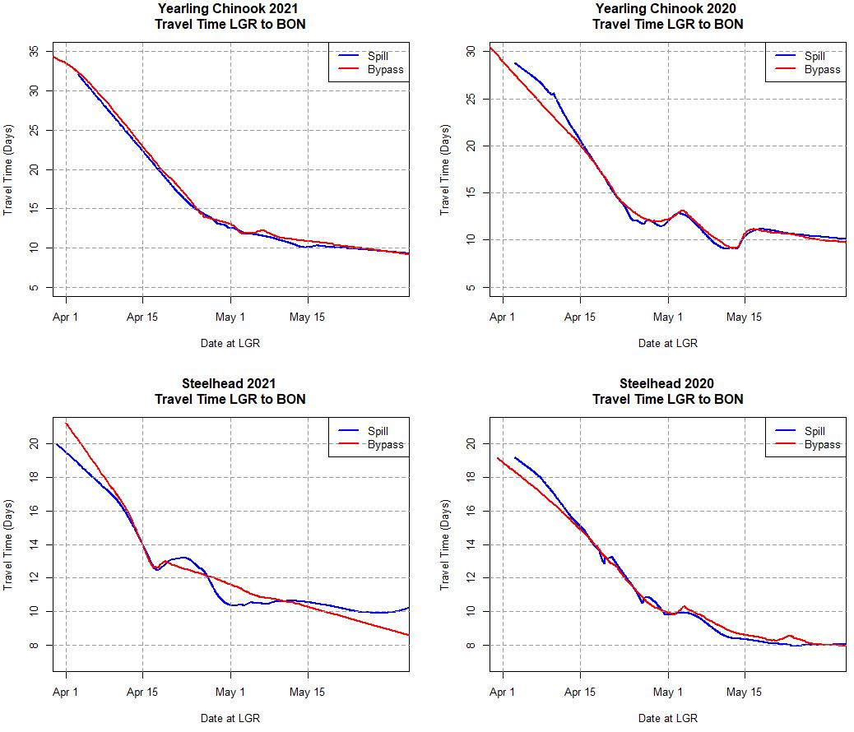

Slide 48
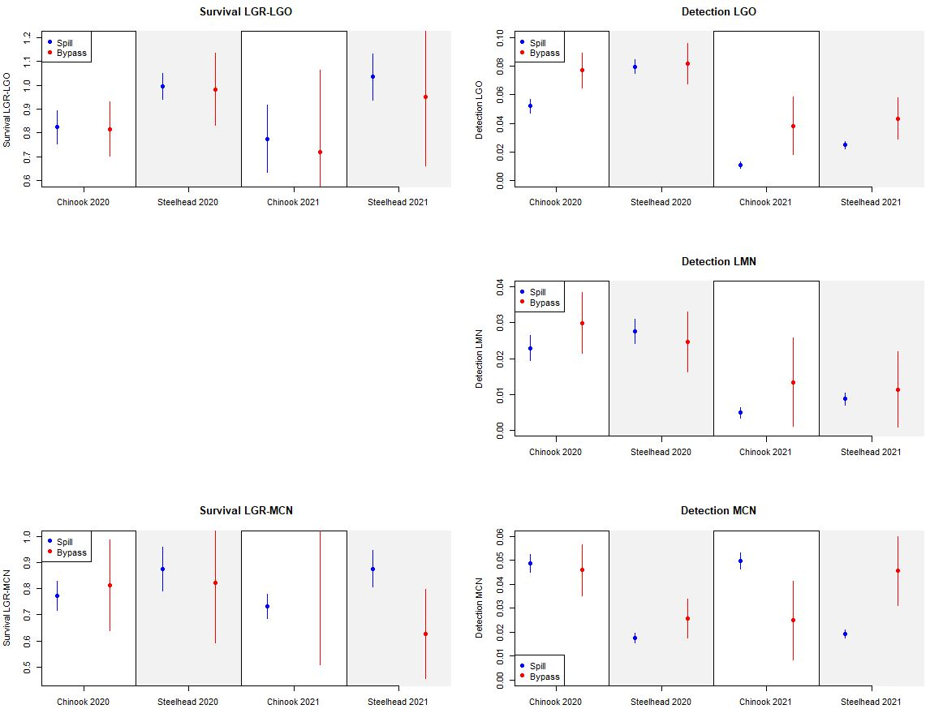
Note: data pooled across full year.
No control for LGR passage timing.

Slide 49
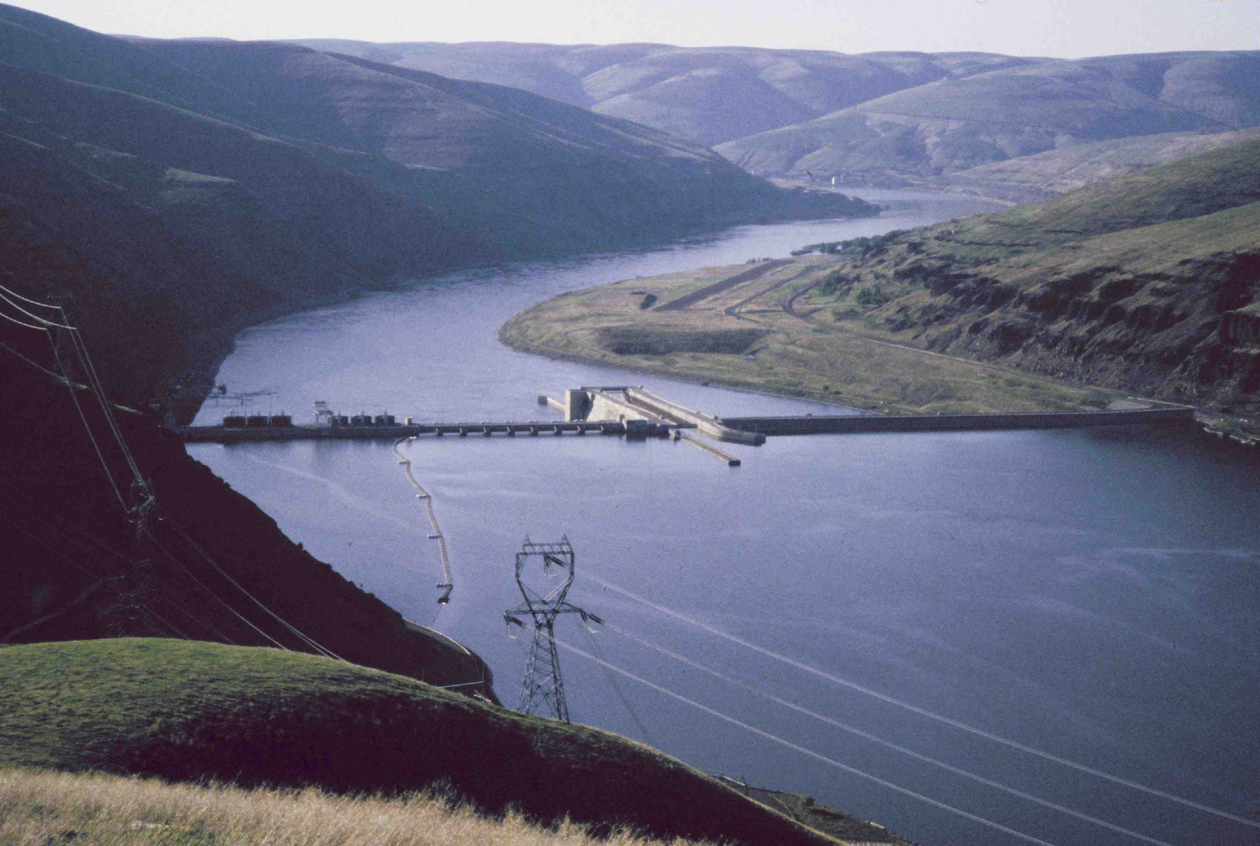
Questions

