Slide 1

Smolt Survival and Travel Time & Transportation Analyses
Update with 2017 Data
Northwest Fisheries Science Center
Technical Management Team
2017 Year-End Review
Steven G. Smith
December 12, 2017

Slide 2
Outline
Migration conditions, travel time and survival of PIT-tagged smolts through the hydropower system in 2017
  September 18 Memo; Draft report to BPA in prep
    Only those fish left to migrate in-river
    Only juvenile data, not survival to adult

Slide 3
2017 Spring Conditions
  High flow, especially in early season
  High spill percentage
  Water warmer than average (0-1º C throughout)
  Shorter than average travel times
    Shorter than low-flow 2015 and similar to average-flow 2016
  Small percentage (<25%) transported

Slide 4
2017 Spring Survival
Chinook survival from hatchery to LGR near average 65%
Reach-by-reach mix of higher and lower than average
Overall hydrosystem survival below average (~6%) for 3rd or 4th consecutive year
Deficit in lower Columbia for both species
  (some data concerns)

Slide 5
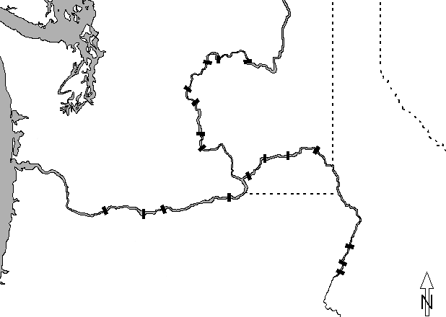


PIT-tag Data Sources
Chief Joseph
Hatchery
Releases
Wells
Grand Coulee
Rocky Reach
Rock Island
Wanapum
Ice Harbor
Priest Rapids
Snake R. trap
Juvenile detectors
Lower Granite
Little Goose
Hatchery &
Trap Releases
PIT tag
trawl
Lower Monumental
McNary
Bonneville
John Day
The Dalles
Hells Canyon
Oxbow
Brownlee
Notes:
Map etc.

Slide 16

Yearling
Chinook salmon
reach survival
LGS
LWG
LMO
SRT
IHR
93.4 (90.8)
95.5 (93.4)
BON
TDA
JDA
MCN
2017
87.2
72.0
91.2
90.8
91.6
NA
BON
JDA
MCN
LMO
LGS
LWG
SRT
Mean 02-17
82.7
87.2
87.2
94.0
93.3
93.6
Notes:
Source: for most recent year: Table 25 of Report (Table 16 for LMO-ICE, ICE-MCN)
For average: sgs’s “Clean S” spreadsheet – averages for 2002-2011

Slide 17
Steelhead
reach survival
LGS
LWG
LMO
SRT
IHR
80.2 (89.1)
92.1 (88.3)
BON
TDA
JDA
MCN
2017
64.3
94.1
84.9
94.3
96.2
NA
BON
JDA
MCN
LMO
LGS
LWG
SRT
Mean 02-17
80.0
85.7
78.3
91.6
94.4
97.0
Notes:
Source: for most recent year: Table 25 of Report (Table 16 for LMO-ICE, ICE-MCN)
For average: sgs’s “Clean S” spreadsheet – averages for 2002-2011

Slide 22
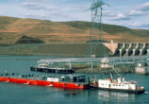

Slide 25
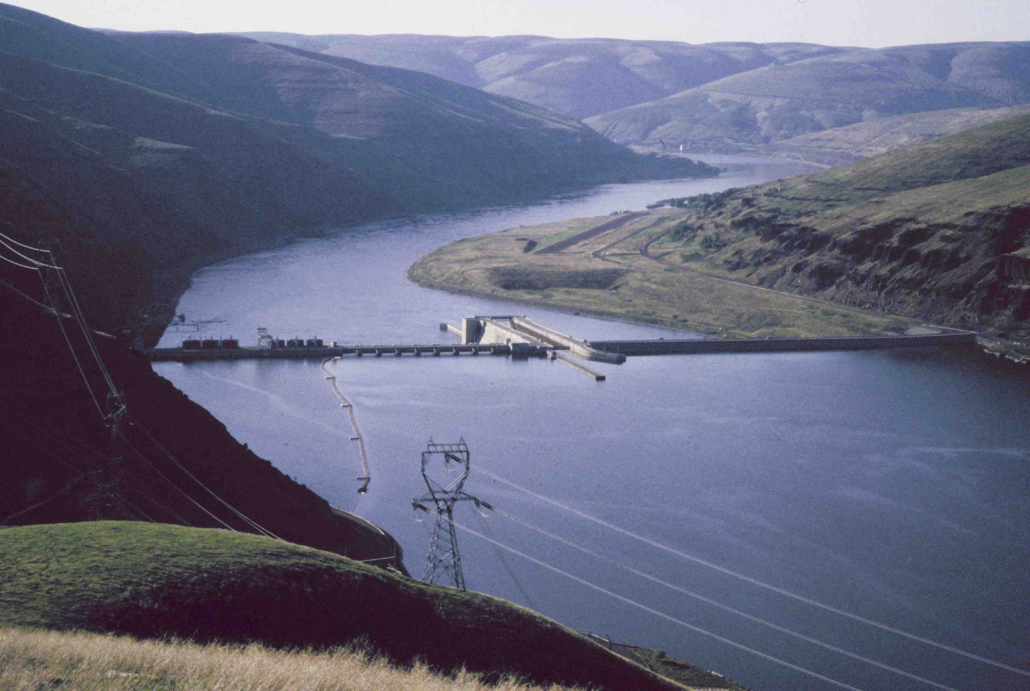
Questions

Slide 26
Smolt Transportation Seasonal Analyses
Yearling Chinook & Steelhead
Migration Years 2013-2015
      Updated with adult returns through Nov 21, 2017
      Added smolt migration year 2015
      SAR and T:B data LGR, LGS, and LMN
      “Adult currency” for all three dams, MY 2006-2015

Slide 27
Estimating Patterns of SAR vs. Date
Need a “time-stamp” – date of passage/detection
These analyses use fish that entered JBS at Lower Granite Dam
  tagged upstream or at the dam
  either transported (T) or bypassed (B or “C1”)
  can adjust “standards” based on observed C0 > C1

Slide 28
Summary / Conclusions
2013: Not much benefit for wild Chinook at any dam;
    Benefit for Steelhead at all 3 dams
2014: T:B ratio > 4 for wild Chinook at LGR, lower elsewhere
    T:B ratio between 2 and 3 for Steelhead at all 3 dams
2015: SAR ~ 1.0% for transp. wild Chinook;
    near 0% for wild Chinook bypassed in May
Poor data for wild Steelhead

Slide 29
Summary / Conclusions
Results tend to be similar for Lower Granite and Little Goose Dams
  About 75-80% of transported fish
Lower Monumental: fewer fish transported, less PIT-tag data,
  lower T:B ratios (often ~ 1.0)

Slide 30
Summary / Conclusions
Less seasonality in T:B ratios in recent years (lines flatter)
More fish migrating in April in recent years
  - More than 10 years since we last gathered substantial transport data from April-migrating fish

Slide 31
A Note on Zero Adult Counts
“If nothing goes right, is everything all wrong?”
Median Unbiased Estimator of Binomial Probability
  10 trials, no successes: MUE = 3.35%
  100 trials, no successes: MUE = 0.345%
  1000 trials, no successes: MUE = 0.0345%
10,000 trials, no successes: MUE = 0.00347%

Slide 32
2013

Slide 39
2014

Slide 46
2015

Slide 50
Lower Granite Dam
Totals for May 1 – June 4, 2015
Wild Chinook |  |  |  |  |  | Wild Steelhead
 | Juv | Adt | SAR | CI |  | Juve | Adt | SAR | CI
Transport | 680 | 8 | 1.20 | 0.47-2.08 |  | 748 | 1 | 0.16 | 0.05-0.56
Bypassed | 873 | 0 | 0.04 | 0.00-0.34 |  | 580 | 1 | 0.20 | 0.06-0.72
T:B Ratio |  |  | 30.3 | 4.5 – 48.8 |  | T:B Ratio |  | 0.78 | 0.08-7.10

Slide 51
Little Goose Dam
Totals for May 1 – June 4, 2015
Wild Chinook |  |  |  |  |  | Wild Steelhead
 | Juv | Adt | SAR | CI |  | Juve | Adt | SAR | CI
Transport | 829 | 9 | 1.11 | 0.50-1.83 |  | 755 | 1 | 0.16 | 0.05-0.55
Bypassed | 2110 | 1 | 0.06 | 0.02-0.20 |  | 801 | 1 | 0.15 | 0.04-0.52
T:B Ratio |  |  | 19.7 | 4.9-104.0 |  | T:B Ratio |  | 1.06 | 0.12-9.71

Slide 52
Lower Monumental Dam
Totals for May 1 – June 4, 2015
Wild Chinook |  |  |  |  |  | Wild Steelhead
 | Juv | Adt | SAR | CI |  | Juve | Adt | SAR | CI
Transport | 333 | 0 | 0.10 | 0-0.90 |  | 224 | 0 | 0.15 | 0-1.34
Bypassed | 758 | 0 | 0.05 | 0-0.40 |  | 190 | 0 | 0.18 | 0-1.58
T:B Ratio |  |  | NA | NA |  | T:B Ratio |  | NA | NA

Slide 53
“Adult Currency”
What do all these percentages and ratios of percentages mean
in terms of numbers of returning adults?

Slide 54
Data Sources for “Adult Currency”
Smolt Monitoring Program – “Collection Count”
  Estimate of the number of fish (tagged + untagged) in the JBS
  (Wild and hatchery steelhead not counted separately)
Daily detection probability estimates from PIT tags
  - Estimate of the proportion of all passing fish that entered JBS
Model-Averaged estimates of SARs for transported and bypassed

Slide 55
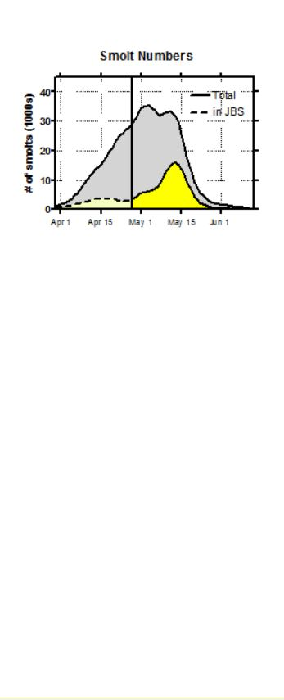
Total arrived at LGR = 1.12 million
Total entered JBS during transport ops = 234,000

Slide 56
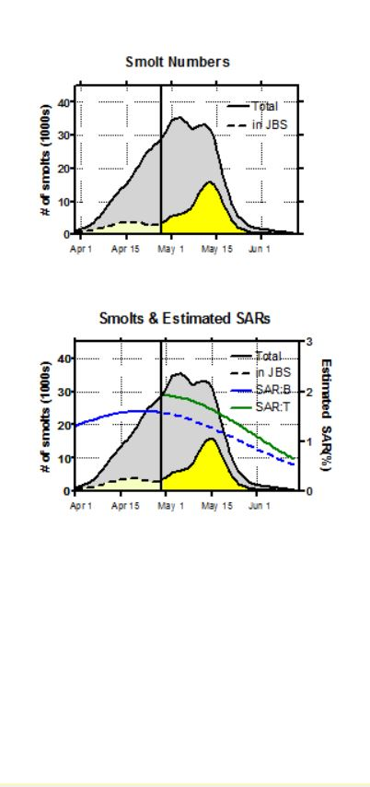
Total arrived at LGR = 1.12 million
Total entered JBS during transport ops = 234,000

Slide 57
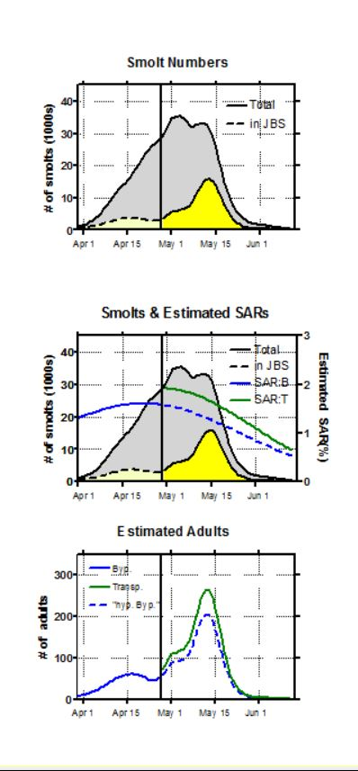
Total arrived at LGR = 1.12 million
Total entered JBS during transport ops = 234,000
Total adults from bypassed smolts in April = 1,170
Total adults from transported smolts in May = 3,985
“Hypothetical” adults if smolts in JBS in May
had been bypassed = 3,105

Slide 58
“Adult Currency” – Transported vs. Bypassed
Assumptions
  Bypass percentages and SARs estimated from PIT-tagged fish apply to untagged fish
  Spill levels and Transportation start date stay the same (not trying to model these!)
  SARs during transport period would not change with different mixture of transported and bypassed fish
  15% of total steelhead passage is wild
  Everything estimated with no error
  (i.e., haven’t yet done the work to characterize error in estimation)

Slide 59
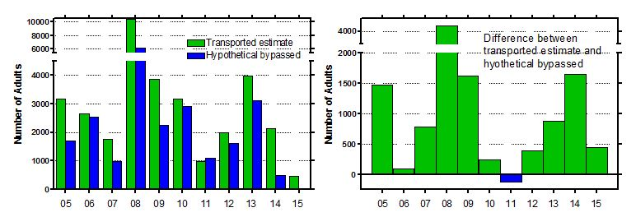
“Adult Currency” – Transported vs. Bypassed
Wild Chinook – Lower Granite Dam
Mean difference for LGR = 1019

Slide 60
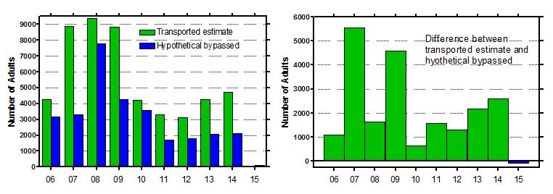
“Adult Currency” – Transported vs. Bypassed
Wild Steelhead – Lower Granite Dam
Mean difference for LGR = 2,221

Slide 61
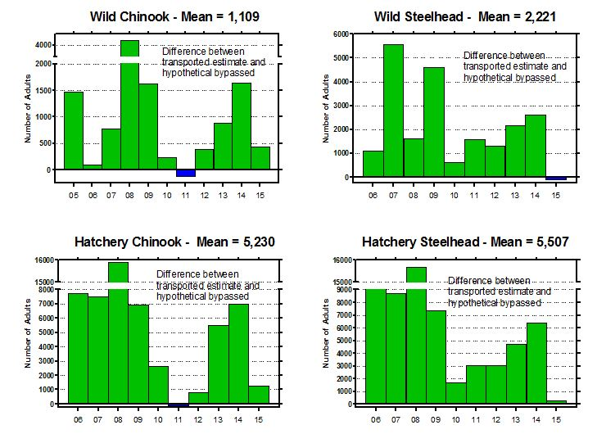
“Adult Currency” – Transported vs. Bypassed
Lower Granite Dam

Slide 62
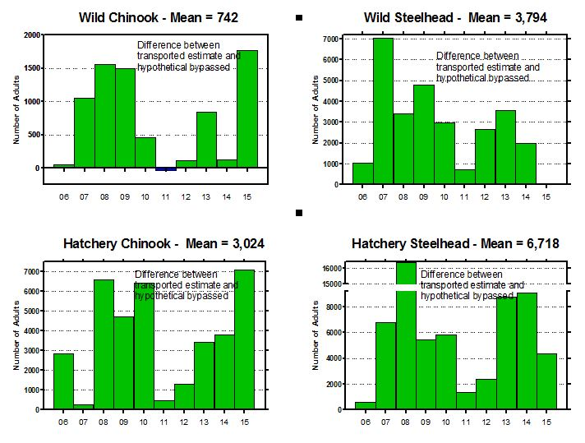
“Adult Currency” – Transported vs. Bypassed
Little Goose Dam

Slide 63
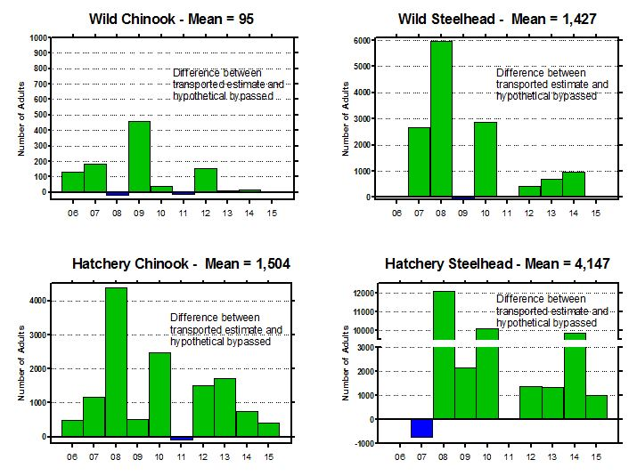
“Adult Currency” – Transported vs. Bypassed
Lower Monumental Dam

Slide 64
“Adult Currency” – Transported vs. Bypassed
2006-2015 Mean difference between transported estimate and hypothetical bypassed
Species x Rear Type | Lower Granite | Little Goose | Lower Moumental
Wild Chinook | 1,019 | 742 | 95
Wild Steelhead | 2,221 | 3,794 | 1,427
Hatchery Chinook | 5,230 | 3,024 | 1,504
Hatchery Steelhead | 5,507 | 6,718 | 4,147

Slide 65
Questions

Slide 66
Smolt Transportation Seasonal Analyses
Subyearling Fall Chinook Salmon
Study in Migration Years 2006, 2008-2012
      Adults complete except for handful of 5-oceans expected in 2017

Slide 67
Types of fall Chinook salmon
Natural
  - Not enough of these to conduct a transportation evaluation
Hatchery production subyearlings
Hatchery production yearlings
  Released in early April, pass dams before spring transportation program begins.
Hatchery-reared surrogates for natural fish
  Lyons Ferry fish specially reared at Irrigon and Dworshak NFH etc.

Slide 68
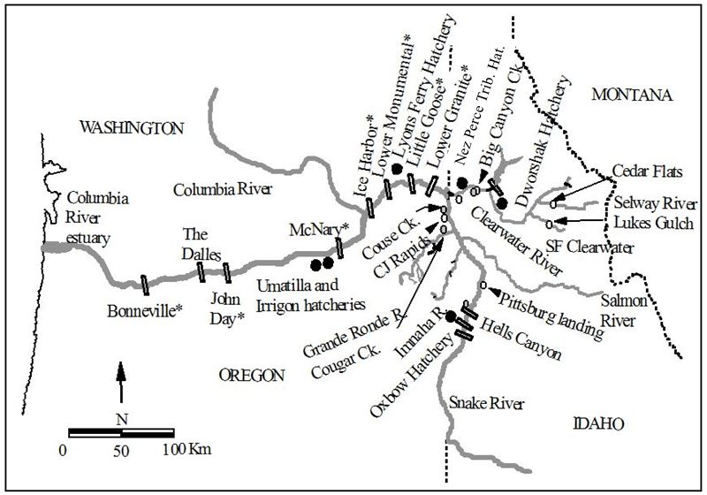

Slide 72
Summary of T:B analyses by dam – Fall Chinook
Seasonal tendencies for surrogate subyearling fall Chinook:
  Migrate throughout summer and into fall and winter (esp. Clearwater releases)
  SAR for bypassed fish increases from earliest to latest
  SAR for Transported fish also increases, but has a peak around September 1
  Early-arriving minority have higher SAR if Bypassed, all others if Transported
  Switch occurs early-to-mid July

Slide 76
Summary of T:B analyses by dam – Fall Chinook
Seasonal tendencies for production subyearling fall Chinook:
  Migrate mostly in June, a minority into July
  Late-arriving minority have higher SAR if Transported, all others if Bypassed
  Switch occurs mid-to-late June

Slide 77
Questions

