Slide 1
Dworshak Hatchery
Impacts from elevated TDG
Spring 2017
Acknowledgements
Dworshak National Fish Hatchery: Steve Rodgers, Mark Drobish, Doug Nemeth, Adam Izbicki
Nez Perce Tribe: Becky Johnson, Mike Tuell
Dworshak Fish Health Center: Marilyn Blair (Guppy), Laura Sprague, Corie Samson
Corps of Engineers: Steve Hall, Darren Pecora, Russel Heaton

Slide 2
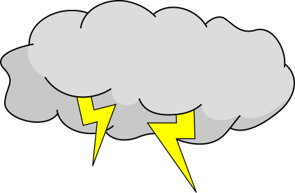
2017…The Perfect Storm
Dworshak Dam
  Three turbines for power generation
    Turbine 1 and 2 combined 5 kcfs capacity
    Turbine 3 is 5 kcfs capacity
  No or limited gas entrainment through turbines
Unusual winter
  Heavy snowpack – spill required
  Wet spring with lots of rain – spill required
Repair of Turbine 3 in 2016-17
  Unit 3 offline for repair – spill required
  Delays by contractor into spring of 2017

Slide 3
2017 Conditions
Turbine 3 at Dworshak Dam down for maintenance
High amount of late season precipitation
Increased spill from Dworshak Dam
Gas supersaturation in the North Fork Clearwater River and Dworshak NFH
Gas bubbles in hatchery fish

Slide 4
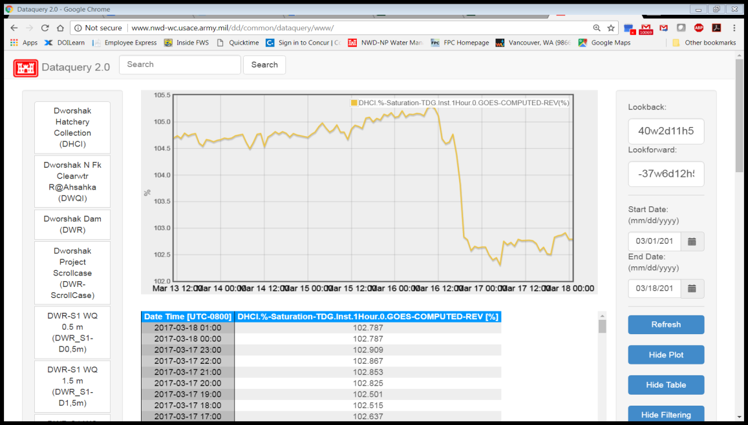
Monitoring
-New TDG meters in hatchery provided by CoE
-real time, online reporting
-Daily fish health reports on GBT by Fish Health Staff -10 fish/species
-gills, fins, lateral lines, stomach contents

Slide 5
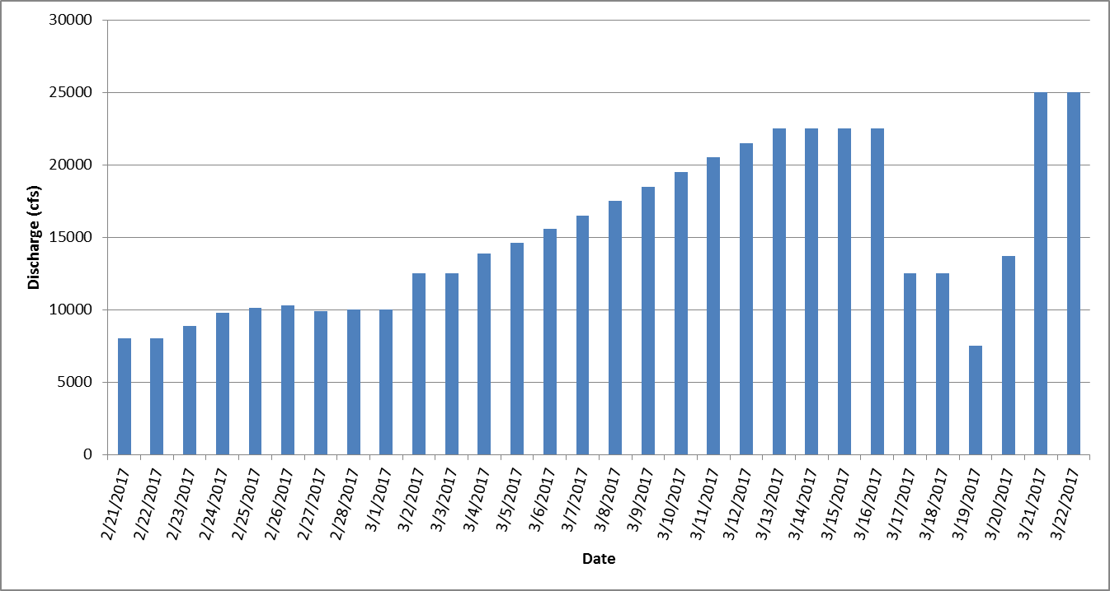
Discharge from Dworshak Dam
Spring Chinook release

Slide 6
Percent TDG in North Fork Clearwater River Relative to Discharge

Slide 7
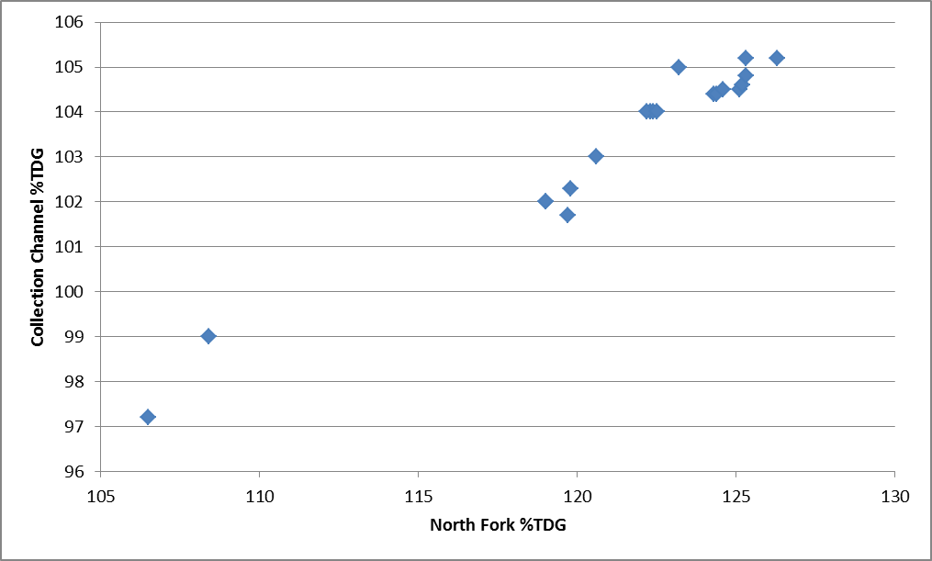
Percent TDG in Collection Channel Relative to % TDG in River

Slide 8
%TDG in River vs. in Hatchery
Comparison of %TDG in North Fork Clearwater R. and the collection channel after degassing of spill from Dworshak Dam from 3/2/2017 to 3/21/2017

Slide 9
%TDG in River vs. Collection Channel vs. System 1
%TDG in North Fork Clearwater R., the collection channel at Dworshak NFH, and a burrows pond in system 1 at Dworshak NFH compared to the discharge from Dworshak Dam from 3/2/2017 to 4/17/2017 on sampled days.

Slide 10
Vacuum Degassing Effectiveness
TDG reduction (raw) after degassing at Dworshak NFH from 3/2/2017 to 3/21/2017

Slide 11
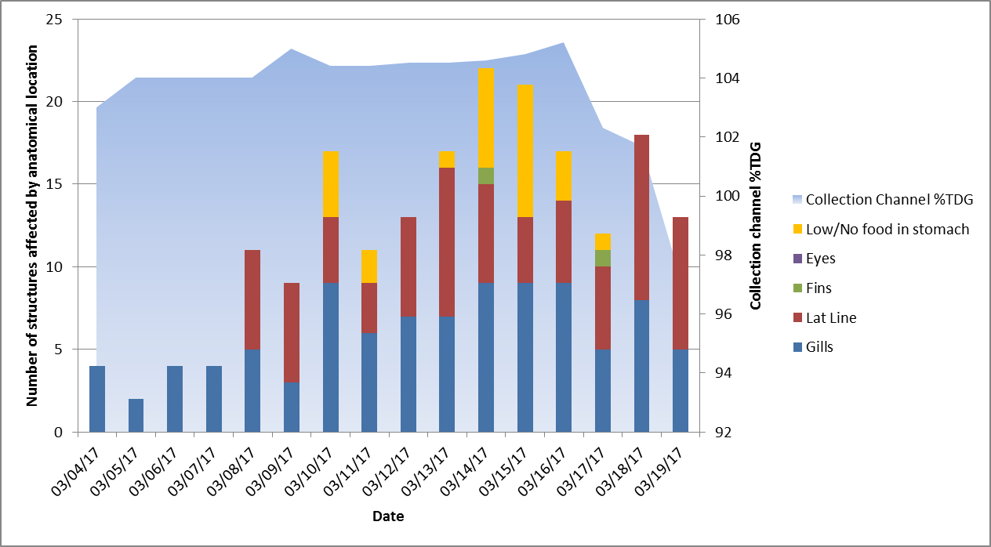
Spring Chinook - Raceways
GB signs relative to %TDG in collection channel, anatomical structure, and time of exposure
Notes:
Number of fish sampled and exhibiting gas bubbles by anatomical location. 10 fish sampled x 5 structures examined (gills, eyes, fins, lat line, stomach) = 50 maximum potential points.

Slide 12
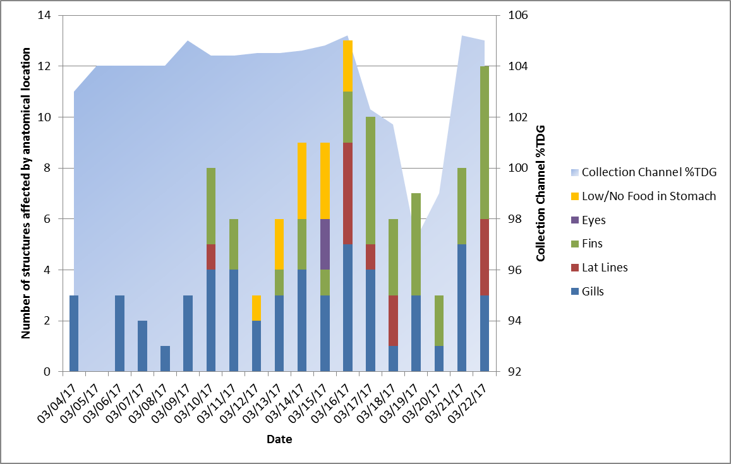
Steelhead - Systems 2 & 3
GB signs relative to % TDG in collection channel, anatomical structure, and time of exposure

Slide 13
Changes to Releases
Early on-site release of 1.6 M spring Chinook on March 20th into mainstem Clearwater during negotiated low spill window
Early (~1 month) on-site and off-site release of some (~300K) steelhead on March 22-24th
Moved remaining steelhead (~1.1 M)into System 1 at same time, and added more reservoir water from Clearwater Fish Hatchery
On-site release of remaining steelhead on April 17th
Notes:
Some upriver stt releases were moved to on-site at DNFH to maximize returns to the hatchery

Slide 14
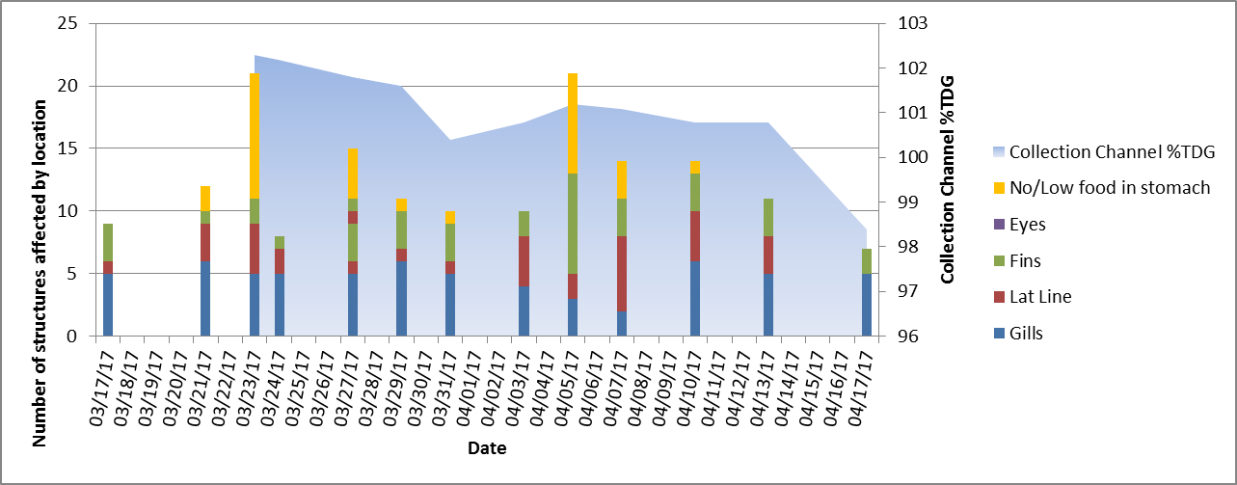
Steelhead - System 1
20%
40%
53%
GB signs relative to % TDG in system 1, anatomical feature, and time of exposure and at different reservoir/river water blends

Slide 15
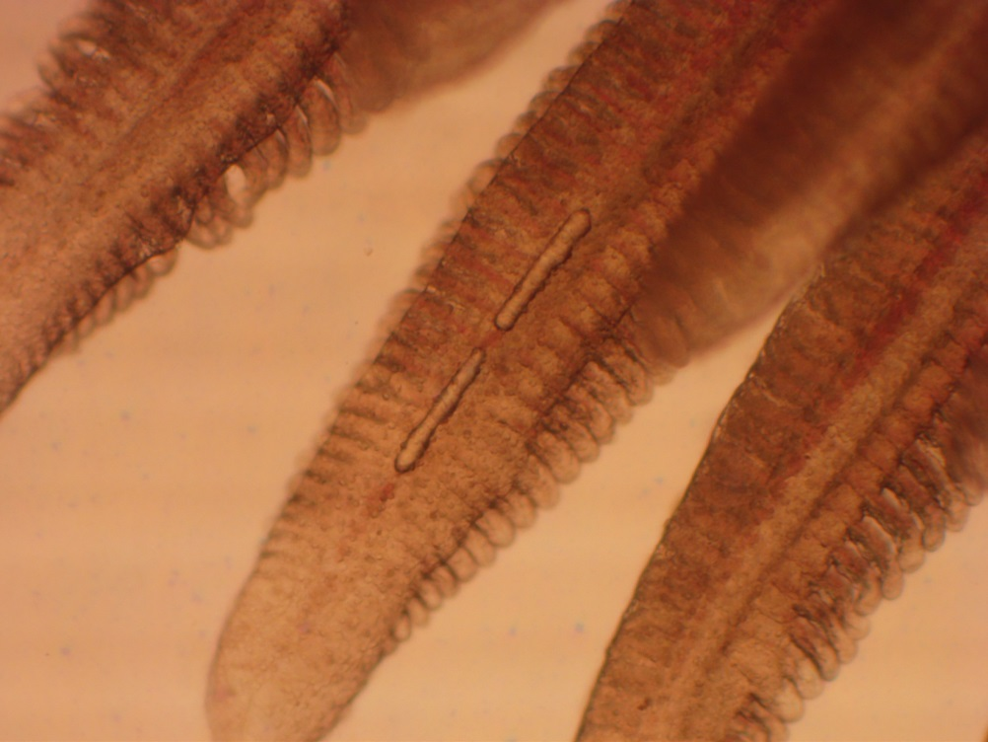
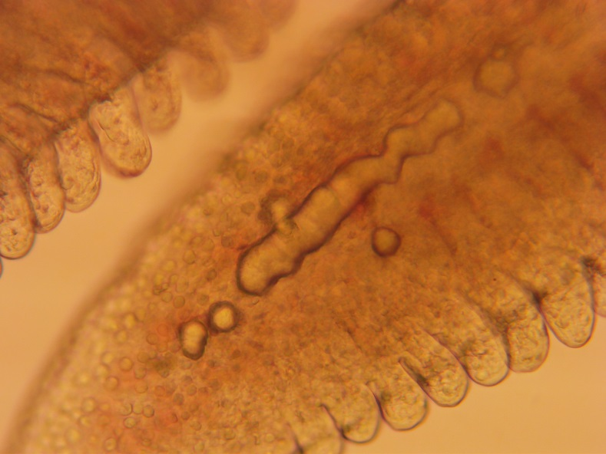
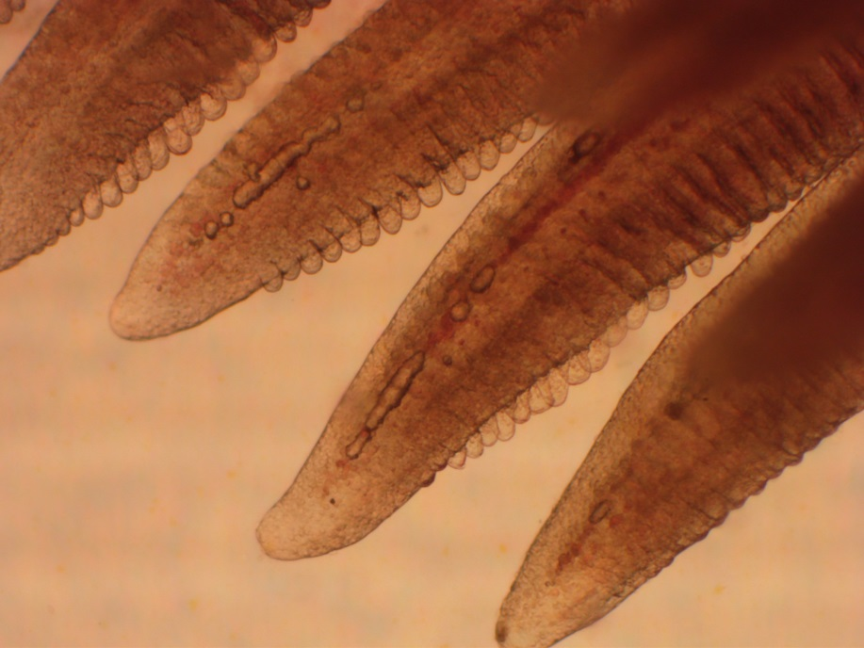
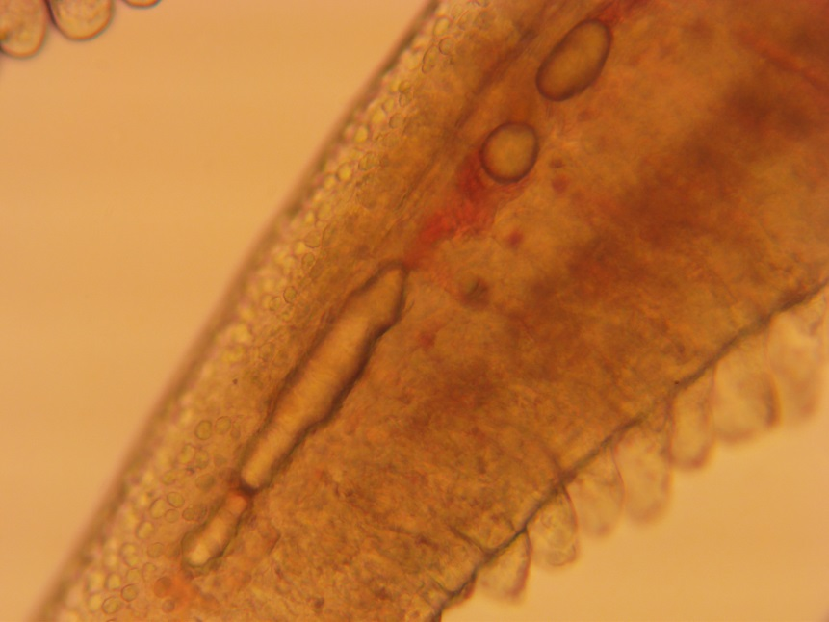
Gills

Slide 16
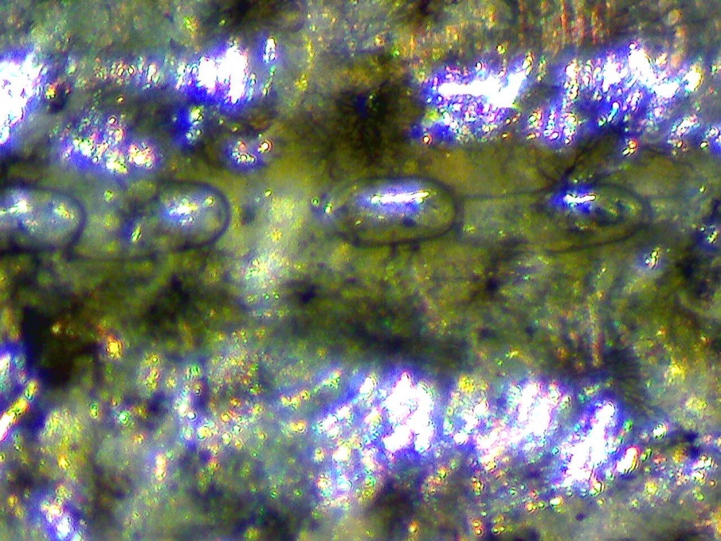
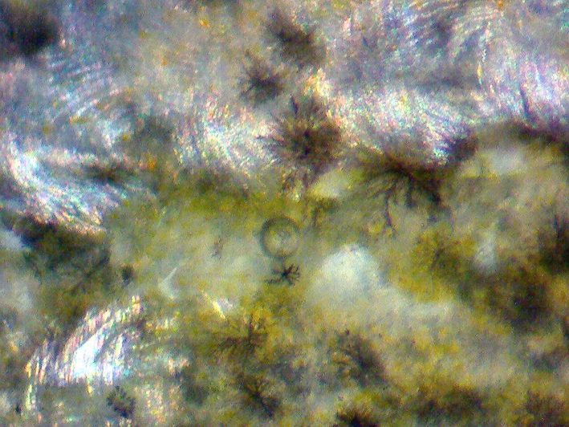
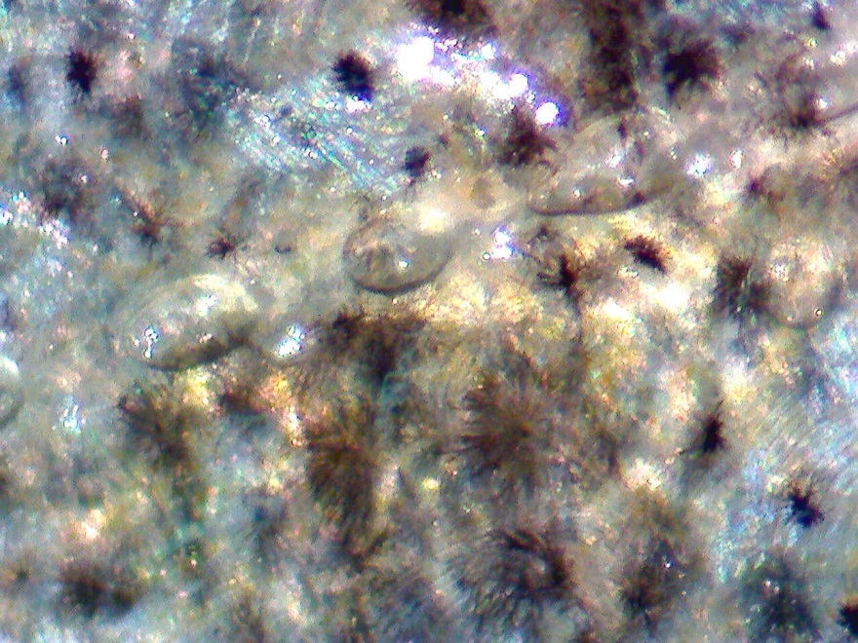
Lateral lines

Slide 17
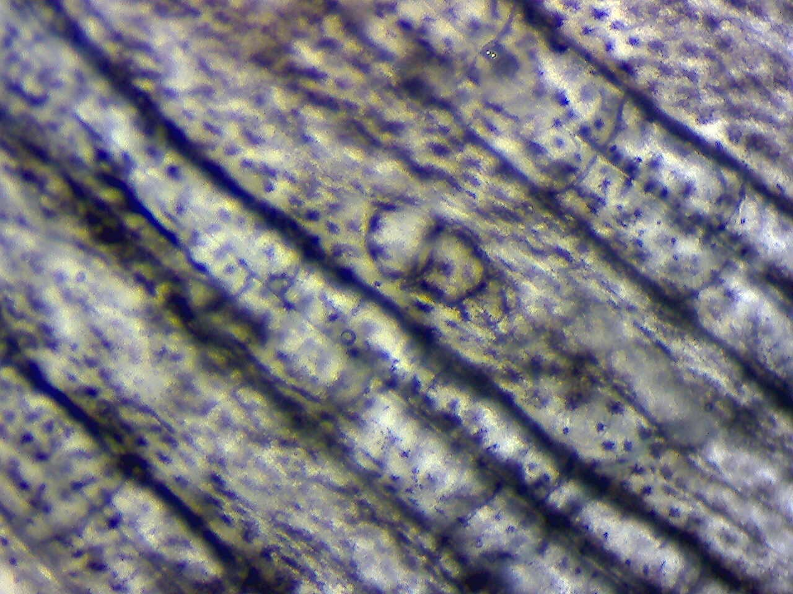
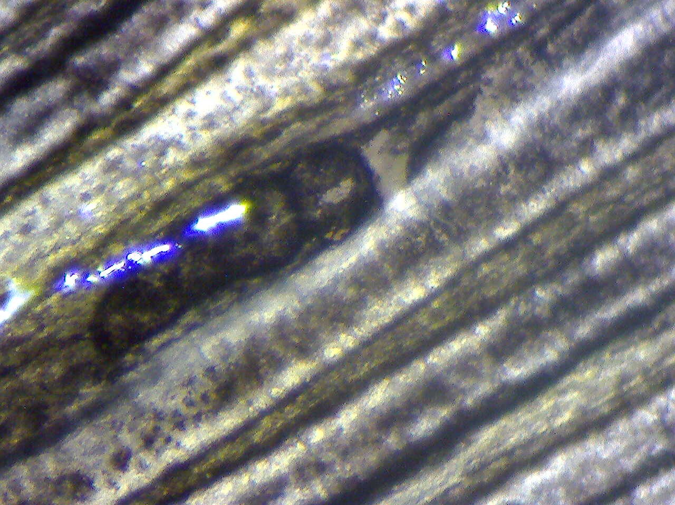
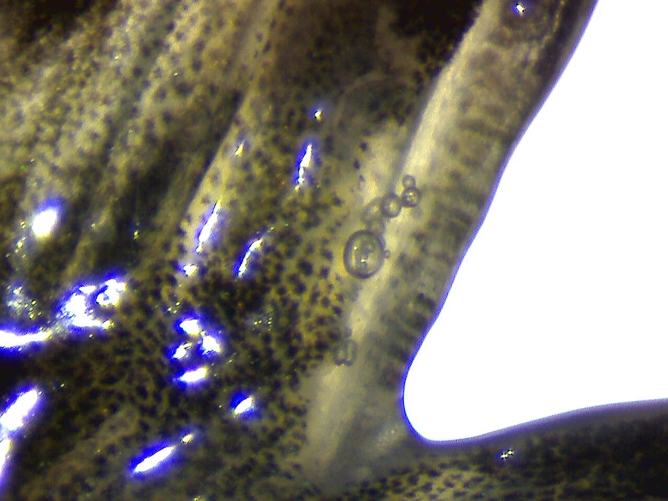
Fins

Slide 18
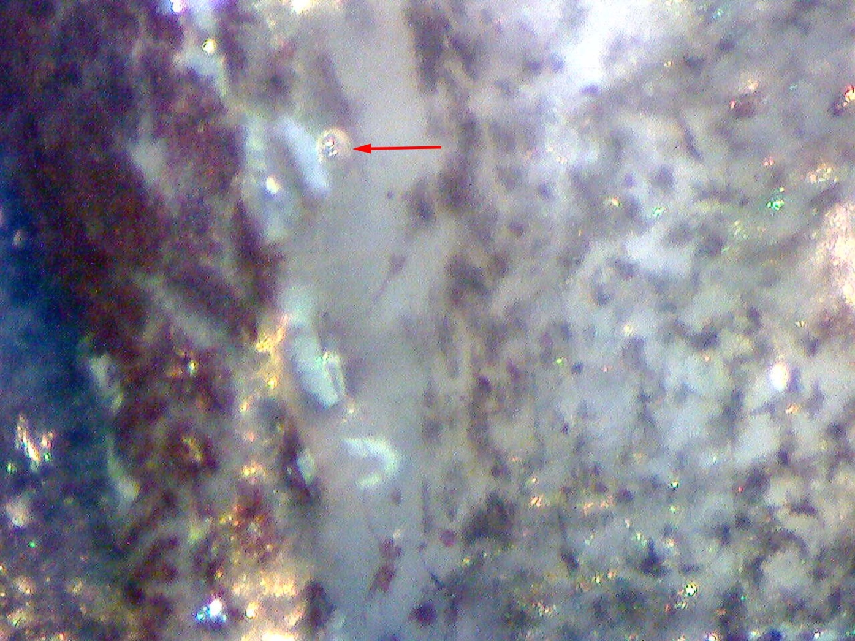
Eyes

Slide 19
Summary
Vacuum degassers reduced river water gas saturation 9-22% (raw) percentage points; but not enough to avoid gas bubbles over time
Effectiveness of vacuum degassers was improved 1-2% by increasing air space in degassing chamber
Strong correlation between elevated TDG exposure time and observed symptoms in fish
At in-hatchery TDGs of 104% and above, feeding behavior was impacted. No observed increase in mortality or secondary disease outbreaks during this extended high saturation exposure
Data not sufficient to establish a “safe” level of TDG exposure for fish produced at DNFH

Slide 20
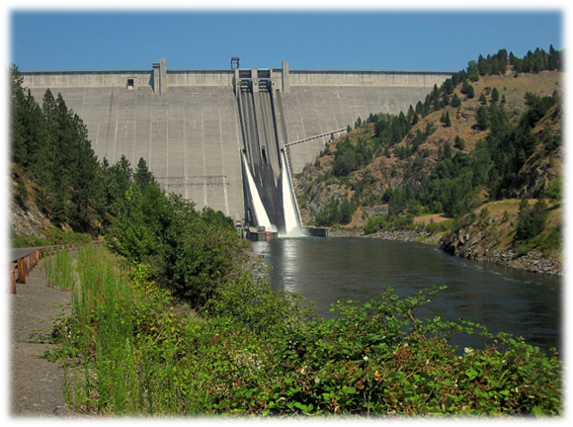

Slide 21
Raw Data

Slide 22

So What Did We DO?
Negotiation and collaboration with partners on fish releases
Negotiation with COE and TMT on spill on behalf of fish
Implemented new fish health monitoring plan
Early on site release of all spring Chinook on March 20 into mainstem Clearwater at negotiated lower spill from dam
Early on site and off site release of some steelhead on March 22-24
Moved remaining steelhead into System 1 at same time and added more reservoir water from CFH
On site release of remaining steelhead April 17

Slide 23
Vacuum Degassing Effectiveness
TDG reduction percentage after degassing at Dworshak NFH from 3/2/2017 to 3/21/2017

Slide 24
Pre-lim survival to LGR
 | 2017 | 5 Yr Avg
Chinook | 66.8 % | 77.2 %
Steelhead | 82.7% | 75.9%

